Slide 1
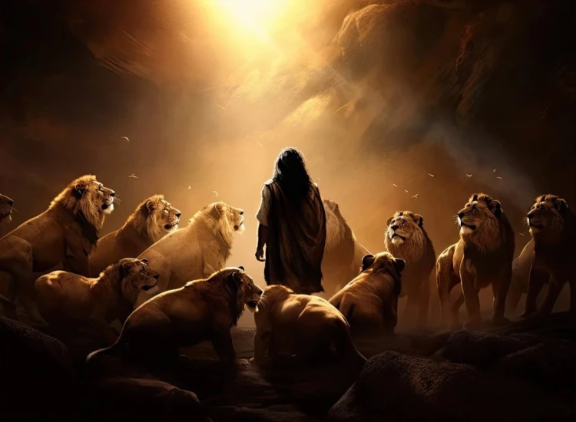


. Daniel . .
Chapter 8
Always Closer To Satan’s Man

Slide 2

Always Closer To Satan’s Man
Alexander the Great: Does Satan’s work in that he conquers & unites the world
Antiochus IV Epiphanes: Does Satan’s work in that he blasphemes God as if he’s God

Slide 3
John 10:22-23
“At that time the Feast of the Dedication took place at Jerusalem; it was winter, & Jesus was walking in the temple in the Portico of Solomon.”

Slide 4
Always Closer To Satan’s Man
Alexander the Great: Does Satan’s work in that he conquers & unites the world
Antiochus IV Epiphanes: Does Satan’s work in that he blasphemes God as if he’s God
Anti-Christ the Man of Sin: Does Satan’s work in that he takes all worldly power to himself

Slide 5
Daniel 12:4
“But as for you, Daniel, conceal these words & seal up the book until the time of the end; many will go to & fro, & knowledge will increase.”

Slide 6
Revelation 1:3
“Blessed is he who reads & those who hear the words of the prophecy & keep the things which are written in it, for the time is near.”

Slide 7
Revelation 22:10
“And he said to me, “Do not seal up the words of the prophecy of this book, for the time is near.”

Slide 8
Always Closer To Satan’s Man
Alexander the Great: Does Satan’s work in that he conquers & unites the world
Antiochus IV Epiphanes: Does Satan’s work in that he blasphemes God as if he’s God
Anti-Christ the Man of Sin: Does Satan’s work in that he takes all worldly power to himself

Slide 9
God writes in prophecy what becomes history – to help us
Let it strengthen our…
Trust in His sovereign plan
Trust in the Word of God
Will to refuse wicked rulers

