Slide 1
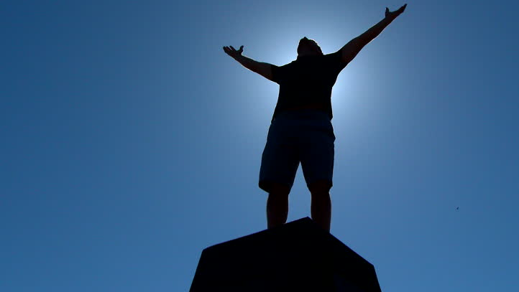

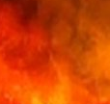
The
Removed From Depression
Psalms .
102-103

Slide 2
Removed From Depression
2023 Gallup Poll of Americans
17.8% report depression or being treated for it
29% diagnosed at some time in life
13.2% currently taking anti-depression meds

Slide 3
The
Removed From Depression
Psalms .
102-103

Slide 4
Removed From Depression
Grab On To God’s Bigger Plan For Us

Slide 5
Proverbs 3:34
“He scoffs at the scoffers, Yet He gives grace to the humble.”
(Humble – same word translated as afflicted in the intro to Psalm 102)

Slide 6
Removed From Depression
Grab On To God’s Bigger Plan For Us

Slide 7
I Kings 19:13-16
“Behold, a voice came to him & said, What are you doing here, Elijah? Then he said, I have been very zealous for Yahweh, the God of hosts; for the sons of Israel have forsaken Your covenant, pulled down Your altars & killed Your prophets with the sword. And I alone am left; & they seek my life, to take it away… (cont)

Slide 8
I Kings 19:13-16
(cont) …And Yahweh said to him, “Go, return on your way to the wilderness of Damascus, & you will arrive & anoint Hazael king over Aram; & Jehu the son of Nimshi you shall anoint king over Israel; & Elisha the son of Shaphat of Abel-meholah you shall anoint as prophet in your place.”

Slide 9
Removed From Depression
Grab On To God’s Bigger Plan For Us

Slide 10
John 16:20
“Truly, truly, I say to you, that you will cry & lament, but the world will rejoice; you will be sorrowful, but your sorrow will be turned into joy.”

Slide 11
I Thessalonians 4:13-14
“But we do not want you to be uninformed, brothers, about those who are asleep, so that you will not grieve as do the rest who have no hope. For if we believe that Jesus died & rose again, even so God will bring with Him those who have fallen asleep in Jesus.”

Slide 12
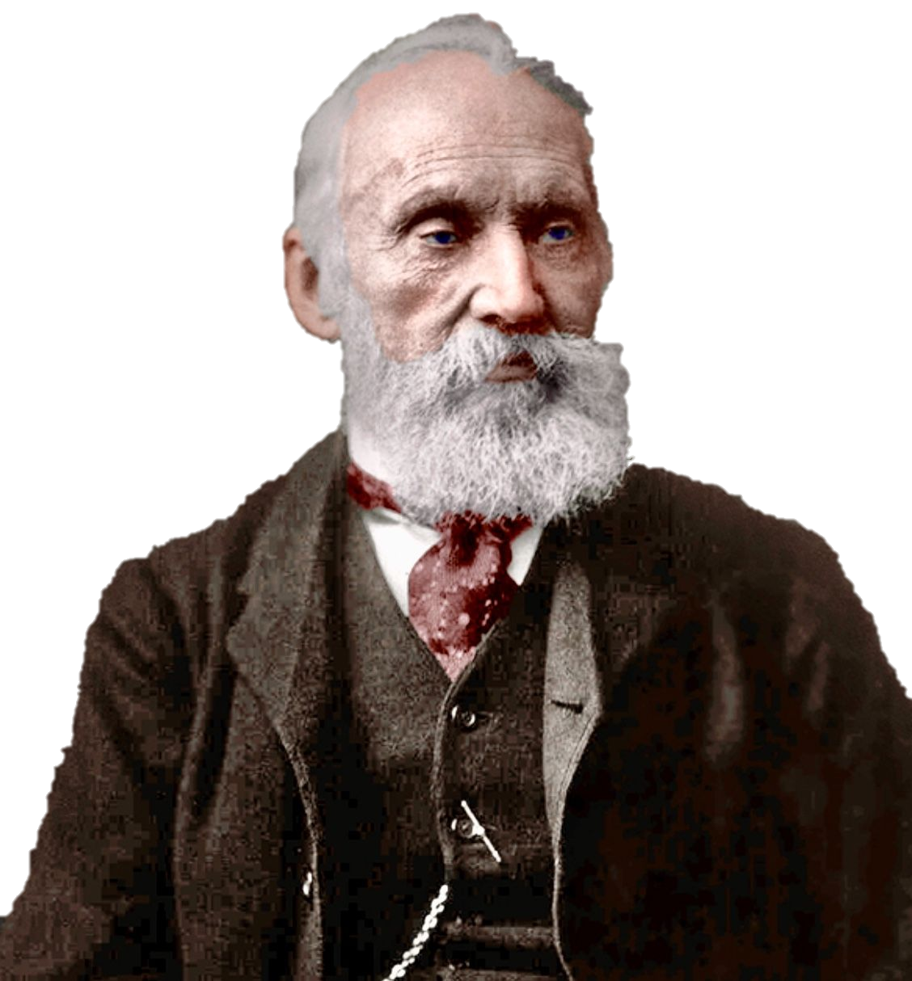
Lord Kelvin
“The Universe is like a clock wound up by the Creator and left to run down.”

Slide 13
Removed From Depression
Grab On To God’s Bigger Plan For Us
Meditate On All God’s Benefits For Us

Slide 14
Psalm 42:5
“Why are you in despair, O my soul? And why are you disturbed within me? Wait for God, for I shall still praise Him, for the salvation of His presence.”

Slide 15
Removed From Depression
Grab On To God’s Bigger Plan For Us
Meditate On All God’s Benefits For Us

Slide 16
The Benefit of Satisfaction
Fulfillment – Has an end
Completion – Doesn’t allow mean it ended good
Satisfaction = “To gratify wants, wishes & desires, to supply possession or enjoyment until no more is needed or even desired”

Slide 17
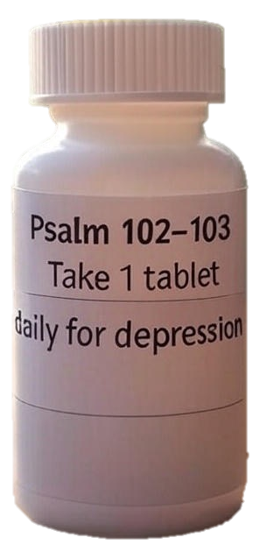
Removed From Depression
Grab On To God’s Bigger Plan For Us
Meditate On All God’s Benefits For Us

