Slide 1
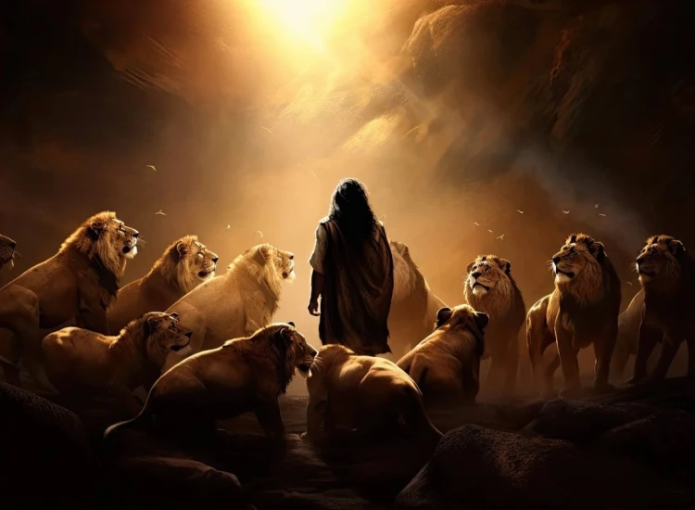


. Daniel . .
Chapter 7
‘Wiles’ The World Waits

Slide 2

‘Wile’ The World Waits
The World: Is this world getting better or worse?

Slide 3
II Corinthians 4:3-4
“If our gospel is veiled, it is veiled to those who are perishing, in whose case the god of this age has blinded the minds of the unbelieving so that they might not see the light of the gospel of the glory of Christ, who is the image of God.”

Slide 4
Revelation 17:15
“And he said to me, ‘The waters which you saw where the harlot sits, are peoples and crowds and nations and tongues.’”

Slide 5
‘Wile’ The World Waits
The World: Is this world getting better or worse?

Slide 6
Revelation 13:2
“The beast which I saw was like a leopard, & his feet were like those of a bear, & his mouth like the mouth of a lion. And the dragon gave him his power & his throne & great authority.”

Slide 7
Revelation 13:6
“And he opened his mouth in blasphemies against God, to blaspheme His name and His tabernacle, that is, those who dwell in heaven.”

Slide 8
‘Wile’ The World Waits
The World: Is this world getting better or worse?
The Wait: Why does God delay judgement? B/c He doesn’t care or b/c He’s awaiting maturity?

Slide 9
Revelation 20:11-12
“Then I saw a great white throne & Him who sits upon it, from whose presence earth & heaven fled away, & no place was found for them. Then I saw the dead, the great & the small, standing before the throne, & books were opened; & another book was opened, which is the book of life. And the dead were judged from the things which were written in the books, according to their deeds.”

Slide 10
‘Wile’ The World Waits
The World: Is this world getting better or worse?
The Wait: Why does God delay judgement? B/c He doesn’t care or b/c He’s awaiting maturity?
The Wiles: How does the enemy attack? Is it primarily with lust or lies?

Slide 11
Revelation 17:12-13
“The ten horns which you saw are ten kings who have not yet received a kingdom, but they receive authority as kings w/ the beast for one hour. These have one purpose, & they give their power & authority to the beast.”

Slide 12
II Corinthians 4:4
“In whose case the god of this age has blinded the minds of the unbelieving so that they might not see the light of the gospel of the glory of Christ, who is the image of God.”

Slide 13
I Timothy 4:1
“But the Spirit explicitly says that in later times some will fall away from the faith, paying attention to deceitful spirits & doctrines of demons.”

Slide 14
Hebrews 12:3
“For consider Him who has endured such hostility by sinners against Himself, so that you will not grow weary, fainting in heart.”

Slide 15
Lamentations 3:19-22
“Remember my affliction and my homelessness, the wormwood and gall. Surely my soul remembers And is bowed down within me. This I will return to my heart; therefore I will wait in hope. The lovingkindnesses of Yahweh indeed never cease, For His compassions never fail.”

Slide 16
Romans 7:25
“Remember my affliction & my homelessness, the wormwood & gall. Surely my soul remembers & is bowed down within me. This I will return to my heart; therefore I will wait in hope. The lovingkindnesses of Yahweh indeed never cease, for His compassions never fail.”

Slide 17
Romans 12:2
“Do not be conformed to this world, but be transformed by the renewing of your mind, so that you may approve what the will of God is, that which is good & pleasing & perfect.”

Slide 18
Ephesians 4:22-24
“Lay aside, in reference to your former conduct, the old man, which is being corrupted in accordance w/ the lusts of deceit, & to be renewed in the spirit of your mind, & to put on the new man, which in the likeness of God has been created in righteousness & holiness of the truth.”

Slide 19
‘Wile’ The World Waits
The World: Is this world getting better or worse?
The Wait: Why does God delay judgement? B/c He doesn’t care or b/c He’s awaiting maturity?
The Wiles: How does the enemy attack? Is it primarily with lust or lies?

Slide 20
Luke 2:52
“And Jesus was advancing in wisdom and stature, and in favor with God and men.”

