Slide 1
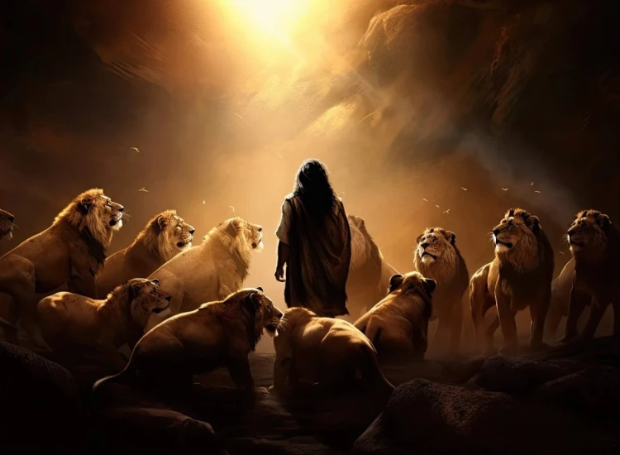


. Daniel . .
Chapter 6
Conviction Or Fiction?

Slide 2
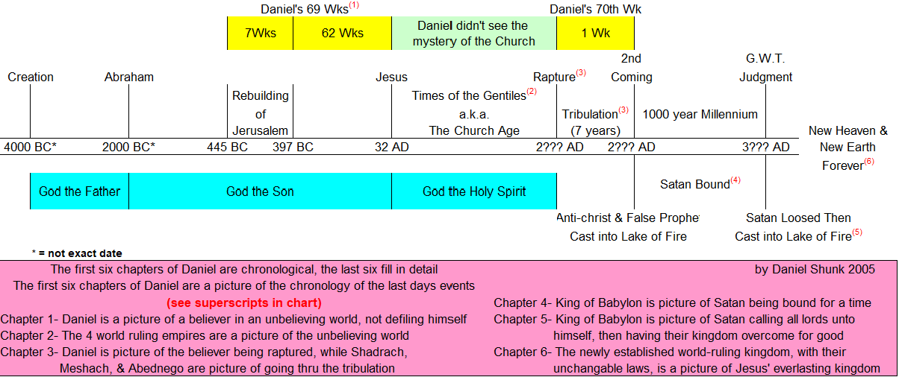

Commitment Among Corruption
dfdfg

Slide 3
. Daniel . .
Chapter 6
Conviction Or Fiction?

Slide 4
Conviction Or Fiction?
We know we’re committed b/c…
We bring the Lord into religious AND secular affairs

Slide 5
Luke 2:52
“And Jesus was advancing in wisdom and stature, and in favor with God and men.”

Slide 6
Proverbs 3:3-4
“Do not let lovingkindness & truth forsake you; bind them around your neck, write them on the tablet of your heart. So you will find favor & good insight in the eyes of God & man.”

Slide 7
I Timothy 3:2
“An overseer, then, must be above reproach, the husband of one wife, temperate, sensible, respectable, hospitable, able to teach…”

Slide 8
I Thessalonians 5:22
“Abstain from every form of evil.”

Slide 9
Conviction Or Fiction?
We know we’re committed b/c…
We bring the Lord into religious AND secular affairs
We know how to choose between conflicting priorities

Slide 10
Luke 20:22-25
“Is it lawful for us to pay taxes to Caesar, or not?’ But He perceived their craftiness & said to them, ’Show Me a denarius. Whose likeness & inscription does it have?’ They said, ‘Caesar’s.’ And He said to them, ‘Then render to Caesar the things that are Caesar’s, & to God the things that are God’s.’”

Slide 11
Conviction Or Fiction?
We know we’re committed b/c…
We bring the Lord into religious AND secular affairs
We know how to choose between conflicting priorities
We’ve grown accustomed to a routine that could cost
We can handle the emotional upheaval the flesh produces

Slide 12
7 Ways Daniel prototypes Jesus
Knowing the plot, he went to pray (vs 10)
Den covered by a stone (vs 17)
Den was sealed by the ruler’s seal (vs 17)
Allies came early in the morning (vs 19)
Angels were involved (vs 22)
Innocent one walks out unharmed (vs 23)
Happened b/c he trusted God (vs 23)

Slide 13
Affliction of our conviction produces
Praise And Glory To God
“Our God lives forever”
“Our God saves and delivers”

Slide 14
Conviction Or Fiction?
We know we’re committed b/c…
We bring the Lord into religious AND secular affairs
We know how to choose between conflicting priorities
We’ve grown accustomed to a routine that could cost
We can handle the emotional upheaval the flesh produces

Slide 15
Revelation 20:8
“And [Satan] will come out to deceive the nations which are in the four corners of the earth, Gog & Magog, to gather them together for the war; the number of them is like the sand of the seashore.”

