Slide 1
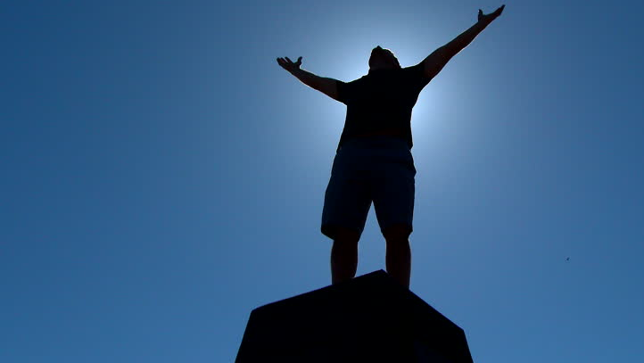


The
A Candidate For Maturity
Psalms .
94-97

Slide 2
A Candidate For Maturity
We mature…
In discipline for treating others justly

Slide 3
Luke 16:15
“He said to them, ‘You are those who justify yourselves in the sight of men, but God knows your hearts, for that which is highly esteemed among men is detestable in the sight of God.’”

Slide 4
A Candidate For Maturity
We mature…
In discipline for treating others justly

Slide 5
Hebrews 12:6-8
“For those whom the Lord loves He disciplines, & he flogs every son whom He receives…God deals w/ you as w/ sons; for what son is there whom his father does not discipline? But if you are w/o discipline…then you are illegitimate children & not sons.”

Slide 6
Philippians 4:6-7
“Be anxious for nothing, but in everything by prayer & petition w/ thanksgiving let your requests be made known to God. And the peace of God, which surpasses all comprehension, will guard your hearts & your minds in Christ Jesus.”

Slide 7
A Candidate For Maturity
We mature…
In discipline for treating others justly
In faith to praise & worship the Lord
In experiences w/ God to evangelize
In hating evil to love God

Slide 8
Ephesians 1:20-21
“Which He [God] worked in Christ, by raising Him from the dead & seating Him at His right hand in the heavenly places, far above all rule & authority & power & dominion, & every name that is named, not only in this age but also in the one to come.”

Slide 9
A Candidate For Maturity
We mature…
In discipline for treating others justly
In faith to praise & worship the Lord
In experiences w/ God to evangelize
In hating evil to love God

Slide 10
Amos 5:14-15
“Seek good & not evil, in order that you may live; & thus may Yahweh God of hosts be with you, just as you have said! Hate evil, love good, & set justice at the gate! Perhaps Yahweh God of hosts may be gracious to the remnant of Joseph.”

Slide 11
A Candidate For Maturity
We mature…
In discipline for treating others justly
In faith to praise & worship the Lord
In experiences w/ God to evangelize
In hating evil to love God

