Slide 1
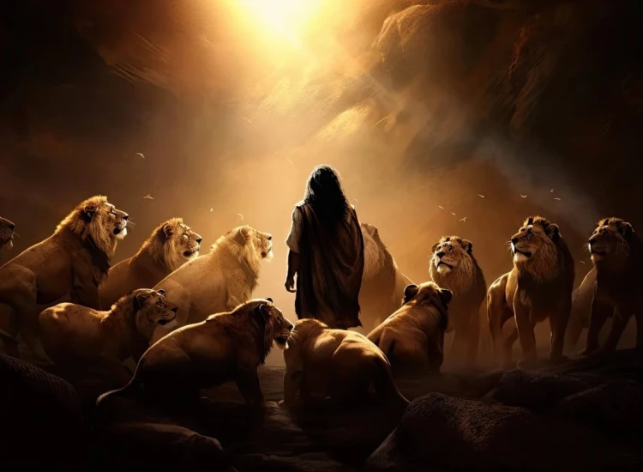


. Daniel . .
Chapter 5
The Grip That Slips

Slide 2
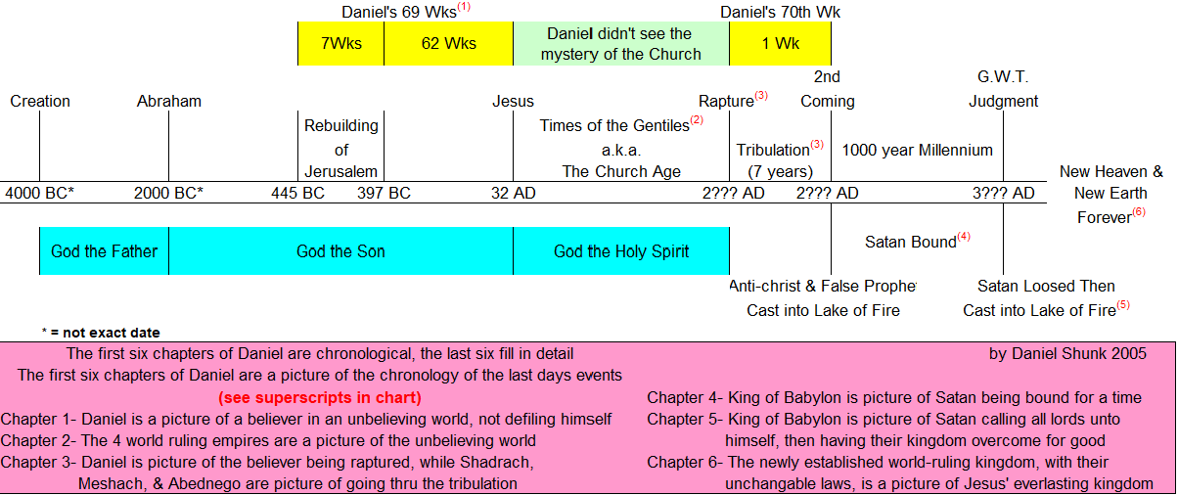

Commitment Among Corruption
dfdfg

Slide 3
. Daniel . .
Chapter 5
The Grip That Slips

Slide 4
The Grip That Slips:
Lies the world tells themselves
We should fight for the treasures of man, rather than the treasure that is man

Slide 5
The Babylonian Kings
Nebuchadnezzar
Evil-Marduk
Nebu Daughter
Neriglissar
Nebu Daughter
Nabonidus
Labashi-Marduk
Belshazzar

Slide 6
Revelation 20:8
“And [Satan] will come out to deceive the nations which are in the four corners of the earth, Gog & Magog, to gather them together for the war; the number of them is like the sand of the seashore.”

Slide 7
Matthew 13:44
“The kingdom of heaven is like a treasure hidden in the field, which a man found & hid again; & from joy over it he goes & sells all that he has and buys that field.”

Slide 8
John 10:10
“The thief comes only to steal & kill & destroy; I came that they may have life, & have it abundantly.”

Slide 9
The Grip That Slips:
Lies the world tells themselves
We should fight for the treasures of man, rather than the treasure that is man

Slide 10
Isaiah 45:1
“Thus says Yahweh to Cyrus His anointed, whom I have taken hold of by his right hand, to subdue nations before him & to loose the loins of kings, to open doors before him so that gates will not be shut.”

Slide 11
The Grip That Slips:
Lies the world tells themselves
We should fight for the treasures of man, rather than the treasure that is man
Church has nothing to offer my day-to-day life, only when I’m in a tough spot

Slide 12
Philippians 4:11-12
“Not that I speak from want, for I learned to be content in whatever circumstances I am. I know how to get along with humble means, & I also know how to live in abundance; in any & all things I have learned the secret of being filled & going hungry, both of having abundance & suffering need.”

Slide 13
The Grip That Slips:
Lies the world tells themselves
We should fight for the treasures of man, rather than the treasure that is man
Church has nothing to offer my day-to-day life, only when I’m in a tough spot

Slide 14
Matthew 6:19-20
“Do not store up for yourselves treasures on earth, where moth & rust destroy, & where thieves break in & steal. But store up for yourselves treasures in heaven, where neither moth nor rust destroys, & where thieves do not break in or steal.”

Slide 15
The Grip That Slips:
Lies the world tells themselves
We should fight for the treasures of man, rather than the treasure that is man
Church has nothing to offer my day-to-day life, only when I’m in a tough spot
God doesn’t see me or rule over me

Slide 16
Psalm 90:12
“So teach us to number our days, that we may present to You a heart of wisdom.”

Slide 17
II Corinthians 5:10
“For we must all appear before the judgment seat of Christ, so that each one may be recompensed for his deeds in the body, according to what he has done, whether good or bad.”

Slide 18
Luke 12:15
“Then He said to them, ‘Watch out & be on your guard against every form of greed, for not even when one has an abundance does his life consist of his possessions.’”

Slide 19
The Grip That Slips:
Lies the world tells themselves
We should fight for the treasures of man, rather than the treasure that is man
Church has nothing to offer my day-to-day life, only when I’m in a tough spot
God doesn’t see me or rule over me

