Slide 1


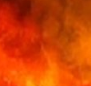
The
In God We Dwell
Psalms .
90-93

Slide 2
In God We Dwell
Submitting to God brings…
Meaning to our short, frail life

Slide 3
Proverbs 9:10
“The fear of Yahweh is the beginning of wisdom, & the knowledge of the Holy One is understanding.”

Slide 4
In God We Dwell
Submitting to God brings…
Meaning to our short, frail life
Protection from worldly dangers

Slide 5
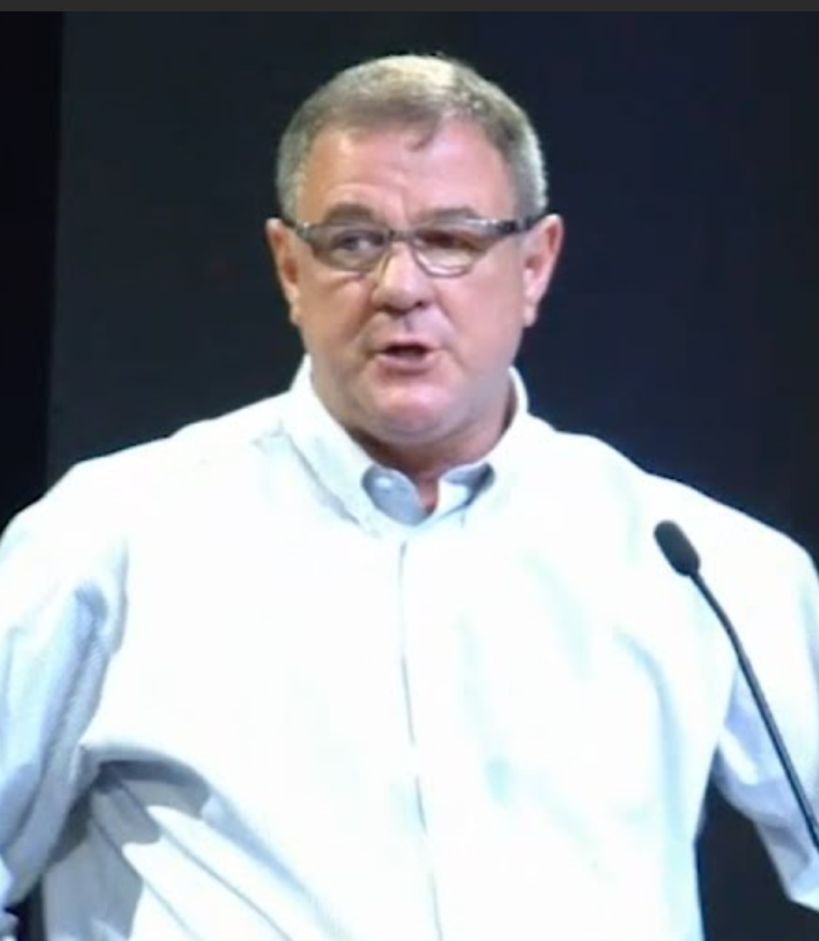
Wes Bentley
‘Far Reaching Ministries’
“My obedience has protected me.”

Slide 6
In God We Dwell
Submitting to God brings…
Meaning to our short, frail life
Protection from worldly dangers

Slide 7
John 14:23
“Jesus answered & said to him, ‘If anyone loves Me, he will keep My word; & My Father will love him, & We will come to him & make Our dwelling with him.’”

Slide 8
In God We Dwell
Submitting to God brings…
Meaning to our short, frail life
Protection from worldly dangers
Hope to the thankful heart

