Slide 1
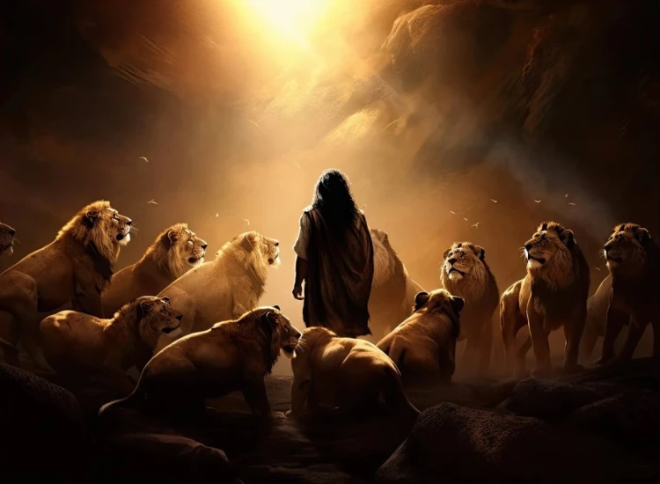


. Daniel . .
Chapter 4
So Close!

Slide 2
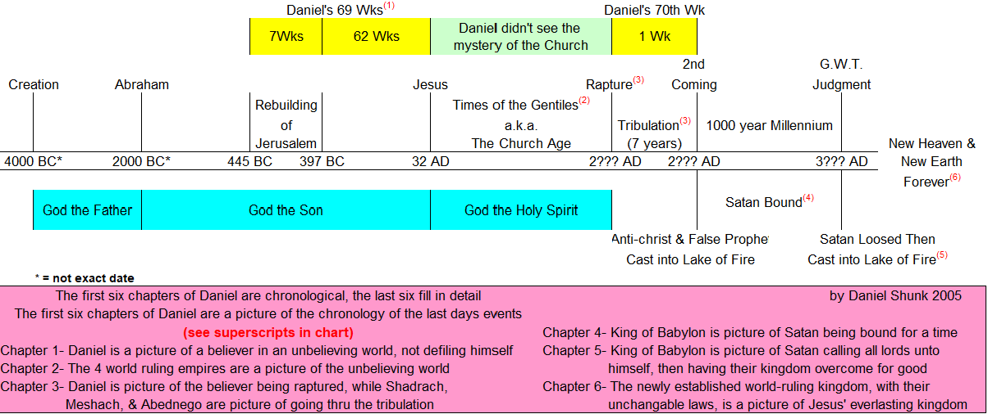

Commitment Among Corruption
dfdfg

Slide 3
. Daniel . .
Chapter 4
So Close!

Slide 4
So Close To God’s Will
Yet Not In It
You have facts without faith

Slide 5
Job 41:11
“Who has given to Me that I should repay him? Whatever is under the whole heaven is Mine.”

Slide 6
So Close To God’s Will
Yet Not In It
You have facts without faith
You have candor without compassion

Slide 7

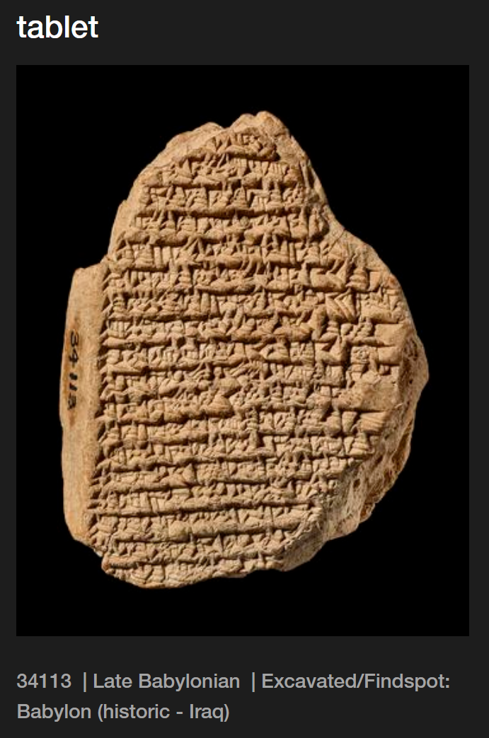
“For 4 years the king sent neither troops nor equipment to Akkad… He did not go out of his house & he did not perform the duties of kingship.”

Slide 8
So Close To God’s Will
Yet Not In It
You have facts without faith
You have candor without compassion
You have gain without gratitude

Slide 9
John 19:10-11
“So Pilate said to Him, You do not speak to me? Do You not know that I have authority to release You, & I have authority to crucify You? Jesus answered, you would have no authority over Me, unless it had been given you from above; for this reason he who delivered Me to you has the greater sin.”

Slide 10
Psalm 75:6-7
“For one’s rising up does not come from the east, nor from the west, & not from the desert; but God is the Judge; He puts down one & raises up another.”

Slide 11
So Close To God’s Will
Yet Not In It
You have facts without faith
You have candor without compassion
You have gain without gratitude

Slide 12
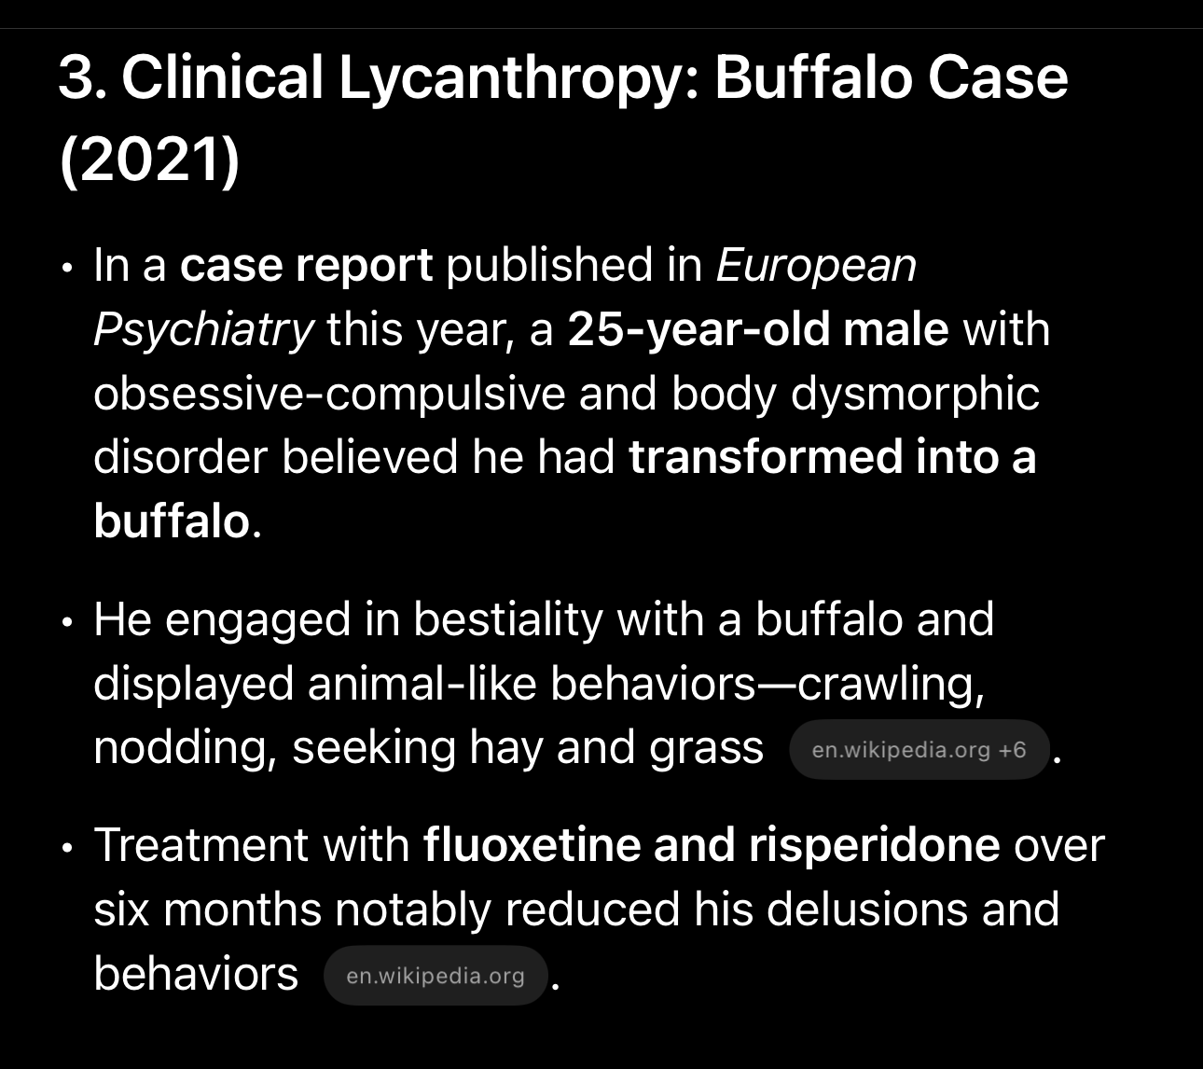
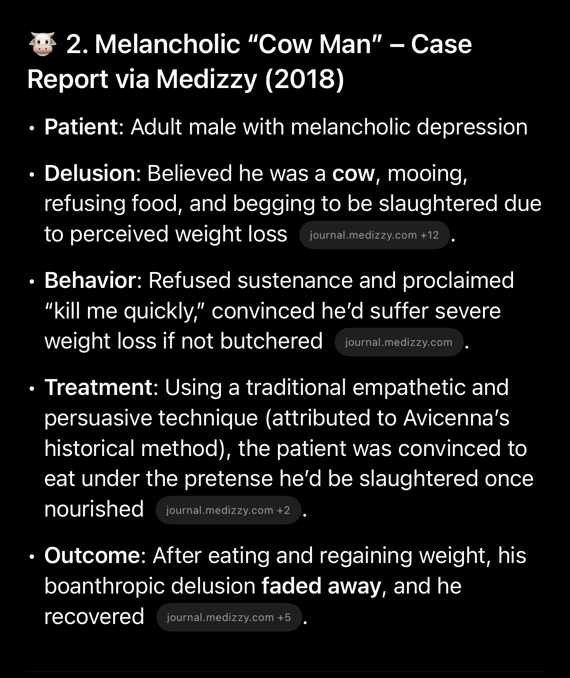
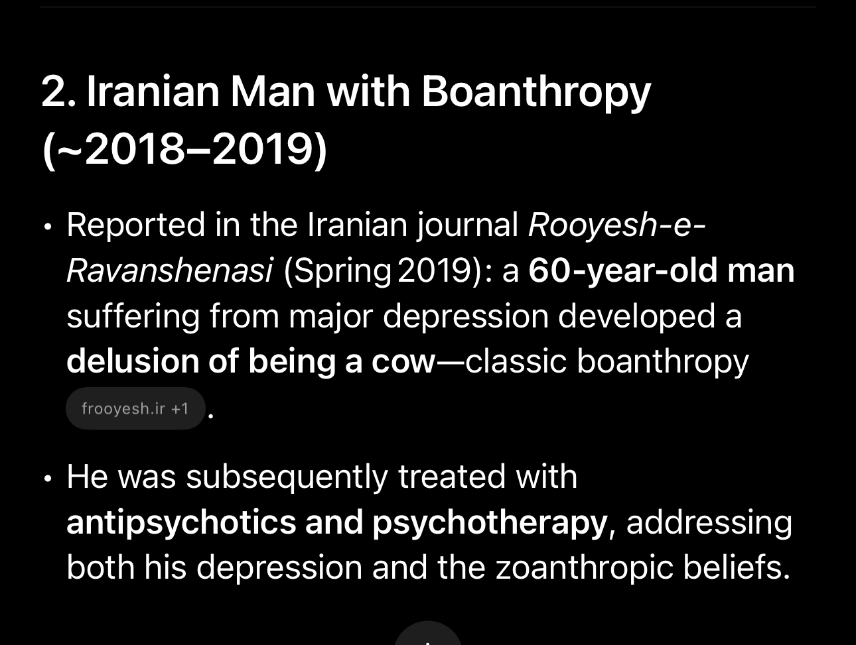
Recent Cases of Boanthropy
1.

Slide 13

Our Omni-God
Omniscience
Omnipresent
Omnipotent

Slide 14
So Close To God’s Will
Yet Not In It
You have facts without faith
You have candor without compassion
You have gain without gratitude

