Slide 1
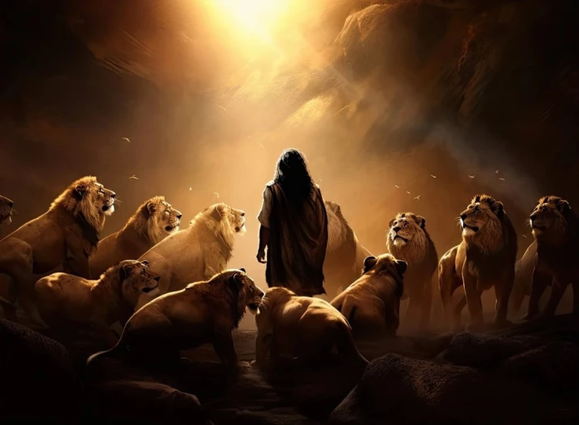
. Daniel . .
Chapter 3
Burning To Shine His Glory

Slide 2
Commitment Among Corruption
dfdfg

Slide 3
. Daniel . .
Chapter 3
Burning To Shine His Glory

Slide 4
Burning To Shine His Glory
How do you respond in tests of faith?
The Cowering of the Coerced Crowd
The Flex of the Faithful Few

Slide 5
Proverbs 18:13
“He who responds with a word before he hears, It is folly and shame to him.”

Slide 6
Burning To Shine His Glory
How do you respond in tests of faith?
The Cowering of the Coerced Crowd
The Flex of the Faithful Few
The Guarantee of the Glorious God

Slide 7
Isaiah 43:2
“When you pass through the waters, I will be with you; & through the rivers, they will not overflow you. When you walk through the fire, you will not be scorched, nor will the flame burn you.”

Slide 8
Burning To Shine His Glory
How do you respond in tests of faith?
The Cowering of the Coerced Crowd
The Flex of the Faithful Few
The Guarantee of the Glorious God

Slide 9
John 16:33
“These things I have spoken to you, so that in Me you may have peace. In the world you have tribulation, but take courage; I have overcome the world.”

Slide 10
Burning To Shine His Glory
How do you respond in tests of faith?
The Cowering of the Coerced Crowd
The Flex of the Faithful Few
The Guarantee of the Glorious God

Slide 11
Romans 5:1
“Therefore, having been justified by faith, we have peace with God through our Lord Jesus Christ.”

Slide 12
I Peter 1:8
“And though you have not seen Him [Jesus], you love Him, & though you do not see Him now, but believe in Him, you rejoice with joy inexpressible & full of glory.”

Slide 13
John 3:16
“For God so loved the world, that He gave His only begotten Son, that whoever believes in Him shall not perish, but have eternal life.”

Slide 14
Burning To Shine His Glory
How do you respond in tests of faith?
The Cowering of the Coerced Crowd
The Flex of the Faithful Few
The Guarantee of the Glorious God

