Slide 1
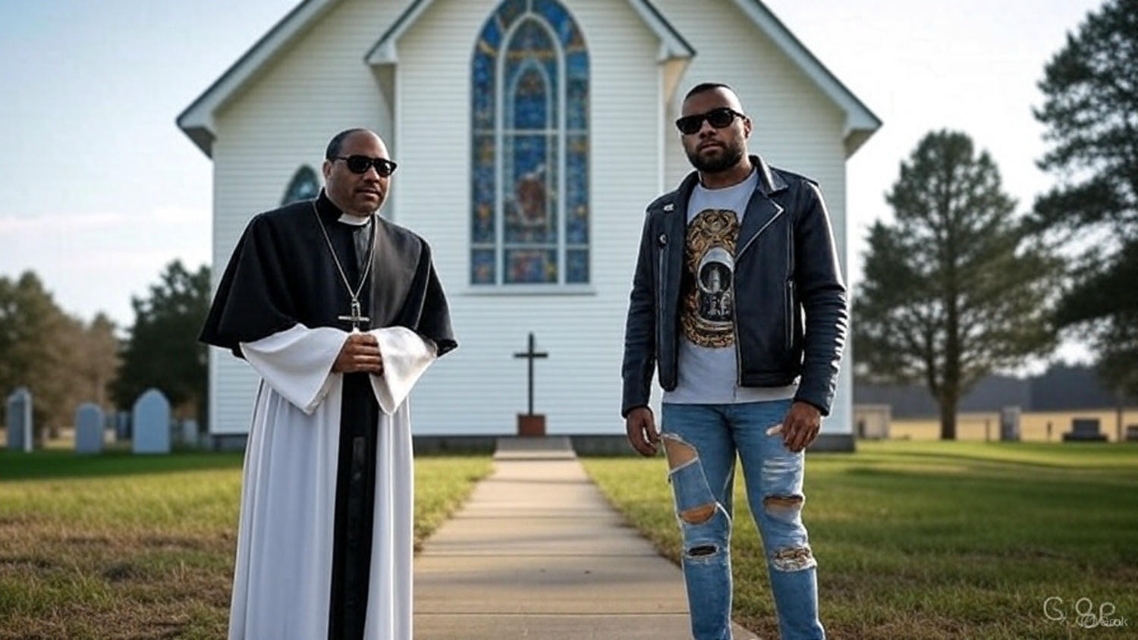

A Scriptural
Worldview & Churchview

Slide 2
Defining Two Movements
Trad-rads = Those that are radical in their traditionalism
    Want to return to one church
Seven Mountains Mandate = The church should dominate all aspects of this world

Slide 3
A Scriptural Worldview & Churchview
Trad-rads & the 7 Mt Mandate Problems
A is for Application of the Word - They misapply significant Scripture & concepts

Slide 4
Genesis 1:28
“God blessed them, & God said to them, Be fruitful & multiply, & fill the earth, & subdue it; & have dominion over the fish of the sea & over the birds of the sky & over every living thing that creeps on the earth.”

Slide 5
Daniel 7:27
“Then the reign, the dominion, & the greatness of all the kingdoms under the whole heaven will be given to the people of the saints of the Highest One; His kingdom will be an everlasting kingdom, & all the dominions will serve & obey Him.”

Slide 6
Ephesians 1:22-23
“He put all things in subjection under His feet, & gave Him as head over all things to the church, which is His body, the fullness of Him who fills all in all.”

Slide 7
John 18:36
“Jesus answered, “My kingdom is not of this world. If My kingdom were of this world, then My servants would be fighting so that I would not be delivered over to the Jews; but as it is, My kingdom is not from here.”

Slide 8
A Scriptural Worldview & Churchview
Trad-rads & the 7 Mt Mandate Problems
A is for Application of the Word - They misapply significant Scripture & concepts

Slide 9
Galatians 3:2-3
“This is the only thing I want to learn from you: did you receive the Spirit by the works of the Law, or by hearing with faith? Are you so foolish? Having begun by the Spirit, are you now being perfected by the flesh?”

Slide 10
A Scriptural Worldview & Churchview
Trad-rads & the 7 Mt Mandate Problems
A is for Application of the Word - They misapply significant Scripture & concepts

Slide 11
Matthew 15:1-3
“Then some Pharisees & scribes came to Jesus from Jerusalem & said, ’Why do Your disciples break the tradition of the elders? For they do not wash their hands when they eat bread.’ And He answered & said to them, “Why do you yourselves transgress the commandment of God for the sake of your tradition?”

Slide 12
A Scriptural Worldview & Churchview
Trad-rads & the 7 Mt Mandate Problems
A is for Application of the Word - They misapply significant Scripture & concepts
E is for Eschatology - They have an erroneous view of End Times concepts

Slide 13
II Timothy 3:1-5
“But know this, that in the last days difficult times will come. For men will be lovers of self, lovers of money, boastful, arrogant, blasphemers, disobedient to parents, ungrateful, unholy, unloving, irreconcilable… (cont)

Slide 14
II Timothy 3:1-5
(cont) …malicious gossips, w/o self-control, w/o gentleness, w/o love for good, treacherous, reckless, conceited, lovers of pleasure rather than lovers of God, holding to a form of godliness, but having denied its power.”

Slide 15
Acts 15:13-17
“Now after they had stopped speaking, James answered, saying, “Brothers, listen to me. Simeon has related how God first concerned Himself about taking from among the Gentiles a people for His name. And with this the words of the Prophets agree, just as it is written… (cont)

Slide 16
Acts 15:13-17
(cont) …after these things I will return, & I will rebuild the fallen house of David, & I will rebuild its ruins, & I will restore it, so that the rest of mankind may seek the lord, & all the Gentiles who are called by My name.”

Slide 17
A Scriptural Worldview & Churchview
Trad-rads & the 7 Mt Mandate Problems
A is for Application of the Word - They misapply significant Scripture & concepts
E is for Eschatology - They have an erroneous view of End Times concepts
I is for Israel - They minimize or demonize the nation & God’s plan for them

Slide 18
Genesis 12:2-3
“And I will make you [Abraham] a great nation, & I will bless you, & make your name great; & so you shall be a blessing; & I will bless those who bless you, & the one who curses you I will curse. And in you all the families of the earth will be blessed.”

Slide 19
Genesis 18:17-18
“Now Yahweh said, ‘Shall I conceal from Abraham what I am about to do, since Abraham will surely become a great & mighty nation, & in him all the nations of the earth will be blessed?”

Slide 20
A Scriptural Worldview & Churchview
Trad-rads & the 7 Mt Mandate Problems
A is for Application of the Word - They misapply significant Scripture & concepts
E is for Eschatology - They have an erroneous view of End Times concepts
I is for Israel - They minimize or demonize the nation & God’s plan for them
O is for Order - They distort a right view of God’s established authority structure

Slide 21
Ephesians 4:11-13
“He Himself gave some as apostles, & some as prophets, & some as evangelists, & some as pastors teachers, for the equipping of the saints for the work of service, to the building up of the body of Christ, until we all attain to the unity of the faith, & of the full knowledge of the Son of God, to a mature man, to the measure of the stature which belongs to the fullness of Christ.”

Slide 22
Ephesians 2:20
“Having been built on the foundation of the apostles & prophets, Christ Jesus Himself being the corner stone.”

Slide 23
A Scriptural Worldview & Churchview
Trad-rads & the 7 Mt Mandate Problems
A is for Application of the Word - They misapply significant Scripture & concepts
E is for Eschatology - They have an erroneous view of End Times concepts
I is for Israel - They minimize or demonize the nation & God’s plan for them
O is for Order - They distort a right view of God’s established authority structure

Slide 24
I Timothy 2:11-12
“A woman must learn in quietness, in all submission. But I do not allow a woman to teach or exercise authority over a man, but to remain quiet.”

Slide 25
A Scriptural Worldview & Churchview
Trad-rads & the 7 Mt Mandate Problems
A is for Application of the Word - They misapply significant Scripture & concepts
E is for Eschatology - They have an erroneous view of End Times concepts
I is for Israel - They minimize or demonize the nation & God’s plan for them
O is for Order - They distort a right view of God’s established authority structure

Slide 26
Acts 17:11
“Now these [Bereans] were more noble-minded than those in Thessalonica, for they received the word with great eagerness, examining the Scriptures daily to see whether these things were so.”

Slide 27
A Scriptural Worldview & Churchview
Trad-rads & the 7 Mt Mandate Problems
A is for Application of the Word - They misapply significant Scripture & concepts
E is for Eschatology - They have an erroneous view of End Times concepts
I is for Israel - They minimize or demonize the nation & God’s plan for them
O is for Order - They distort a right view of God’s established authority structure
U is for Unity - They place the burden on us to unite the church & the world

Slide 28
Luke 16:13
“No servant can serve two masters; for either he will hate the one & love the other, or else he will be devoted to one & despise the other. You cannot serve God & wealth.”

Slide 29
A Scriptural Worldview & Churchview
Trad-rads & the 7 Mt Mandate Problems
A is for Application of the Word - They misapply significant Scripture & concepts
E is for Eschatology - They have an erroneous view of End Times concepts
I is for Israel - They minimize or demonize the nation & God’s plan for them
O is for Order - They distort a right view of God’s established authority structure
U is for Unity - They place the burden on us to unite the church & the world

Slide 30
Matthew 10:34
“Do not think that I [Jesus] came to bring peace on the earth; I did not come to bring peace, but a sword.”

Slide 31
Ephesians 2:13-14
“But now in Christ Jesus you who formerly were far off have been brought near by the blood of Christ. For He Himself [Jesus] is our peace, who made both groups [Jew & Gentile] one & broke down the dividing wall of the partition.”

Slide 32
A Scriptural Worldview & Churchview
Trad-rads & the 7 Mt Mandate Problems
A is for Application of the Word - They misapply significant Scripture & concepts
E is for Eschatology - They have an erroneous view of End Times concepts
I is for Israel - They minimize or demonize the nation & God’s plan for them
O is for Order - They distort a right view of God’s established authority structure
U is for Unity - They place the burden on us to unite the church & the world

