Slide 1
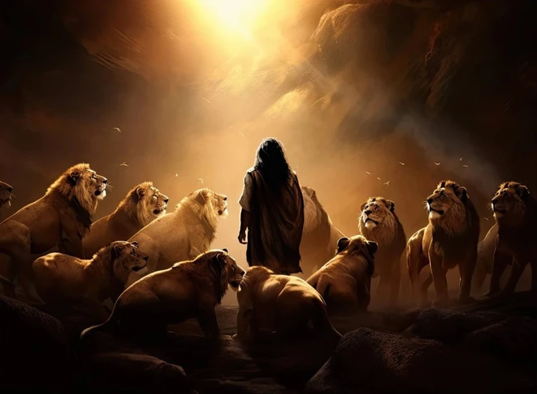
. Daniel . .
Chapter 2
How Much Greater A Kingdom

Slide 2
Commitment Among Corruption
dfdfg

Slide 3
. Daniel . .
Chapter 2
How Much Greater A Kingdom

Slide 4
How Much Greater A Kingdom
They have worldly wisdom; we have godly wisdom

Slide 5
Genesis 41:15-16
“Pharaoh said to Joseph, ‘I have had a dream, but no one can interpret it; yet I have heard it said about you, that you hear a dream & that you can interpret it.’ Joseph then answered Pharaoh, saying, ‘It is not in me; God will answer concerning the welfare of Pharaoh.’”

Slide 6
How Much Greater A Kingdom
They have worldly wisdom; we have godly wisdom
They trust in themselves; we trust in God

Slide 7
Luke 17:15-19
“Now one of them, when he saw that he had been healed, turned back, glorifying God w/ a loud voice, & he fell on his face at His feet, giving thanks to Him. And he was a Samaritan….” (cont)

Slide 8
Luke 17:15-19
(cont) “…Then Jesus answered & said, “Were there not ten cleansed? But the nine—where are they? “Was there no one found who turned back to give glory to God, except this foreigner?” He said to him, “Stand up & go; your faith has saved you.”

Slide 9
How Much Greater A Kingdom
They have worldly wisdom; we have godly wisdom
They trust in themselves; we trust in God
They choose harmful friends; we choose helpful friends

Slide 10
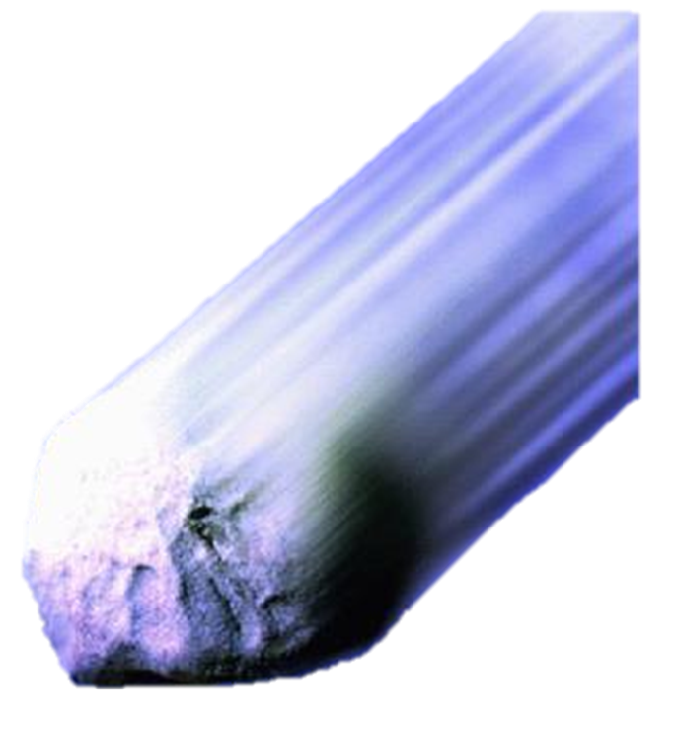
Form of gov’t becomes weaker

Slide 11
Matthew 24:37-39
“For just as the days of Noah were, so the coming of the Son of Man will be. For as in those days before the flood they were eating & drinking, marrying & giving in marriage, until the day that Noah entered the ark, & they did not understand until the flood came & took them all away; so will the coming of the Son of Man be.”

Slide 12
Toes = 10 kingdoms of the Anti-Christ

Slide 13
How Much Greater A Kingdom
They have worldly wisdom; we have godly wisdom
They trust in themselves; we trust in God
They choose harmful friends; we choose helpful friends

Slide 14
Acts 1:6
“So when they had come together, they were asking Him, saying, “Lord, is it at this time You are restoring the kingdom to Israel?”

Slide 15
Acts 15:16
“After these things I will return, and I will rebuild the fallen house of David, and I will rebuild its ruins, and I will restore it.”

Slide 16
How Much Greater A Kingdom
They have worldly wisdom; we have godly wisdom
They trust in themselves; we trust in God
They choose harmful friends; we choose helpful friends

