Slide 1
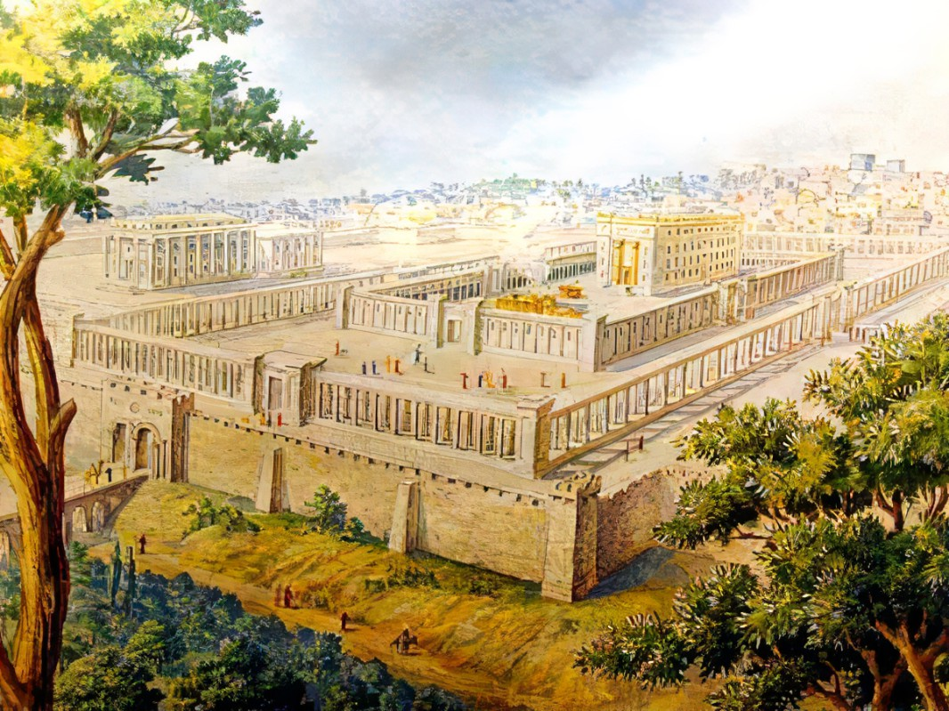

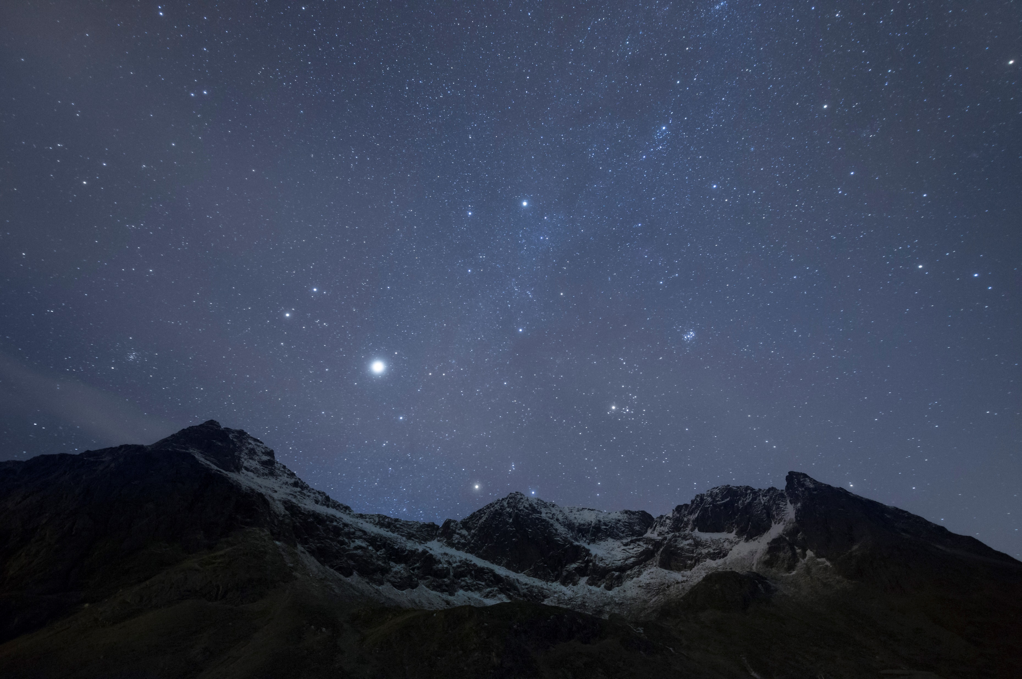
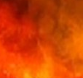
Providing His Presence For His People
Ezekiel
The
Book of
Chapter
47-48 .

Slide 2
Ezekiel’s 5th Section:
The Millennial Kingdom
The Millennial Temple (Chap 40-43)
Its Rituals and Practices (Chap 44-46)
The New Holy Land (Chap 47-48)
HOUSE
HABITS
Homestead

Slide 3
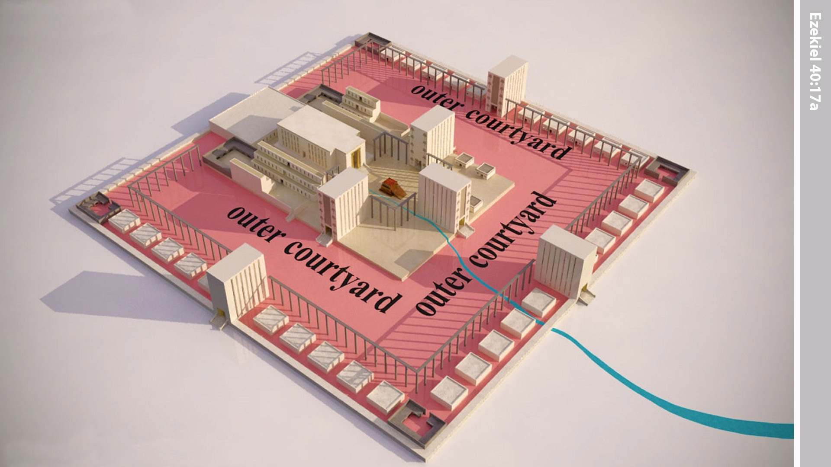
Notes:
In the vision Ezekiel was taken through the passageway to the inner courtyard.

Slide 4
Providing His Presence For His People
Ezekiel
The
Book of
Chapter
47-48 .

Slide 5
3 Millennial Places And Their Prominence
God’s provision in the river

Slide 6
Genesis 2:10
“Now a river went out of Eden to water the garden; and from there it divided and became four rivers.”

Slide 7
Joel 3:18
“And it will be in that day, that the mountains will drip with sweet wine, & the hills will flow with milk, & all the brooks of Judah will flow with water; & a spring will go out from the house of Yahweh to water the valley of Shittim.”

Slide 8
Zecheriah 14:8
“And it will be in that day, that living waters will flow out of Jerusalem, half of them toward the eastern sea & the other half toward the western sea; it will be in summer as well as in winter.”

Slide 9
Revelation 22:1-2
“Then he showed me a river of the water of life, bright as crystal, coming from the throne of God & of the Lamb, in the middle of its street. On either side of the river was the tree of life, bearing twelve kinds of fruit, yielding its fruit every month; & the leaves of the tree were for the healing of the nations.”

Slide 10
Jeremiah 2:13
“For My people have done two evils: they have forsaken Me, the fountain of living waters, to hew for themselves cisterns, broken cisterns that can hold no water.”

Slide 11
John 4:10-14
“Jesus answered & said to her, “If you knew the gift of God, & who it is who says to you, ‘Give Me a drink,’ you would have asked Him, & He would have given you living water.” She said to Him, “Sir, You have nothing to draw w/ & the well is deep. Where then do You get that living water? “Are You greater than our father Jacob, who gave us this well, & drank of it himself & his sons & his cattle?... (con’t)

Slide 12
John 4:10-14
(con’t) …Jesus answered & said to her, “Everyone who drinks of this water will thirst again; but whoever drinks of the water that I will give him will never thirst—ever; but the water that I will give him will become in him a well of water springing up to eternal life.”

Slide 13
3 Millennial Places And Their Prominence
God’s provision in the river

Slide 14
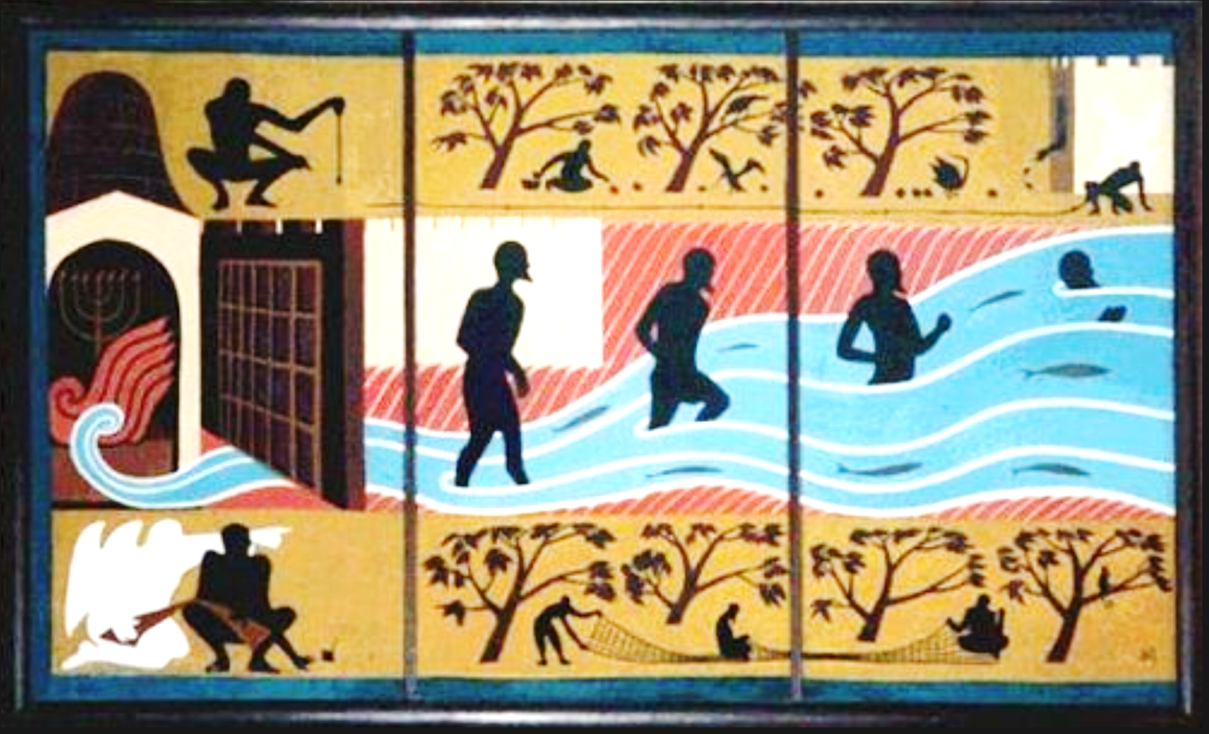

Slide 15
John 7:37-39
“Now on the last day, the great day of the feast, Jesus stood & cried out, saying, “If anyone is thirsty, let him come to Me & drink. “He who believes in Me, as the Scripture said, ‘From his innermost being will flow rivers of living water.’” But this He spoke of the Spirit, whom those who believed in Him were going to receive; for the Spirit was not yet given, b/c Jesus was not yet glorified.”

Slide 16
3 Millennial Places And Their Prominence
God’s provision in the river

Slide 17
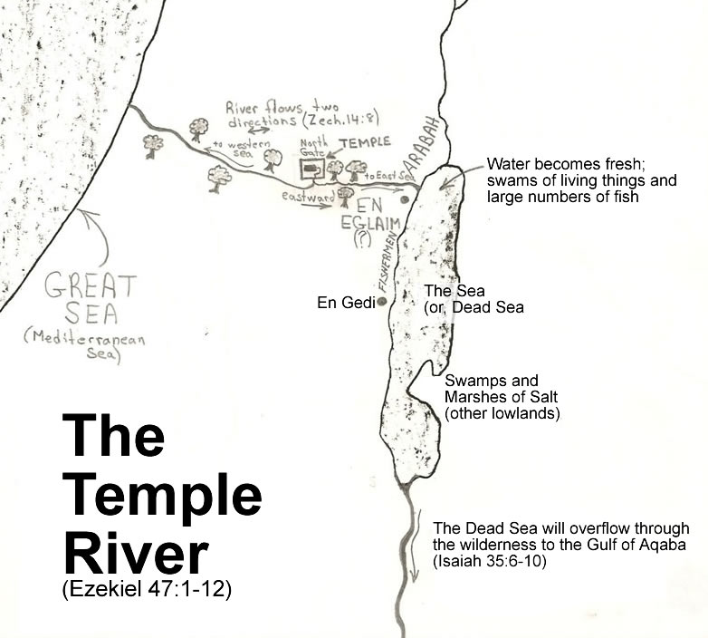
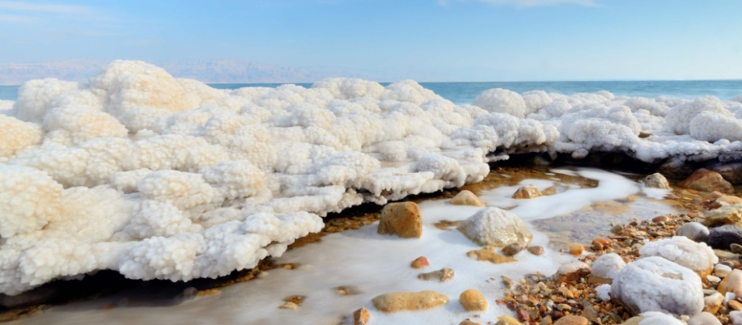

Slide 18
3 Millennial Places And Their Prominence
God’s provision in the river
God’s people in the land

Slide 19
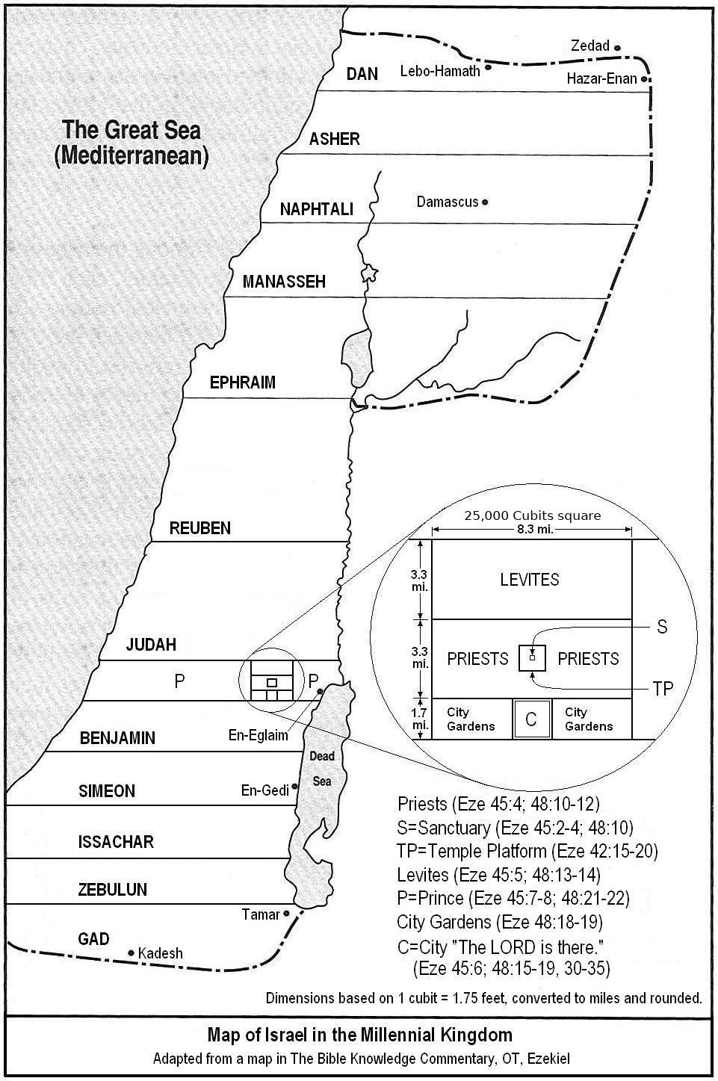
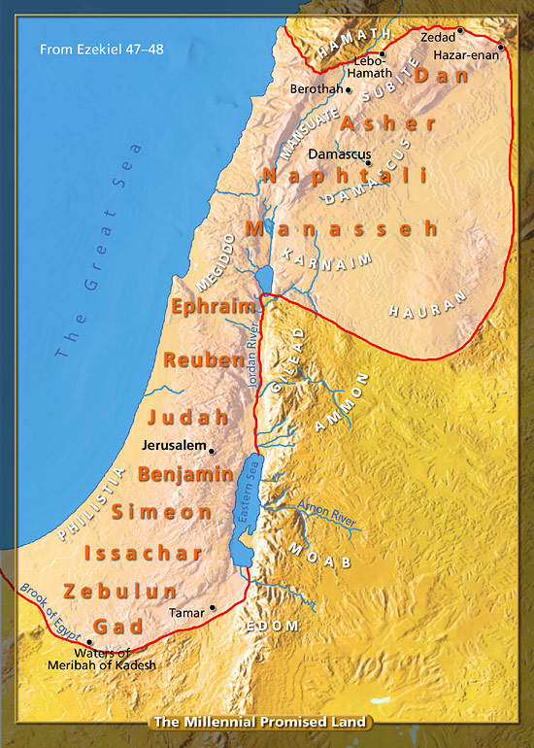



Slide 20



Slide 23



Slide 24
3 Millennial Places And Their Prominence
God’s provision in the river
God’s people in the land
God’s presence in the city

Slide 25
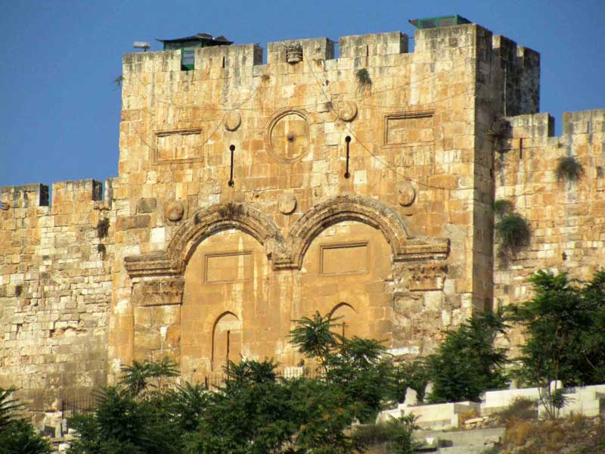
12 Gates For The City
Reuben Judah Levi
Gad
Asher
Naphtali
Joseph
Benjamin
Dan
Jerusalem
Simeon Issachar Zebulun

Slide 26
3 Millennial Places And Their Prominence
God’s provision in the river
God’s people in the land
God’s presence in the city

Slide 27
Matthew 28:19-20
“Go therefore & make disciples of all the nations, baptizing them in the name of the Father & the Son & the Holy Spirit, teaching them to keep all that I commanded you; & behold, I am with you always, even to the end of the age.”

Slide 28
3 Millennial Places & Their Prominence
“There is a river whose streams make glad the city of God, The holy dwelling places of the Most High. God is in the midst of her, she will not be shaken; God will help her when morning dawns. The nations roar, the kingdoms shake; He gives His voice, the earth melts. Yahweh of hosts is with us; The God of Jacob is our stronghold.”
God’s provision in the river
God’s people in the land
God’s presence in the city

