Slide 1
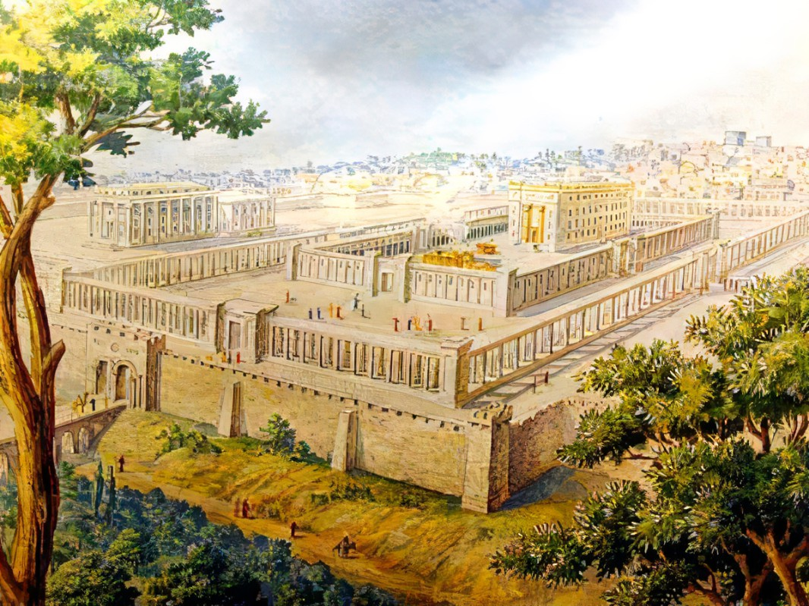


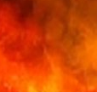
Why Sacrifice In The Millennium?
Ezekiel
The
Book of
Chapter
44-46 .

Slide 2
Ezekiel’s 5th Section:
The Millennial Kingdom
The Millennial Temple (Chap 40-43)
Its Rituals and Practices (Chap 44-46)
The New Holy Land (Chap 47-48)
HOUSE
HABITS
Homestead

Slide 3
Why Sacrifice In The Millennium?
Ezekiel
The
Book of
Chapter
44-46 .

Slide 4
Millennial Kingdom Rituals
Levitical Priests: Their choosing, qualifications & duties

Slide 5
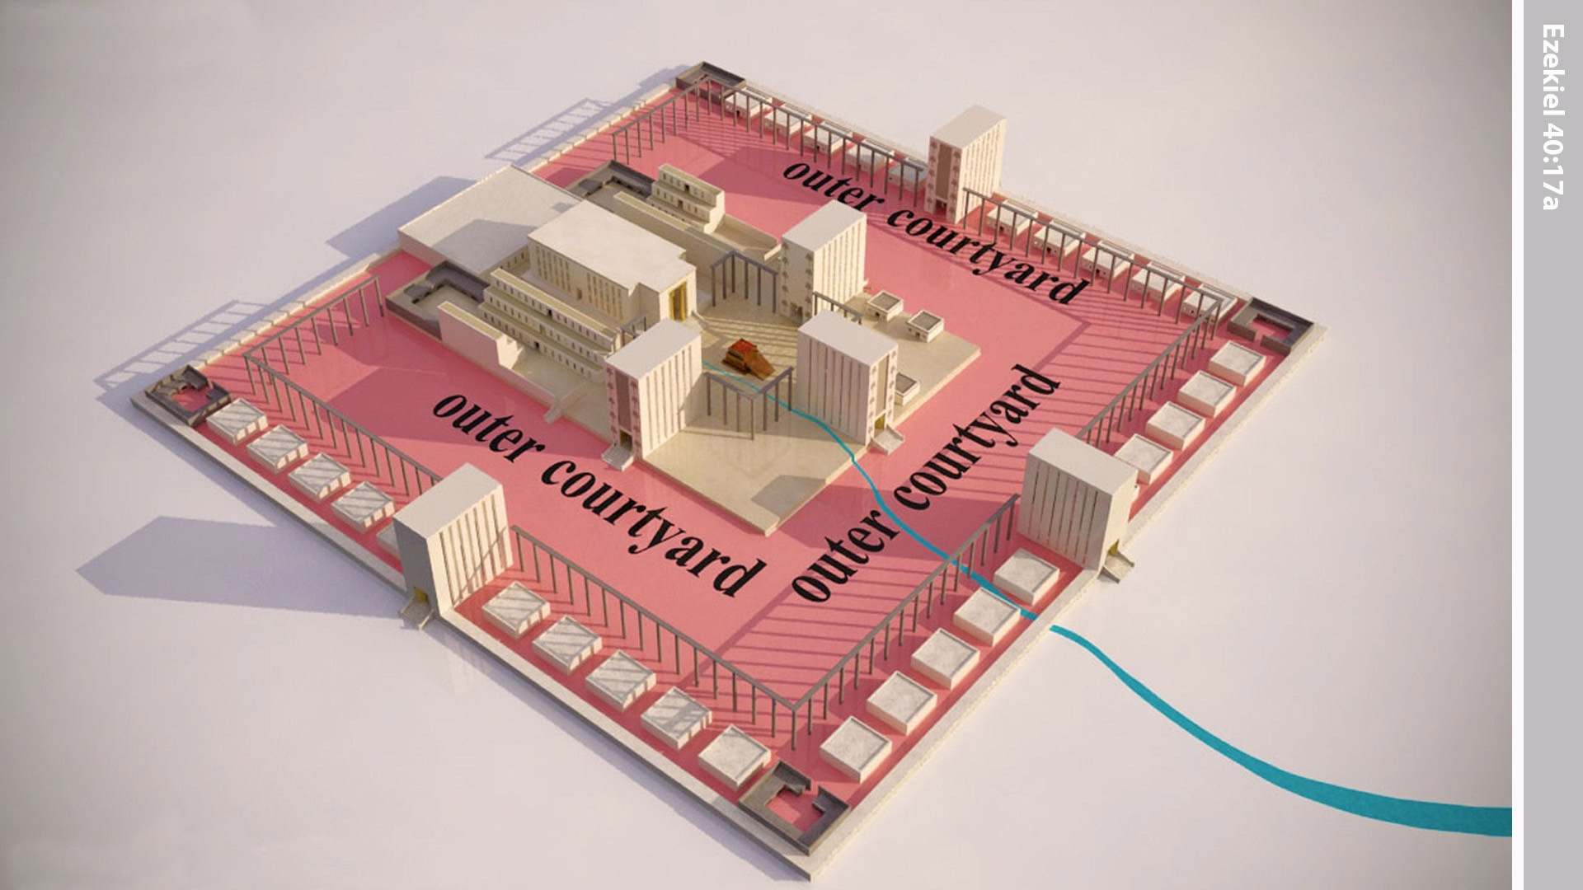
Notes:
In the vision Ezekiel was taken through the passageway to the inner courtyard.

Slide 6
Millennial Kingdom Rituals
Levitical Priests: Their choosing, qualifications & duties
The Prince: His land, civil service & ritual service

Slide 7
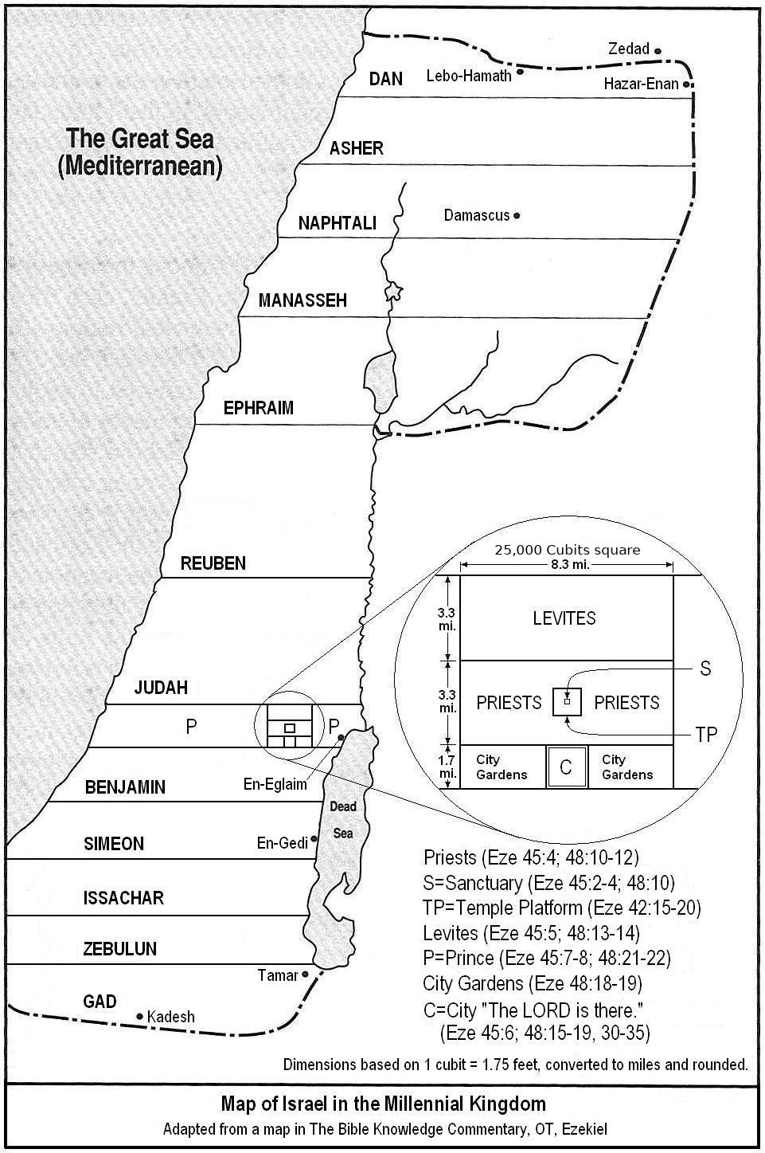

Slide 8
Millennial Kingdom Rituals
Levitical Priests: Their choosing, qualifications & duties
The Prince: His land, civil service & ritual service
The Planning: Temple rituals around the calendar

Slide 9
Notes:
In the vision Ezekiel was taken through the passageway to the inner courtyard.

Slide 10
Millennial Kingdom Rituals
Levitical Priests: Their choosing, qualifications & duties
The Prince: His land, civil service & ritual service
The Planning: Temple rituals around the calendar

Slide 11
Notes:
In the vision Ezekiel was taken through the passageway to the inner courtyard.

Slide 12
Millennial Kingdom Rituals
Levitical Priests: Their choosing, qualifications & duties
The Prince: His land, civil service & ritual service
The Planning: Temple rituals around the calendar

Slide 13
Why Does The Kingdom Need A Sacrificial System?
As a commemoration of sin’s atonement
The ‘wages of sin’ need seen by the mortals
Mortals need ceremonial cleaning
So we can finally see what proper worship looks like

