Slide 1
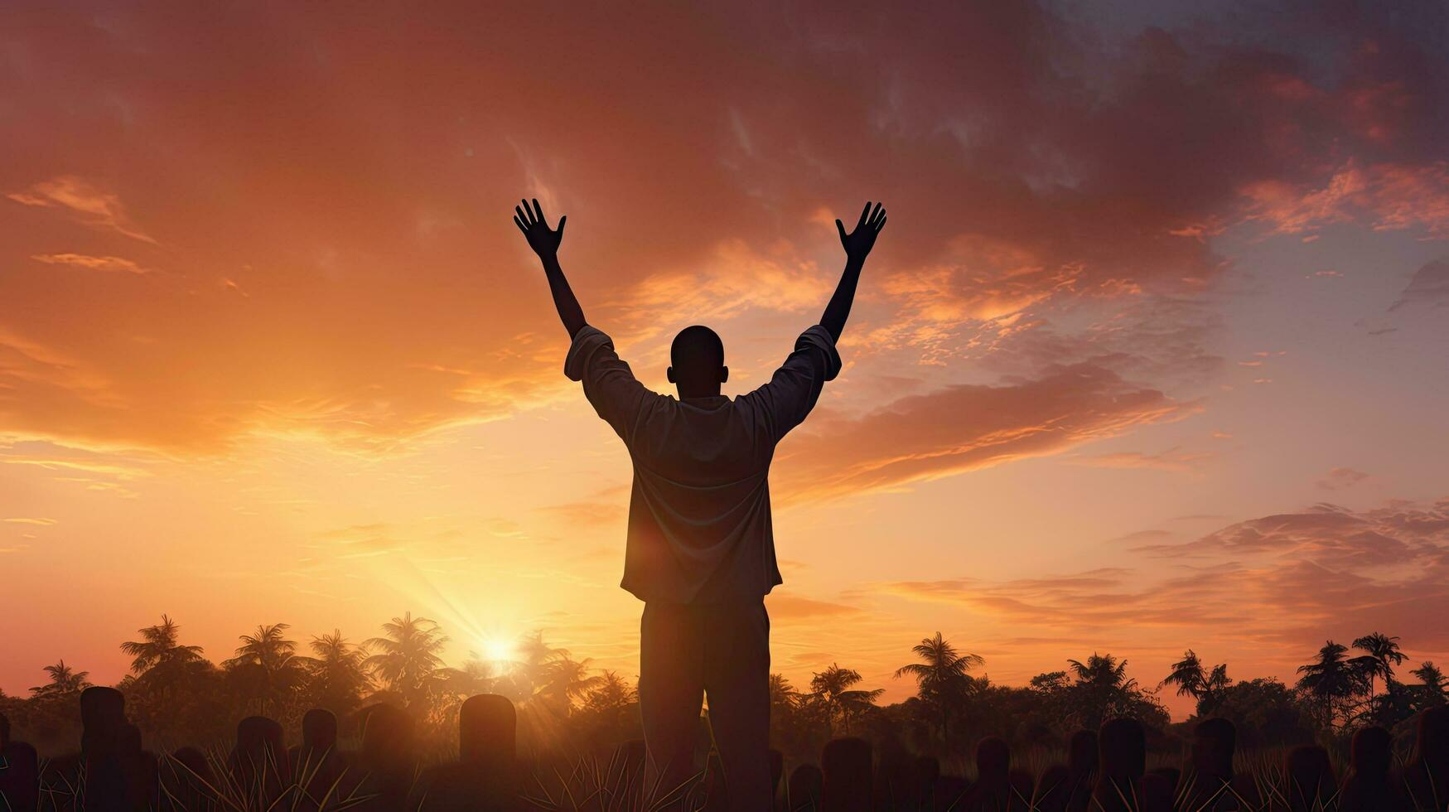

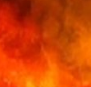
The
Psalms
87-89
So We May Live, Jesus Took Death

Slide 2
John 5:46
“For if you believed Moses, you would believe Me [Jesus], for he wrote about Me.”

Slide 3
Luke 24:25-27
“And He [Jesus] said to them, “O foolish ones & slow of heart to believe in all that the prophets have spoken! “Was it not necessary for the Christ to suffer these things & to enter into His glory? Then beginning with Moses & with all the prophets, He interpreted to them the things concerning Himself in all the Scriptures.”

Slide 4
The
Psalms
87-89
So We May Live, Jesus Took Death

Slide 5
So We May Live, Jesus Took Death
Beloved Jerusalem:
Jesus comes to bring life

Slide 6
Isaiah 28:16
“Therefore thus says Lord Yahweh, “Behold, I am laying in Zion a stone, a tested stone, a costly cornerstone for the foundation, firmly placed. He who believes in it will not be disturbed.”

Slide 7
So We May Live, Jesus Took Death
Beloved Jerusalem:
Jesus comes to bring life

Slide 8
Jeremiah 2:13
“For My people have done two evils: they have forsaken Me, the fountain of living waters, to hew for themselves cisterns, broken cisterns that can hold no water.”

Slide 9
So We May Live, Jesus Took Death
Beloved Jerusalem:
Jesus comes to bring life
Engulfed In Darkness:
Jesus came to the cross

Slide 10
Psalm 41:9
“Even my close friend in whom I trusted, who ate my bread, has lifted up his heel against me.”

Slide 11
So We May Live, Jesus Took Death
Beloved Jerusalem:
Jesus comes to bring life
Engulfed In Darkness:
Jesus came to the cross

Slide 12
Isaiah 59:2
“But your iniquities have made a separation between you & your God, & your sins have hidden His face from you so that He does not hear.”

Slide 13
So We May Live, Jesus Took Death
Beloved Jerusalem:
Jesus comes to bring life
Engulfed In Darkness:
Jesus came to the cross
The Great Exchange:
Jesus’ resurrection brings eternal life …at a price

Slide 14
John 1:14
“And the Word became flesh, & dwelt among us, & we beheld His glory, glory as of the only begotten from the Father, full of grace & truth.”

Slide 15
John 10:28-29
“I give eternal life to them, & they will never perish—ever; & no one will snatch them out of My hand. My Father, who has given them to Me, is greater than all; & no one is able to snatch them out of the Father’s hand.”

Slide 16
So We May Live, Jesus Took Death
Beloved Jerusalem:
Jesus comes to bring life
Engulfed In Darkness:
Jesus came to the cross
The Great Exchange:
Jesus’ resurrection brings eternal life …at a price

Slide 17
John 2:19
“Jesus answered them, destroy this sanctuary, & in three days I will raise it up.”

Slide 18
Hebrews 2:9b-10
“Jesus, b/c of the suffering of death crowned w/ glory & honor, so that by the grace of God He might taste death for everyone. For it was fitting for Him… thru whom are all things, in bringing many sons to glory, to perfect the author of their salvation through sufferings.”

Slide 19
So We May Live, Jesus Took Death
Beloved Jerusalem:
Jesus comes to bring life
Engulfed In Darkness:
Jesus came to the cross
The Great Exchange:
Jesus’ resurrection brings eternal life …at a price

