Slide 1
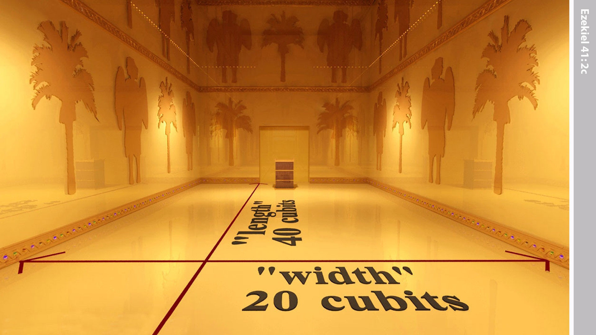
Notes:
The Holy Place was 40 cubits long and 20 cubits wide.

Slide 2
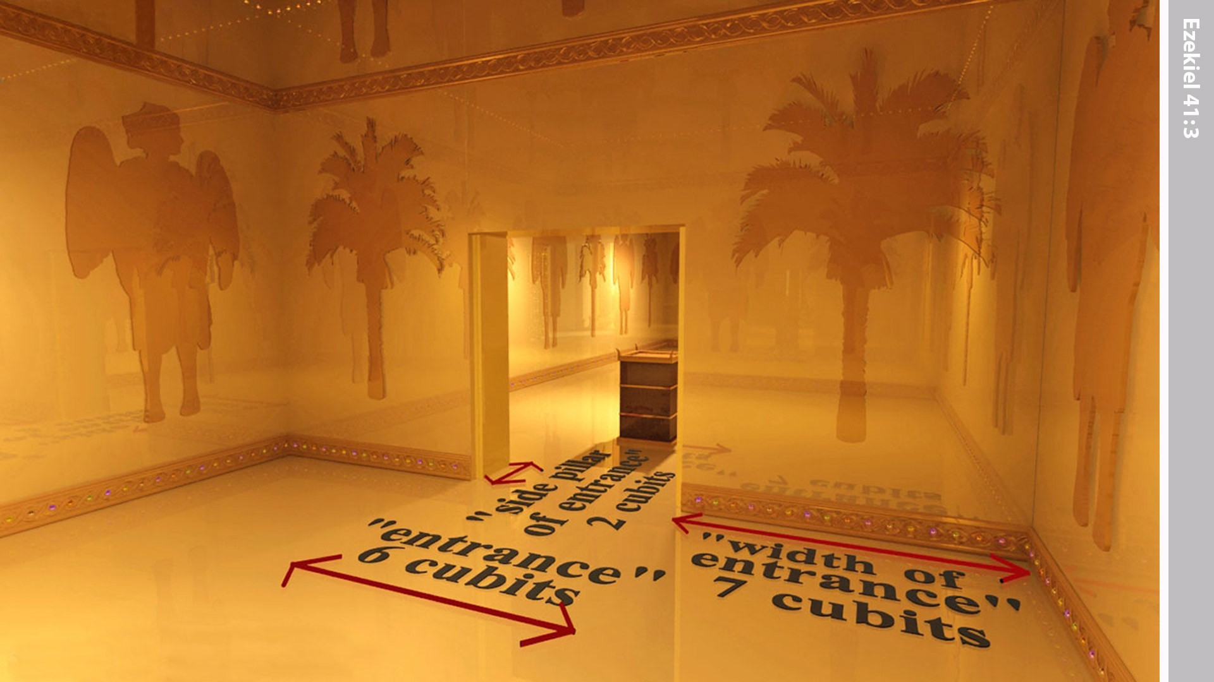
Notes:
Then the ‘man’ went into the last room. He measured the walls on either side of the doorway. Each side wall was 2 cubits thick and 7 cubits wide. The doorway was 6 cubits wide.

Slide 3
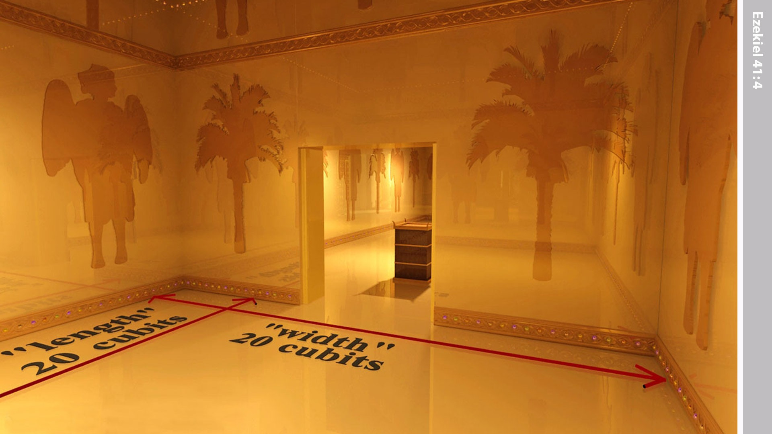
Notes:
Then he measured the length of the room. It was 20 cubits long and 20 cubits wide. He told Ezekiel, ‘This is the Most Holy Place.’

Slide 4
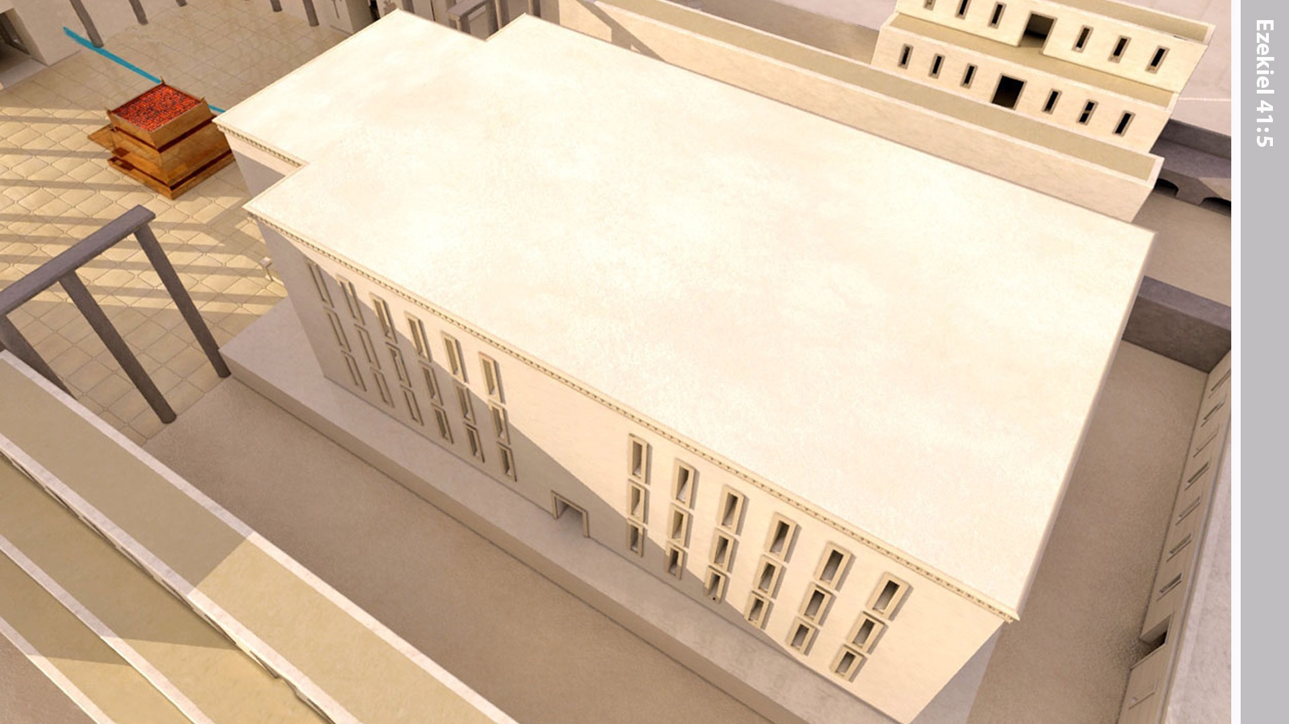
Notes:
The ‘man’ then measured the wall of the temple.

Slide 5
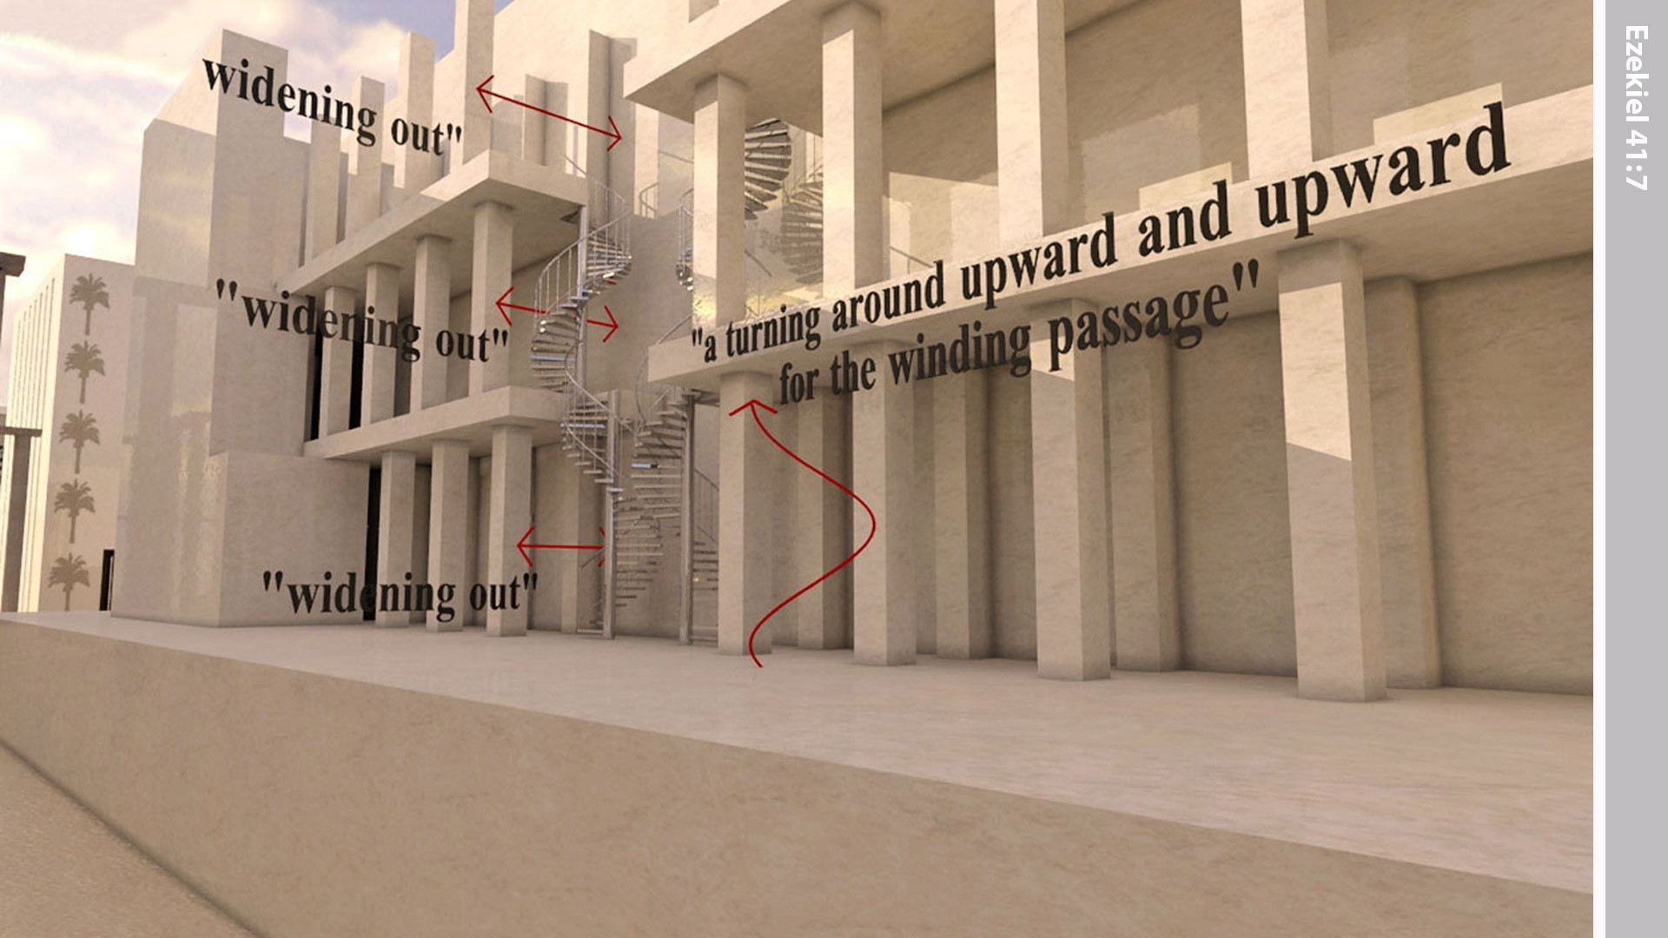
Notes:
The side rooms rested on these ledges but were not connected to the Temple wall itself. Each floor of the side rooms around the Temple was wider than the floor below. The walls of the rooms around the Temple became narrower the higher they went. A stairway went up from the lowest floor to the highest floor through the middle floor.

Slide 6
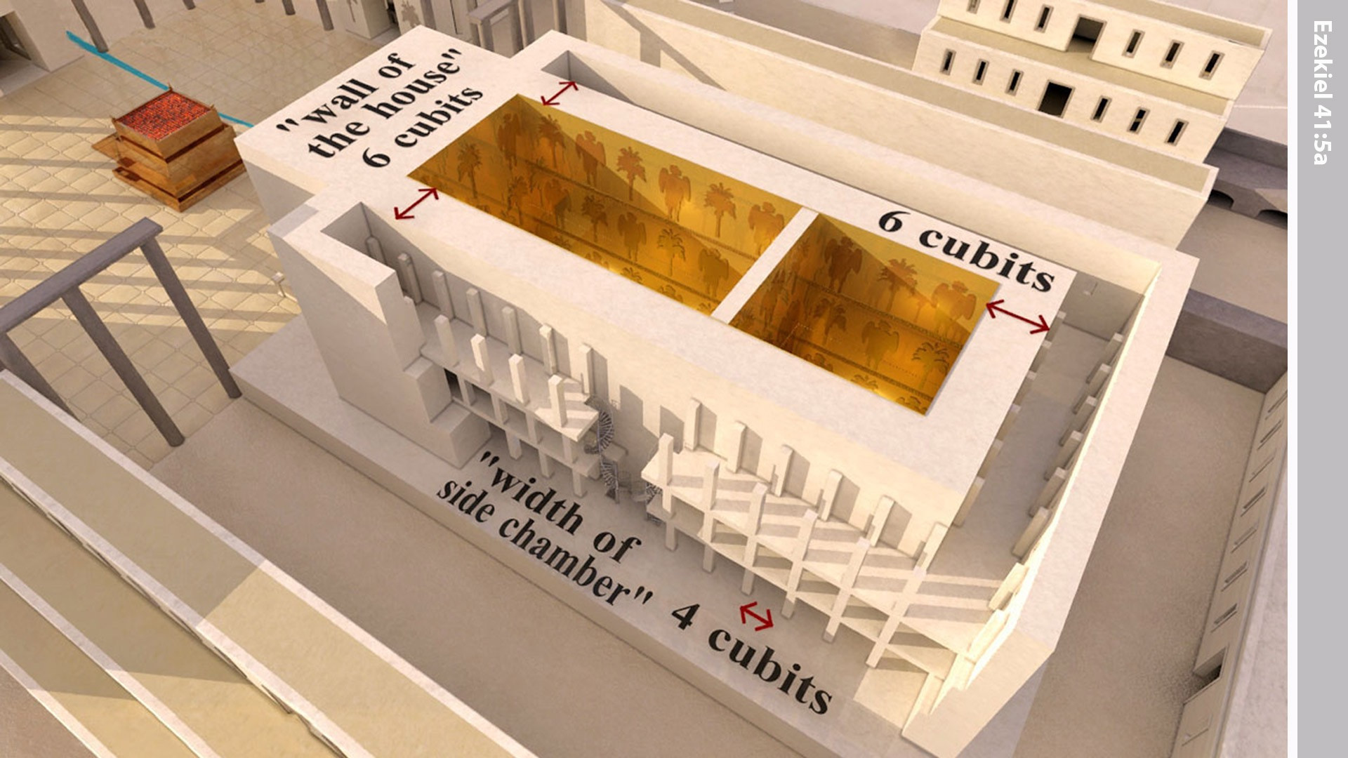
Notes:
It was six cubits thick, and each side room around the temple was four cubits wide.

Slide 7
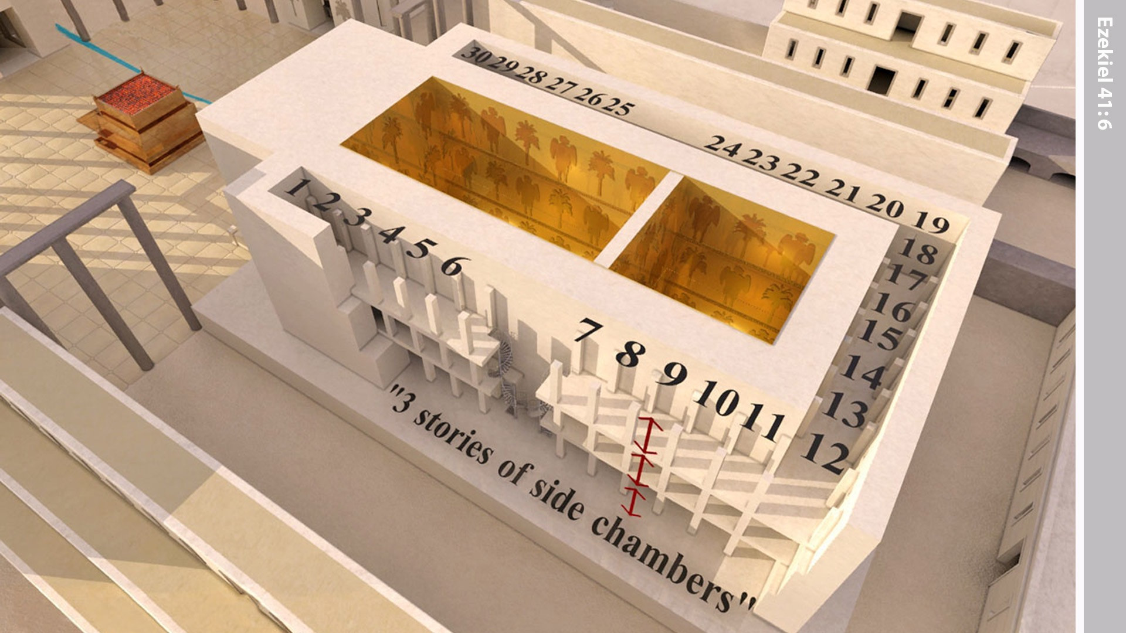
Notes:
The side rooms were on three levels, one above another, thirty on each level.

Slide 8
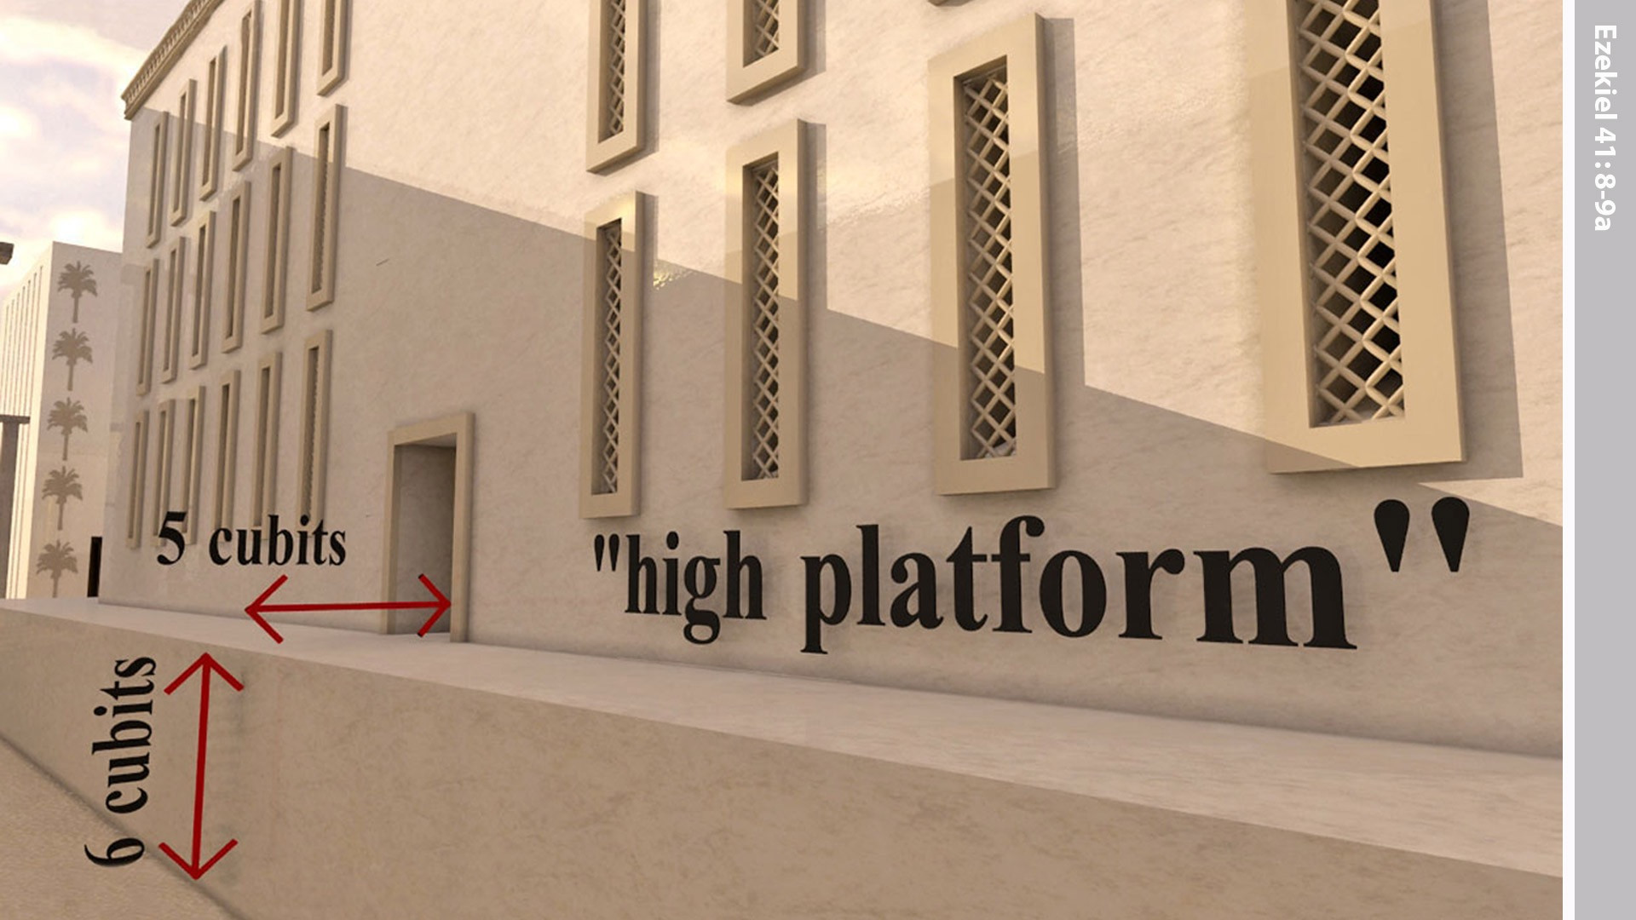
Notes:
Ezekiel saw that the Temple had a raised base as the foundation for the side rooms, and it was a 6 cubits high and 5 cubits thick.

Slide 9
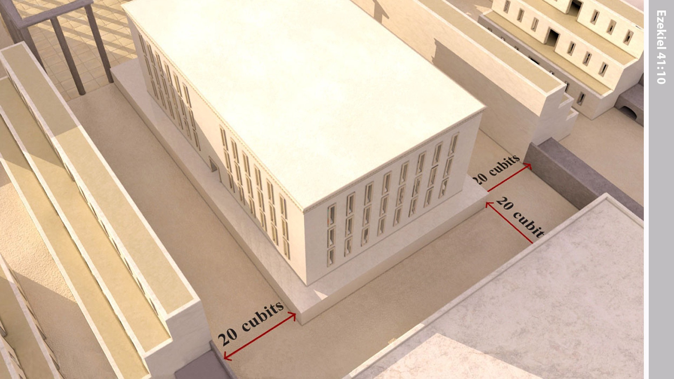
Notes:
There was an open area between the side rooms of the Temple and the priests’ rooms. It was 20 cubits wide and went all the way around the Temple.

Slide 10
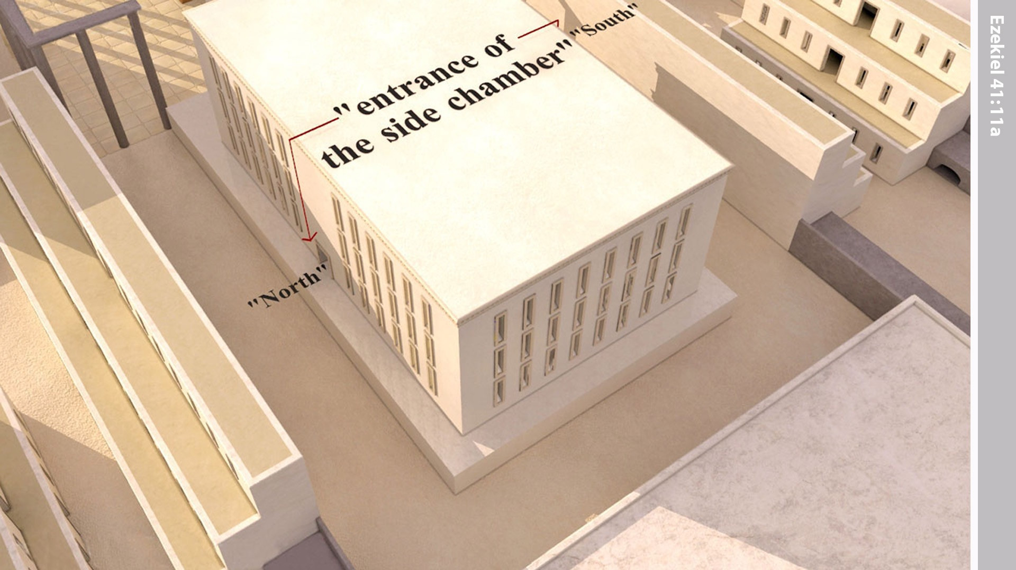
Notes:
There were entrances to the side rooms from the open area, one on the north and another on the south.

Slide 11
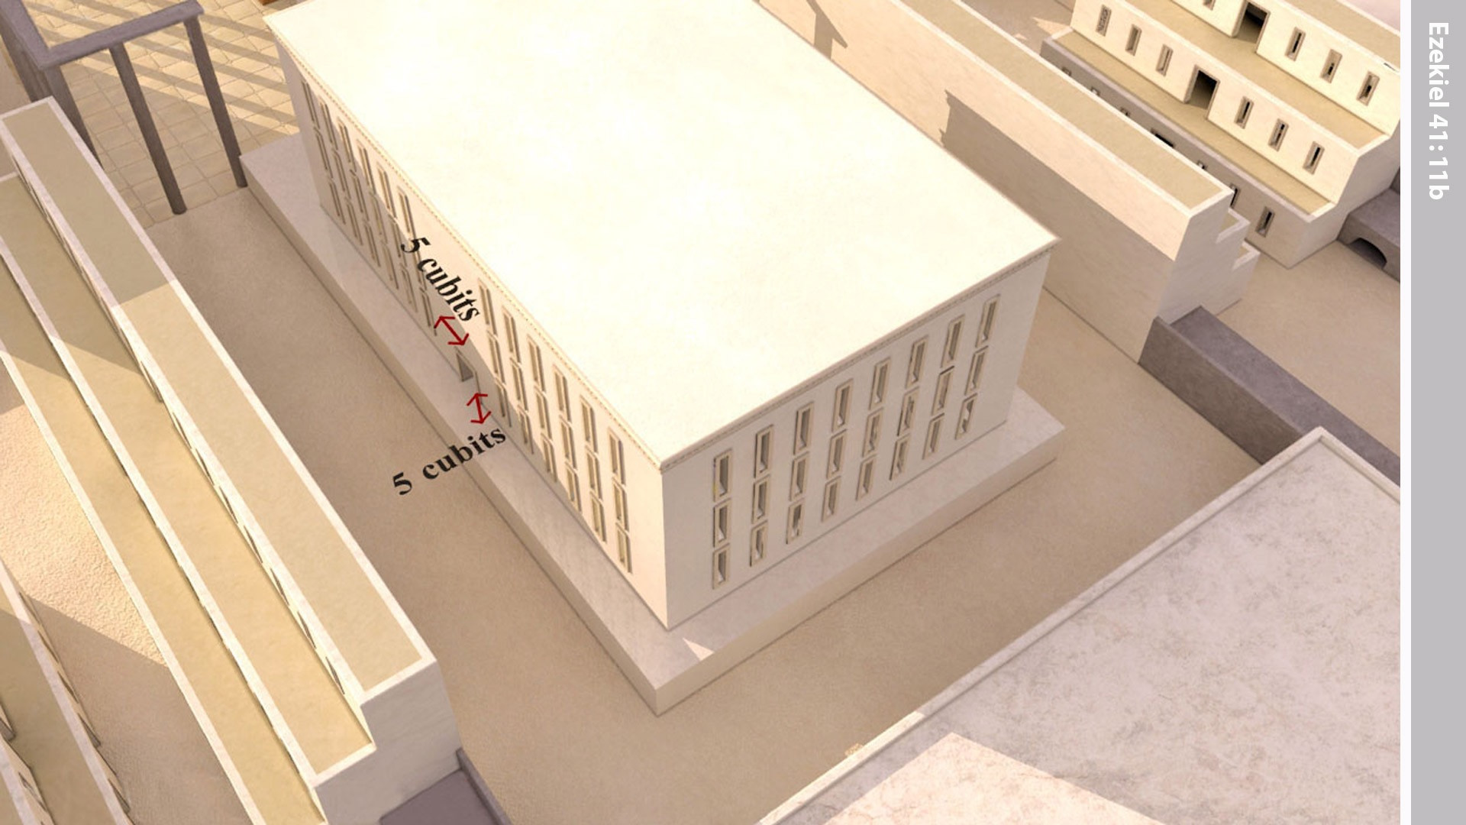
Notes:
The base adjoining the open area was five cubits wide all around.

Slide 12
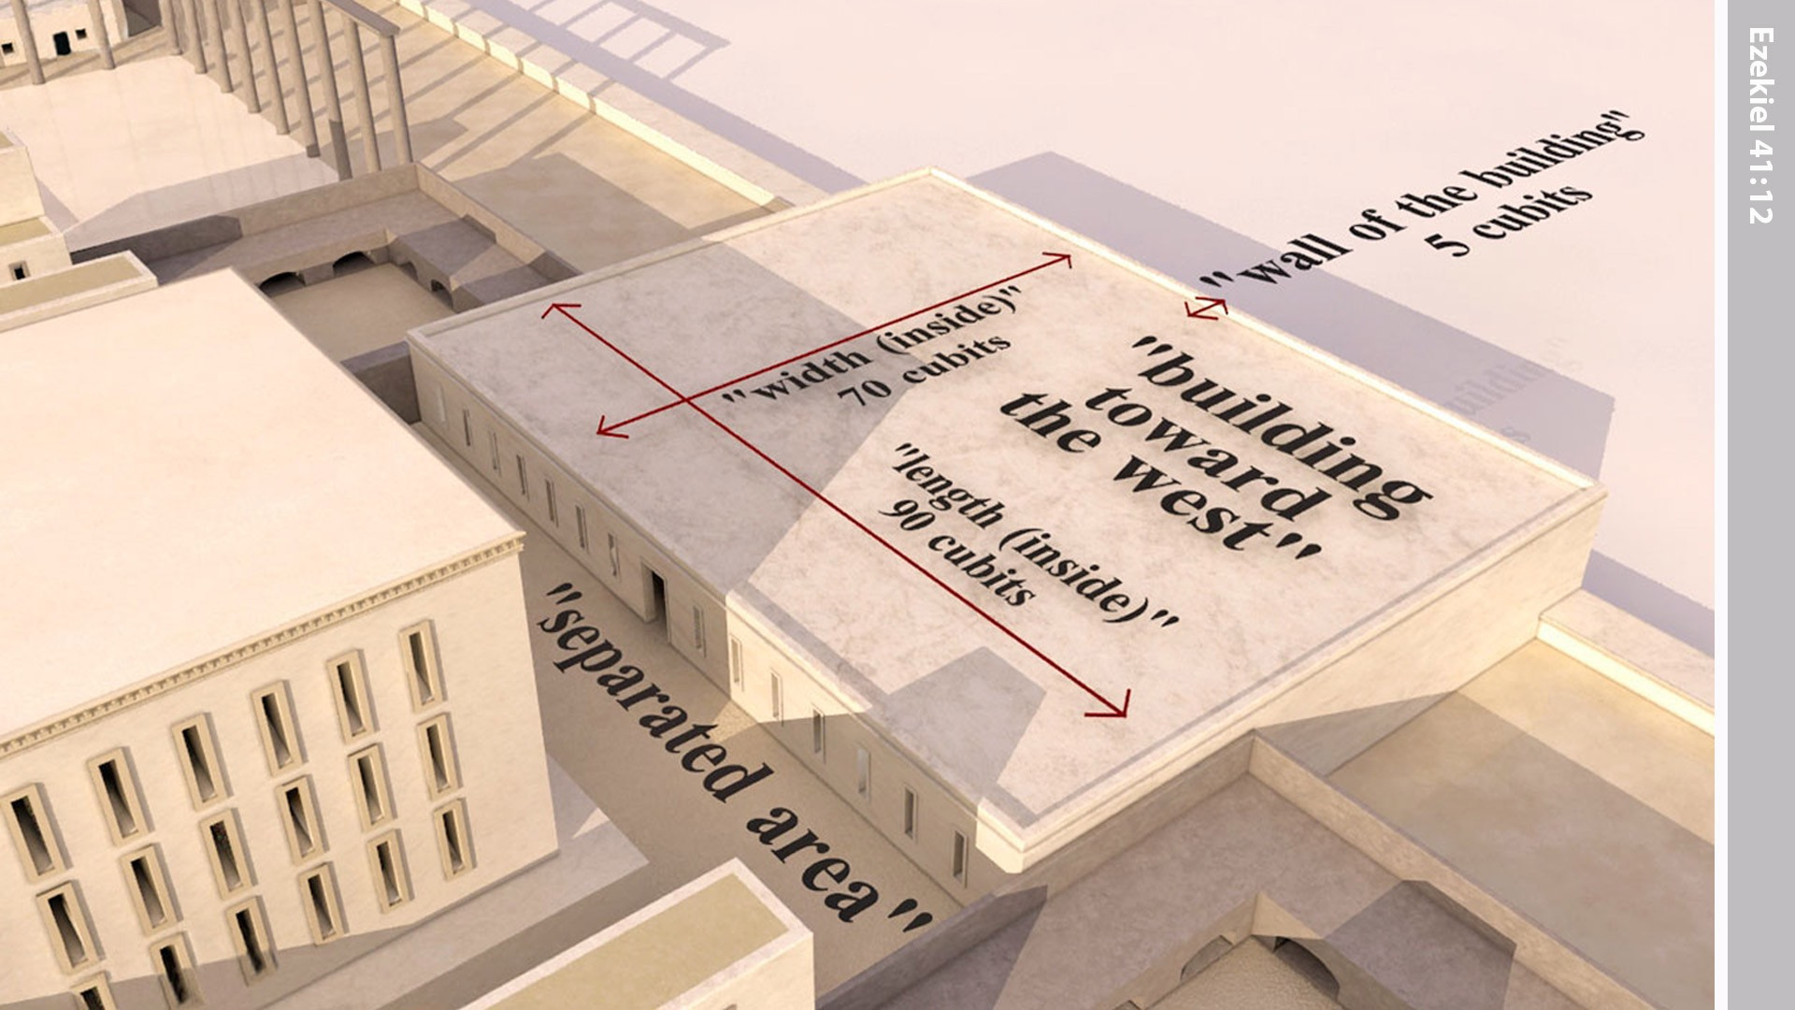
Notes:
The building facing the temple courtyard on the west side was seventy cubits wide. The wall of the building was five cubits thick all around, and its length was ninety cubits

Slide 13
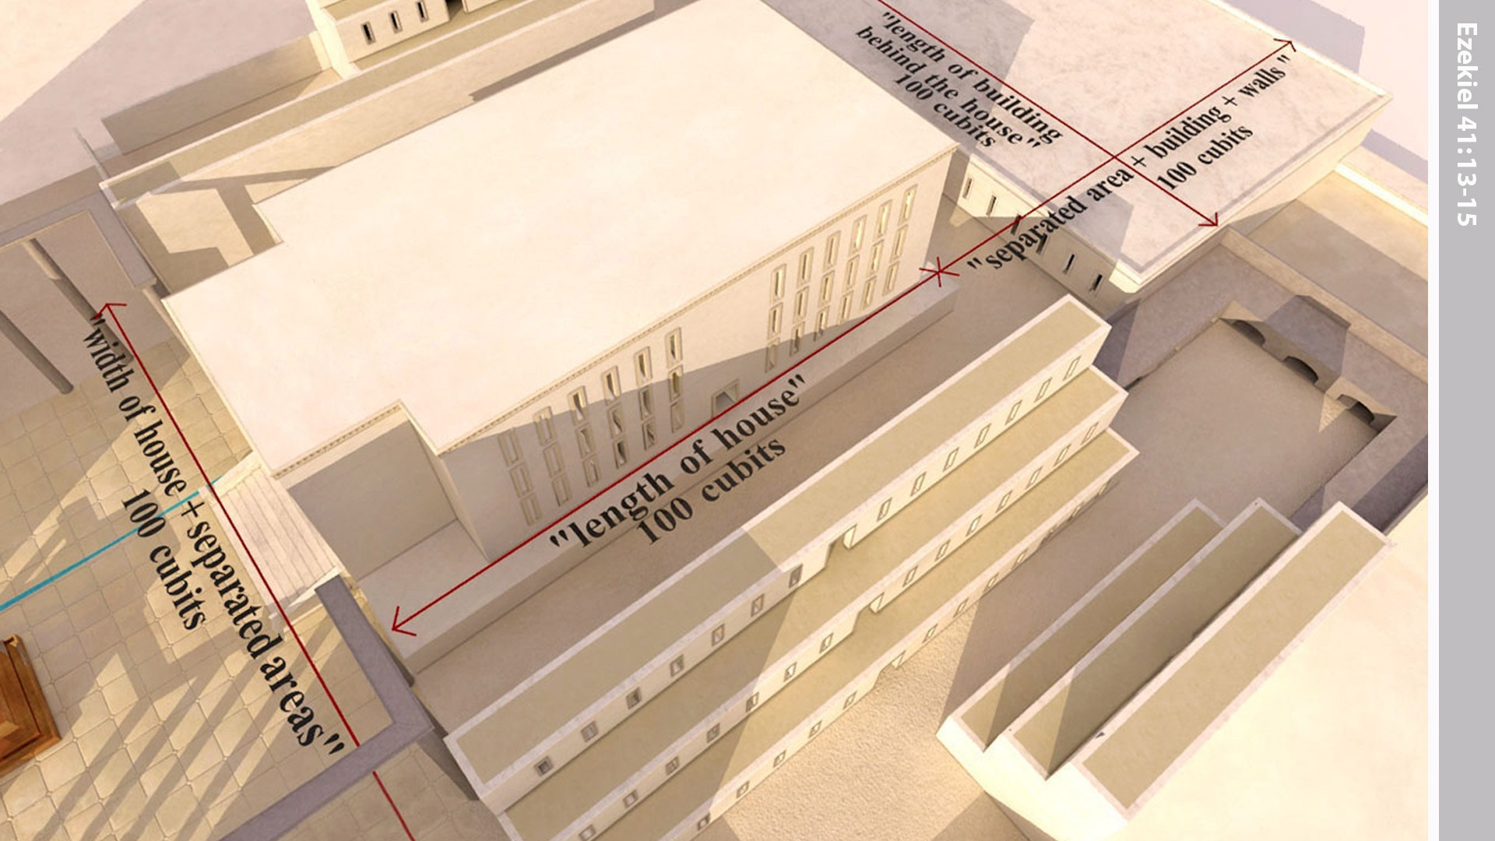
Notes:
Then the ‘man’ measured the Temple. It was 100 cubits long. The restricted area, including the building and its walls, was also 100 cubits long. The restricted area on the east side was also 100 cubits long. The building in the restricted area at the rear of the Temple was 100 cubits from one wall to the other wall.

Slide 14
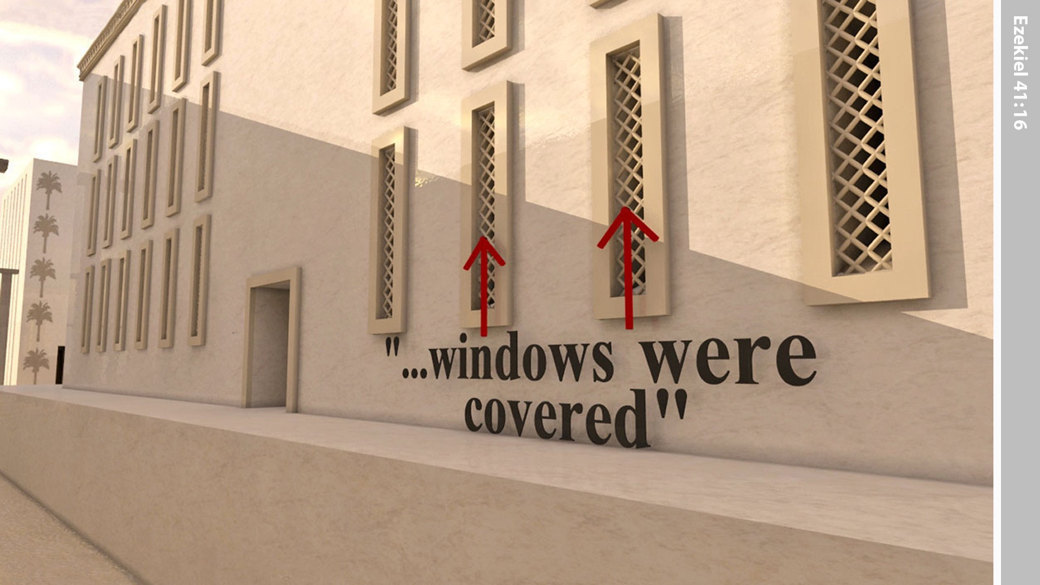
Notes:
The thresholds and the narrow windows and galleries around, including the threshold, was covered with wood.

Slide 15
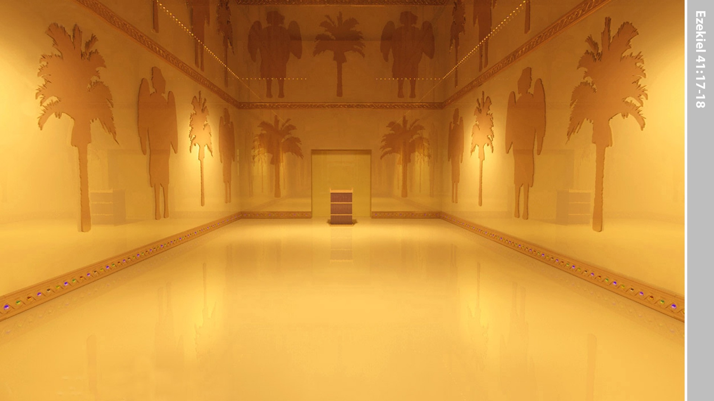
Notes:
On the walls at regular intervals all around the inner and outer sanctuary were carved cherubim and palm trees. Palm trees alternated with cherubim.

Slide 16
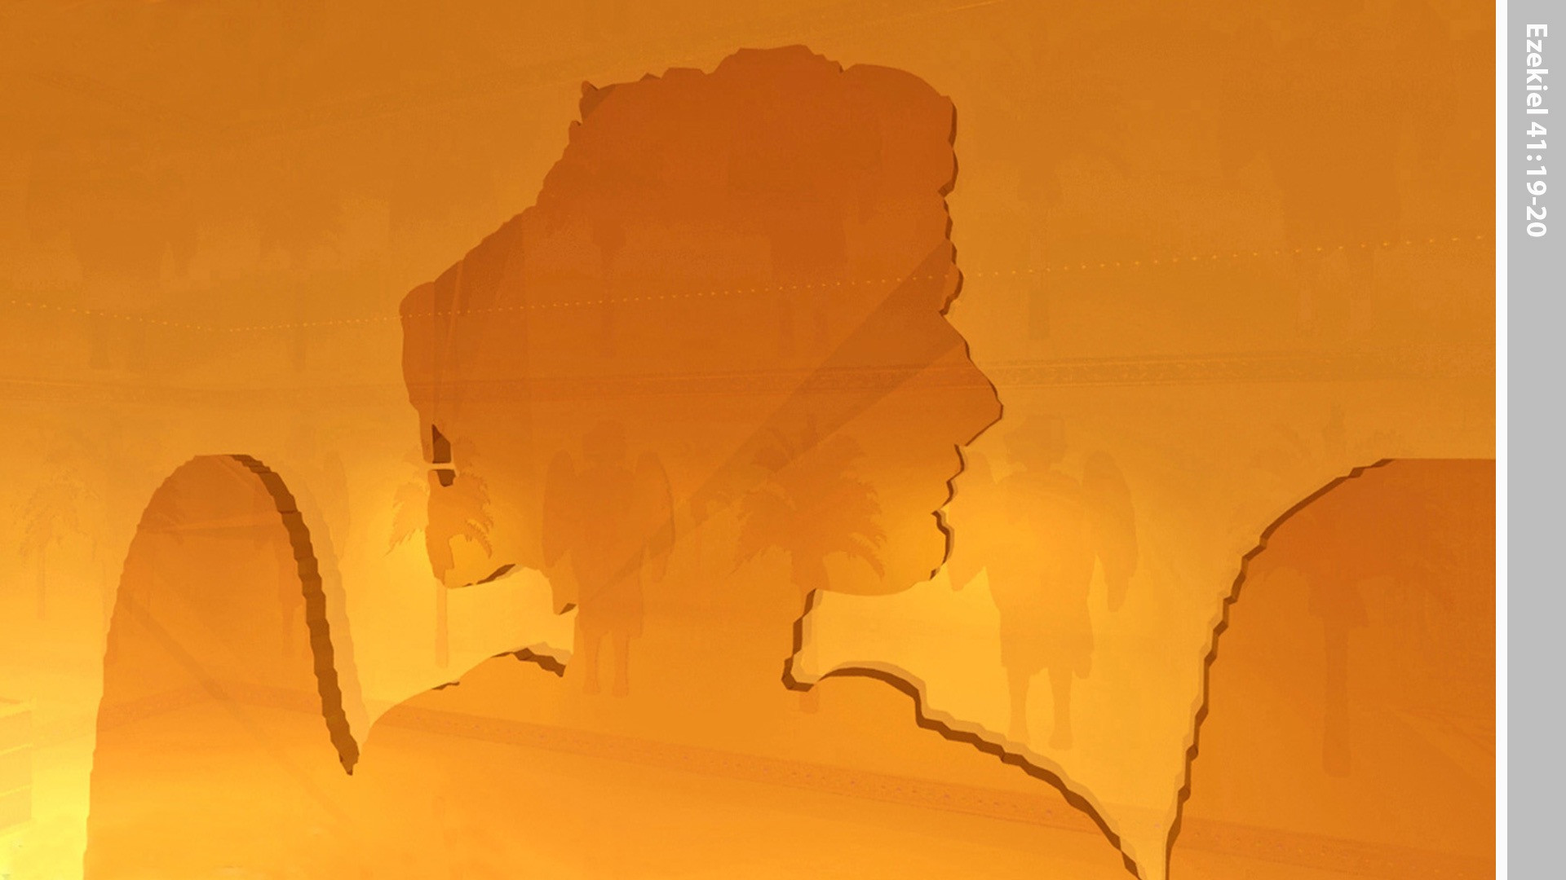
Notes:
Each cherub had two faces - the face of a human being toward the palm tree on one side and the face of a lion toward the palm tree on the other.

Slide 17
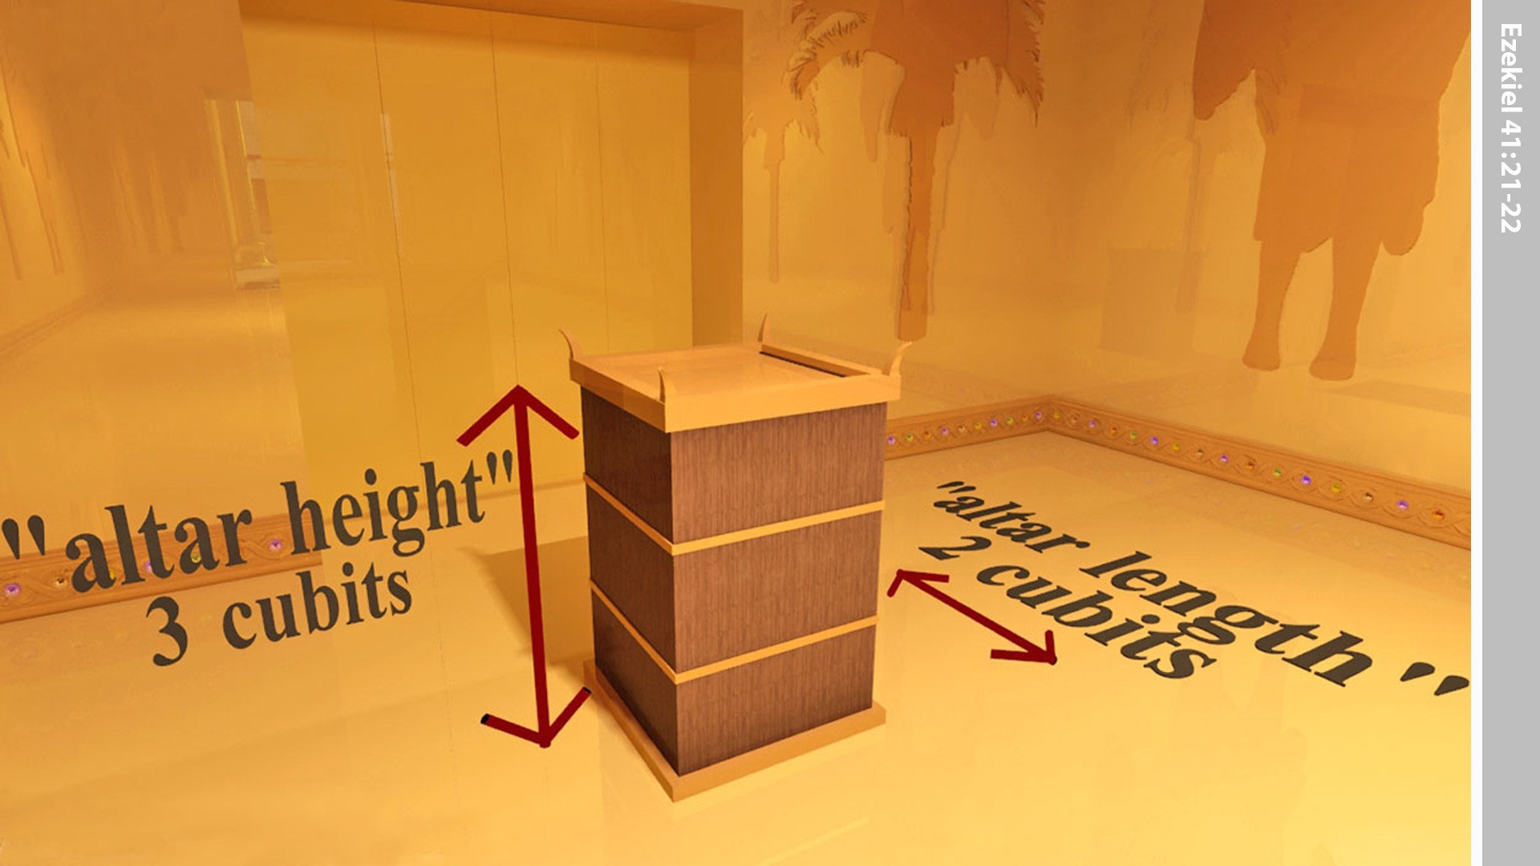
Notes:
There was a wooden altar three cubits high and two cubits square. Its corners, base and sides were of wood. The man told Ezekiel, ‘This is the table that is before the Lord.’

Slide 18
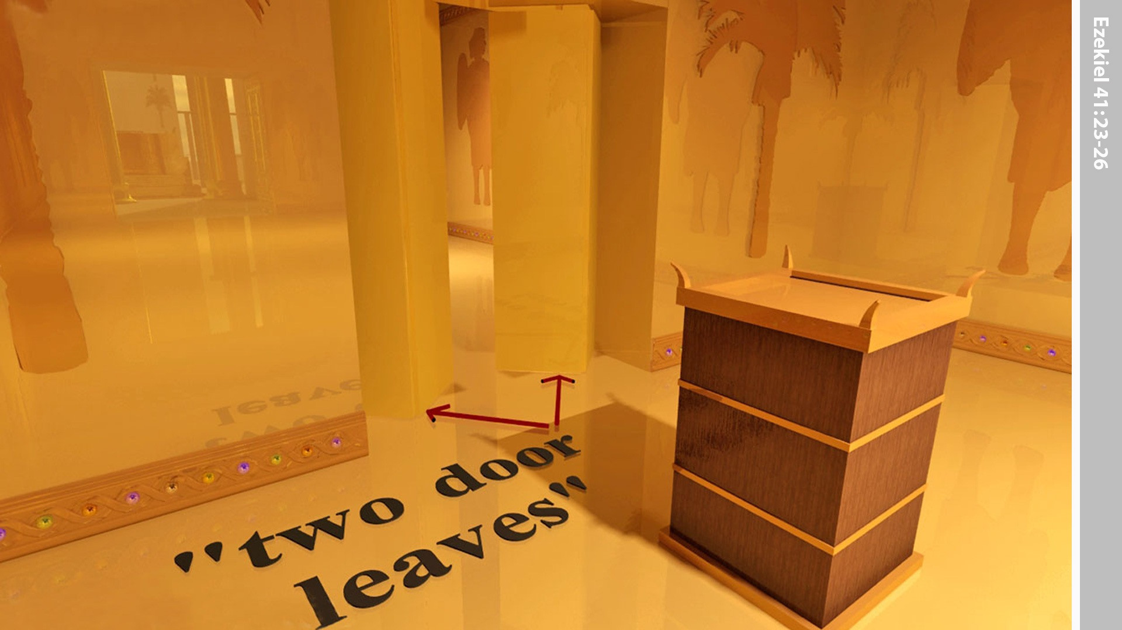
Notes:
Both the Holy Place and the Most Holy Place had double doors. Each door had two hinged leaves.

Slide 19
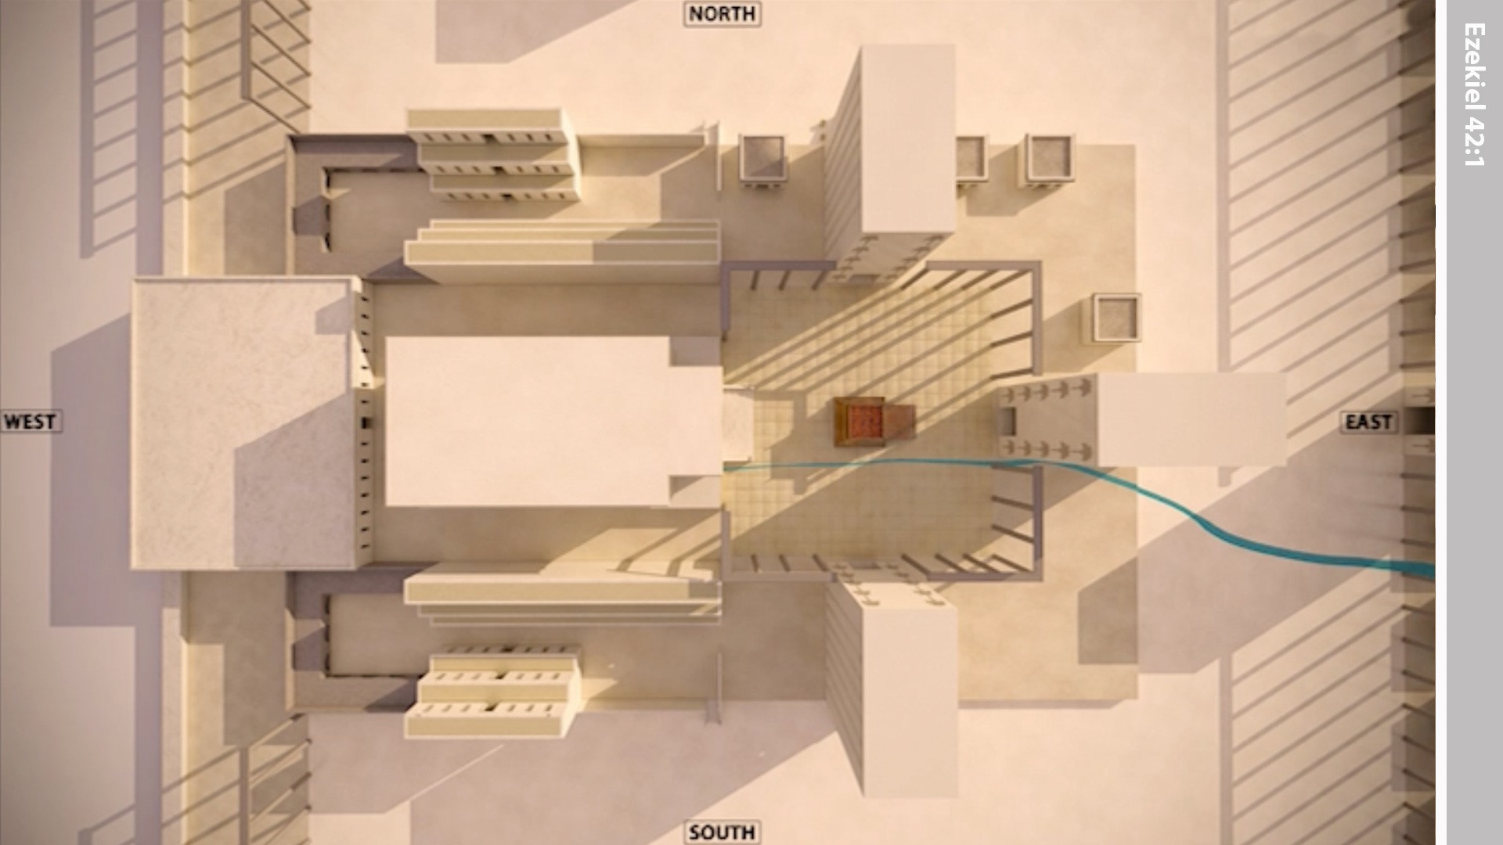
Notes:
In Ezekiel’s vision the ‘man’ led him through the north gate out into the outer courtyard.

Slide 20
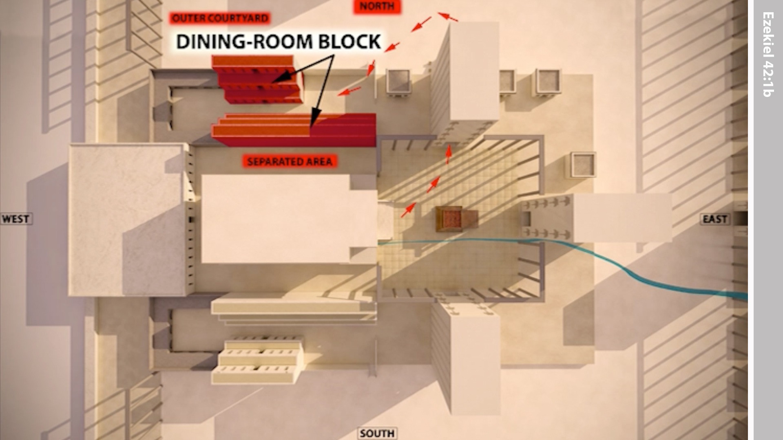
Notes:
Here were buildings with many rooms where the priests would eat the most holy offerings (v13).

Slide 21
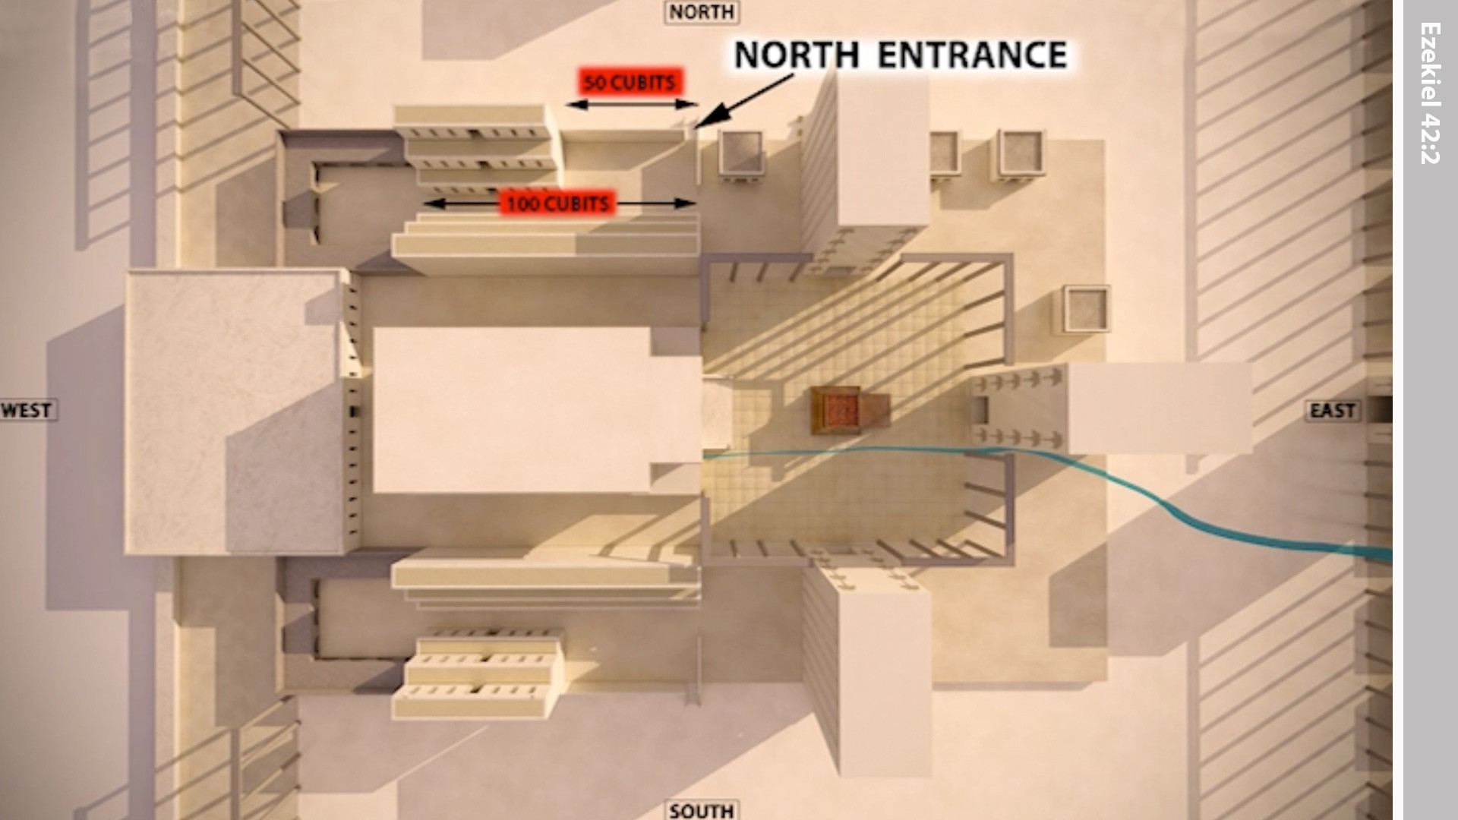
Notes:
The building whose door faced north was 100 cubits long and the building opposite it was 50 cubits in length.

Slide 22
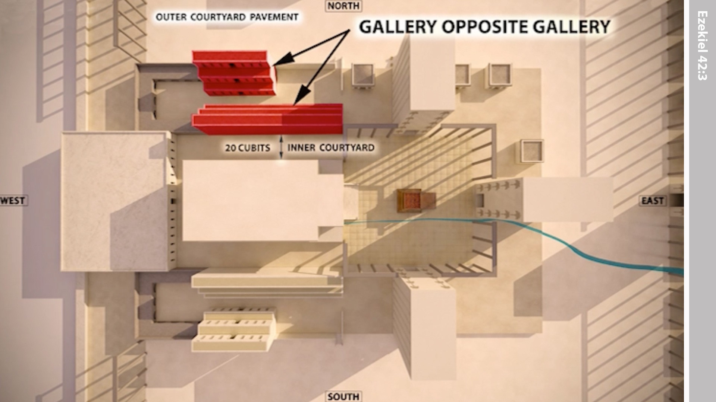
Notes:
The rooms were in three tiers, overlooking the outer court on one side.

Slide 23
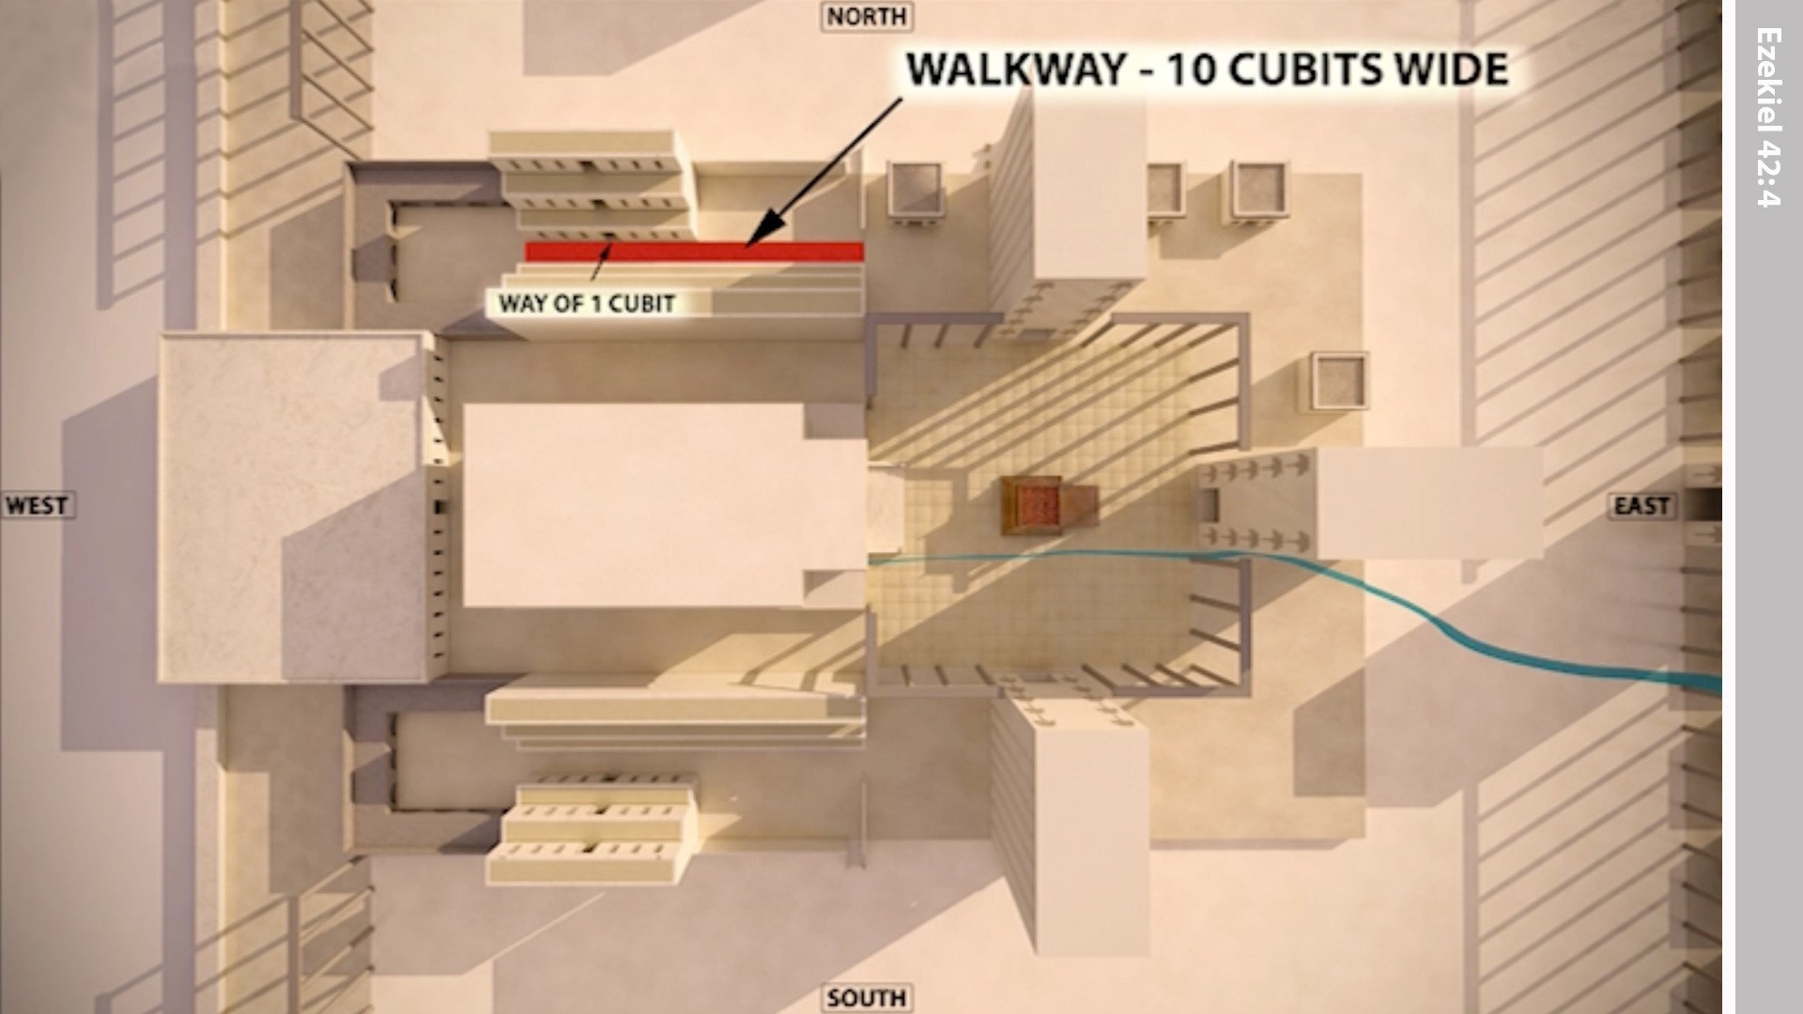
Notes:
In front of the rooms was an inner passageway ten cubits wide and a hundred cubits long.

Slide 24
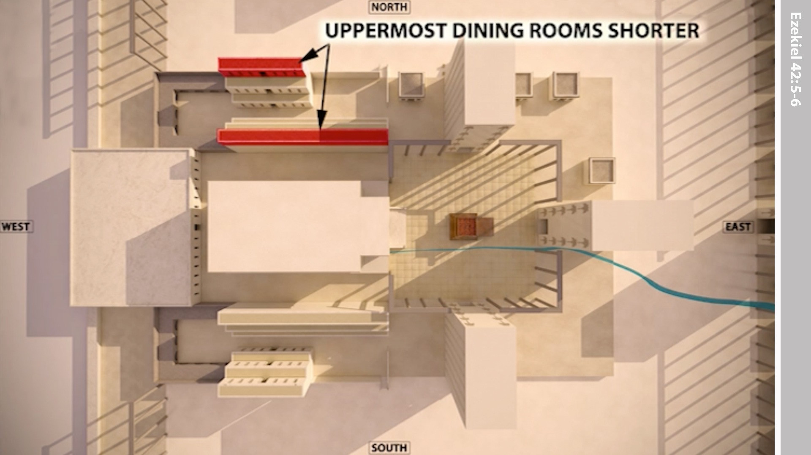
Notes:
The upper two tiers of rooms were not as wide as the lower one, because the upper tiers had wider walkways beside them.

Slide 25
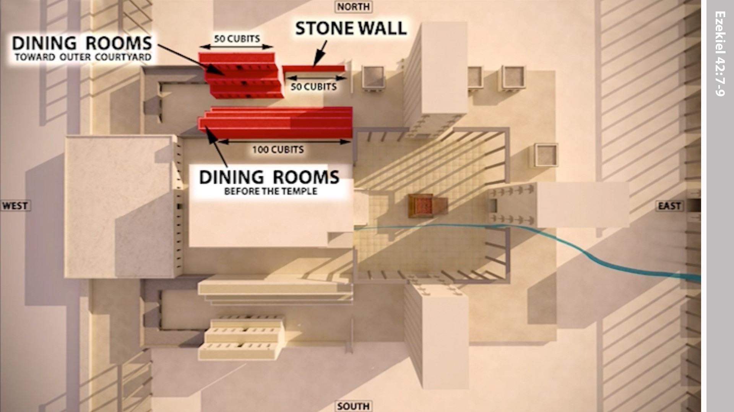
Notes:
There was a wall, 50 cubits long, that was parallel to the rooms and ran along the outer courtyard. The row of rooms that ran along the outer courtyard was also 50 cubits long.

Slide 26
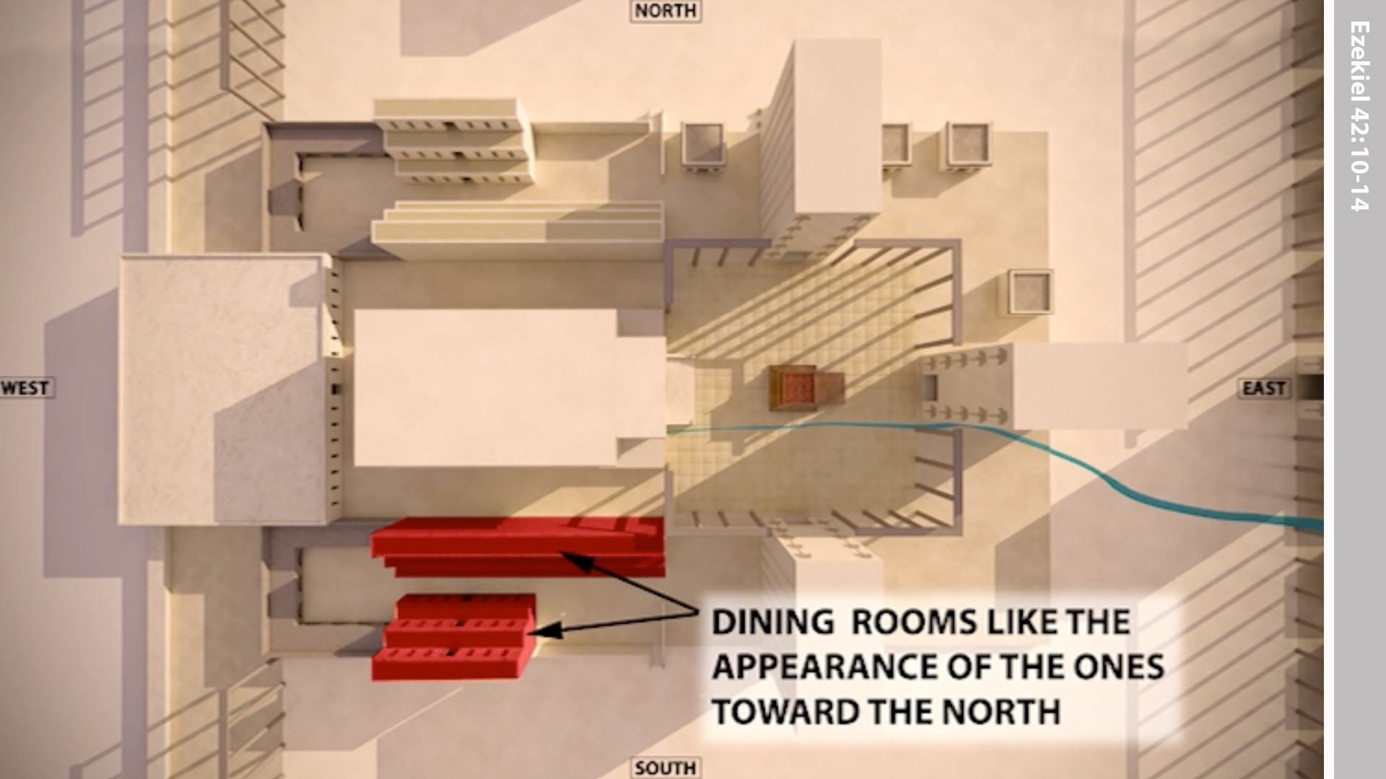
Notes:
On the south side, by the restricted area, there were buildings like those on the north side.

Slide 27
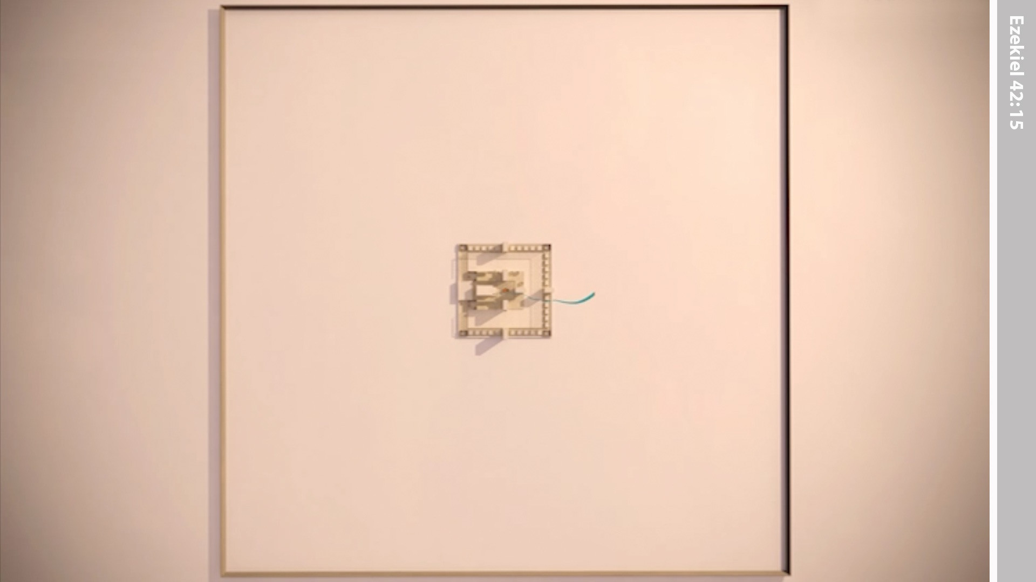
Notes:
When the man had finished measuring inside the Temple area he brought Ezekiel out through the East gate and measured all around that area.

Slide 28
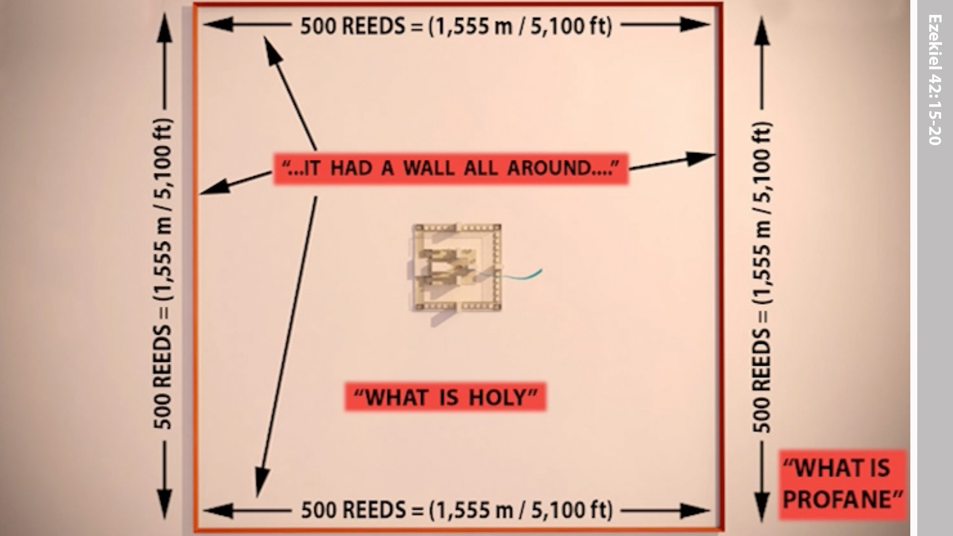
Notes:
It was 500 reeds square (KJV - note modern translations have this at 500 cubits). The surrounding wall separated the holy from the outside areas.

Slide 29
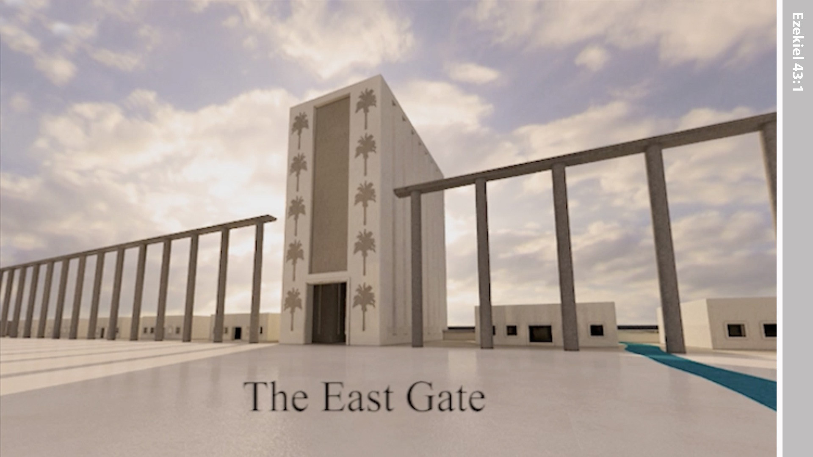
Notes:
In Ezekiel’s vision the ‘man’ brought him to the East gate.

Slide 30
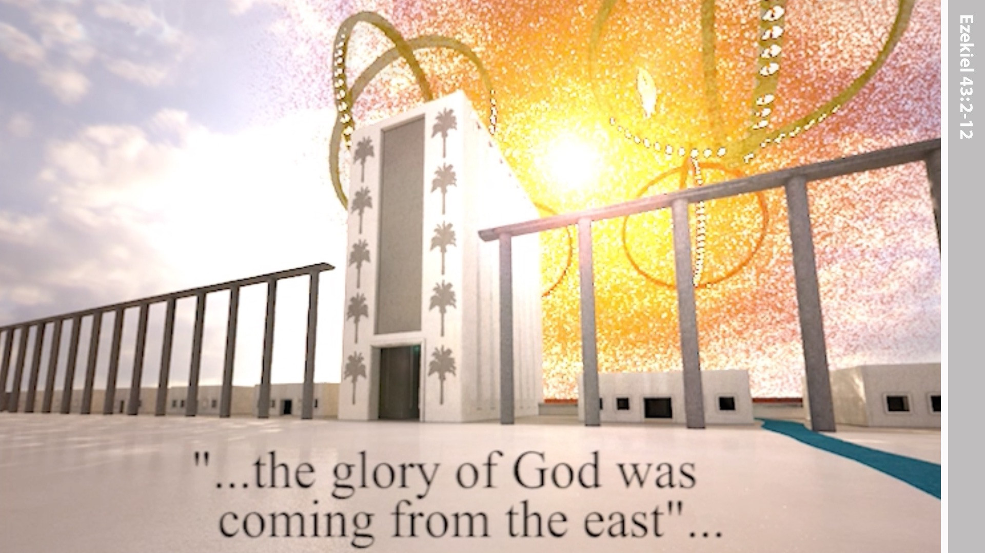
Notes:
He saw the glory of the Lord, as he had seen in an earlier vision by the Kebar river, entering the temple through the east gate.

Slide 31
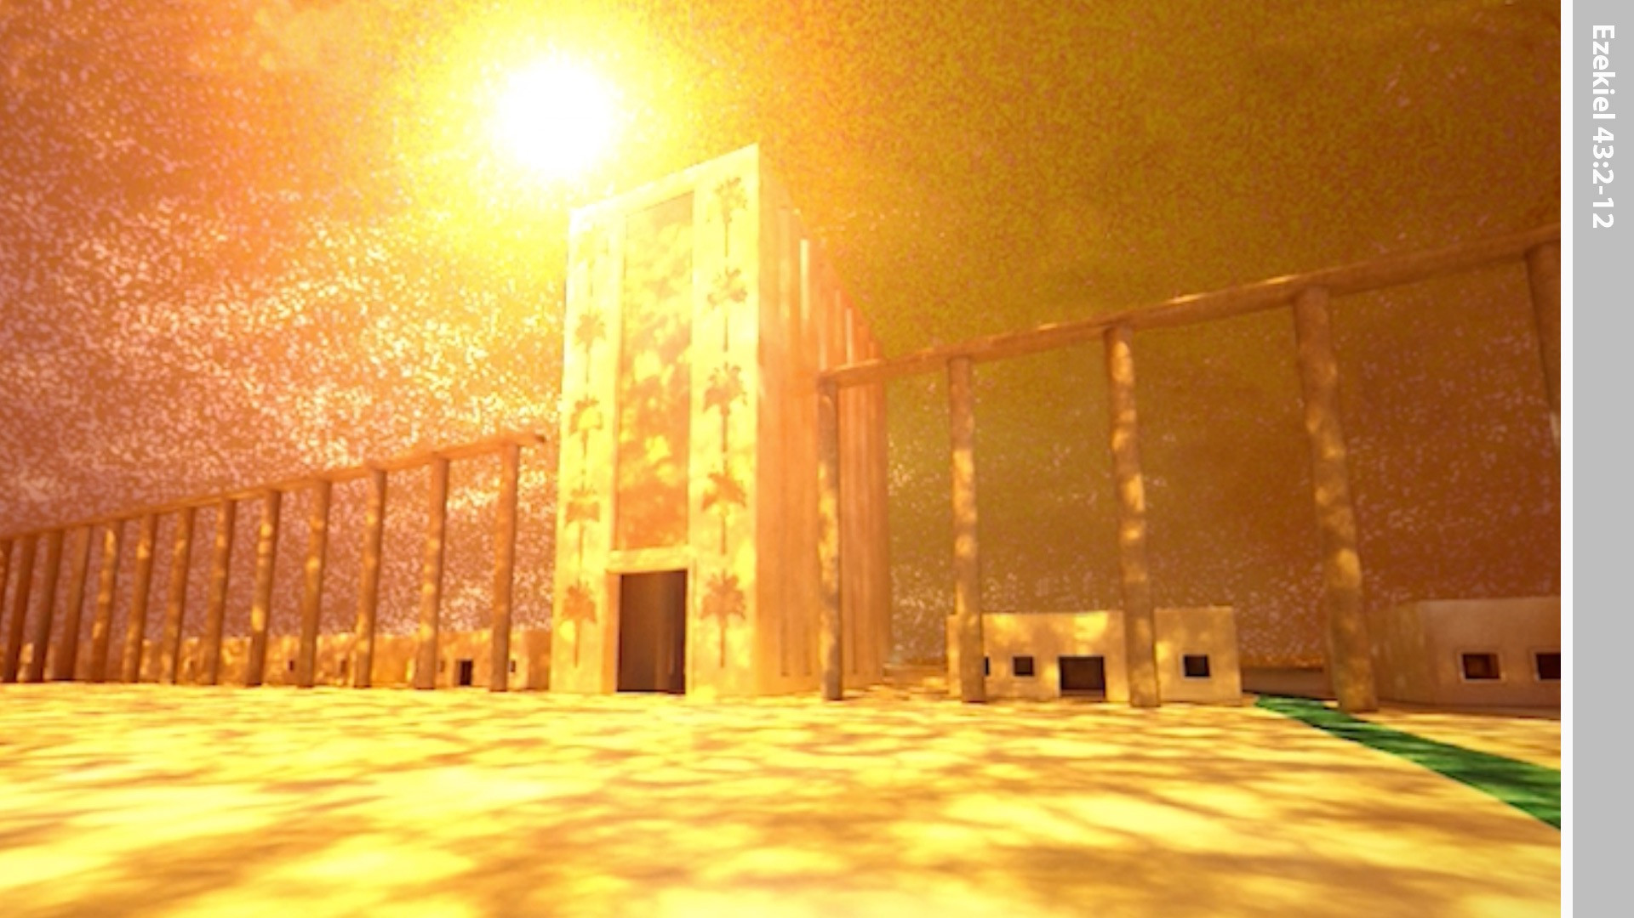
Notes:
Ezekiel fell face down. The glory of the Lord filled the temple.

Slide 32
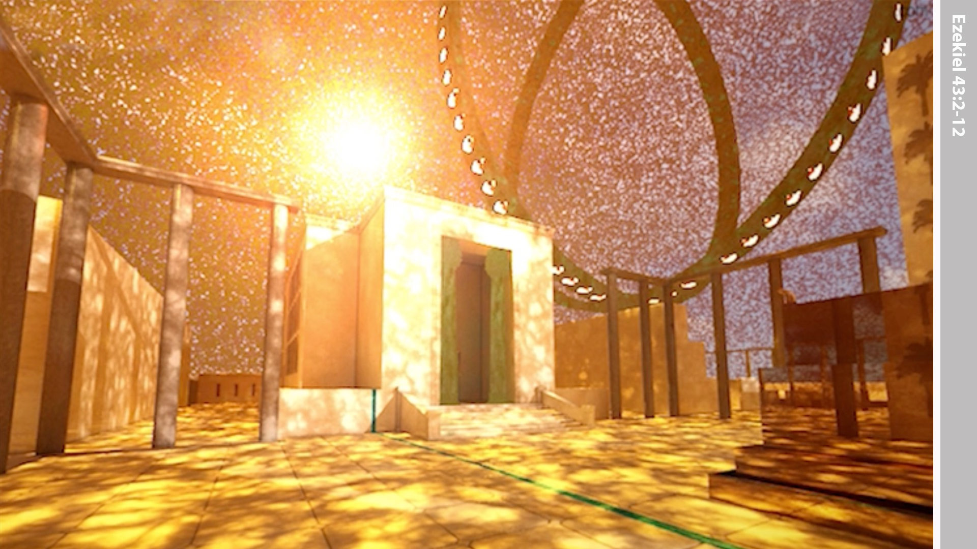
Notes:
Ezekiel heard a voice speaking from inside the Temple. ‘This is where I will live among the Israelites forever. Let them put away their detestable practices and I will live among them forever.

Slide 33
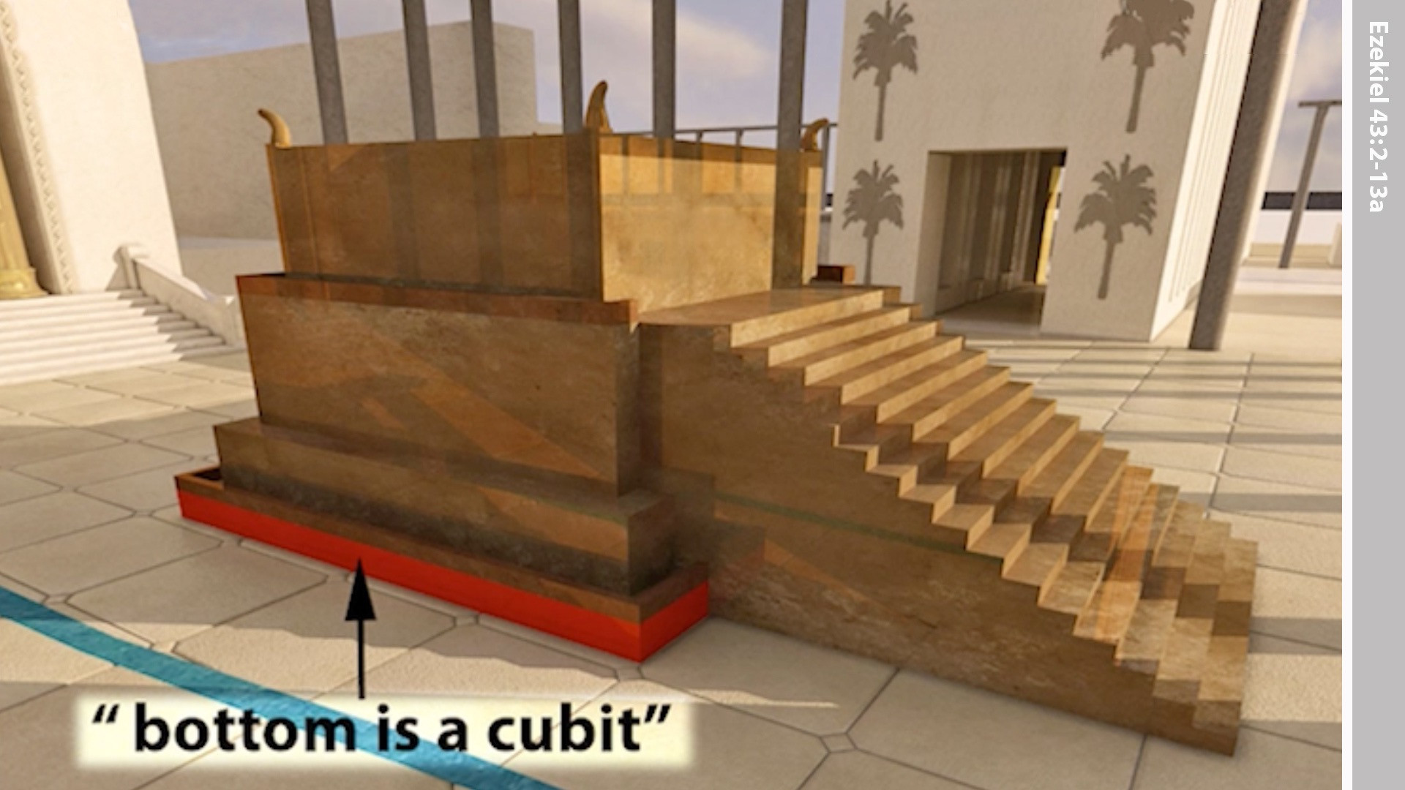
Notes:
Ezekiel was then told that the altar would have a base of one cubit (these cubits were long cubits being a cubit plus the width of a hand).

Slide 34
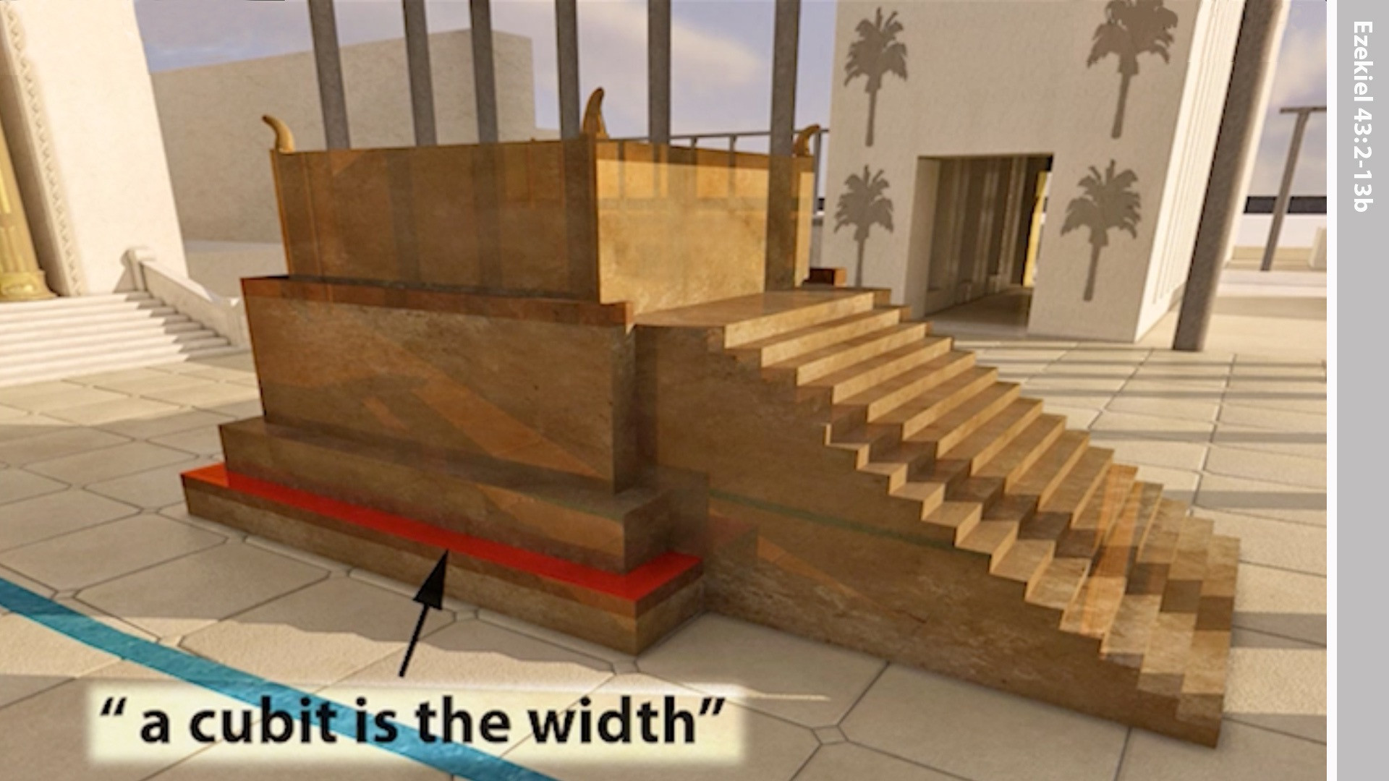
Notes:
Its width would be a cubit.

Slide 35
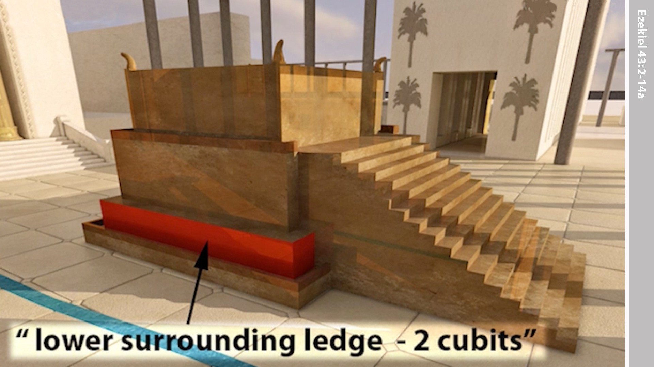
Notes:
Its lower surrounding ledge would be two cubits.

Slide 36
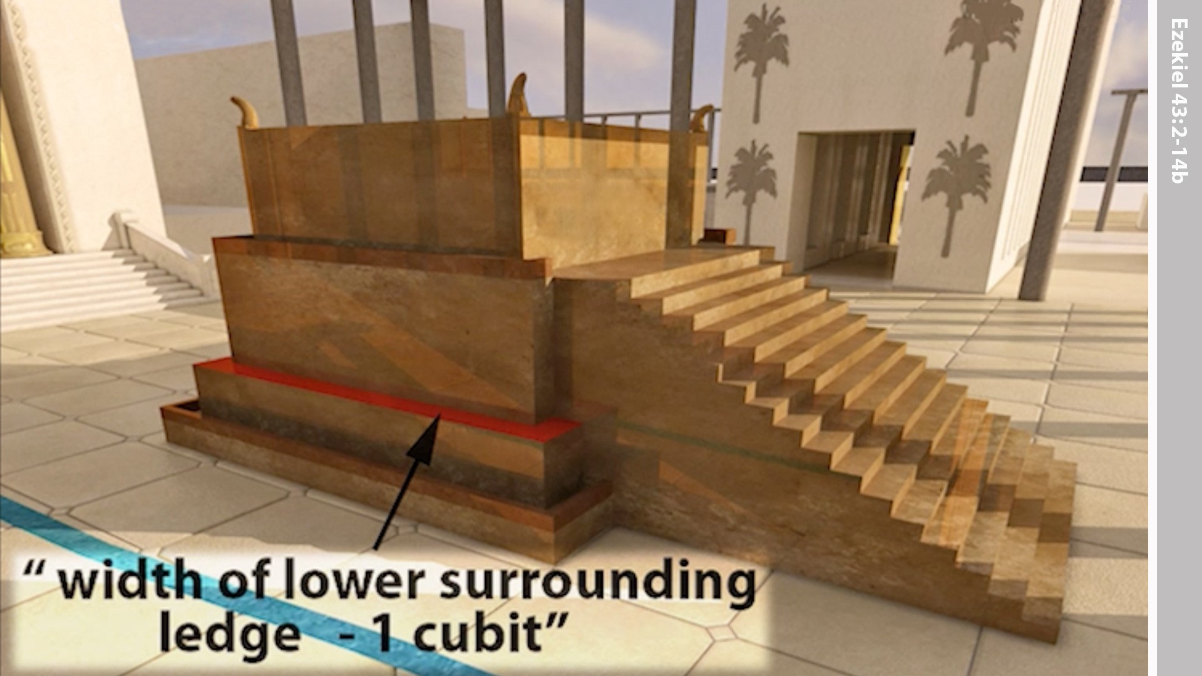
Notes:
And its ledge one cubit.

Slide 37
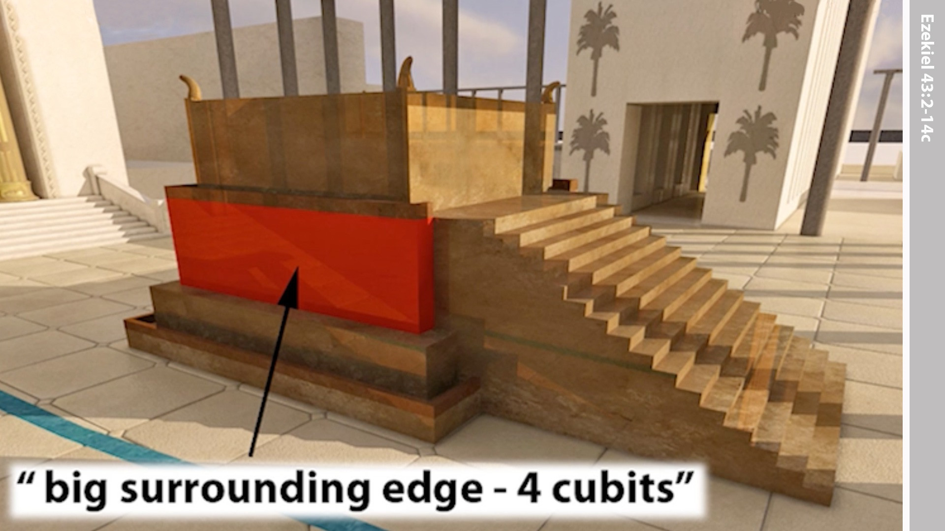
Notes:
The upper section of the altar was 4 cubits high.

Slide 38
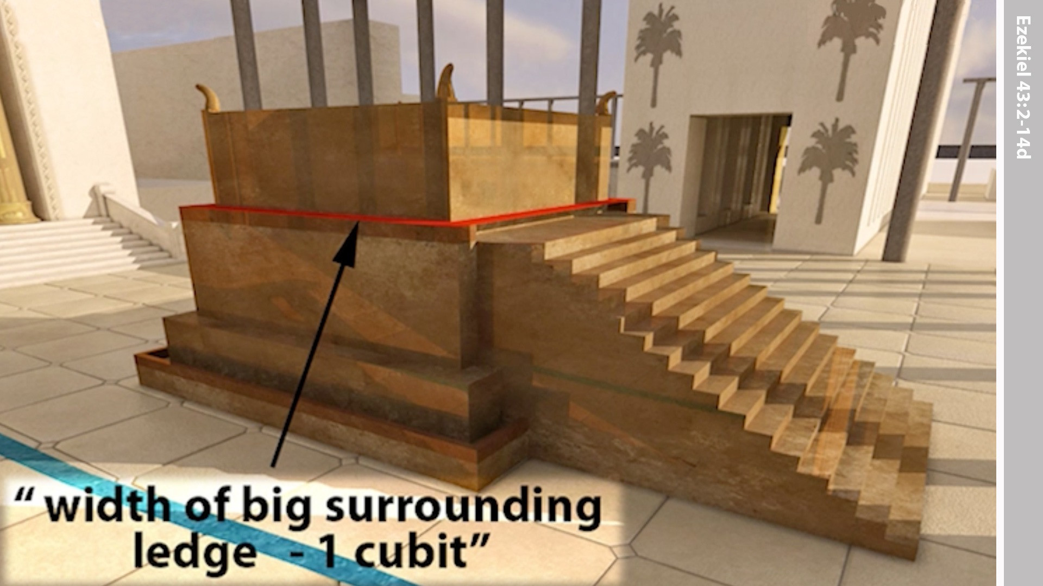
Notes:
And that had a surrounding ledge of one cubit.

Slide 39
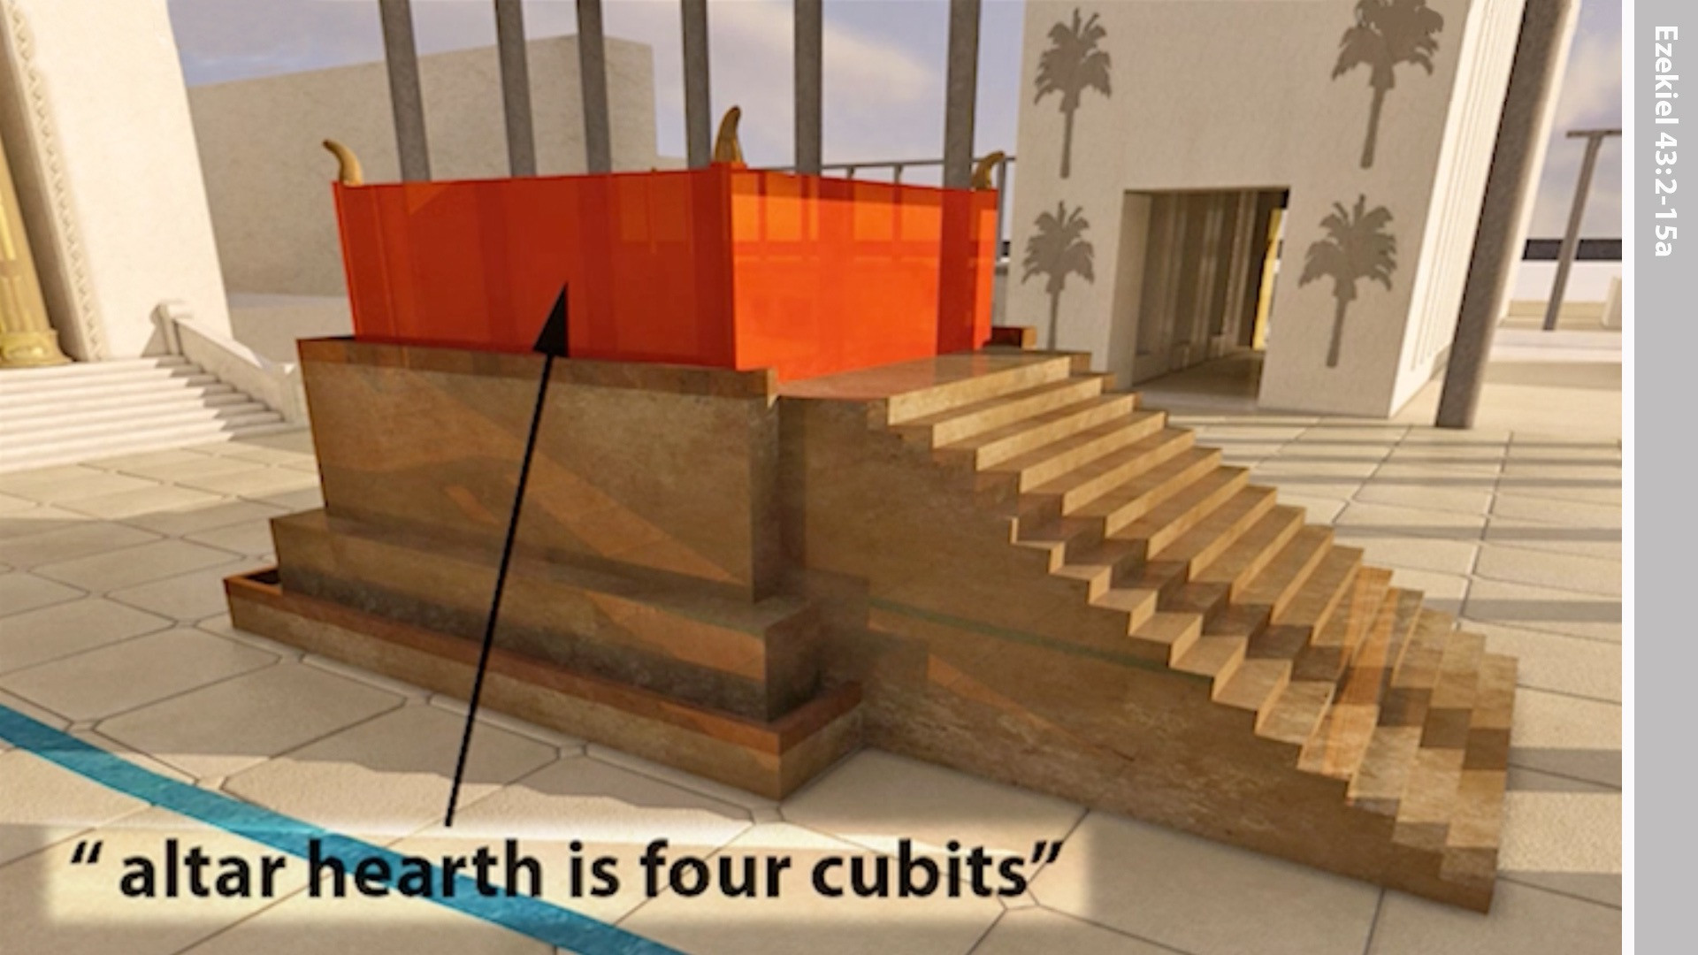
Notes:
The hearth of the altar measured 4 cubits high.

Slide 40
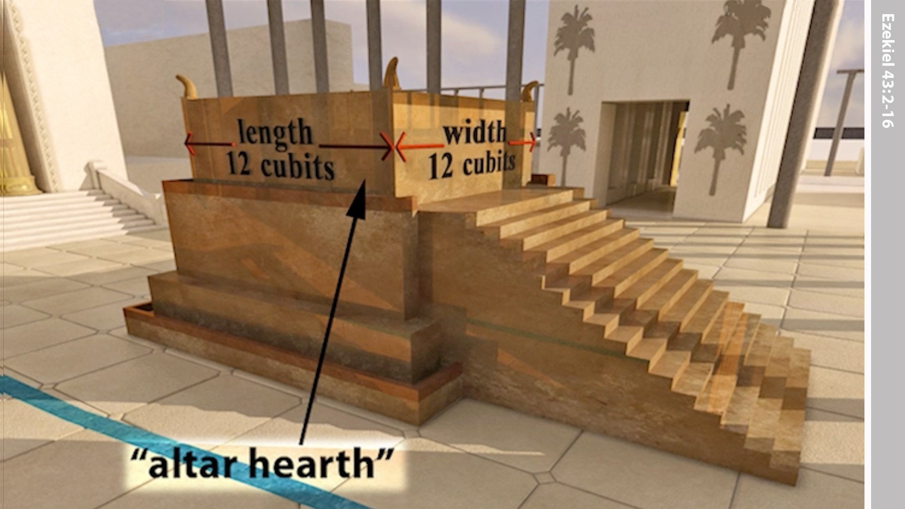
Notes:
And it was 12 cubits square …

Slide 41
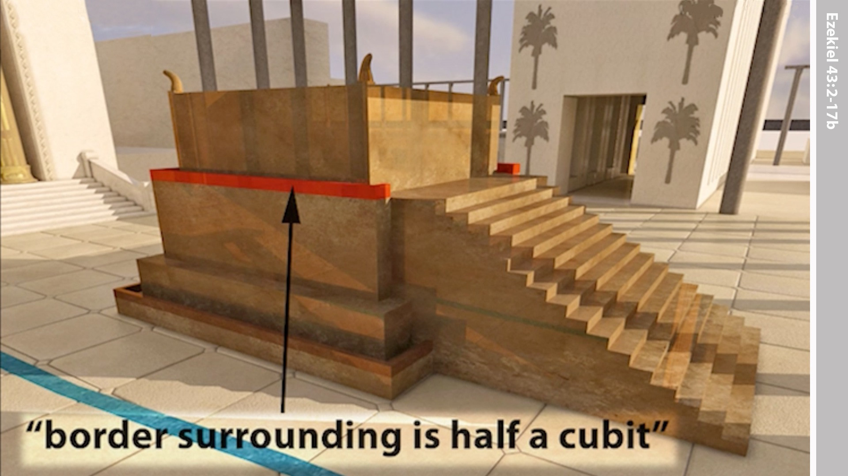
Notes:
… and a rim of half a cubit.

Slide 42
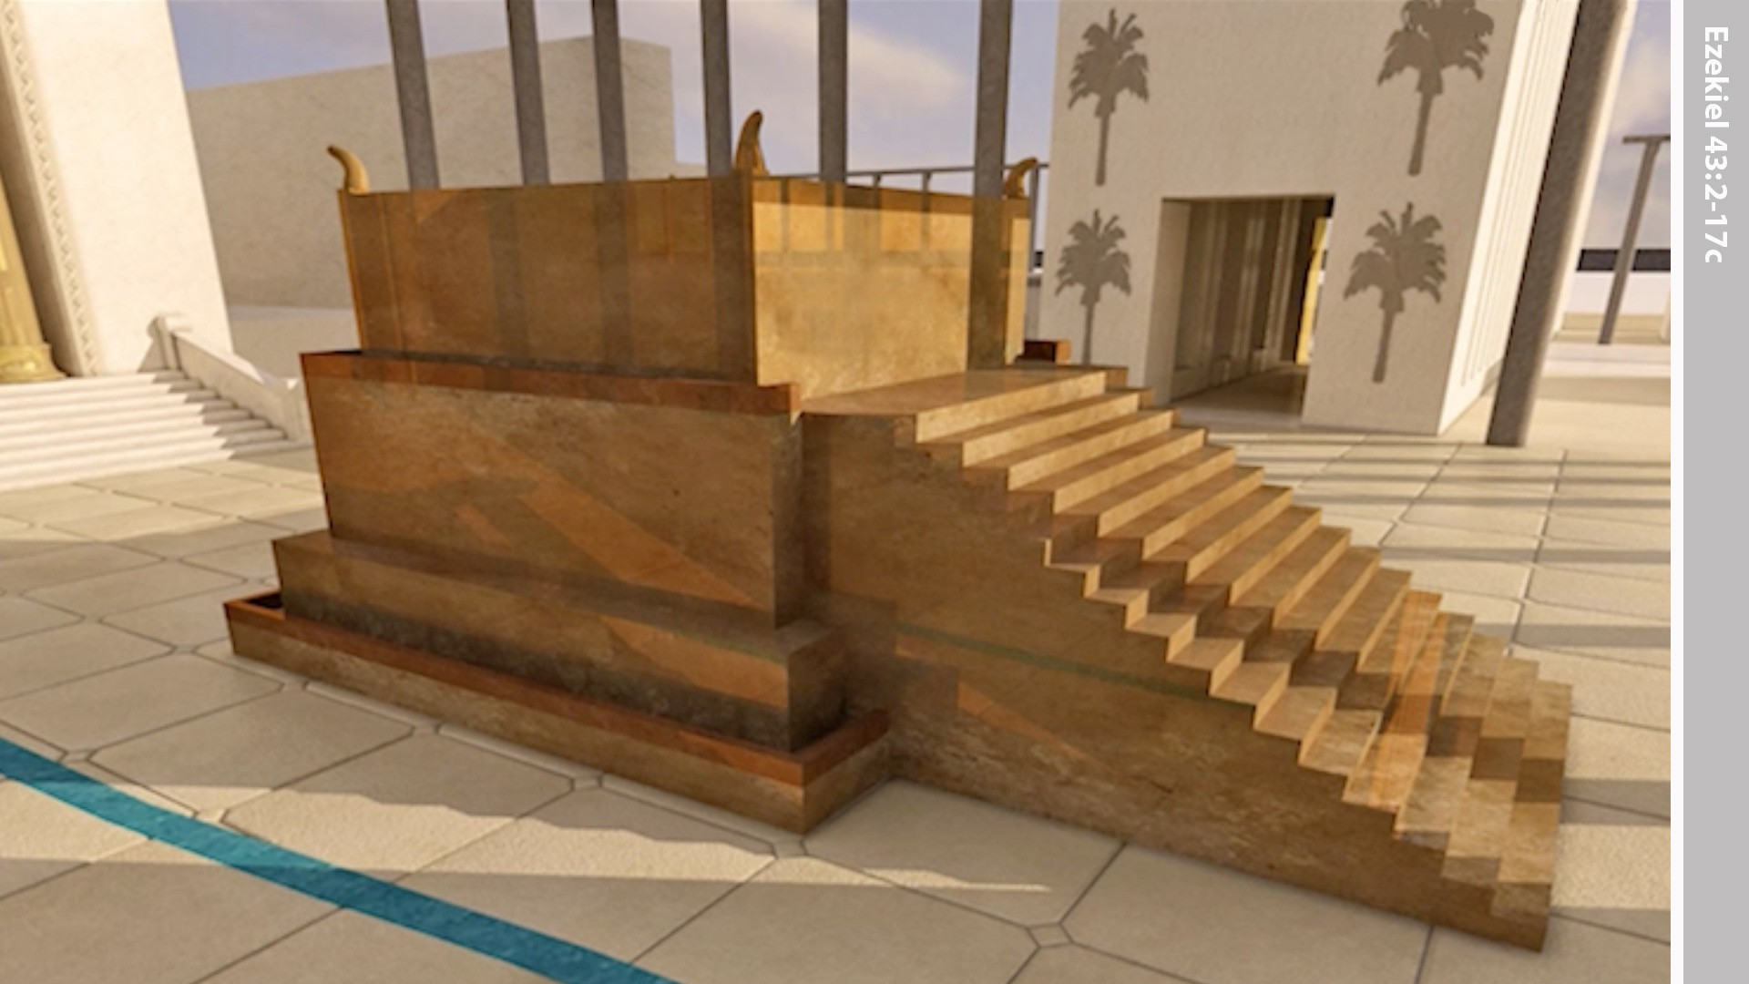
Notes:
The steps of the altar faced east.

Slide 43
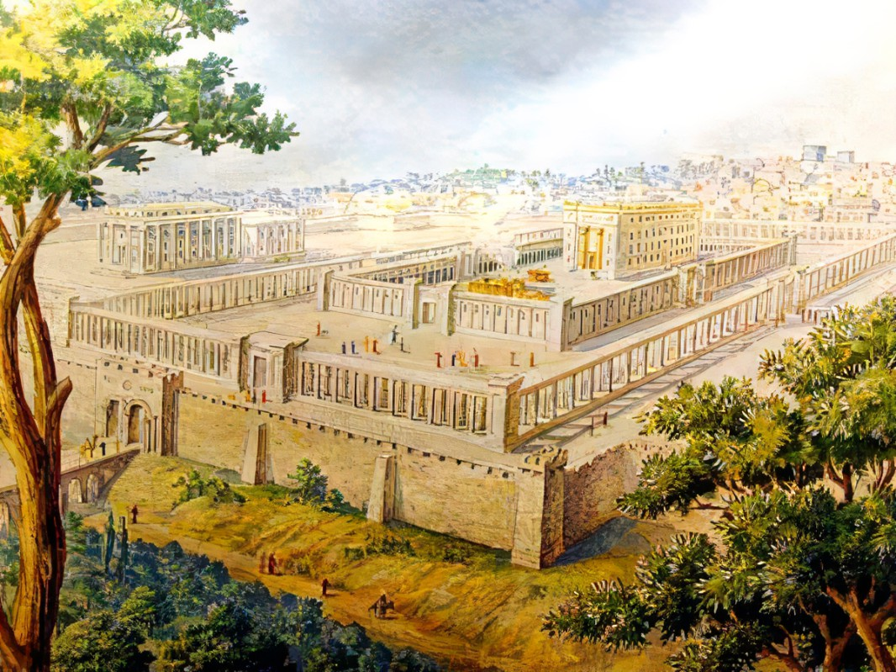

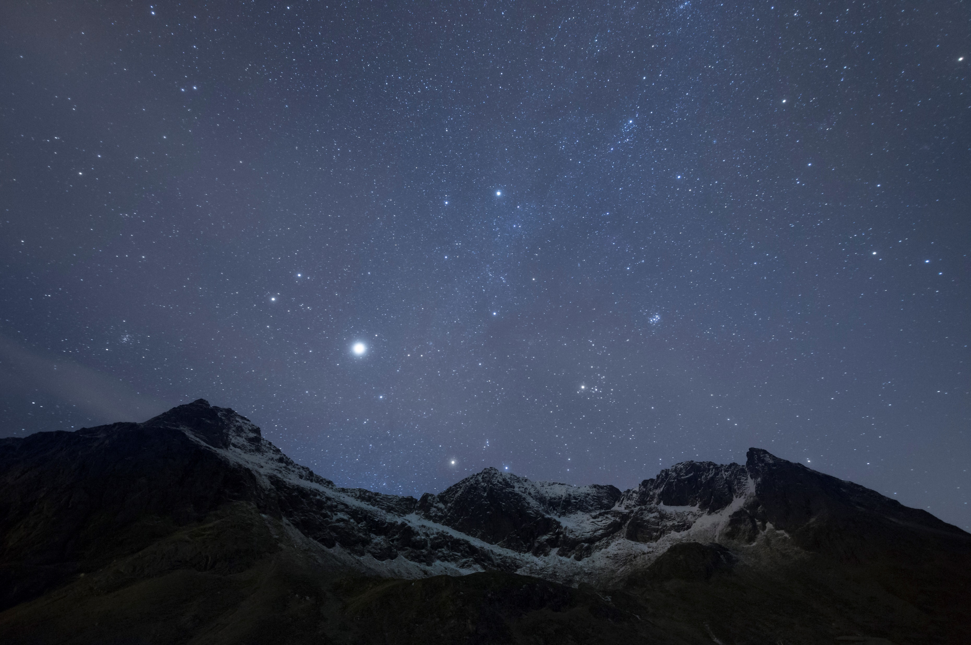
What We DON’T See at the Millennial Temple
Rarely a mention of the actual building material – New items to come?
No mention of or need of the Ark of the Covenant

Slide 44
Why We Need This In The Bible
Jews: To use as the blueprint to build the Millennial Temple
All People: To understand God’s prescription for order, worship & faithfulness
All Believers: To be instill with a true hope for the future

