Slide 1
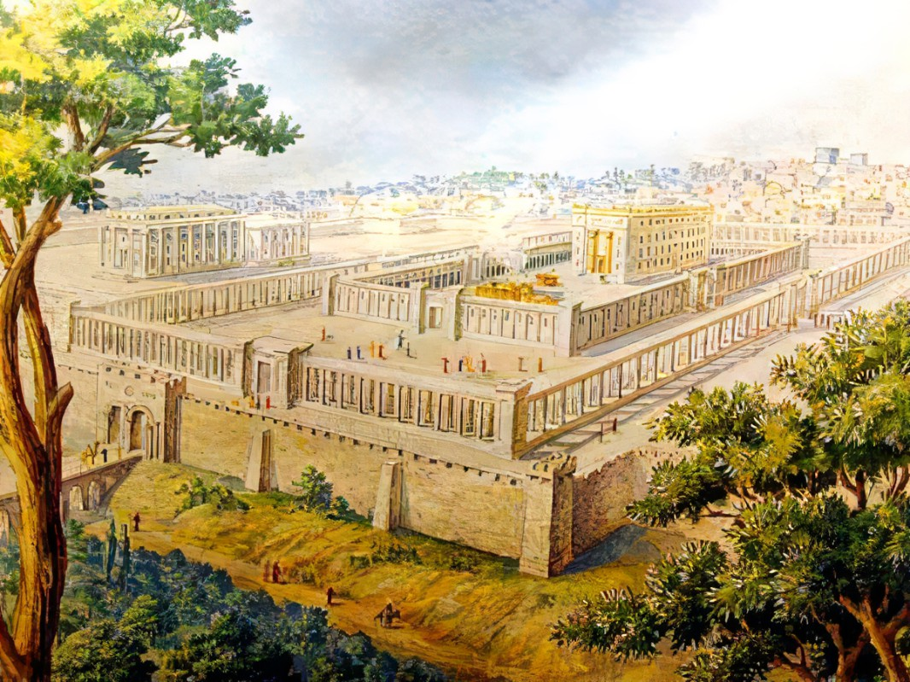

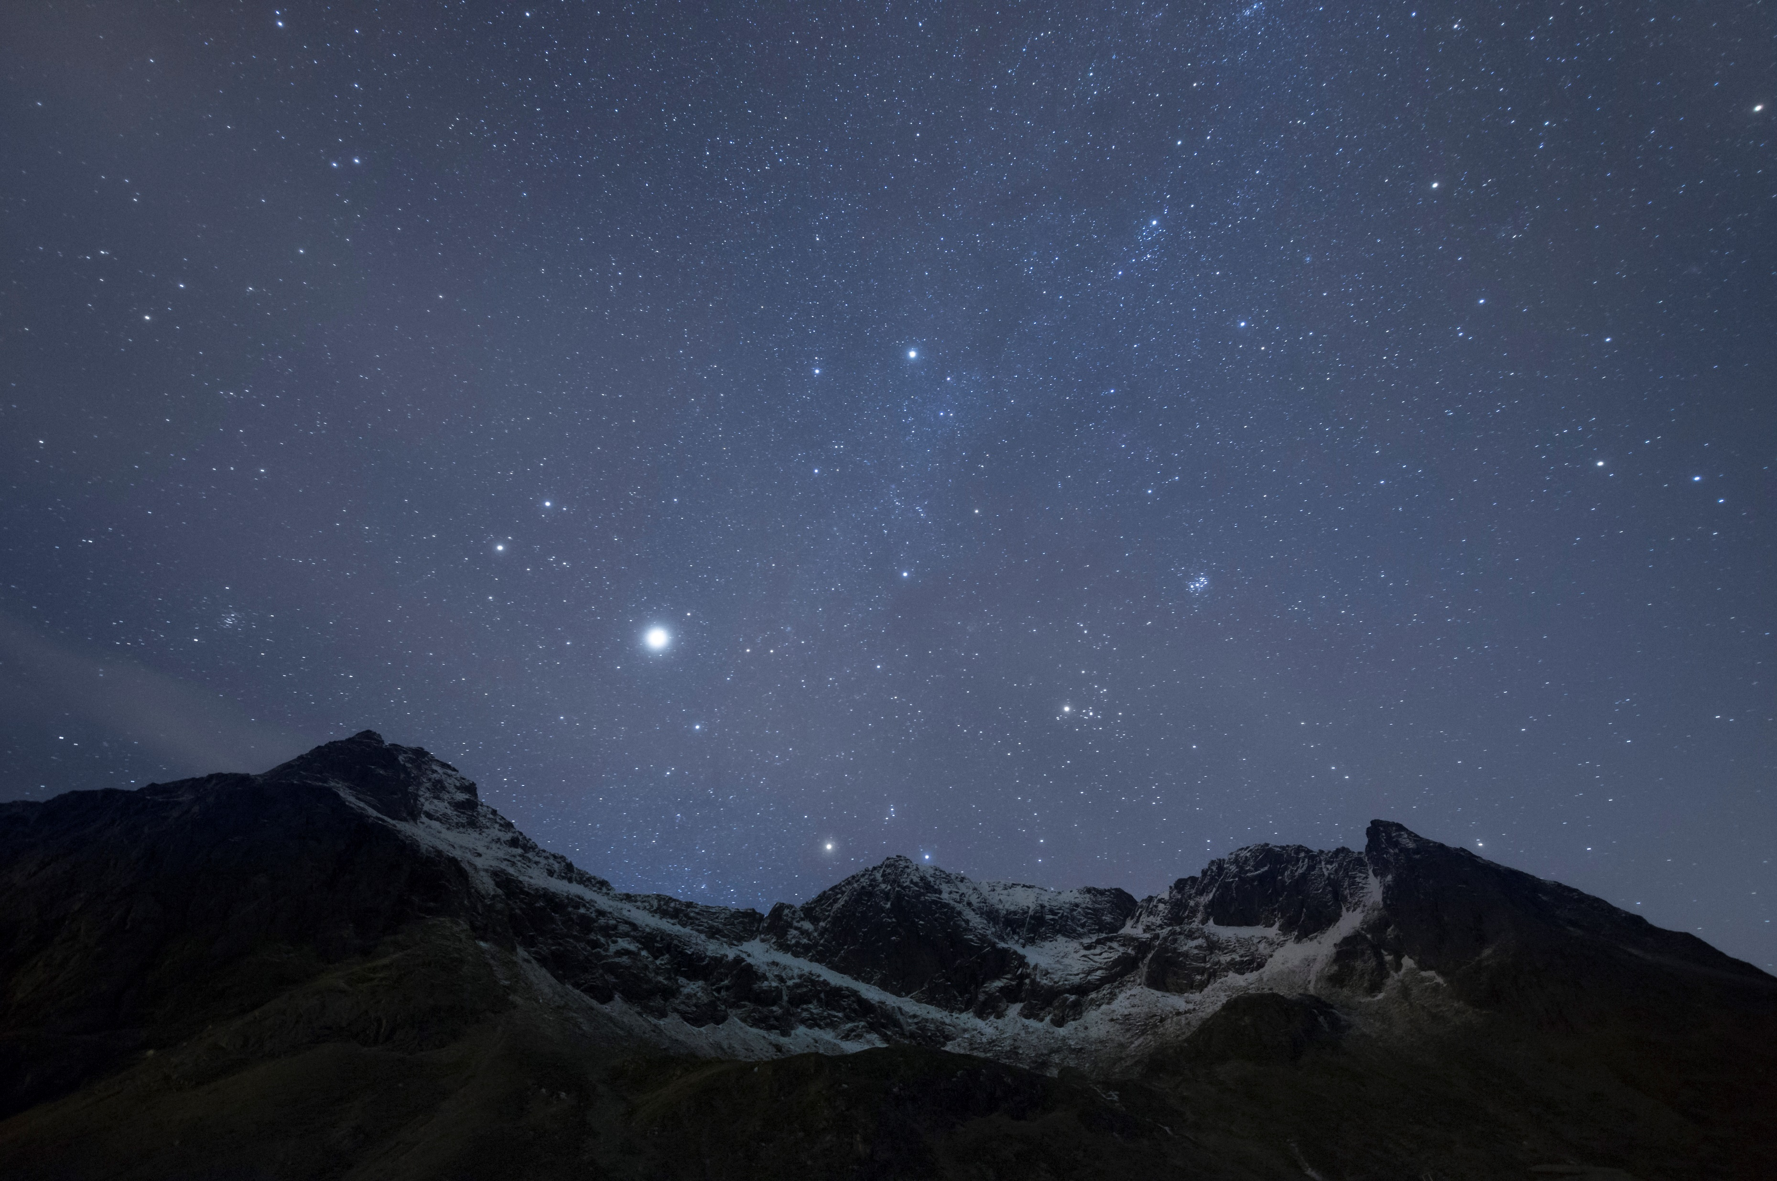
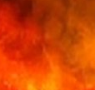
The Millennial Temple
Ezekiel
The
Book of
Chapter
40-43 .

Slide 2
Ezekiel’s 5th Section:
The Millennial Kingdom
The Millennial Temple (Chap 40-43)
Its Rituals and Practices (Chap 44-46)
The New Holy Land (Chap 47-48)

Slide 3
The Millennial Temple
Ezekiel
The
Book of
Chapter
40-43 .

Slide 4
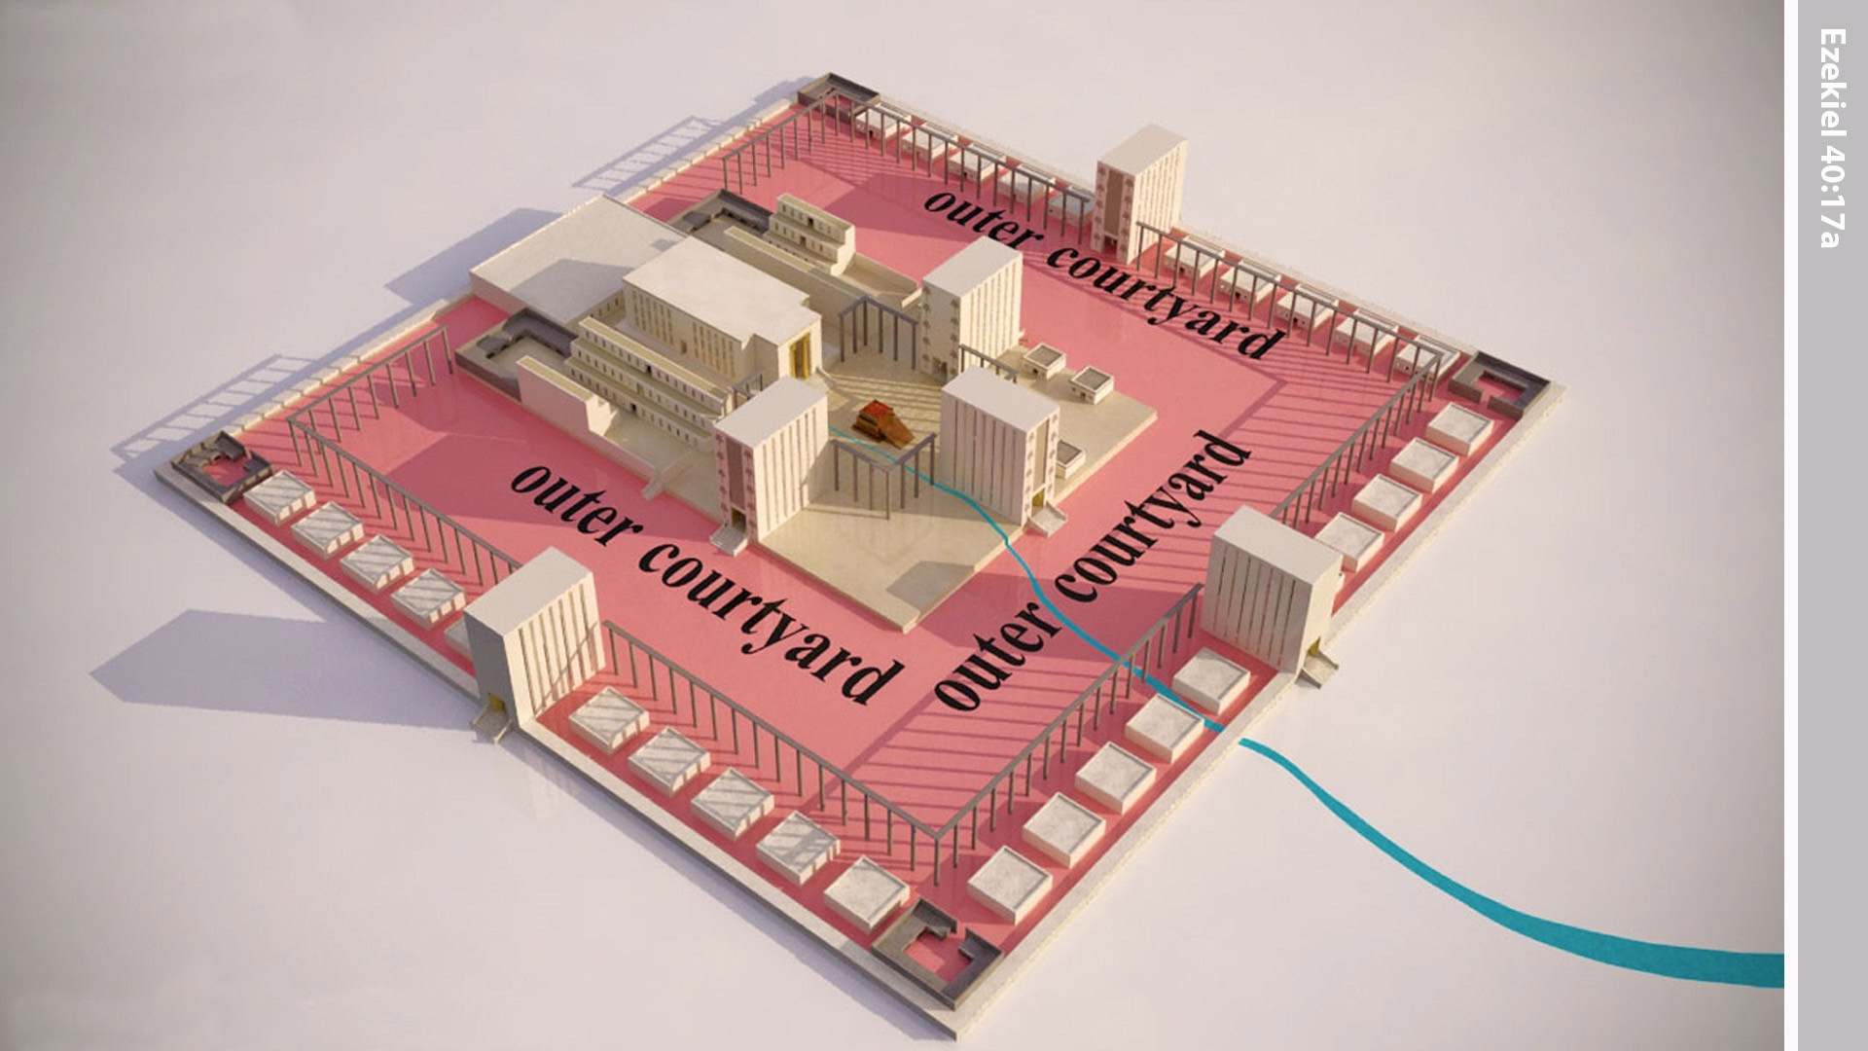
Notes:
In the vision Ezekiel was taken through the passageway to the inner courtyard.

Slide 5
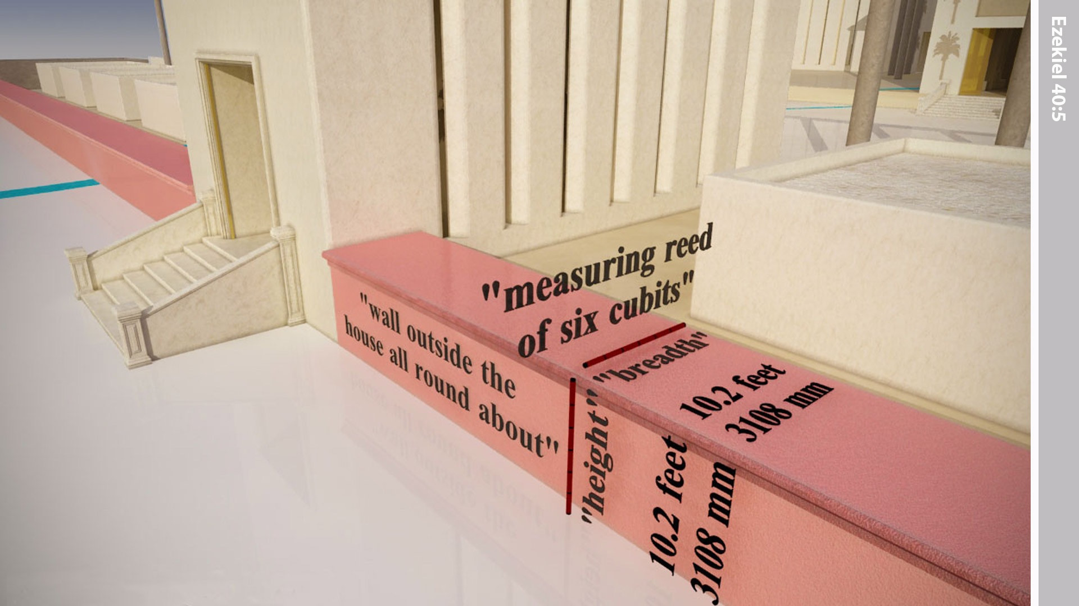
Notes:
In the 25th year of exile in Babylon, God brought Ezekiel to Israel in a vision. He saw a ‘man with the appearance of bronze’ holding a linen cord and measuring rod in his hand. Ezekiel was shown a wall all around the outside of the Temple area. The length of the measuring rod in the man's hand was six long cubits, each being a cubit and a handbreadth in length. The ‘man’ measured the thickness of the wall, as one reed (10.2ft - 3.108m) and the height as one reed.

Slide 6
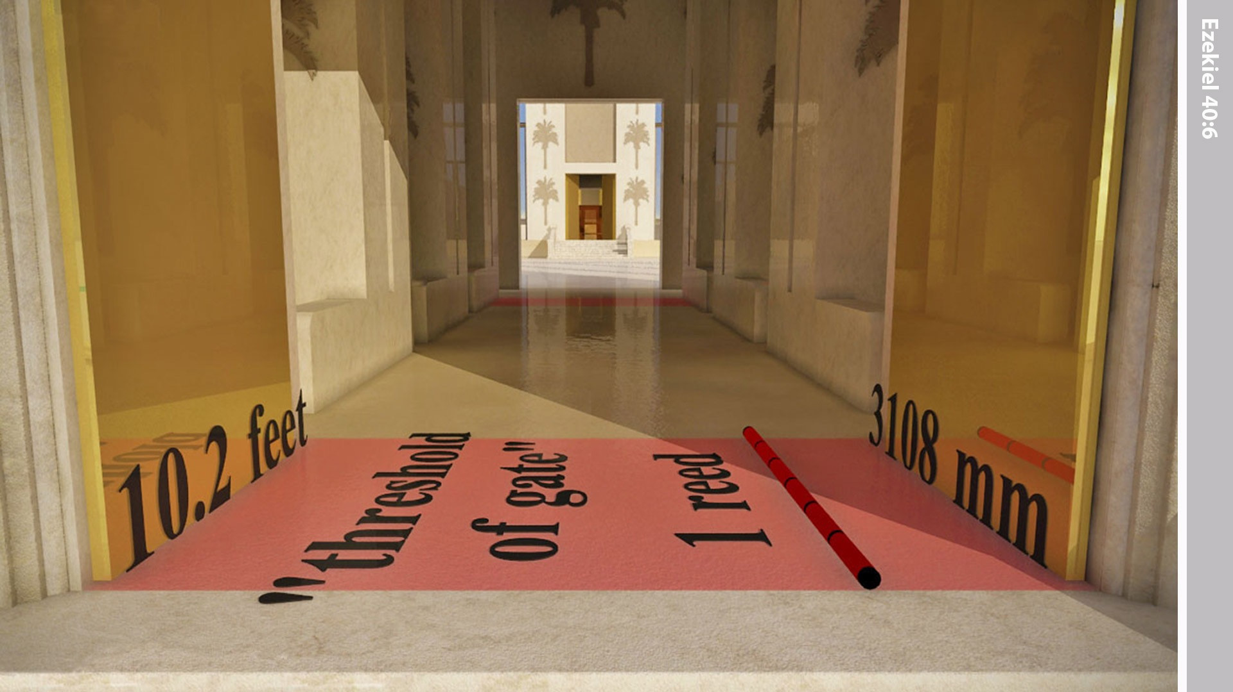
Notes:
Then he went into the gateway facing east, going up its steps, and measured the threshold of the gate, one reed deep.

Slide 7
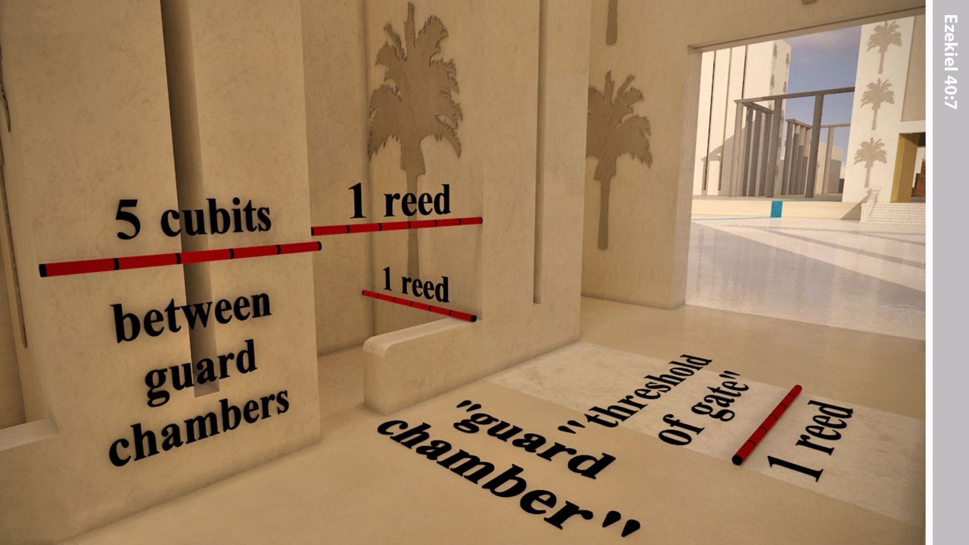
Notes:
The side rooms were one reed long and one reed broad. The space between the side rooms was five cubits. The threshold of the gate at the inner end was one reed.

Slide 8
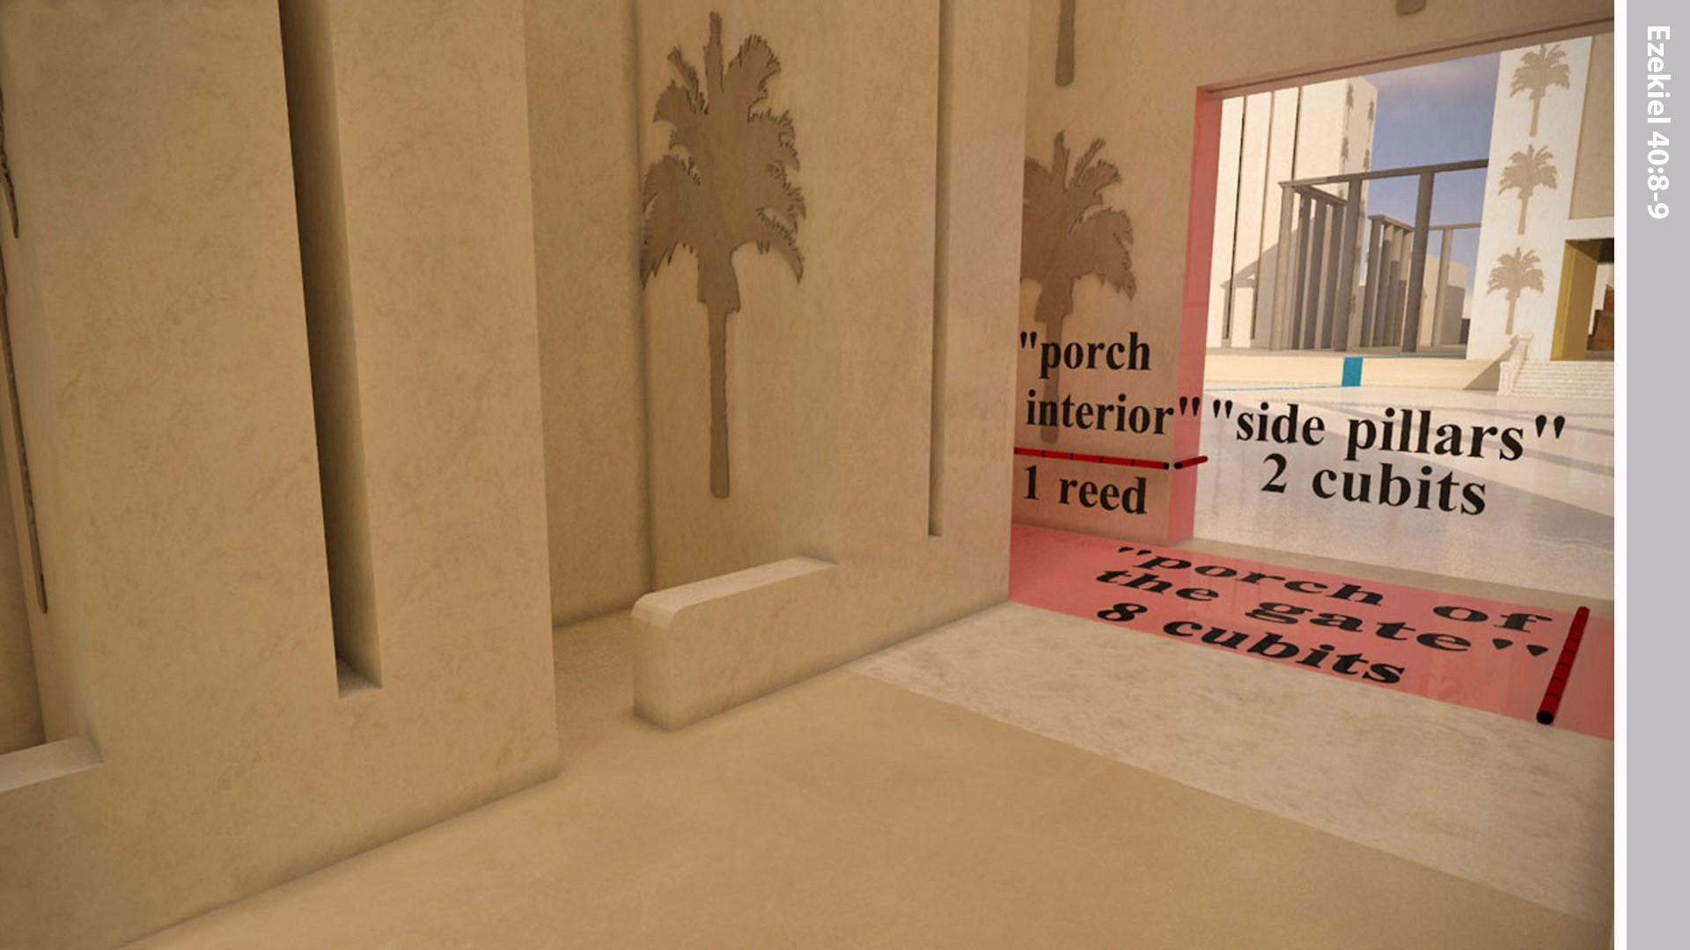
Notes:
The vestibule of the gateway, on the inside, was one reed. The vestibule of the inner gateway measured 8 cubits and its jambs, 2 cubits.

Slide 9
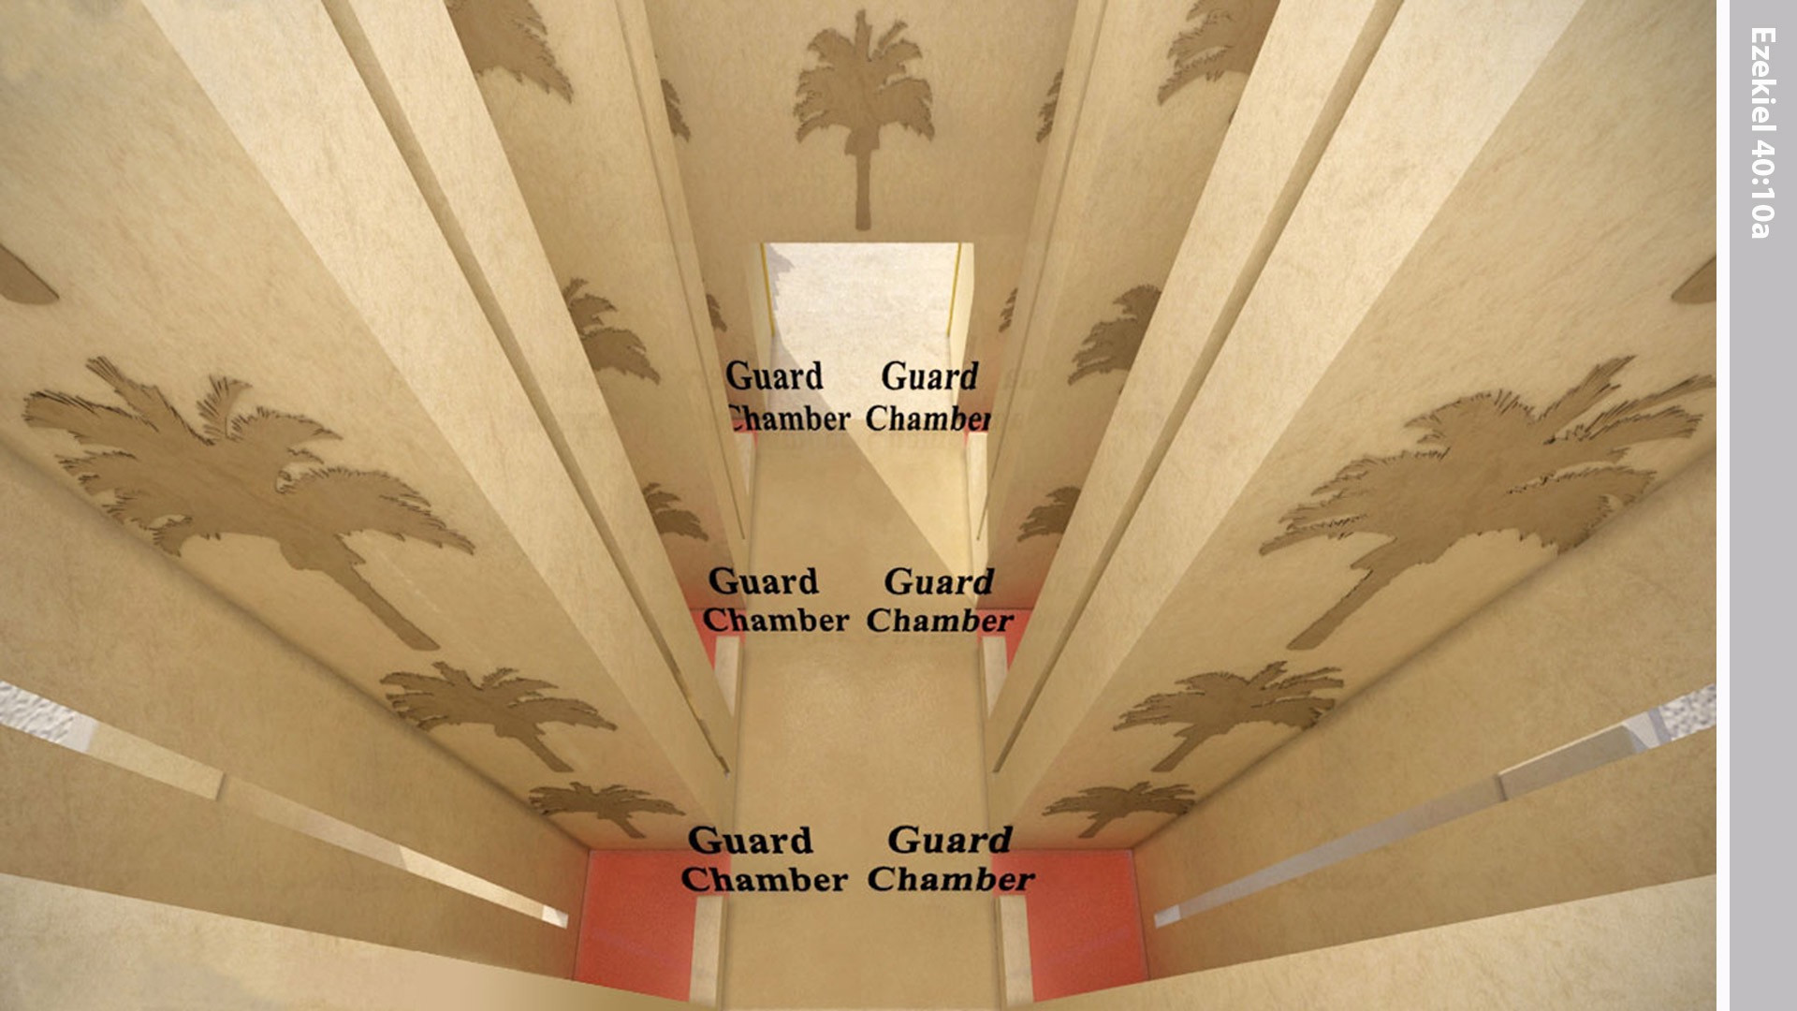
Notes:
There were three guard chambers of the same size on either side of the East Gate.

Slide 10
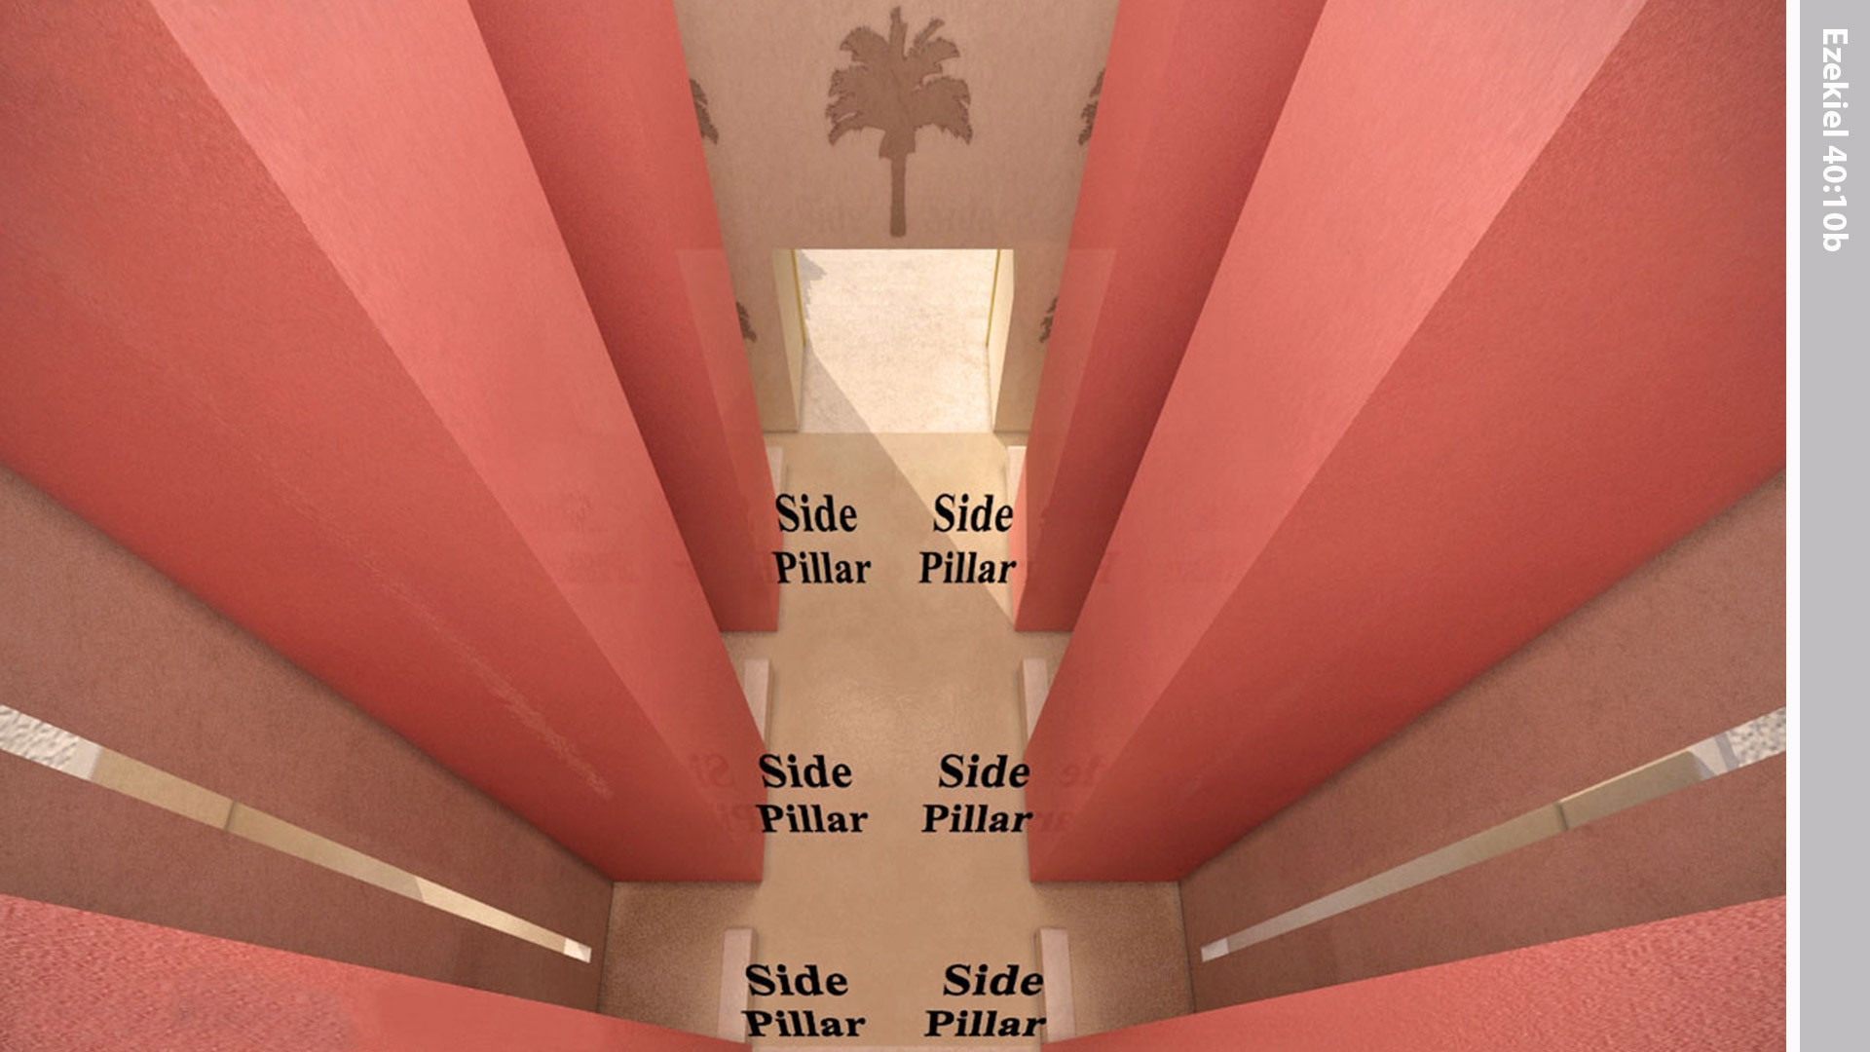
Notes:
The side pillars between the rooms were of the same size also.

Slide 11
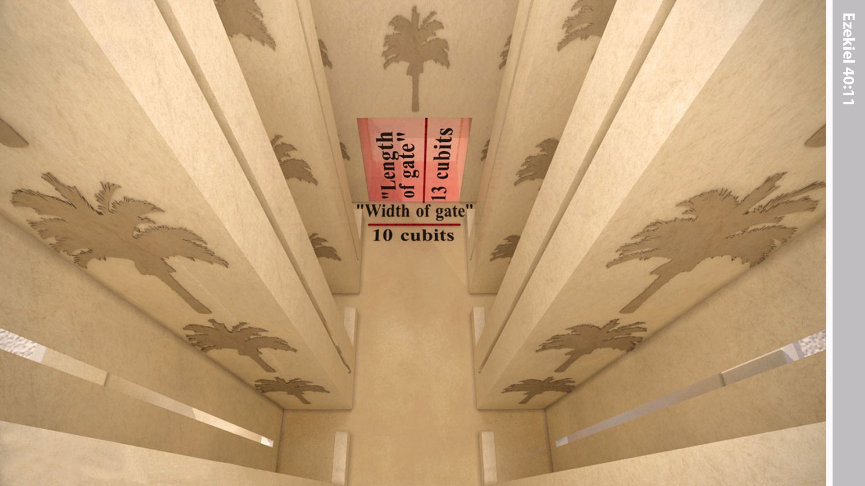
Notes:
The opening of the gateway was 10 cubits and the length 13 cubits.

Slide 12
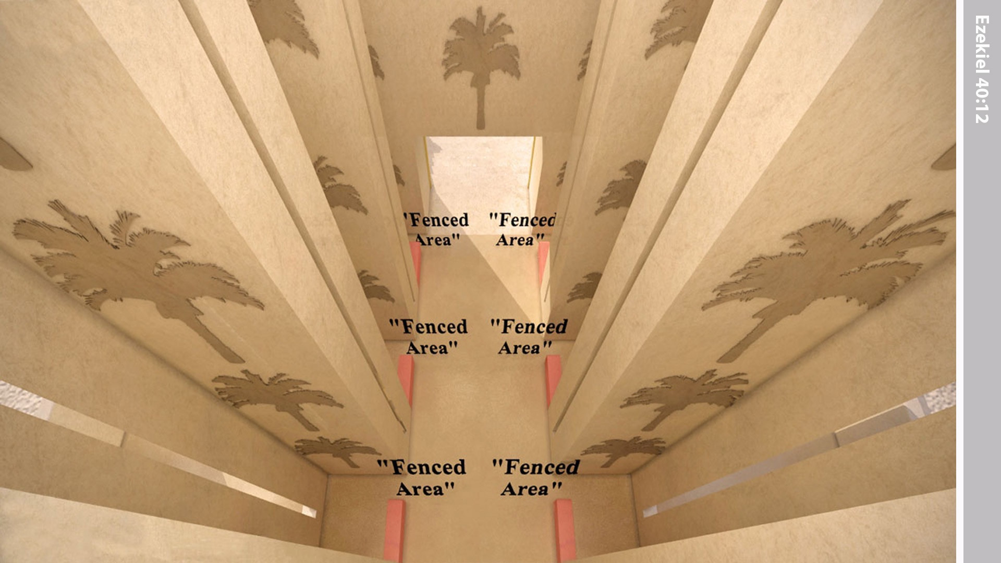
Notes:
There was a low barrier in front of each of the side rooms, one cubit high. Each room was 6 cubits square.

Slide 13
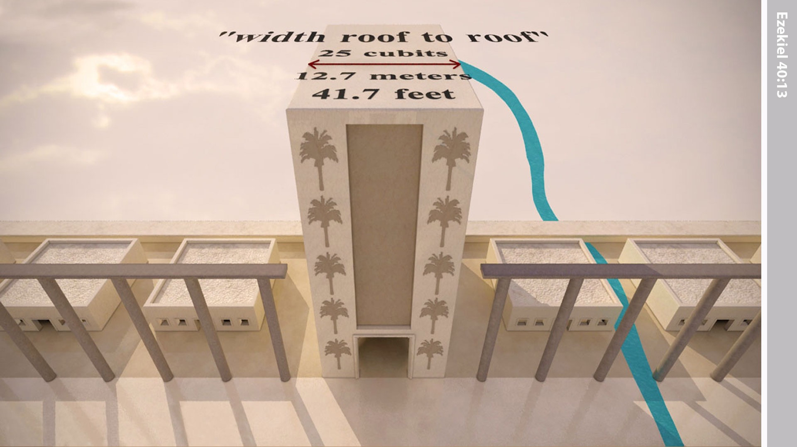
Notes:
The width of the gateway was 25 cubits from one parapet opening to the opposite one.

Slide 14
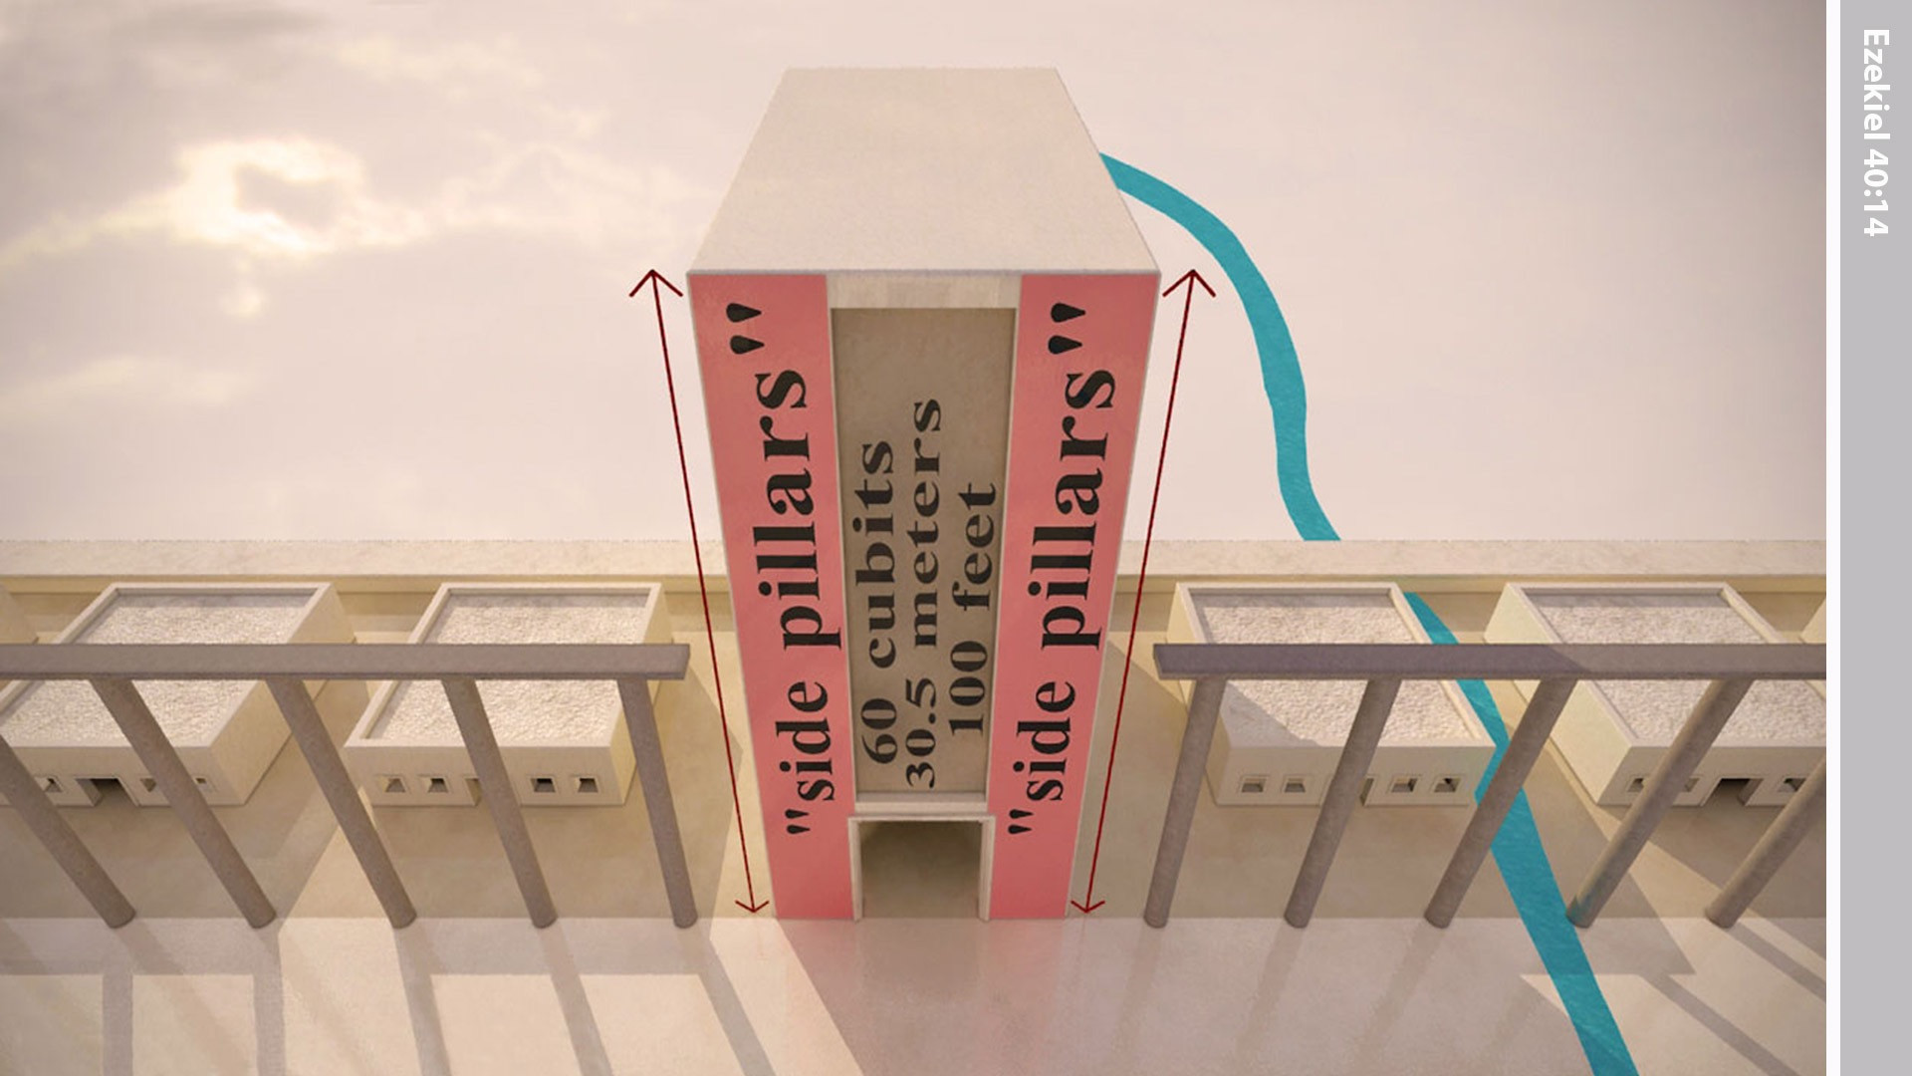
Notes:
The ‘man’ measured along the faces of the projecting walls all around the inside of the gateway – sixty cubits.

Slide 15
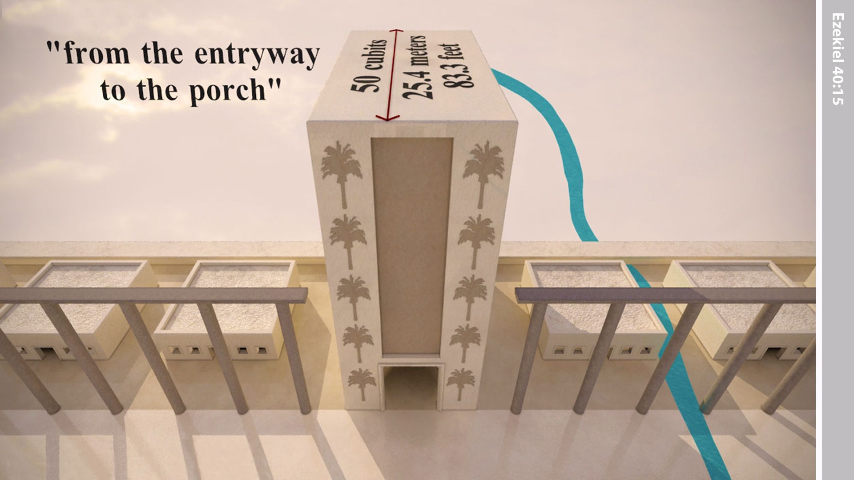
Notes:
The distance from the entrance of the gateway to the far end of its portico was fifty cubits.

Slide 16
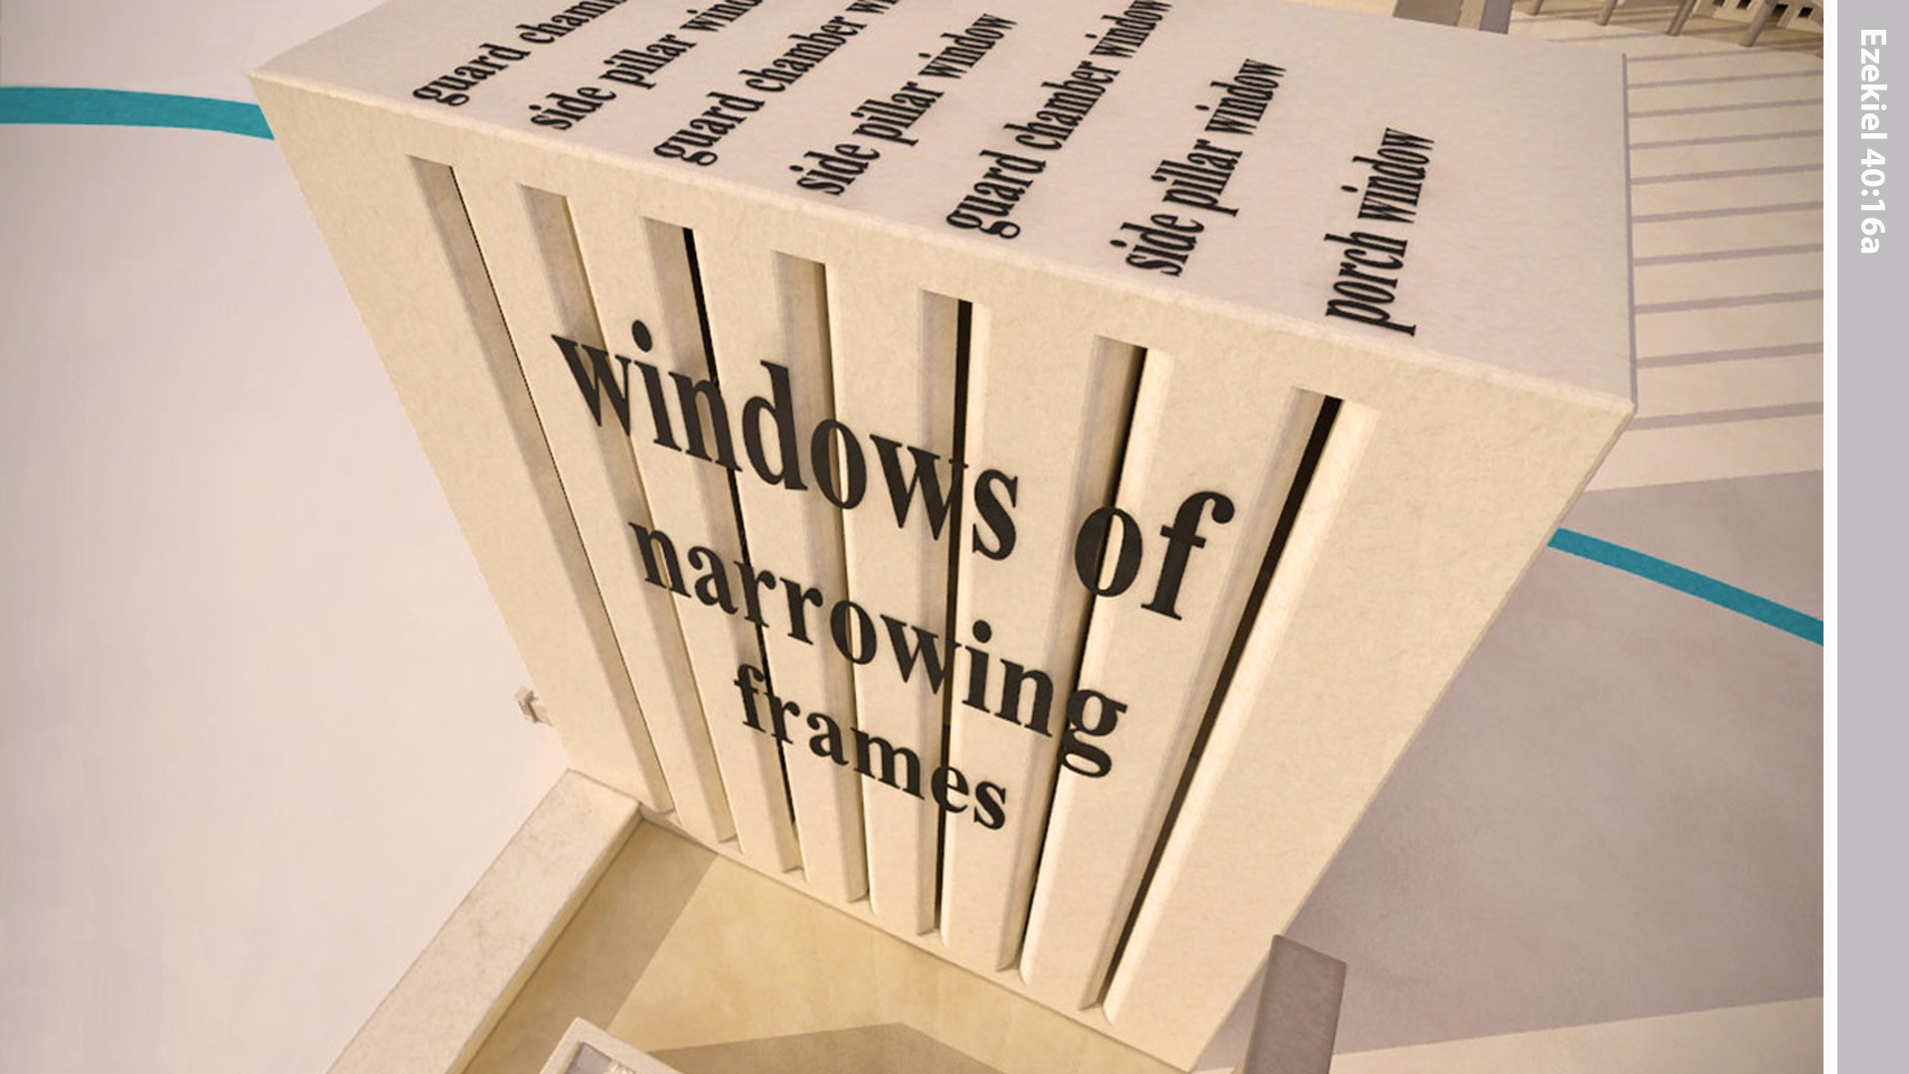
Notes:
There were windows that narrowed inward through the walls along both sides of the passageway and along the guardroom walls. The windows were also in the exit and in the entrance halls.

Slide 17
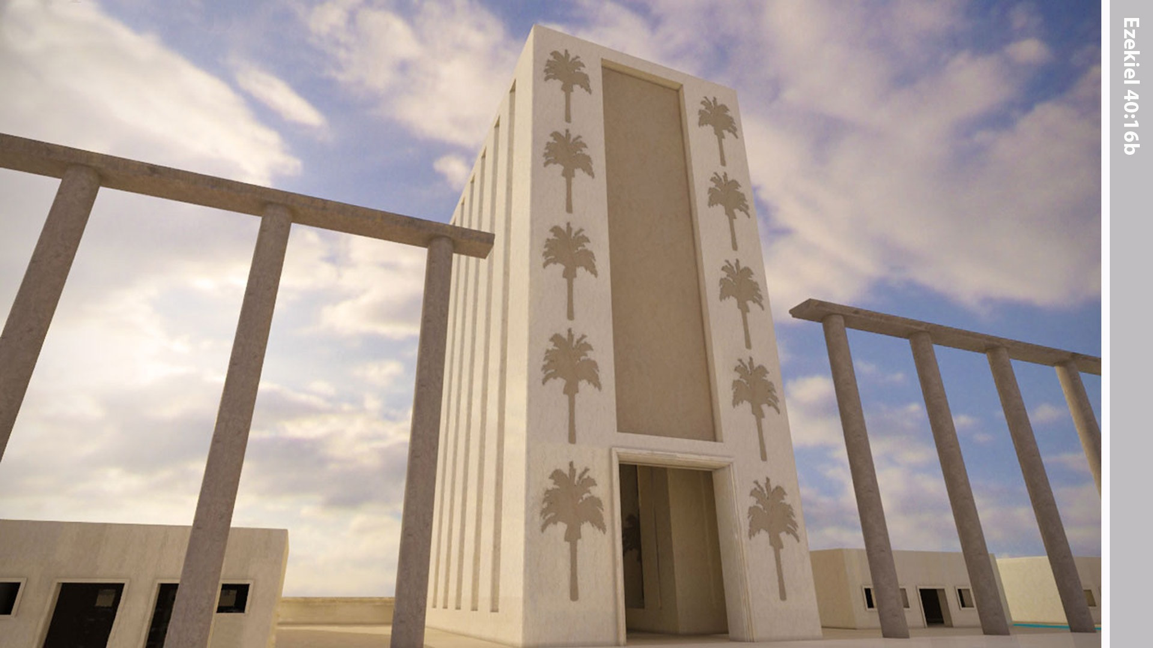
Notes:
The faces of the projecting walls were decorated with palm trees.

Slide 18
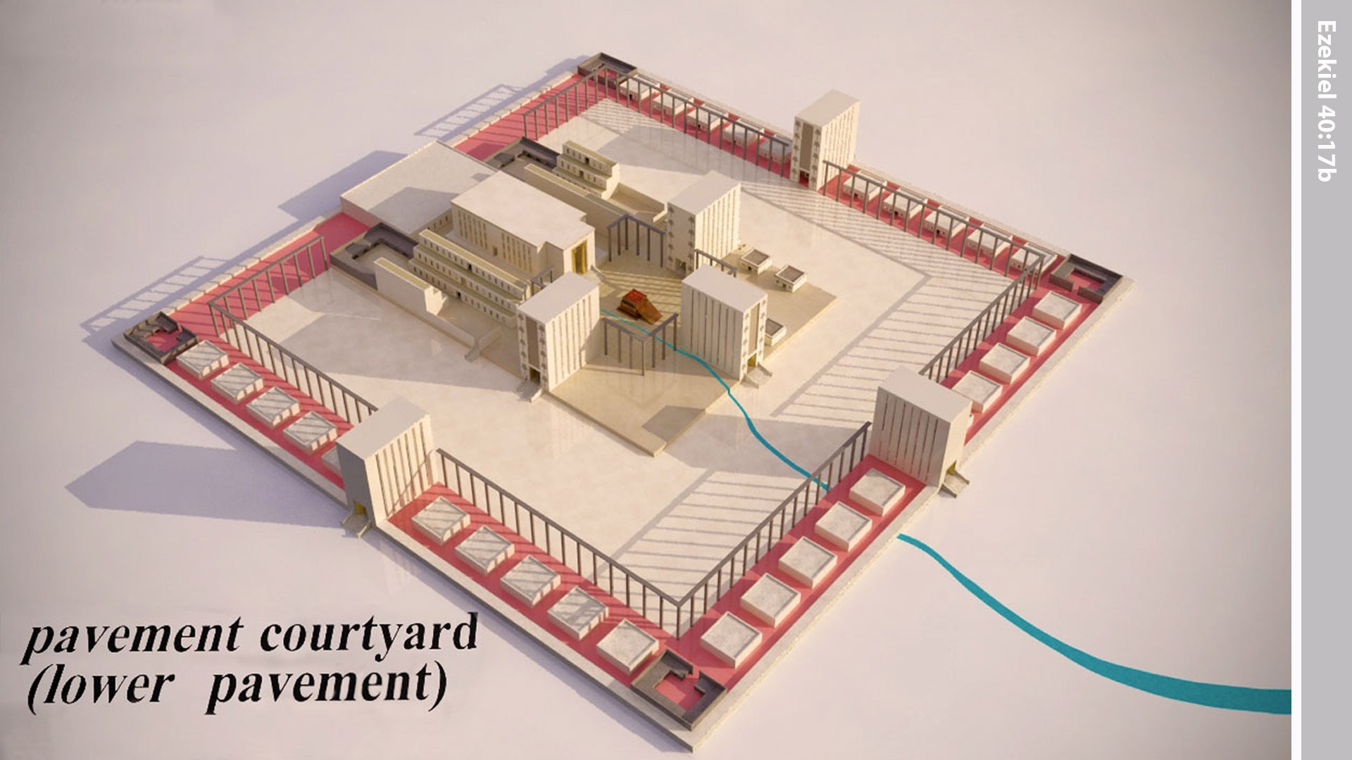
Notes:
A stone pavement, called the lower pavement, ran around the inner courtyard.

Slide 19
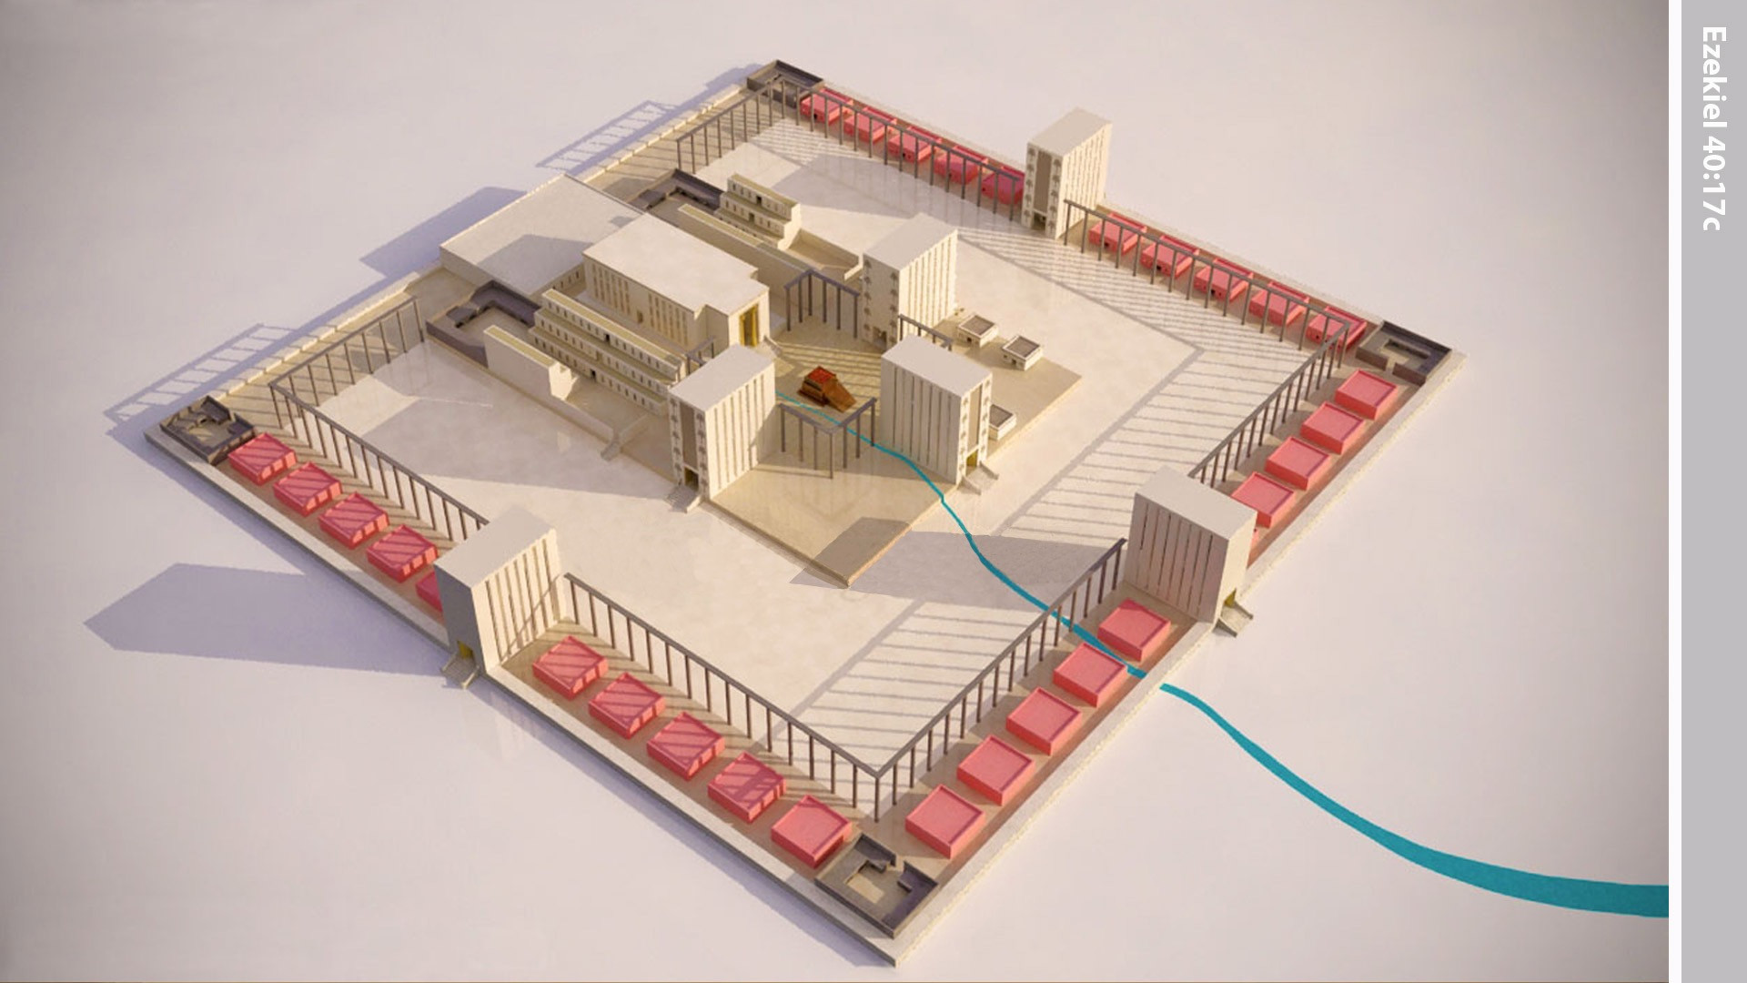
Notes:
Thirty rooms were built against the walls, opening onto this pavement.

Slide 20
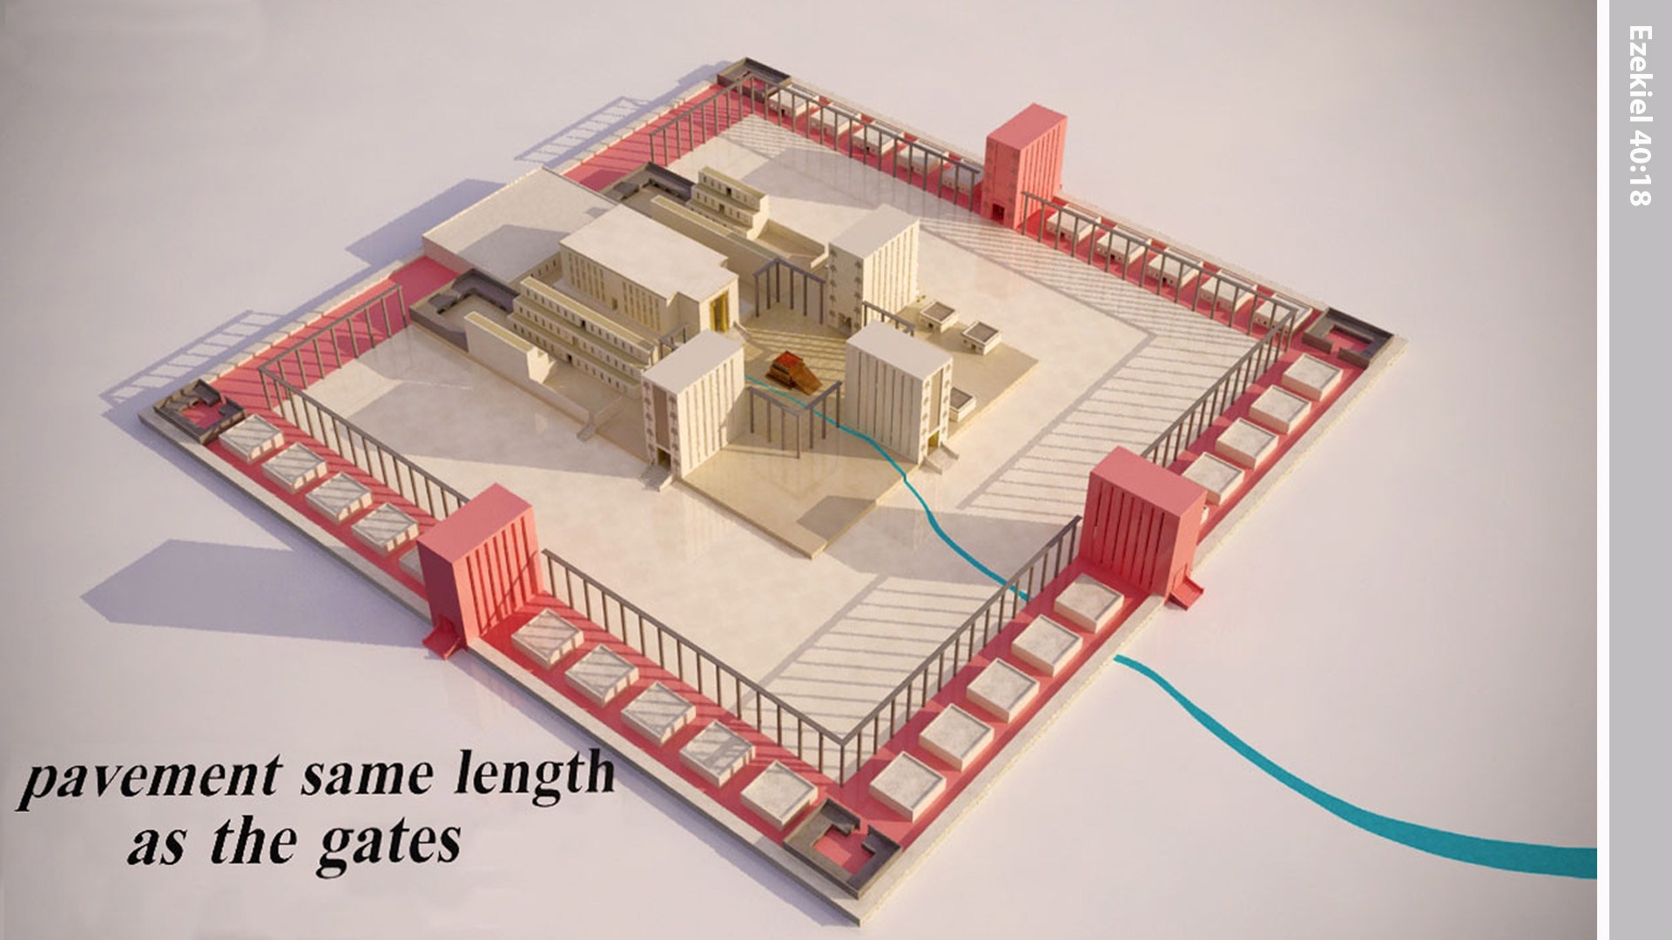
Notes:
The pavement was the same length as the gates.

Slide 21
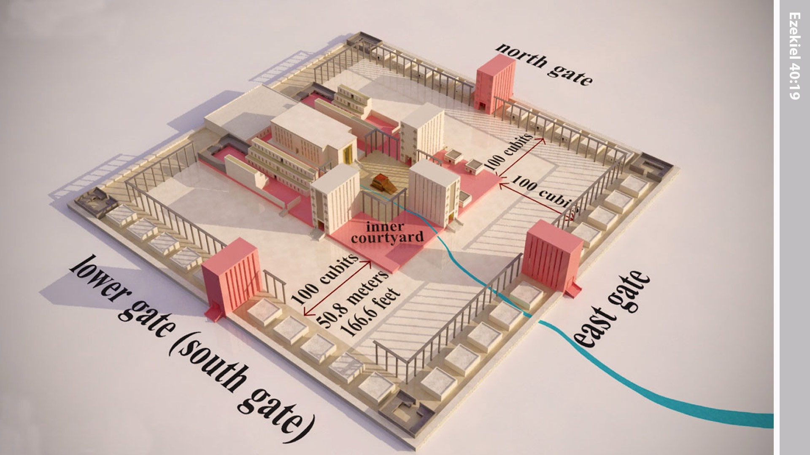
Notes:
There was a gateway at a higher level that led to the inner courtyard. The man measured the distance between the two gateways, as 100 cubits.

Slide 22
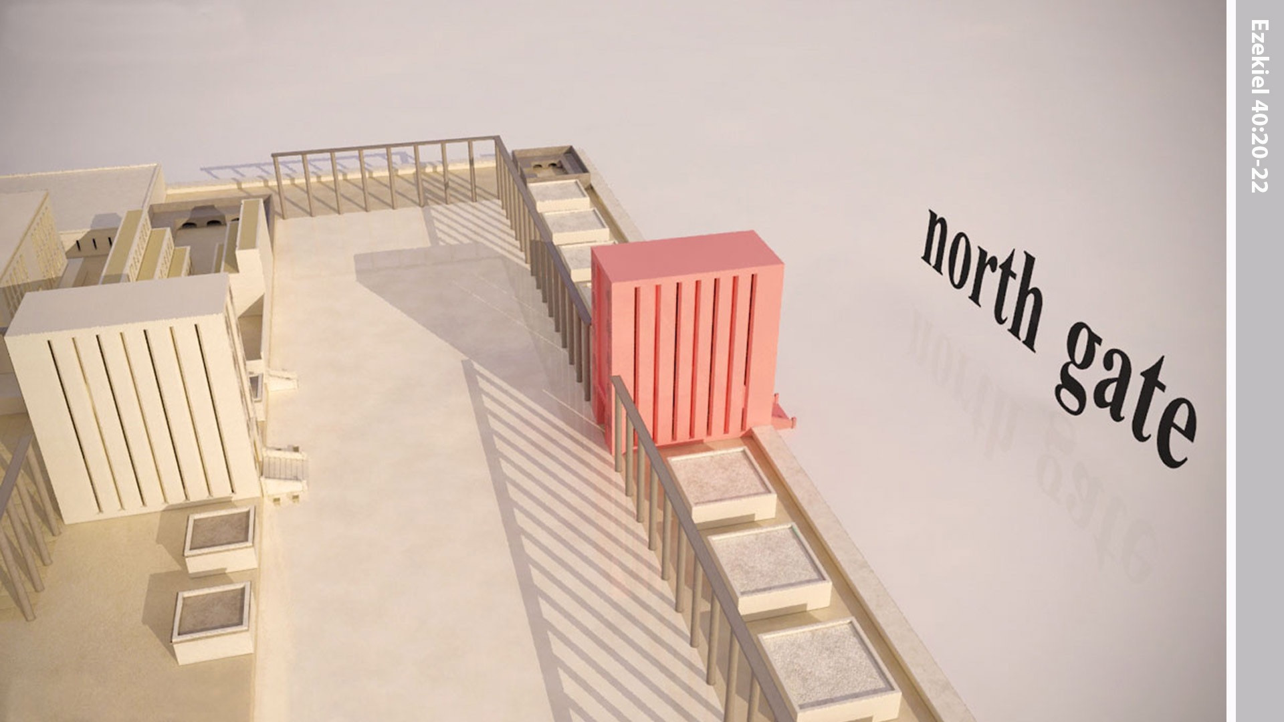
Notes:
Then the ‘man’ measured the gateway on the north side that led into the outer courtyard. It had the same measurements as those in the East Gateway. The entrance room, the windows, and the carved palm trees were like those in the east gate. Seven steps led up to the gate.

Slide 23
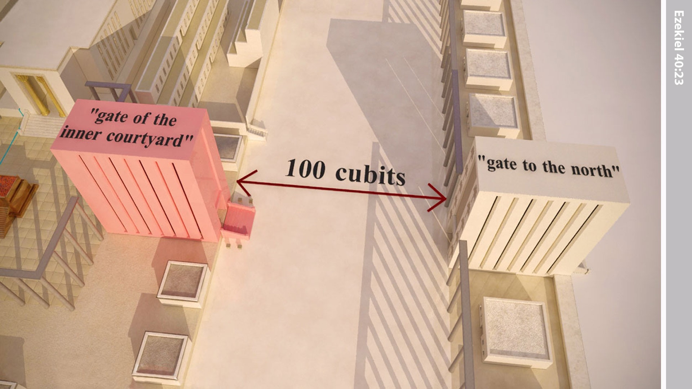
Notes:
Across the courtyard from this north gateway was another gateway leading to the inner courtyard, just as there was on the east side. The man measured the distance between these two gateways, and it was 100 cubits.

Slide 24
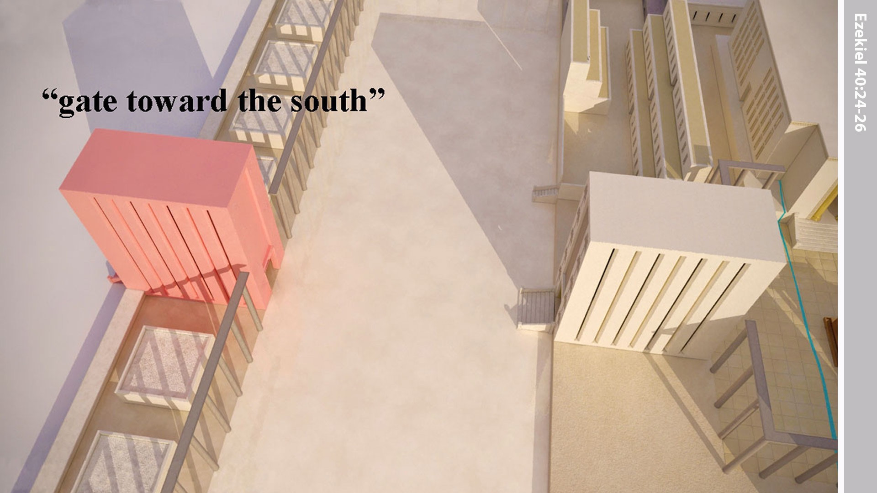
Notes:
Next, the ‘man’ took Ezekiel to the south side where he saw another gateway the same size and decoration as the East and North Gates. Seven steps led up to it.

Slide 25
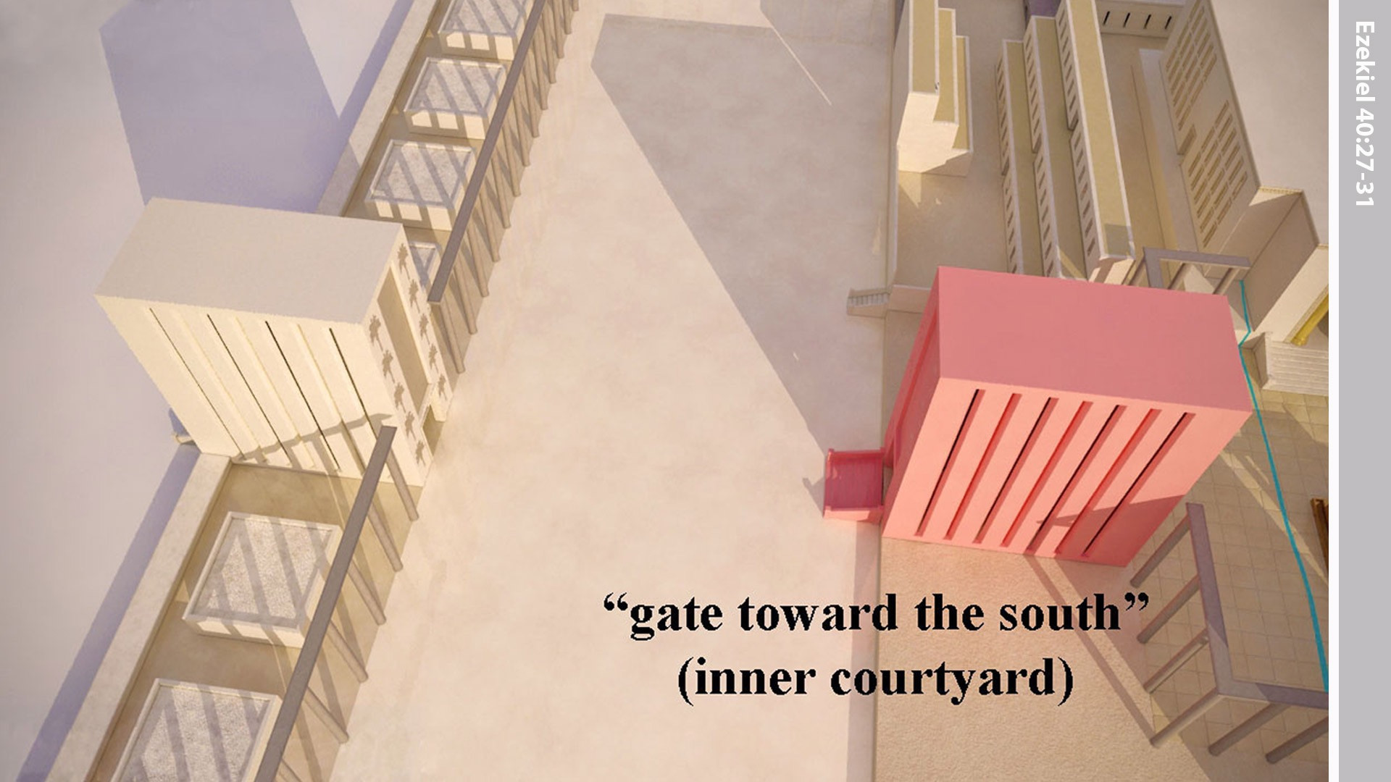
Notes:
The ‘man’ took Ezekiel through the south gateway into the inner courtyard. He measured the gateway, and it was the same size as the gateways in the outer wall.

Slide 26
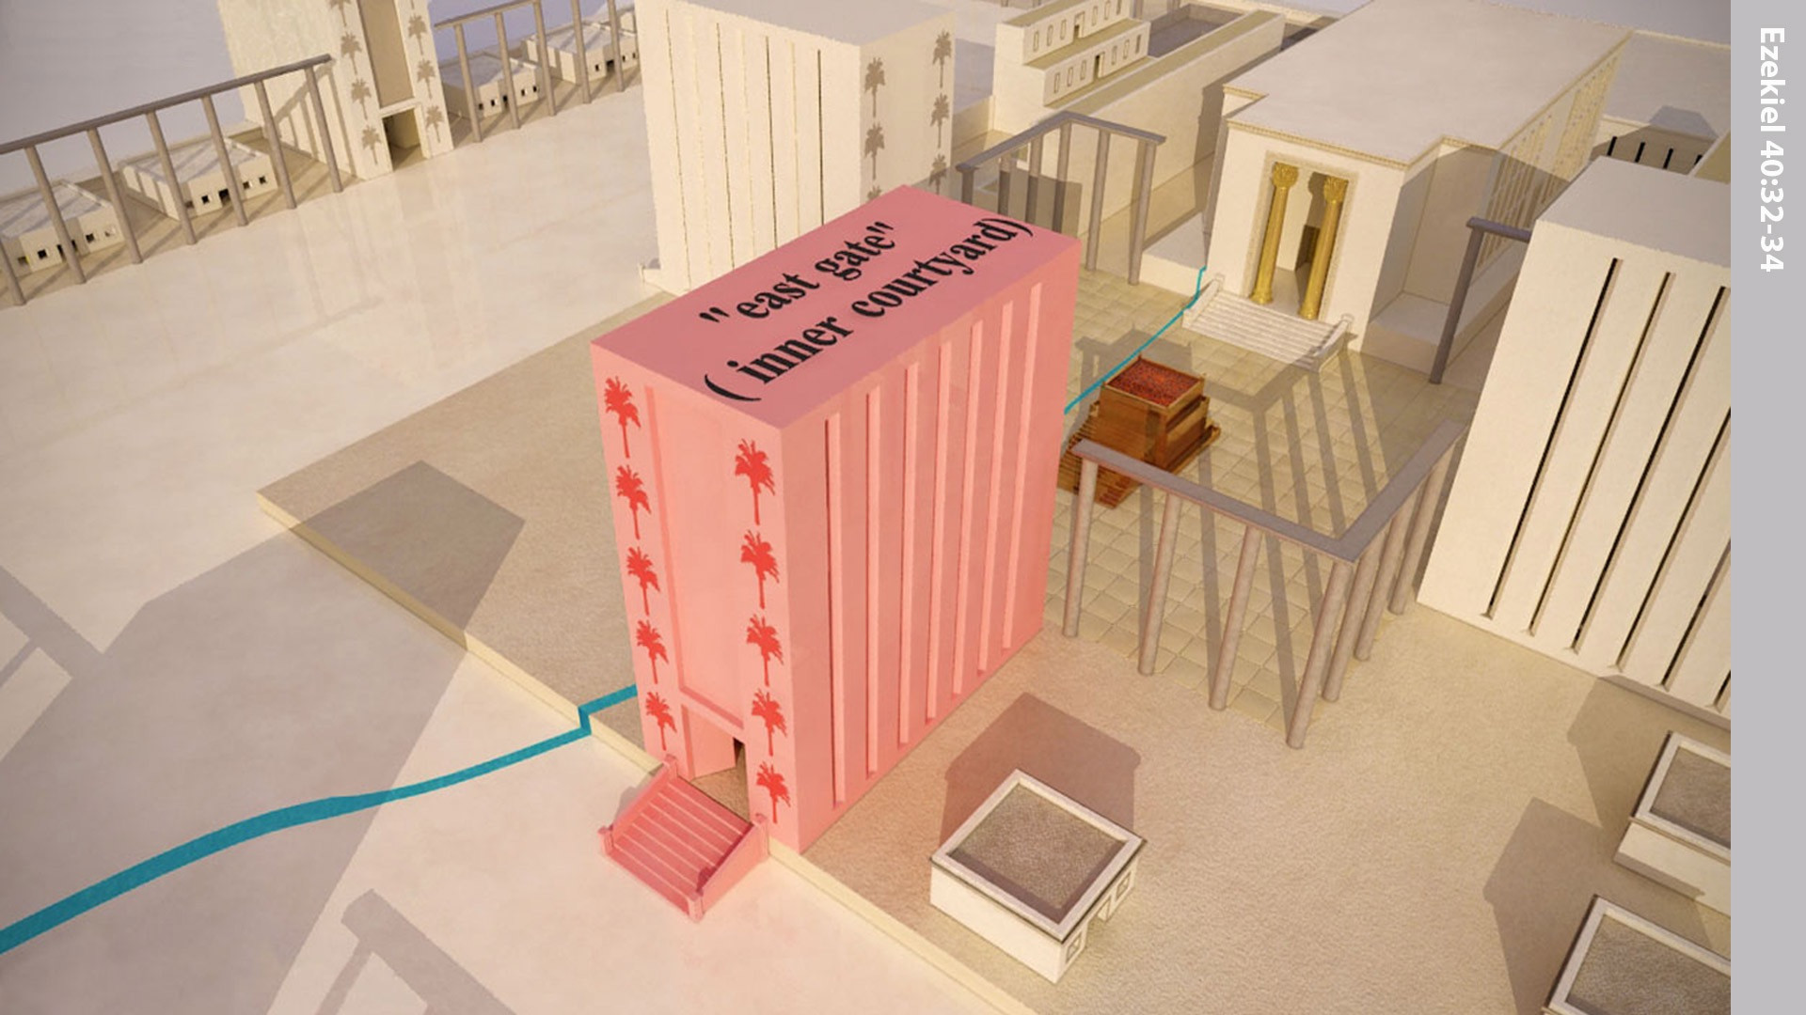
Notes:
Ezekiel was then taken through the East Gate to the inner courtyard. Its guardrooms, its entrance room, and its inner walls measured the same as those in the other gateways. Palm trees were carved on the walls along the passageway. Eight steps led up to this gate.

Slide 27
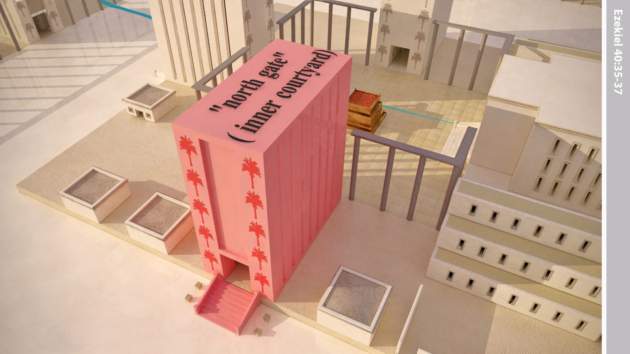
Notes:
The ‘man’ then took Ezekiel to the North Gateway. It was the same size as the others and like them, had guardrooms, decorated inner walls, an entrance room, and windows all around. Eight steps led up to this gate.

Slide 28
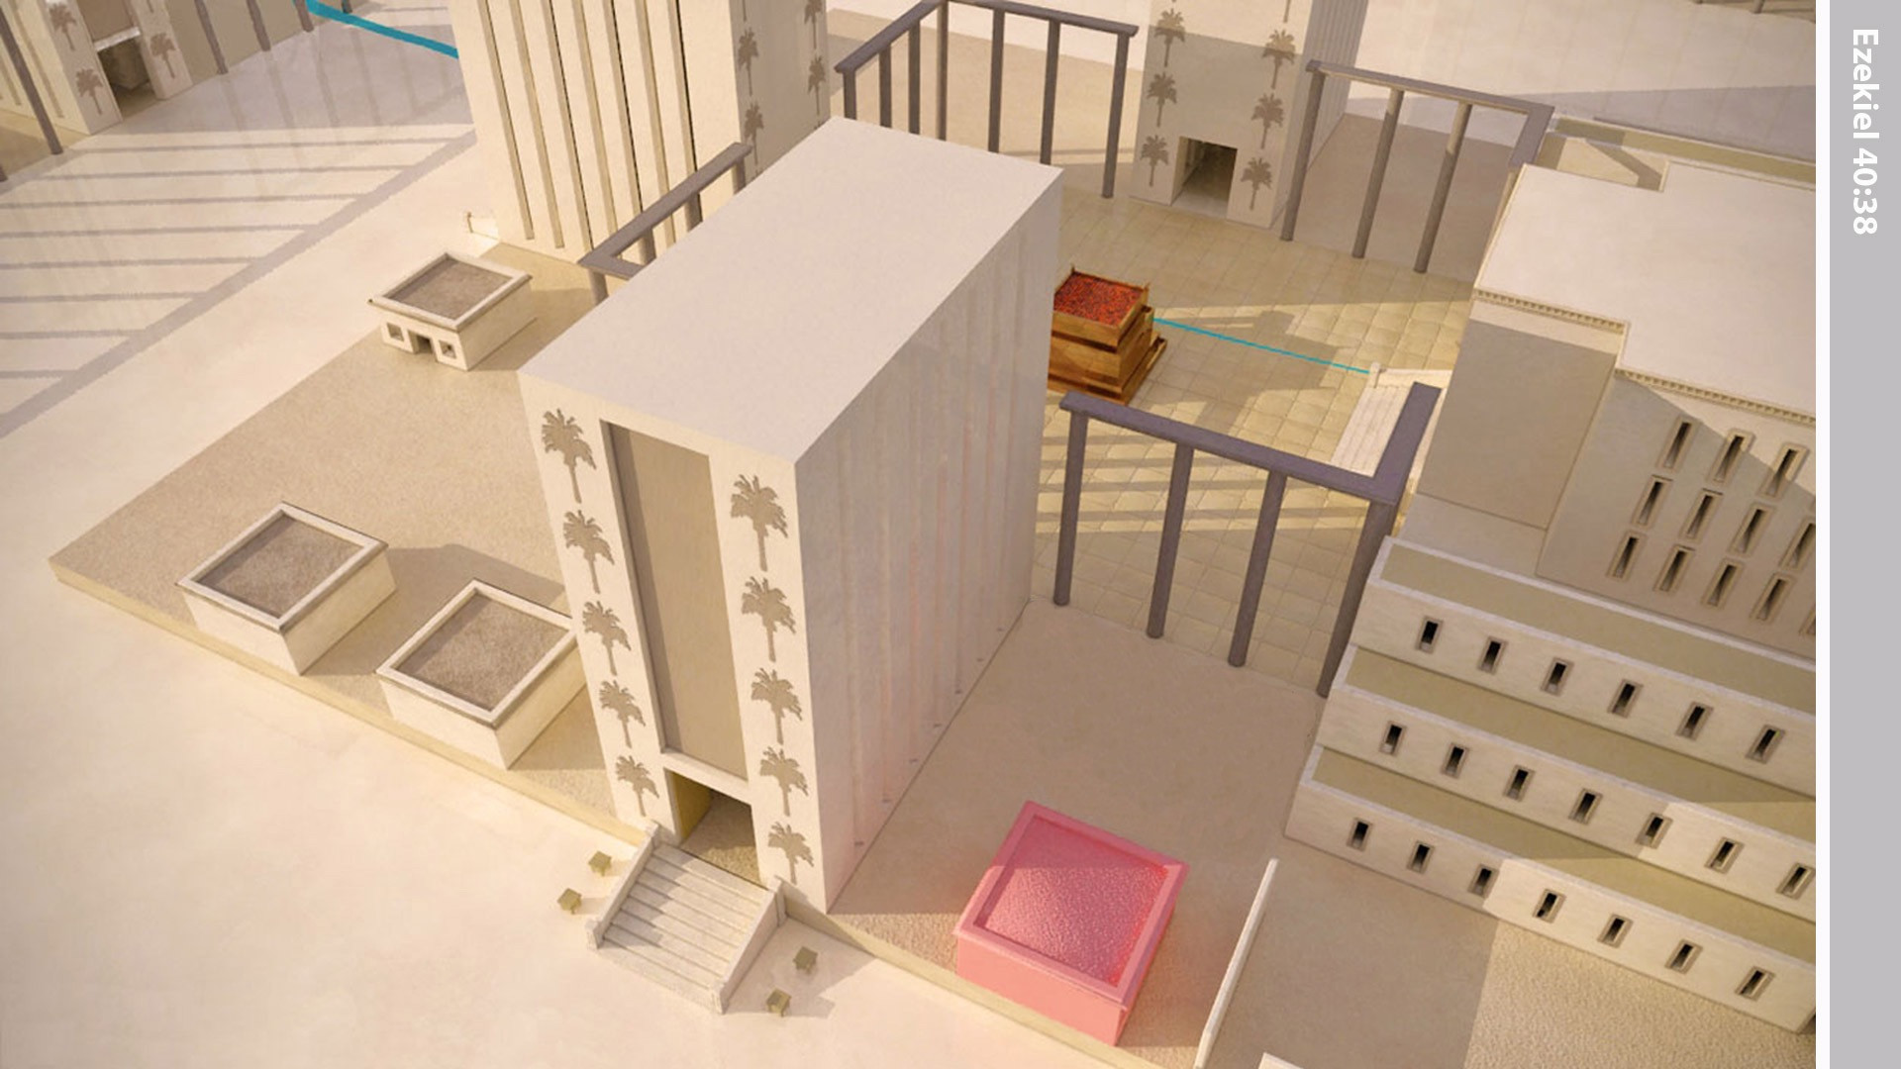
Notes:
In the outer courtyard there was an annex on the north side. It opened into the entrance room that faced the courtyard, and there they washed the carcasses of the animals to be burned whole as sacrifices.

Slide 29
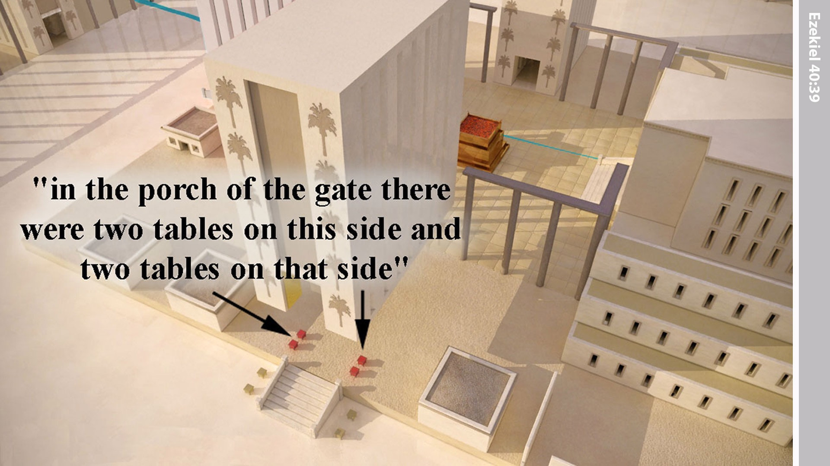
Notes:
In the porch of the gate were four tables, two on each side of the room. It was on these tables that they killed the animals to be offered as sacrifices.

Slide 30
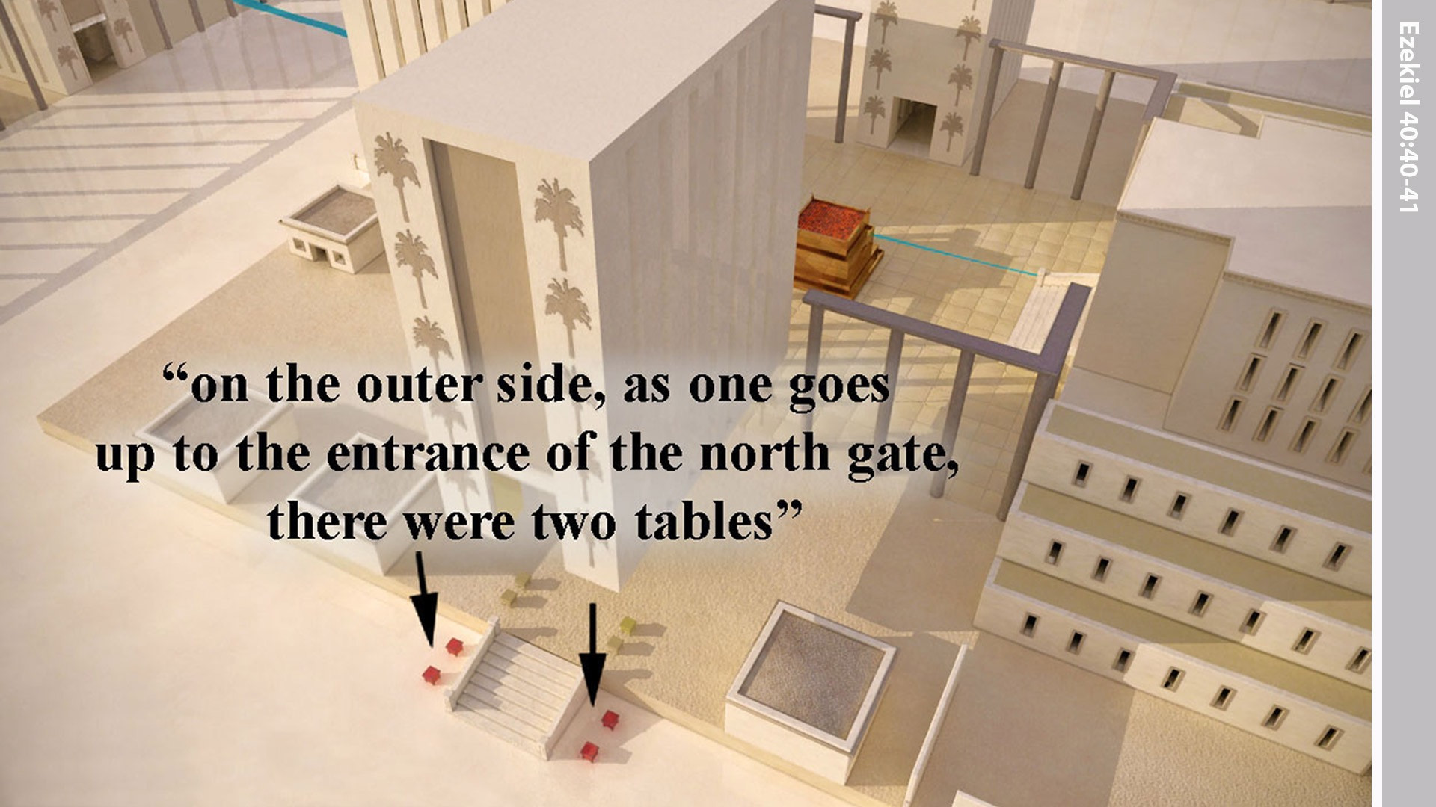
Notes:
Outside the entry hall, on each side of the stairs going up to the north entrance, there were two more tables. So, in all there were eight tables, four inside and four outside, where the sacrifices were cut up and prepared.

Slide 31
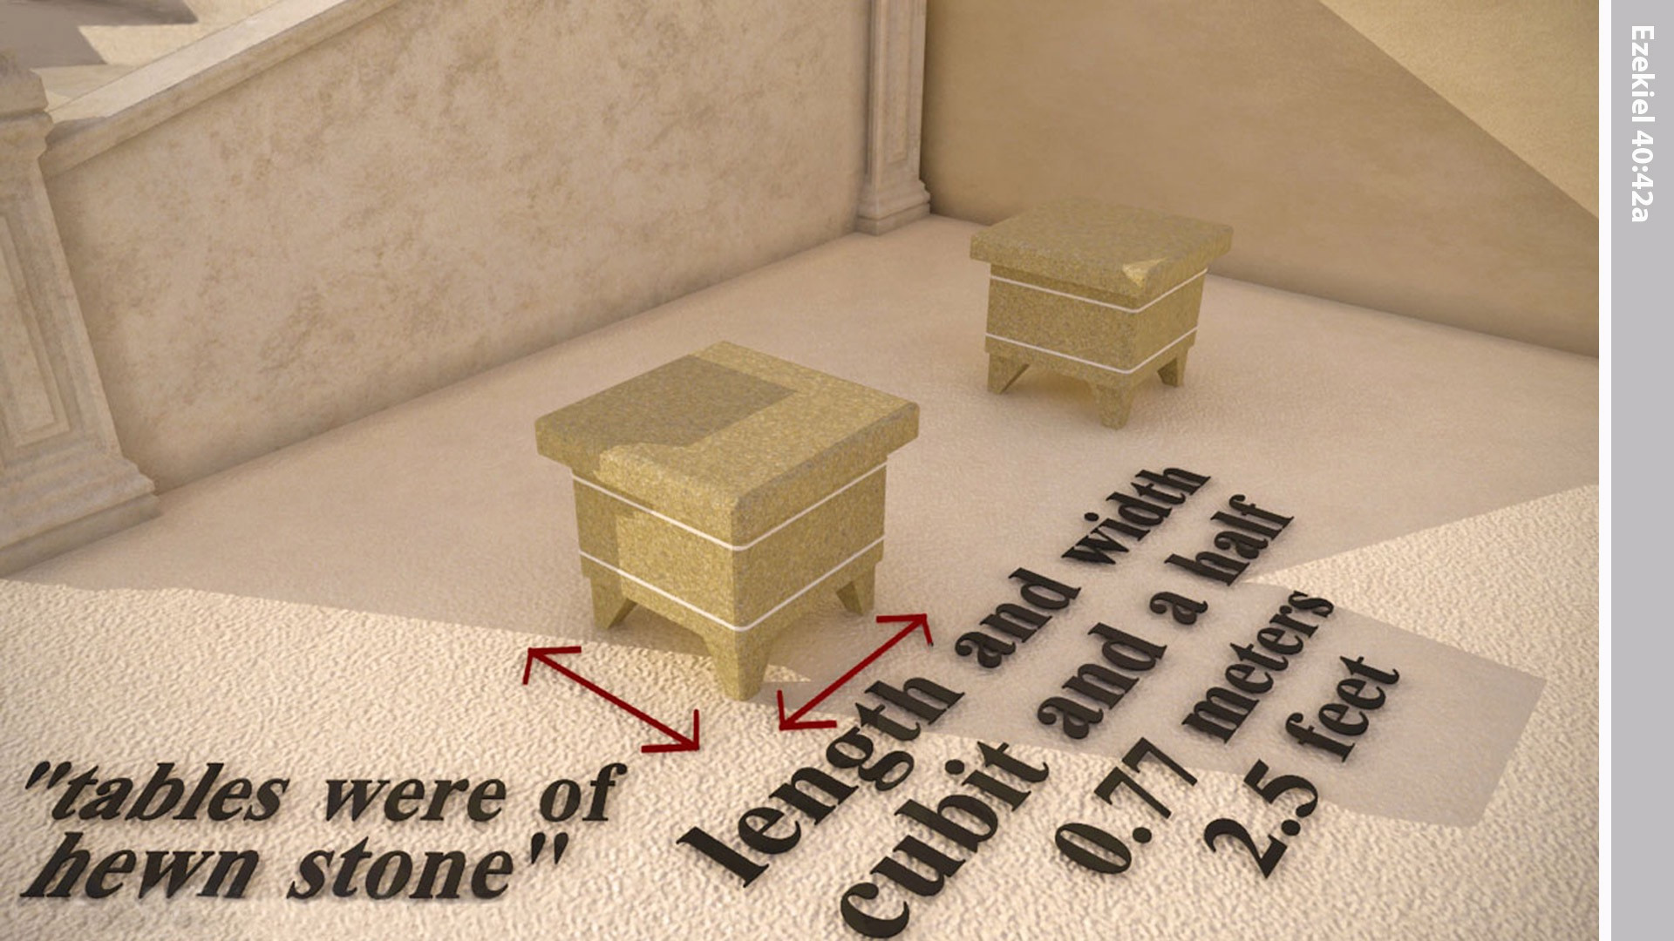
Notes:
There were also four stone tables where the butchering knives and other implements were laid.

Slide 32
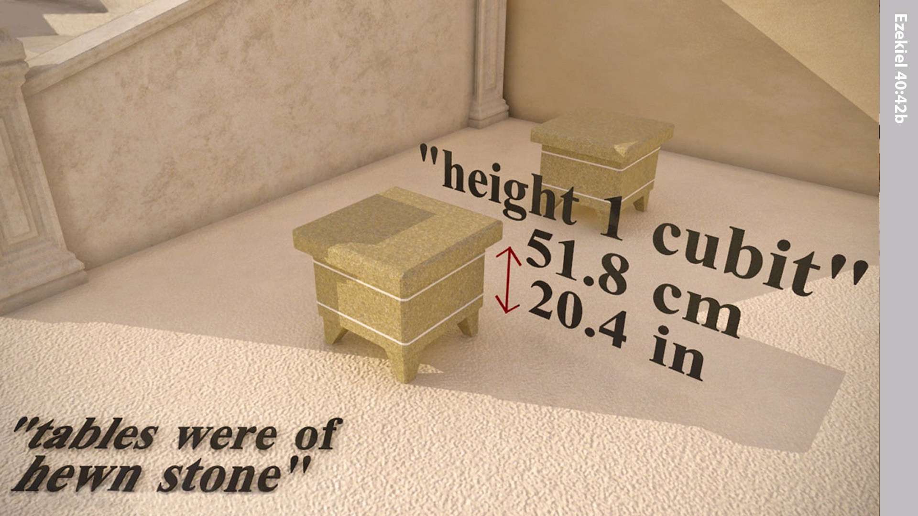
Notes:
These stone tables were 1 cubit.

Slide 33
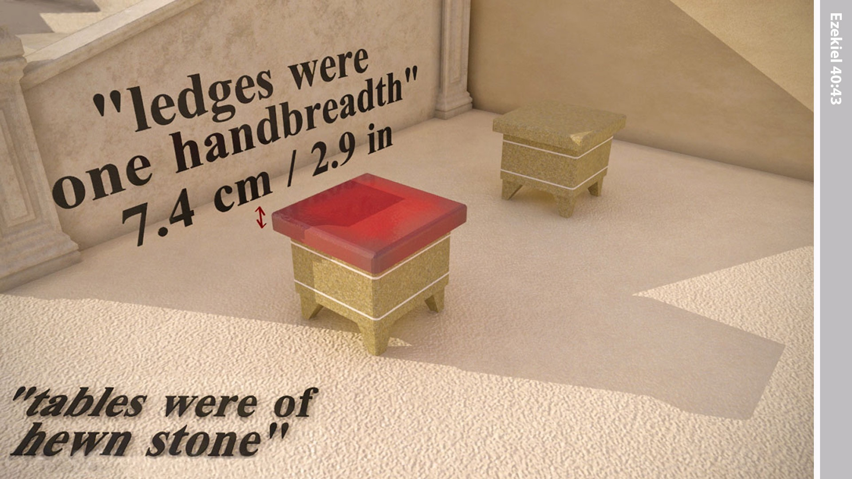
Notes:
They had an overlapping ledge the width of a hand.

Slide 34
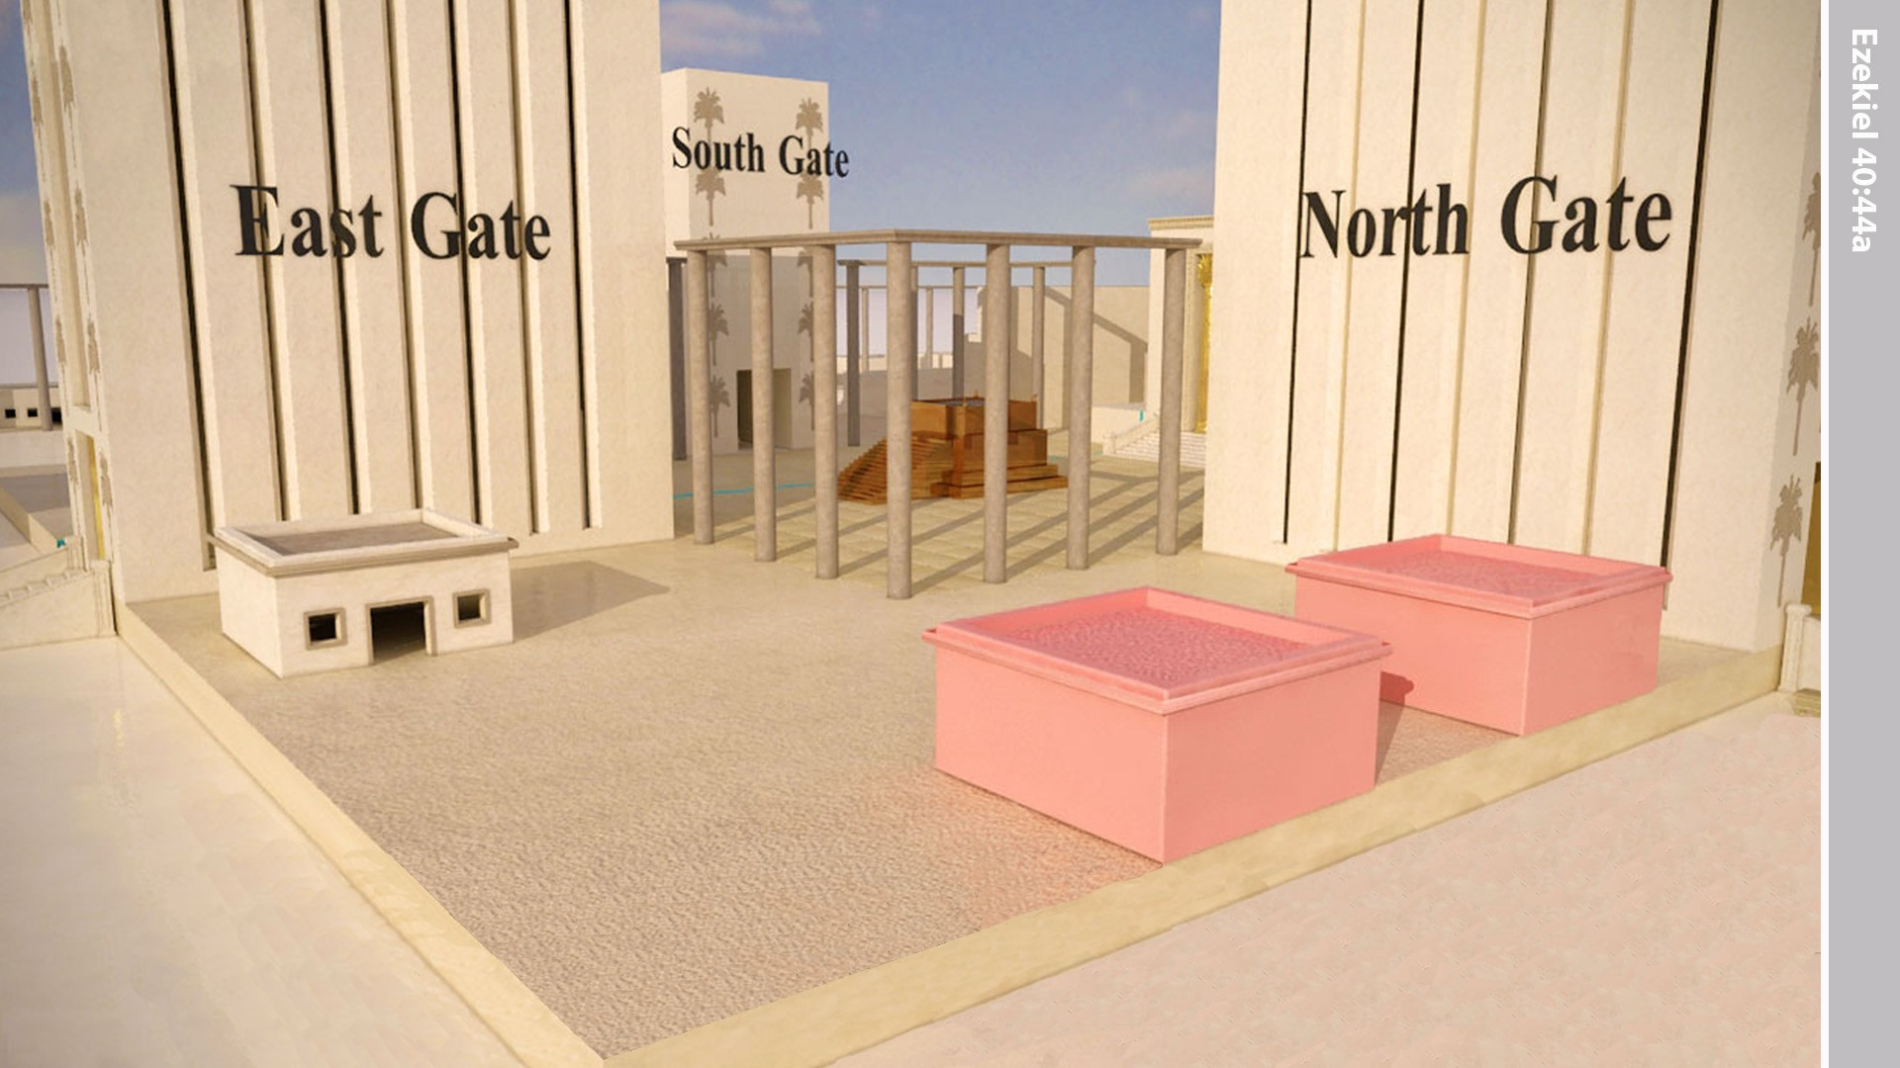
Notes:
In the inner court there stood a building beside the northern entrance, facing south, for the priests who guarded the temple.

Slide 35
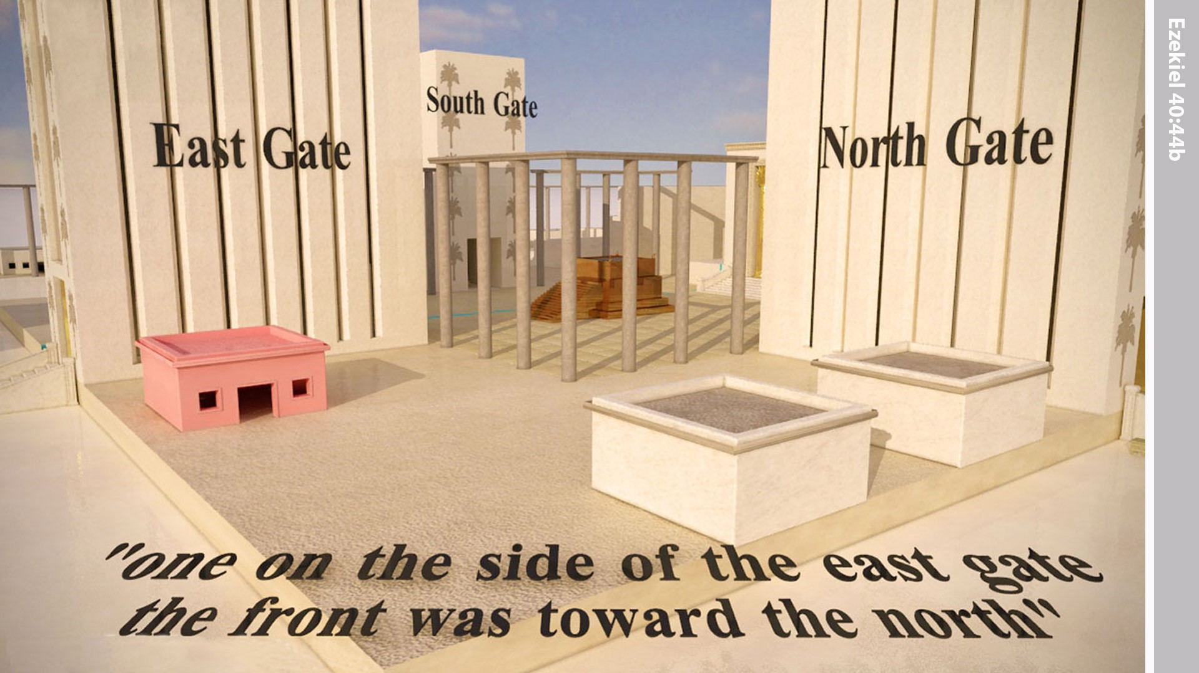
Notes:
Beside the southern entrance, facing north, was the room for the priests who guarded the altar.

Slide 36
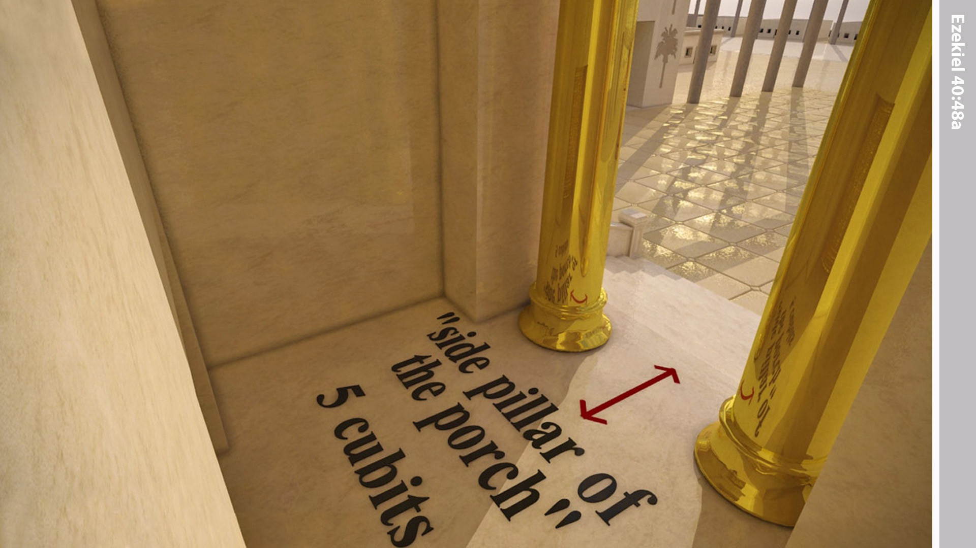
Notes:
Ezekiel was then brought to the entrance hall of the Temple. Ten steps led up to it from the inner court. Its walls extended up on either side to form two pillars.

Slide 37
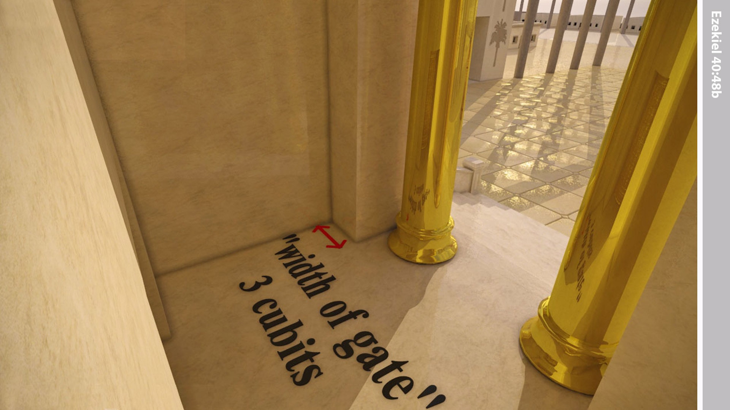
Notes:
The projecting walls were 3 cubits wide.

Slide 38
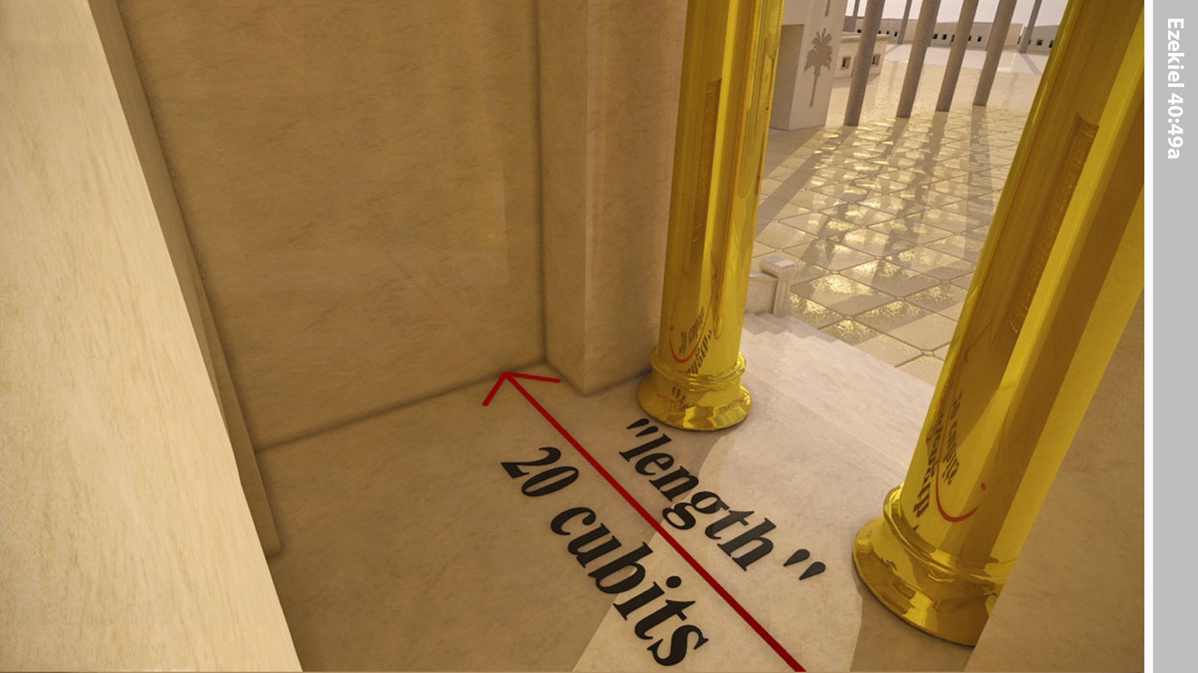
Notes:
The entry hall was 20 cubits wide …

Slide 39
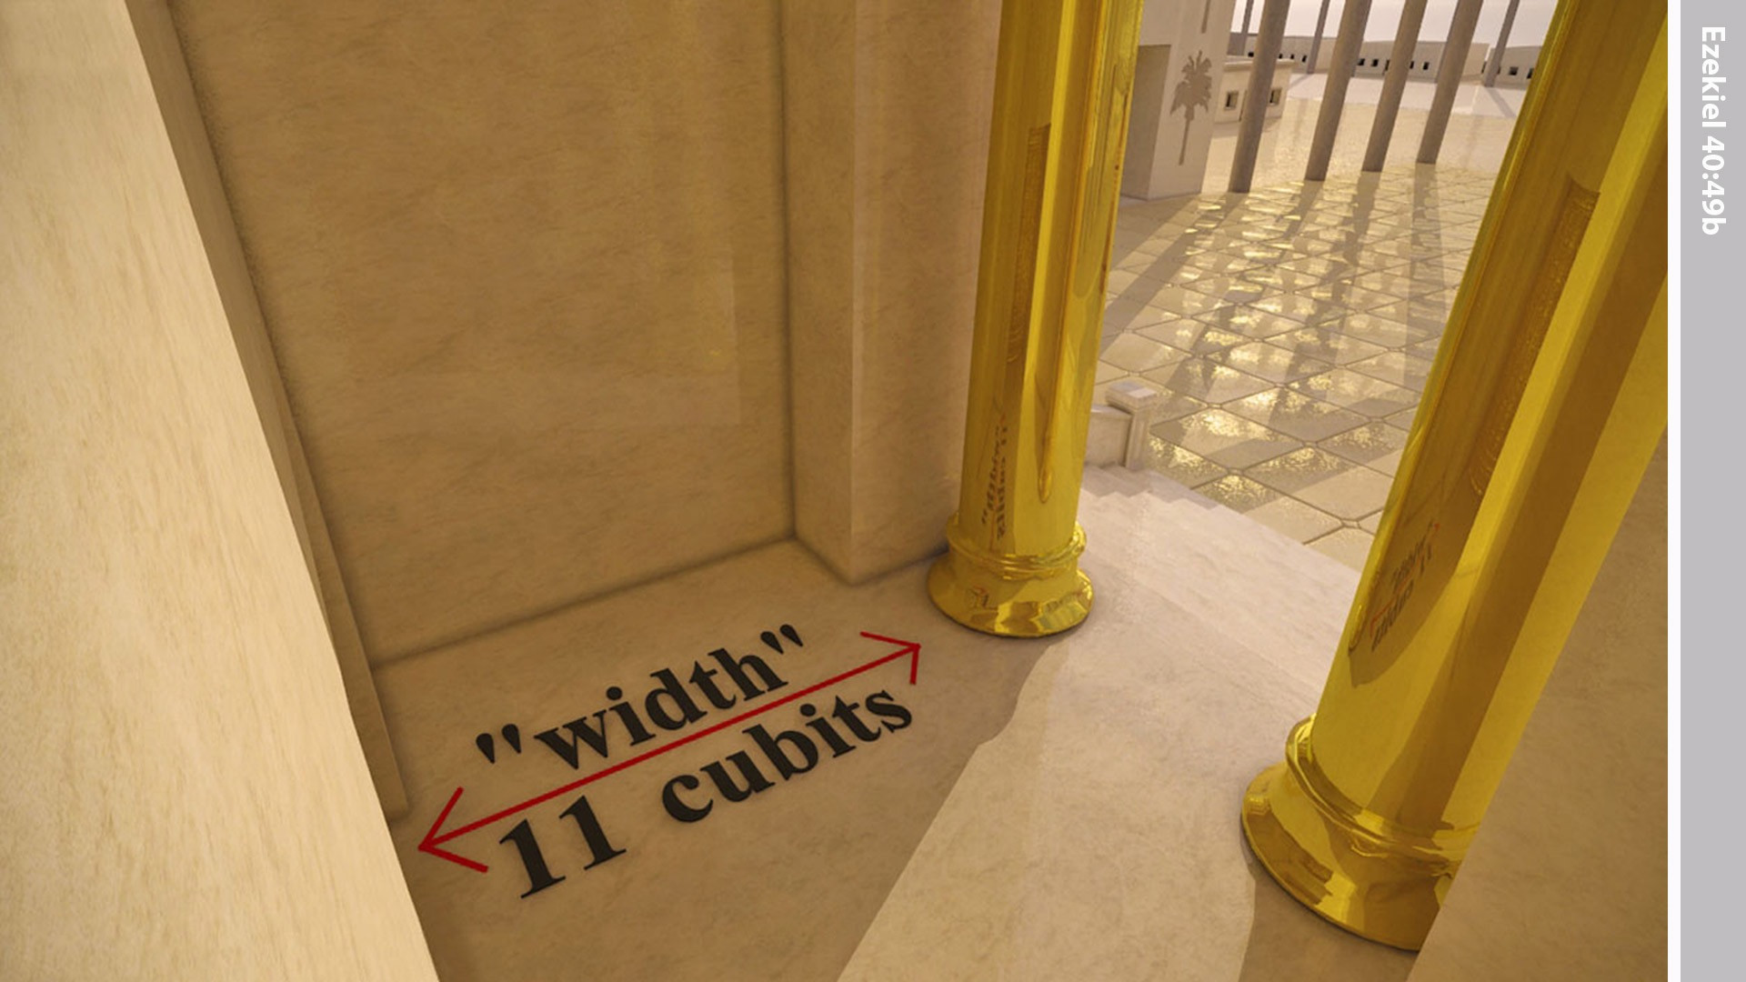
Notes:
… and 11 cubits deep.

Slide 40
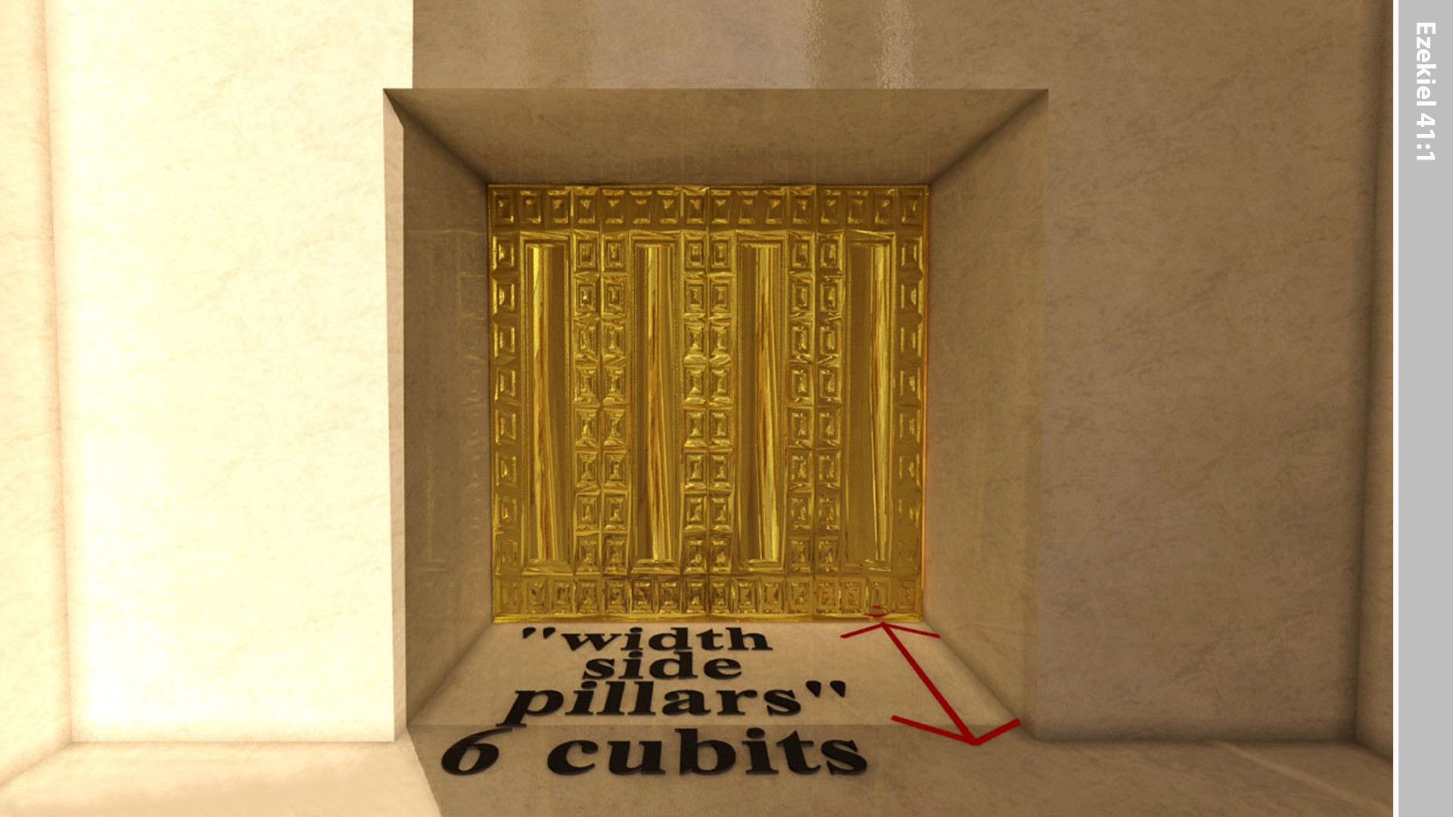
Notes:
The ‘man’ in Ezekiel’s vision took him into the large main room ‘the Holy Place’ of the Temple, and measured the pillars that formed its doorway. The width was 6 cubits.

Slide 41
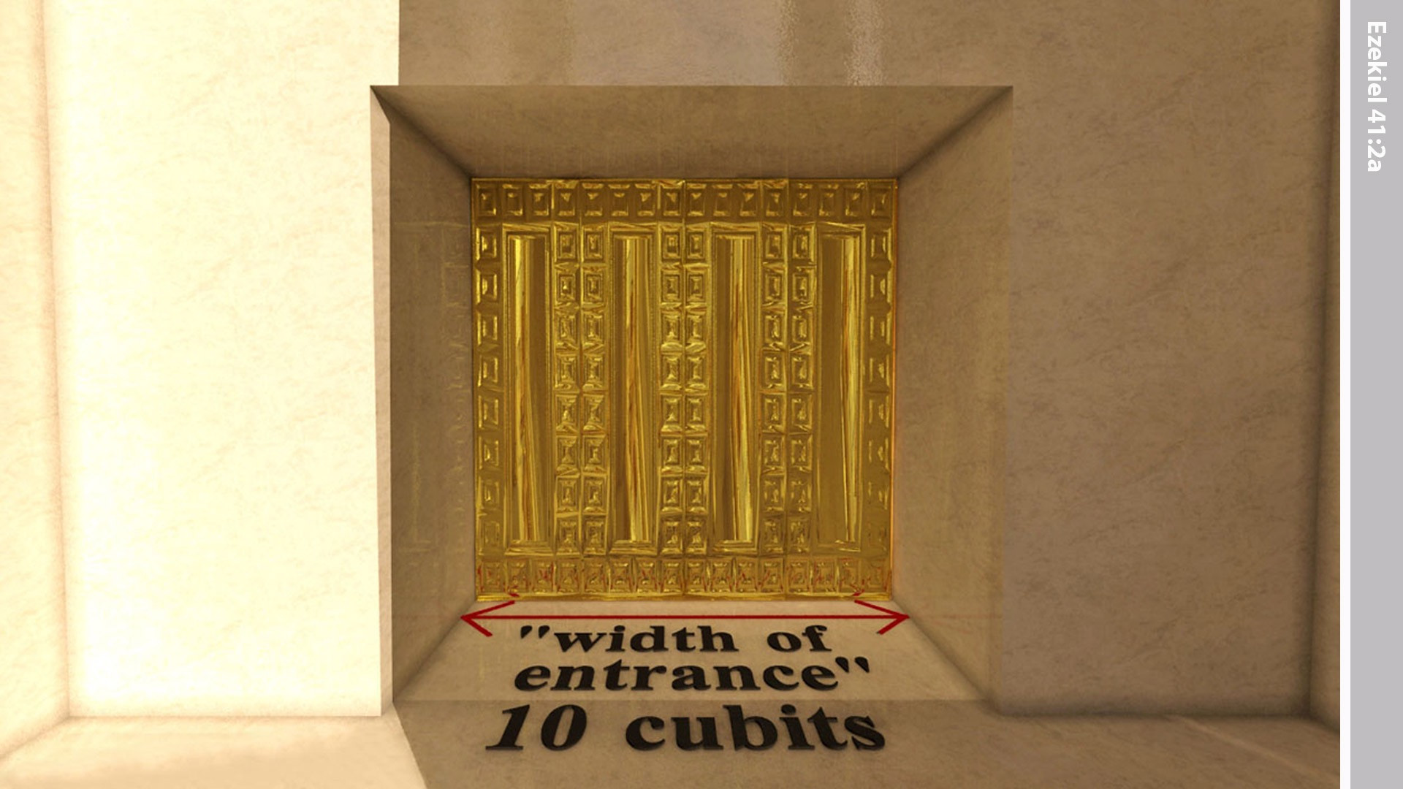
Notes:
The width of the entrance was measured at 10 cubits.

Slide 42
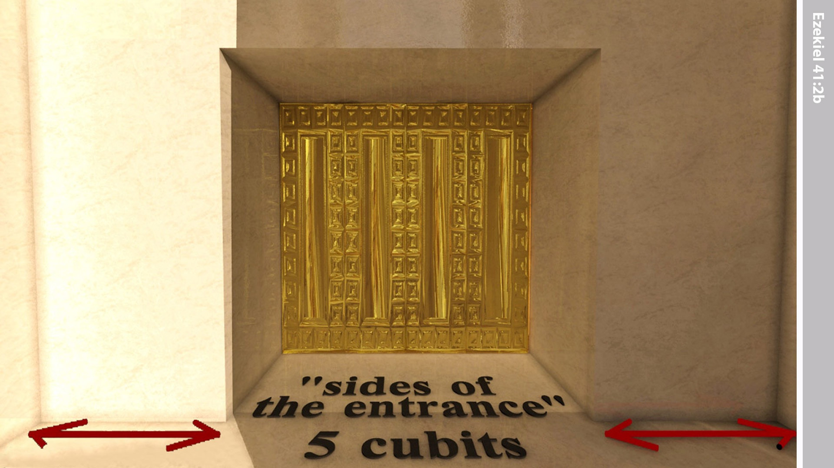
Notes:
And the sides were 5 cubits wide.

