Slide 1
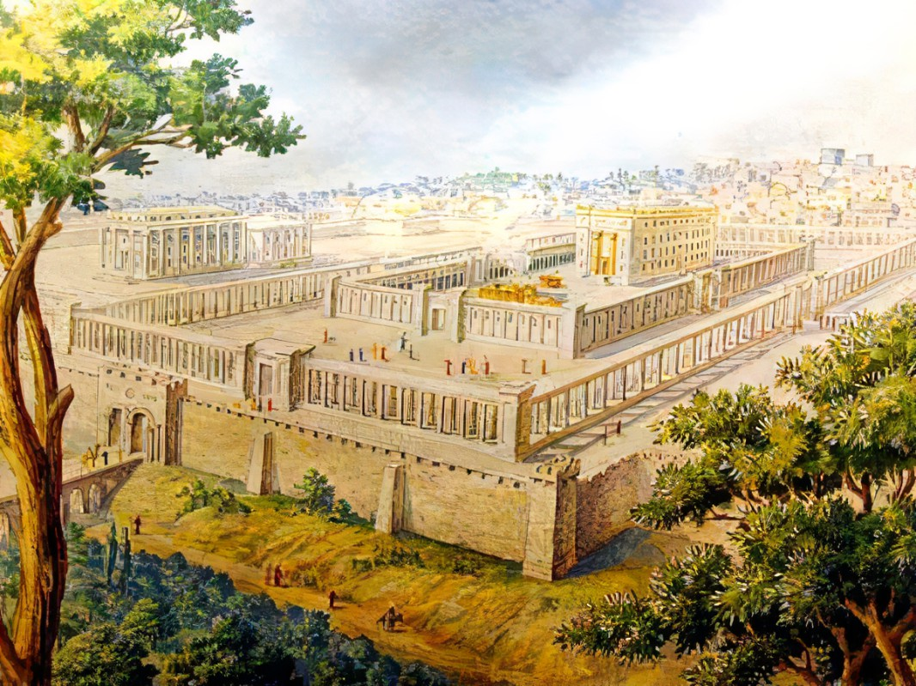


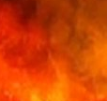
Final Attack:
God’s Victory Over Gog
Episode 2 of 2
Ezekiel
The
Book of
Chapter
39 .

Slide 2
Ezekiel in 5 Sections
Ezekiel’s Commission (Chap 1-3)
Against Judah (Chap 4-24)
Against Nations (Chap 25-32)
Of Israel’s Restoration (Chap 33-39)
Of the Millennial Kingdom (Chap 40-48)

Slide 3
Ezekiel’s 4th Section:
Of Israel’s Restoration
Good Leaders Arise (Chap 33-34)
Preparing The Land For Fruitful (Chap 35-36)
Israel’s New Heart & Unified Life (Chap 36-37)
Trusting God Thru The Attacks (Chap 38-39)

Slide 4
Gog’s Forces Attack Israel
We identified the players, places & what prompts them

Slide 5
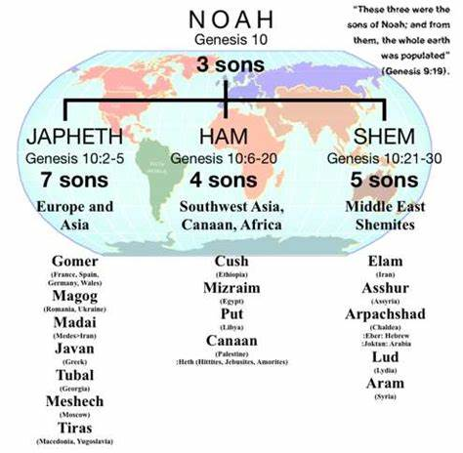
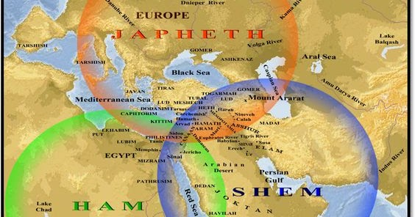
“These three were the sons of Noah; and from them, the whole earth was scattered abroad.” Genesis 9:19
Gomer
(Parts of Turkey)
Magog
(Russia)
Javan
(Greeks)
Tubal
(Parts of Turkey)
Meshech
(Parts of Turkey)
Tiras
(Macedonia)
Cush
(Ethiopia)
Mizraim
(Egypt)
Put
(Libya)
Canaan
(All the ‘ites’)
Elam
(Ancient Iran)
Asshur
(Assyria)
Arpachshad
(Chaldea)
Lud
(Lydia)
Aram
(Syria)

Slide 6
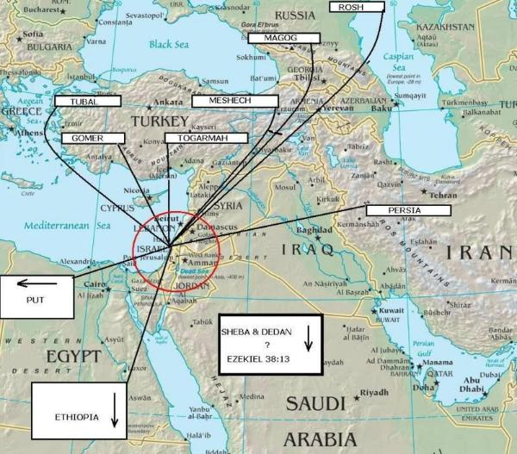

Slide 7
Gog’s Forces Attack Israel
We identified the players, places & what prompts them
We identified God’s plan & activity

Slide 8
Gog’s Forces Attack Israel
Let’s identify the scope of Gog’s Attack
We see Gog’s intentions are turned backward

Slide 9
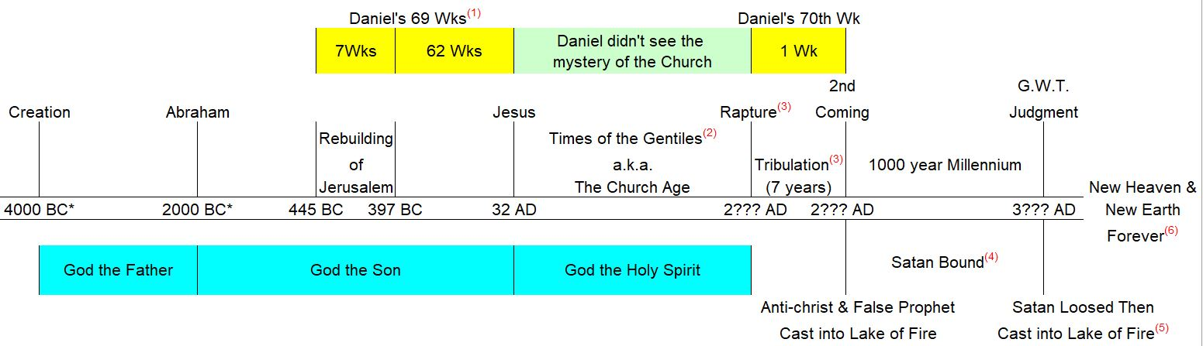
When will Gog attack???

Slide 10
Gog’s Forces Attack Israel
Let’s identify the scope of Gog’s Attack
We see Gog’s intentions are turned backward
It’s always been about saving Israel

Slide 11
God Over Gog
We’ve identified the players, places & what prompts them
We’ve identified God’s plan & activity
We’ve identified the scope of Gog’s Attack
We’ve seen Gog’s intentions are turned backward
It’s always been about saving Israel

