Slide 1
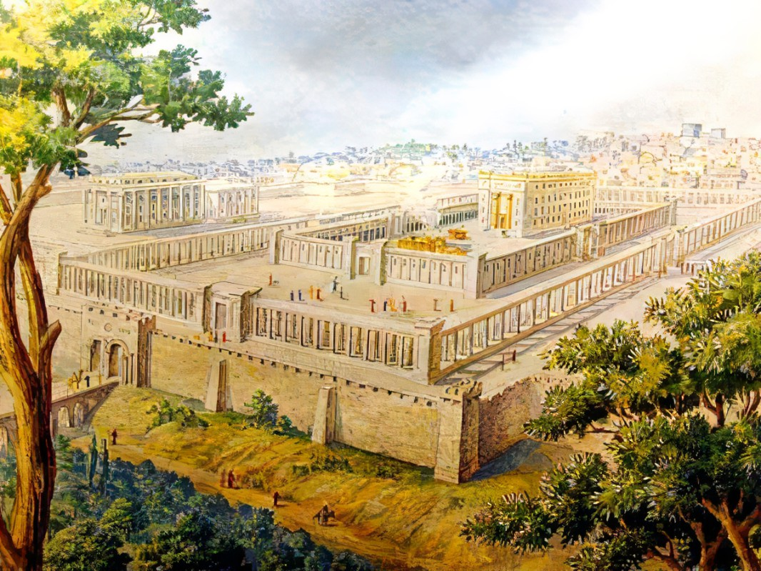


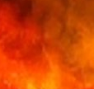
Final Attack:
God’s Victory Over Gog
Episode 1 of 2
Ezekiel
The
Book of
Chapter
38 .

Slide 2
Ezekiel in 5 Sections
Ezekiel’s Commission (Chap 1-3)
Against Judah (Chap 4-24)
Against Nations (Chap 25-32)
Of Israel’s Restoration (Chap 33-39)
Of the Millennial Kingdom (Chap 40-48)

Slide 3
Ezekiel’s 4th Section:
Of Israel’s Restoration
Good Leaders Arise (Chap 33-34)
Preparing The Land For Fruitful (Chap 35-36)
Israel’s New Heart & Unified Life (Chap 36-37)
Trusting God Thru The Attacks (Chap 38-39)

Slide 4
Gog’s Forces Attack Israel
Let’s identify the players, places & what prompts them

Slide 5
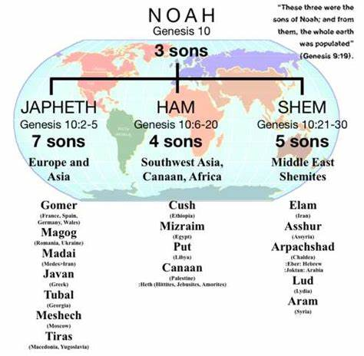
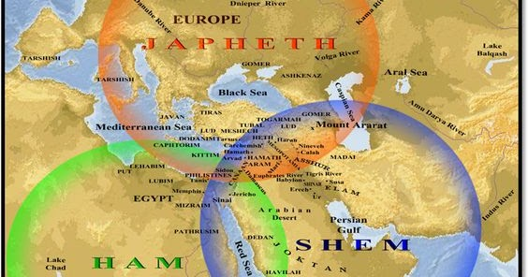
“These three were the sons of Noah; and from them, the whole earth was scattered abroad.” Genesis 9:19
Gomer
(Parts of Turkey)
Magog
(Russia)
Javan
(Greeks)
Tubal
(Parts of Turkey)
Meshech
(Parts of Turkey)
Tiras
(Macedonia)
Cush
(Ethiopia)
Mizraim
(Egypt)
Put
(Libya)
Canaan
(All the ‘ites’)
Elam
(Ancient Iran)
Asshur
(Assyria)
Arpachshad
(Chaldea)
Lud
(Lydia)
Aram
(Syria)

Slide 6
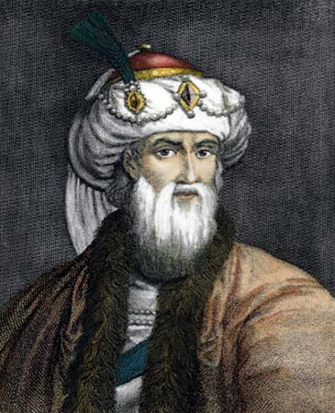
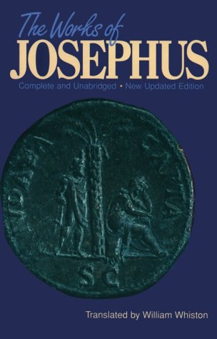
“Now they were the grandchildren of Noah, in honor of whom names were imposed on the nations by those that first seized upon them. Japhet, the son of Noah, had seven sons: they inhabited so, that, beginning at the mountains Taurus & Amanus, they proceeded along Asia, as far as the river Tanais, & along Europe to Cadiz; & settling themselves on the lands which they light upon, which none had inhabited before, they called the nations by their own names. For Gomer founded those whom the Greeks now call Galatians, [Galls,] but were then called Gomerites. Magog founded those that from him were named Magogites, but who are by the Greeks called Scythians.”

Slide 7
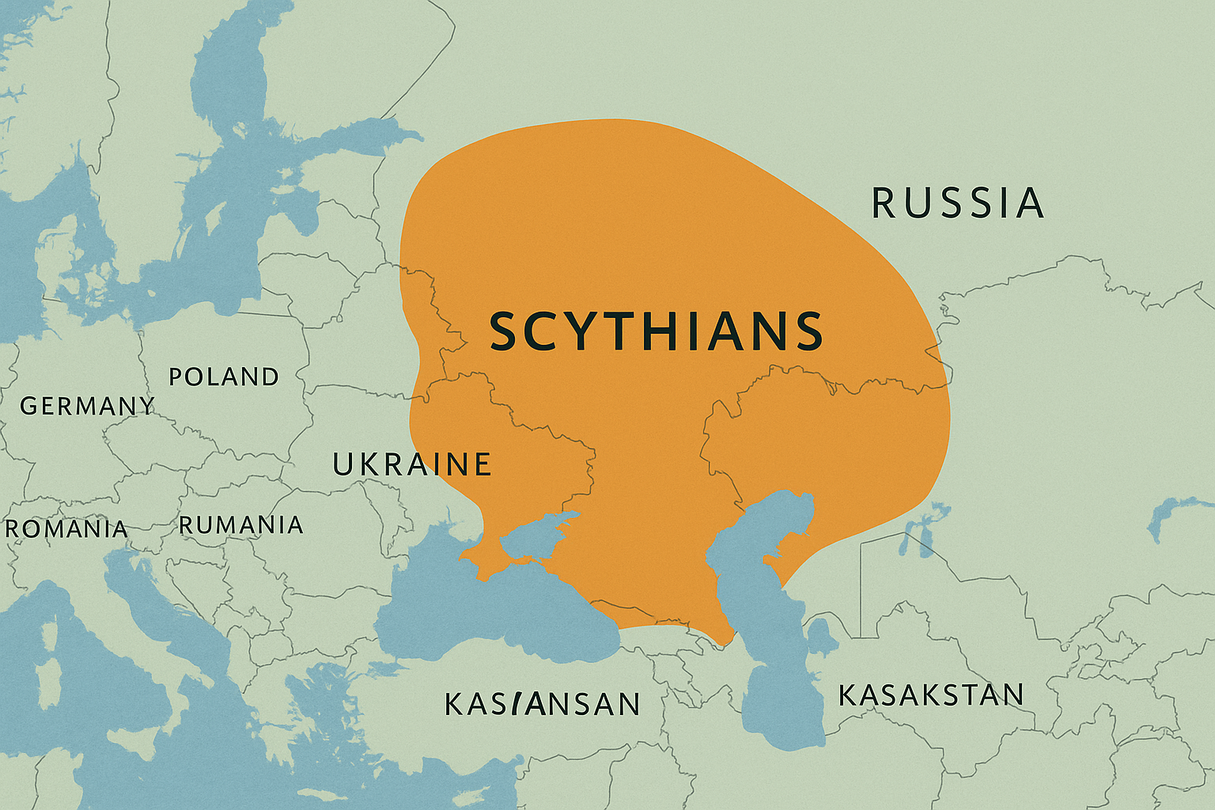
TURKEY
IRAN
Syria
IRAQ

Slide 8
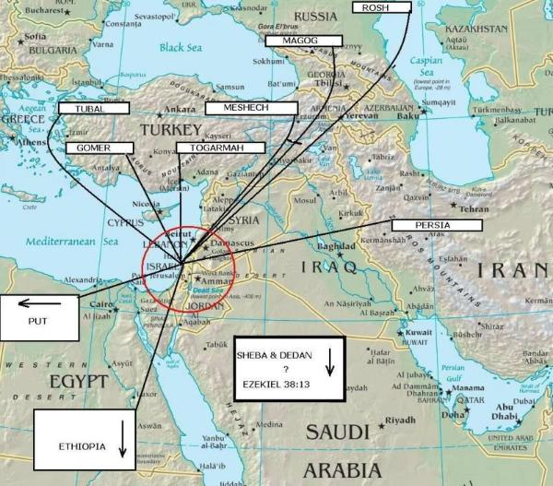

Slide 9
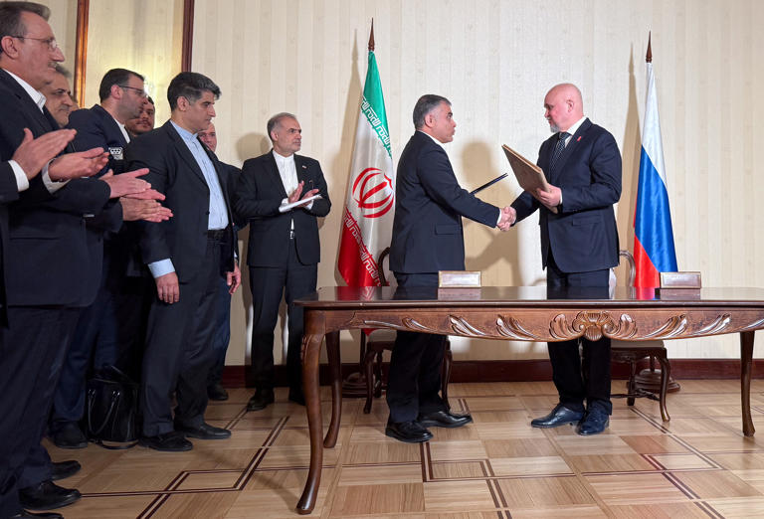
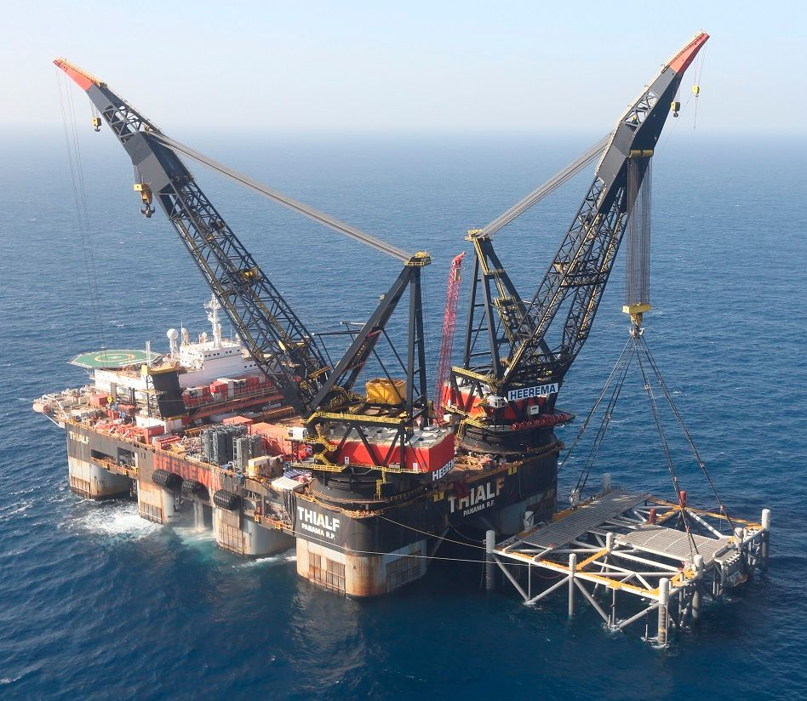
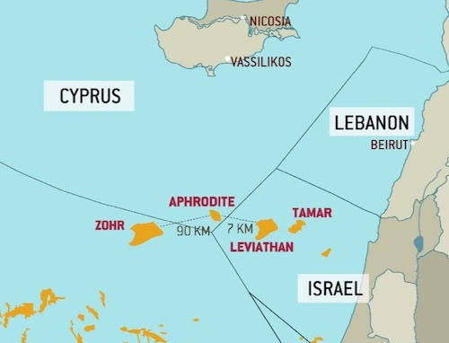
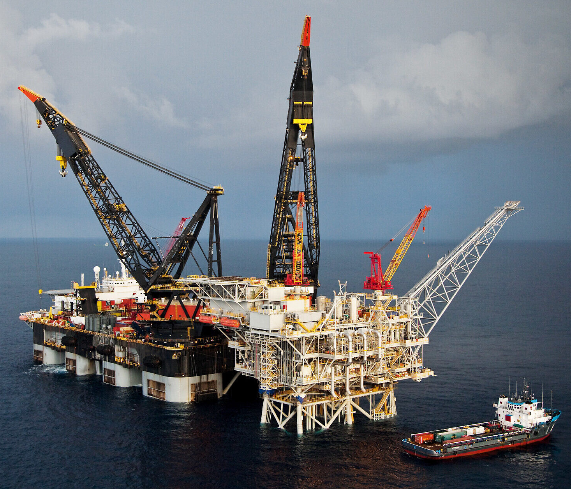
Gog’s Forces Attack Israel
Let’s identify the players, places & what prompts them
Leviathan
Tamar
April 25, 2025

Slide 10
Gog’s Forces Attack Israel
Let’s identify the players, places & what prompts them
Let’s identify God’s plan & activity
“There shall come a man out of his seed, and he shall rule over many nations; & the kingdom of Gog shall be exalted, & his kingdom shall be increased.”
Numbers 24:7 - LXX

Slide 11
Gog’s Forces Attack Israel
Let’s identify the players, places & what prompts them
Israel’s foes led by a new enemy
Let’s identify God’s plan & activity
God’s always been prepared to intervene & destroy Satan’s plan

