Slide 1
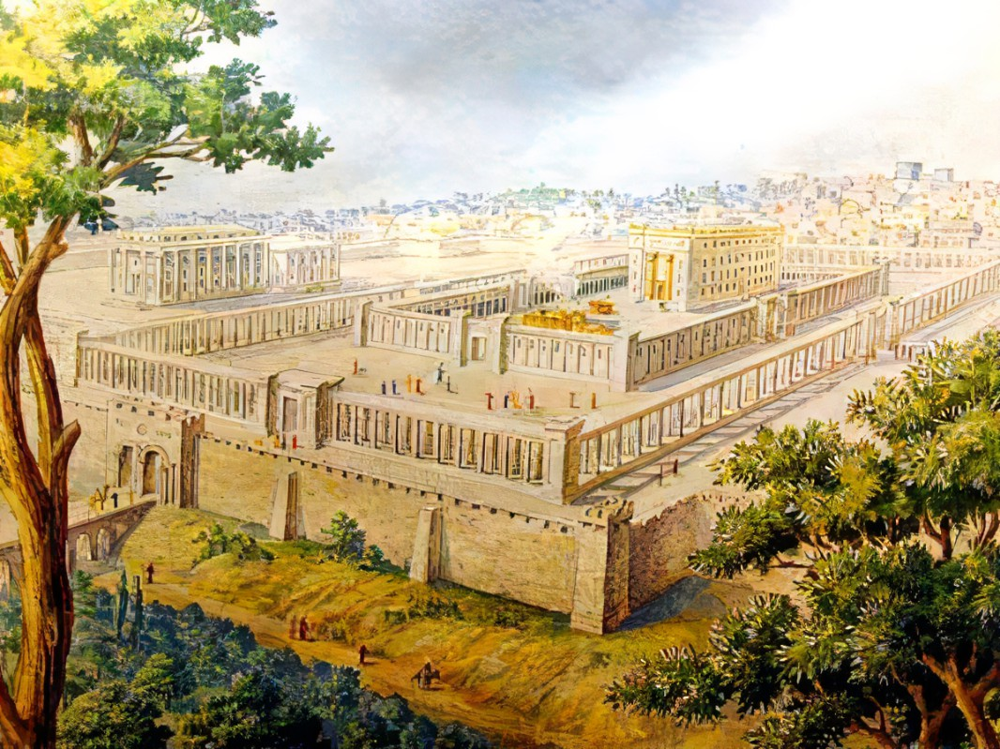



Preparing A People For Eternity
Ezekiel
The
Book of
Chapter
36:16-37:28

Slide 2
Ezekiel in 5 Sections
Ezekiel’s Commission (Chap 1-3)
Against Judah (Chap 4-24)
Against Nations (Chap 25-32)
Of Israel’s Restoration (Chap 33-39)
Of the Millennial Kingdom (Chap 40-48)

Slide 3
Ezekiel’s 4th Section:
Of Israel’s Restoration
Good Leaders Arise (Chap 33-34)
Preparing The Land For Fruitful (Chap 35-36)
Israel’s New Heart & Unified Life (Chap 36-37)
Trusting God Thru The Attacks (Chap 38-39)

Slide 4
Preparing Israel For Their Final Restoration
Their restoration is all for God’s glory
Their new heart & spirit are from God

Slide 5
II Corinthians 5:17
“Therefore if anyone is in Christ, he is a new creation; the old things passed away; behold, new things have come.”

Slide 6
Ephesians 4:22-24
“Lay aside, in reference to your former conduct, the old man, which is being corrupted in accordance w/ the lusts of deceit, & be renewed in the spirit of your mind, & put on the new man, which in the likeness of God has been created in righteousness & holiness of the truth.”

Slide 7
Jeremiah 31:31-33
“Behold, days are coming, declares Yahweh, when I will cut a new covenant w/ the house of Israel & w/ the house of Judah, not like the covenant which I cut w/ their fathers in the day I took them by the hand to bring them out of the land of Egypt, My covenant which they broke, but I was a husband to them, declares Yahweh… (cont)

Slide 8
Jeremiah 31:31-33
(cont) “But this is the covenant which I will cut with the house of Israel after those days, declares Yahweh: I will put My law within them, and on their heart I will write it; and I will be their God, and they shall be My people.”

Slide 9
Preparing Israel For Their Final Restoration
Their restoration is all for God’s glory
Their new heart & spirit are from God

Slide 10
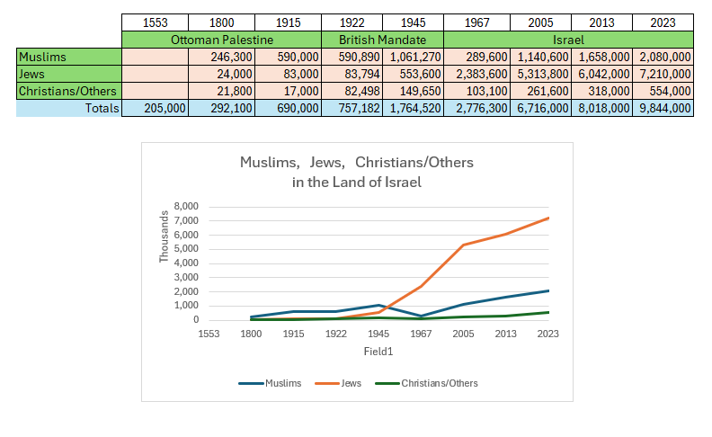

Slide 11
Preparing Israel For Their Final Restoration
Their restoration is all for God’s glory
Their new heart & spirit are from God
Their life comes when God’s Word is sent

Slide 12
Revelation 11:11
“But after the 3.5 days, the breath of life from God came into them [the Two Witnesses], & they stood on their feet, & great fear fell upon those who were watching them.”

Slide 13
Preparing Israel For Their Final Restoration
Their restoration is all for God’s glory
Their new heart & spirit are from God
Their life comes when God’s Word is sent

Slide 14
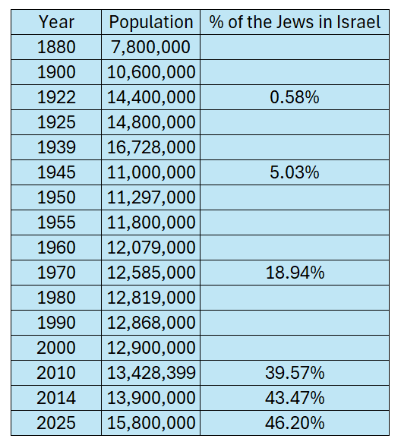
Worldwide Jewish Population
&
Their Migration Back To The Promised Land

Slide 15
Preparing Israel For Their Final Restoration
Their restoration is all for God’s glory
Their new heart & spirit are from God
Their life comes when God’s Word is sent
Their unity & peace will be everlasting

Slide 16
Joshua 18:5
“And they shall divide it into seven portions; Judah shall stay in its territory on the south, and the house of Joseph shall stay in their territory on the north.”

Slide 17
I Chronicles 5:1-2
“Now the sons of Reuben the firstborn of Israel (for he was the firstborn, but b/c he profaned his father’s bed, his birthright was given to the sons of Joseph the son of Israel; so that he is not recorded in the genealogy according to the birthright. Though Judah prevailed over his brothers, & from him came the ruler, yet the birthright belonged to Joseph).”

Slide 18
Preparing Israel For Their Final Restoration
Their restoration is all for God’s glory
Their new heart & spirit are from God
Their life comes when God’s Word is sent
Their unity & peace will be everlasting

Slide 19
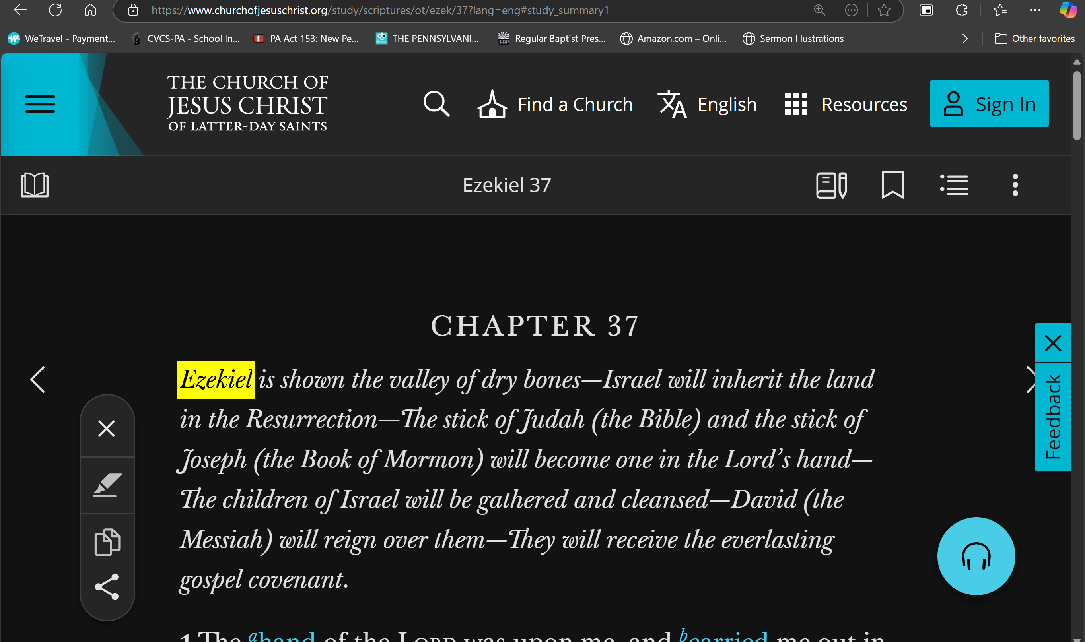

Slide 20
Preparing Israel For Their Final Restoration
Their restoration is all for God’s glory
Their new heart & spirit are from God
Their life comes when God’s Word is sent
Their unity & peace will be everlasting

Slide 21
Jeremiah 23:5-6
“Behold, the days are coming, declares Yahweh, When I will raise up for David a righteous Branch; & He will reign as king & prosper & do justice & righteousness in the land. In His days Judah will be saved, & Israel will dwell securely; & this is His name by which He will be called, ‘Yahweh our righteousness.’”

Slide 22
Preparing Israel For Their Final Restoration
Their restoration is all for God’s glory
Their new heart & spirit are from God
Their life comes when God’s Word is sent
Their unity & peace will be everlasting

