Slide 1
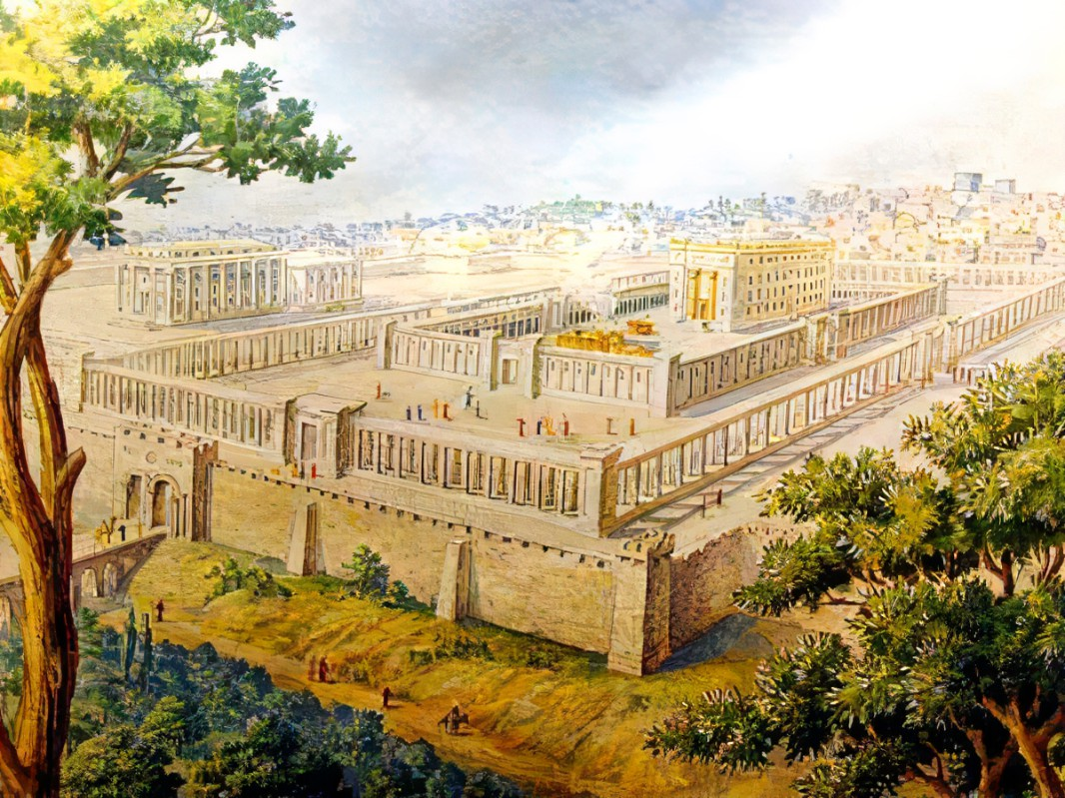


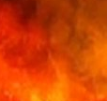
Preparing The Land To Be Fruitful
Ezekiel
The
Book of
Chapter
35:1-36:15

Slide 2
Ezekiel in 5 Sections
Ezekiel’s Commission (Chap 1-3)
Against Judah (Chap 4-24)
Against Nations (Chap 25-32)
Of Israel’s Restoration (Chap 33-39)
Of the Millennial Kingdom (Chap 40-48)

Slide 3
Ezekiel’s 4th Section:
Of Israel’s Restoration
Good Leaders Arise (Chap 33-34)
Preparing The Land For Fruitful (Chap 35-36)
Israel’s New Heart & Unified Life (Chap 36-37)
Trusting God Thru The Attacks (Chap 38-39)

Slide 4
Preparing The Land For Israel
Removing The Flesh

Slide 5
Jeremiah 1:10
“See, I have appointed you this day over the nations and over the kingdoms, to uproot and to tear down, to cause to perish and to pull down, to build and to plant.”

Slide 6
John 15:1-2 & 5
“I am the true vine, & My Father is the vine-grower. Every branch in Me that does not bear fruit, He takes away; & every branch that bears fruit, He cleans it so that it may bear more fruit… I am the vine, you are the branches; he who abides in Me & I in him, he bears much fruit, for apart from Me you can do nothing.”

Slide 7
Preparing The Land For Israel
Removing The Flesh

Slide 8
Matthew 7:1-2
“Do not judge, so that you will not be judged. For with what judgment you judge, you will be judged; & with what measure you measure, it will be measured to you.”

Slide 9
Preparing The Land For Israel
Removing The Flesh
Enduring A Season Of Preparation With Patience

Slide 10
Hebrews 12:1
“Therefore, since we have so great a cloud of witnesses surrounding us, laying aside every weight and the sin which so easily entangles us, let us run with endurance the race that is set before us.”

Slide 11
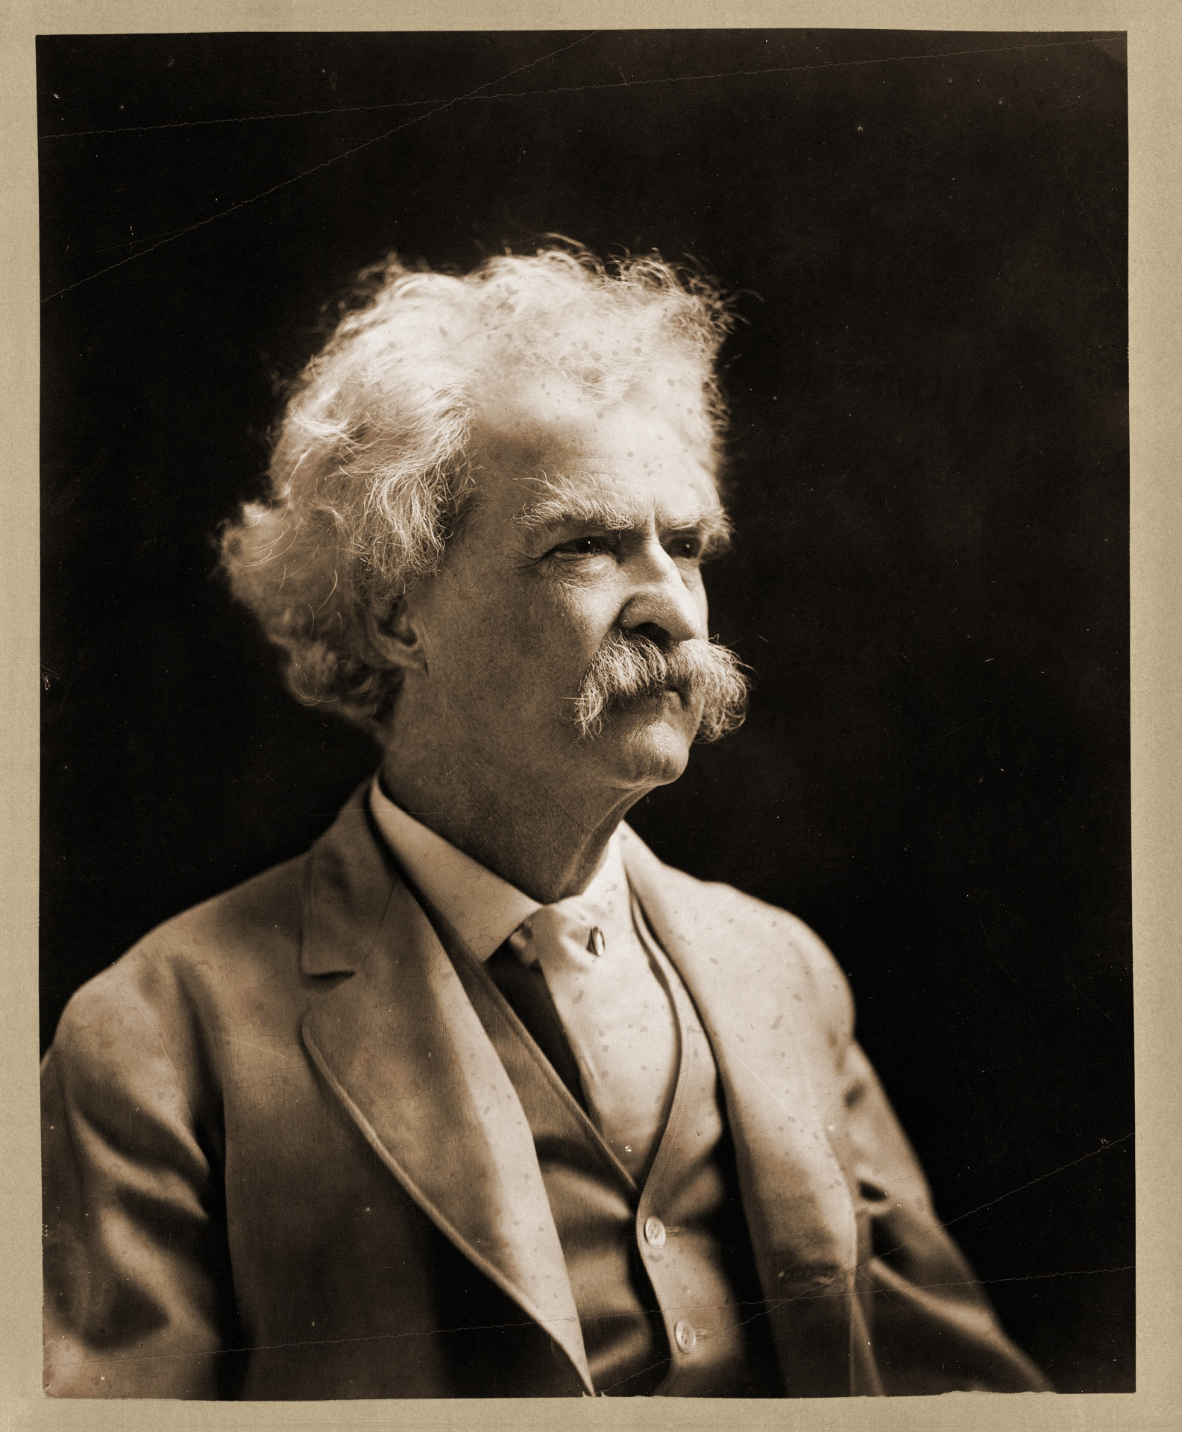
“It’s a blistering, naked & treeless land…even a goat couldn’t find something to eat”
Mark Twain
“Innocents Abroad”

Slide 12
“A desolate country whose soil is rich enough, but is given over wholly to weeds …a silent mournful expanse …a desolation …we never saw a human being on the whole route.”
Mark Twain
“Innocents Abroad”

Slide 13
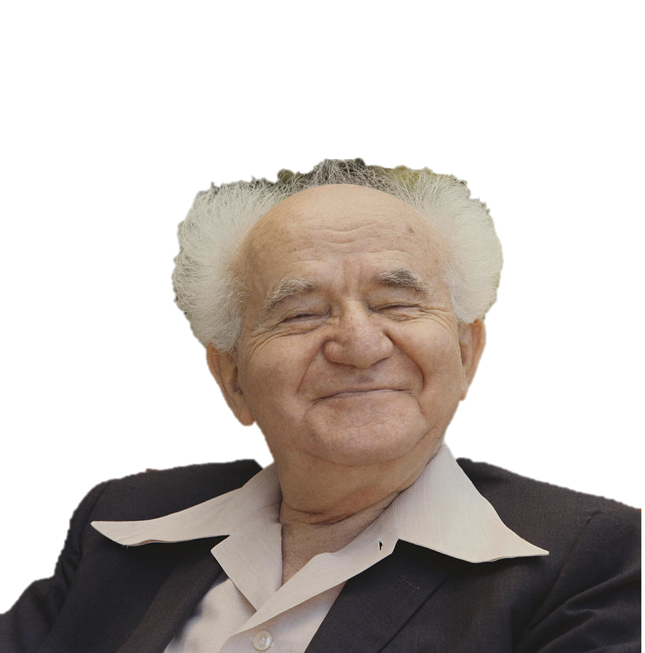
“In Israel, in order to be a realist, you must believe in miracles.”
David
Ben Gurion

Slide 14
Preparing The Land For Israel
Removing The Flesh
Enduring A Season Of Preparation With Patience

