Slide 1
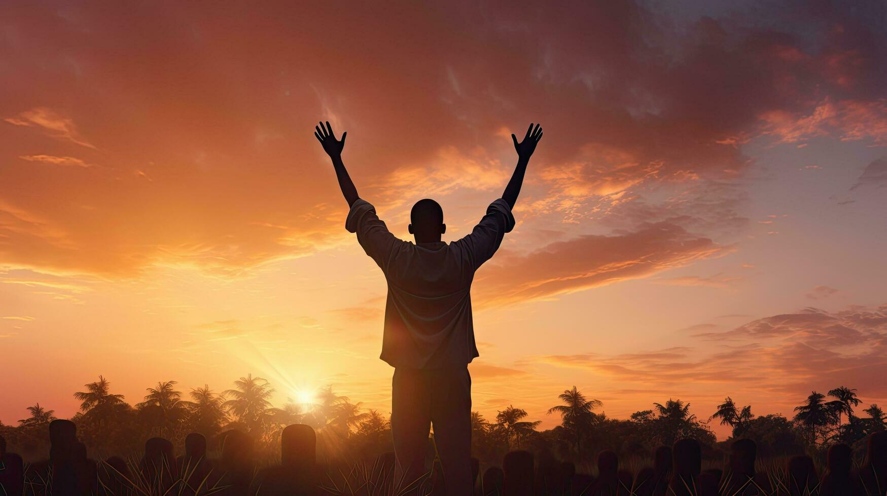

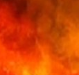
The
Psalms
75-77
Our faithful
Sovereign Warrior God

Slide 2
Thank God…
For His sovereign solutions which establishes whom He wills

Slide 3
Lamentations 3:22
“The lovingkindnesses of Yahweh indeed never cease, For His compassions never fail.”

Slide 4
Thank God…
For His sovereign solutions which establishes whom He wills

Slide 5
Revelation 14:9-10
“Then another angel, a third one, followed them, saying with a loud voice, “If anyone worships the beast & his image, & receives a mark on his forehead or on his hand, & he also will drink of the wine of the wrath of God, which is mixed in full strength in the cup of His rage, & he will be tormented w/ fire & brimstone in the presence of the holy angels & in the presence of the Lamb.”

Slide 6
Revelation 19:2
“His judgments are true & righteous; for He has judged the great harlot who was corrupting the earth with her sexual immorality, & He has avenged the blood of His slaves shed by her hand.”

Slide 7
Thank God…
For His sovereign solutions which establishes whom He wills
For His warrior will which saves the humble

Slide 8
Psalms 2:1-4
“Why do the nations rage & the peoples meditate on a vain thing? The kings of the earth take their stand & the rulers take counsel together against Yahweh & against His Anointed, saying, “Let us tear their fetters apart & cast away their cords from us!” He who sits in the heavens laughs, The Lord mocks them.”

Slide 9
Thank God…
For His sovereign solutions which establishes whom He wills
For His warrior will which saves the humble
For His potent promises which heal depression

Slide 10
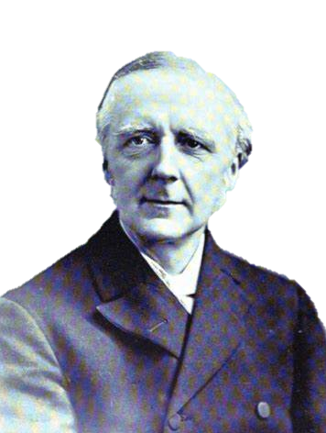
“It is well to give expression to grief, but do not lock it in your breast.”
F.B. Meyer

Slide 11
Thank God…
For His sovereign solutions which establishes whom He wills
For His warrior will which saves the humble
For His potent promises which heal depression

Slide 12
Philippians 3:13-14
“Brothers, I do not consider myself as having laid hold of it yet, but one thing I do: forgetting what lies behind & reaching forward to what lies ahead, I press on toward the goal for the prize of the upward call of God in Christ Jesus.”

Slide 13
Thank God…
For His sovereign solutions which establishes whom He wills
For His warrior will which saves the humble
For His potent promises which heal depression

Slide 14
II Corinthians 12:7-10
“B/c of the surpassing greatness of the revelations, for this reason, to keep me from exalting myself, there was given me a thorn in the flesh, a messenger of Satan to torment me—to keep me from exalting myself! Concerning this I pleaded with the Lord three times that it might leave me. (cont)

Slide 15
II Corinthians 12:7-10
(cont) “And He has said to me, “My grace is sufficient for you, for power is perfected in weakness.” Most gladly, therefore, I will rather boast in my weaknesses, so that the power of Christ may dwell in me. Therefore I am well content w/ weaknesses, w/ insults, w/ distresses, w/ persecutions & hardships, for the sake of Christ, for when I am weak, then I am strong.”

Slide 16
Thank God…
For His sovereign solutions which establishes whom He wills
For His warrior will which saves the humble
For His potent promises which heal depression

