Slide 1
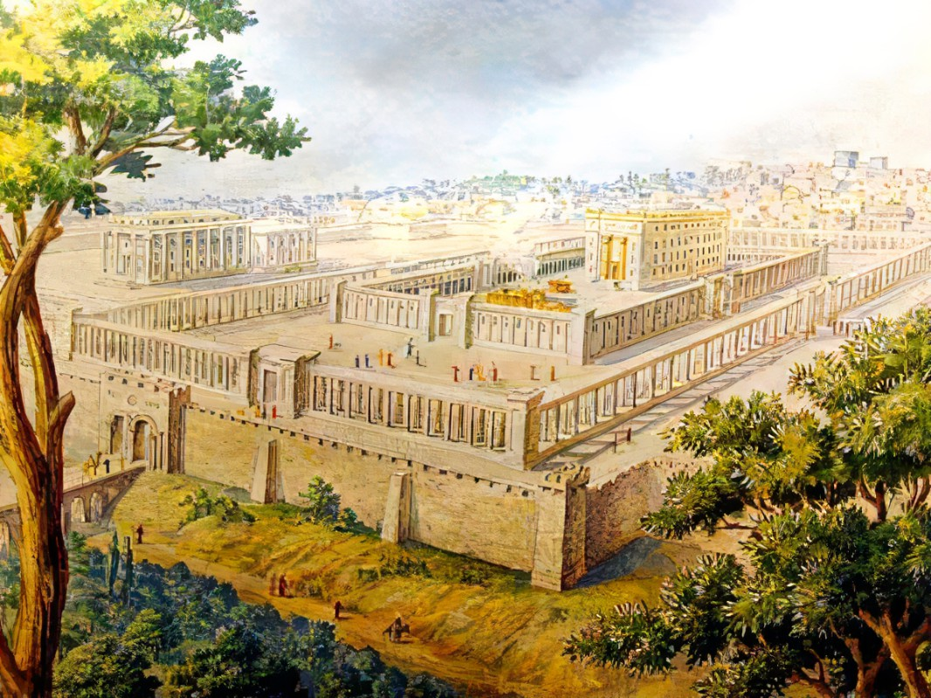


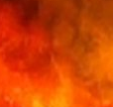
Dirigo
Ezekiel
The
Book of
Chapter
33-34

Slide 2
Ezekiel in 5 Sections
Ezekiel’s Commission (Chap 1-3)
Against Judah (Chap 4-24)
Against Nations (Chap 25-32)
Of Israel’s Restoration (Chap 33-39)
Of the Millennial Kingdom (Chap 40-48)

Slide 3
Dirigo
Ezekiel
The
Book of
Chapter
33-34

Slide 4
Dirigo: How Good Leaders Guide
We need Watchmen that teach corporate & individual responsibility

Slide 5
Colossians 1:27-28
“To whom God willed to make known what is the riches of the glory of this mystery among the Gentiles, which is Christ in you, the hope of glory. Him we proclaim, admonishing [warning] every man & teaching every man with all wisdom, so that we may present every man complete in Christ.”

Slide 6
Ezekiel 3:17
“Son of man, I have given you as a watchman to the house of Israel; so you will hear a word from My mouth, & you shall warn them from Me.”

Slide 7
Acts 20:25-27
“And now, behold, I know that all of you, among whom I went about preaching the kingdom, will no longer see my face. Therefore, I testify to you this day that I am innocent of the blood of all. For I did not shrink from declaring to you the whole purpose of God.”

Slide 8
Ezekiel 3:18-21
“When I say to the wicked, ‘You will surely die,’ & you do not warn him…that wicked man shall die in his iniquity, but his blood I will require at your hand. “Yet if you have warned the wicked & he does not turn from his wickedness…he shall die in his iniquity; but you have delivered yourself. “Again, when a righteous man turns away from his righteousness & does evil…he will die; since you have not warned him…but his blood I will require at your hand. “However, if you have warned the righteous man that the righteous should not sin & he does not sin, he shall surely live because he took warning; & you have delivered yourself.”

Slide 9
Dirigo: How Good Leaders Guide
We need Watchmen that teach corporate & individual responsibility
We need Shepherds that role-model giving and not taking

Slide 10
John 21:15
“So when they had finished breakfast, Jesus said to Simon Peter, ‘Simon, son of John, do you love Me more than these?’ He said to Him, ‘Yes, Lord; You know that I love You.’ He said to him, ‘Tend My lambs.’”

Slide 11
I Peter 5:2-4
“Shepherd the flock of God among you, overseeing not under compulsion, but willingly, according to God; & not for dishonest gain, but with eagerness; nor yet as lording it over those allotted to you, but being examples to the flock. When the Chief Shepherd appears, you will receive the unfading crown of glory.”

Slide 12
II Peter 2:1-3
“But false prophets also arose among the people, just as there will also be false teachers among you, who will secretly introduce destructive heresies, even denying the Master who bought them, bringing swift destruction upon themselves. Many will follow their sensuality, & b/c of them the way of the truth will be maligned. In their greed they will exploit you with false words, their judgment from long ago is not idle, & their destruction is not asleep.”

Slide 13
Dirigo: How Good Leaders Guide
We need Watchmen that teach corporate & individual responsibility
We need Shepherds that role-model giving and not taking

Slide 14
Zechariah 11:15-17
“Then Yahweh said to me, “Take again for yourself the equipment of a foolish shepherd. “For behold, I am going to raise up a shepherd in the land who will not care for those who face annihilation, seek the young, heal the broken, or sustain the one standing, but will consume the flesh of the fat sheep & tear off their hoofs. “Woe to the worthless shepherd who forsakes the flock! A sword will be on his arm & on his right eye! His arm will be totally dried up, & his right eye will be utterly dimmed.”

Slide 15
Dirigo: How Good Leaders Guide
We need Watchmen that teach corporate & individual responsibility
We need Shepherds that role-model giving and not taking
We need the Good Shepherd that takes full responsibility for us all

Slide 16
John 10:11 & 14
“I am the good shepherd; the good shepherd lays down His life for the sheep… I am the good shepherd, and I know My own and My own know Me.”

Slide 17
Dirigo: How Good Leaders Guide
We need Watchmen that teach corporate & individual responsibility
We need Shepherds that role-model giving and not taking
We need the Good Shepherd that takes full responsibility for us all

Slide 18
John 8:39
“They answered and said to Him, ‘Abraham is our father.’ Jesus said to them, ‘If you are Abraham’s children, you would do the deeds of Abraham.’”

Slide 19
Luke 3:8
“Therefore bear fruits in keeping with repentance, & do not begin to say to yourselves, ‘We have Abraham for our father,’ for I say to you that from these stones God is able to raise up children to Abraham.”

Slide 20
Ezekiel 20:37-38a
“I will make you pass under the rod, & I will bring you into the bond of the covenant; & I will purge from you the rebels & those who transgress against Me.”

Slide 21
Dirigo: How Good Leaders Guide
We need Watchmen that teach corporate & individual responsibility
We need Shepherds that role-model giving and not taking
We need the Good Shepherd that takes full responsibility for us all

