Slide 1
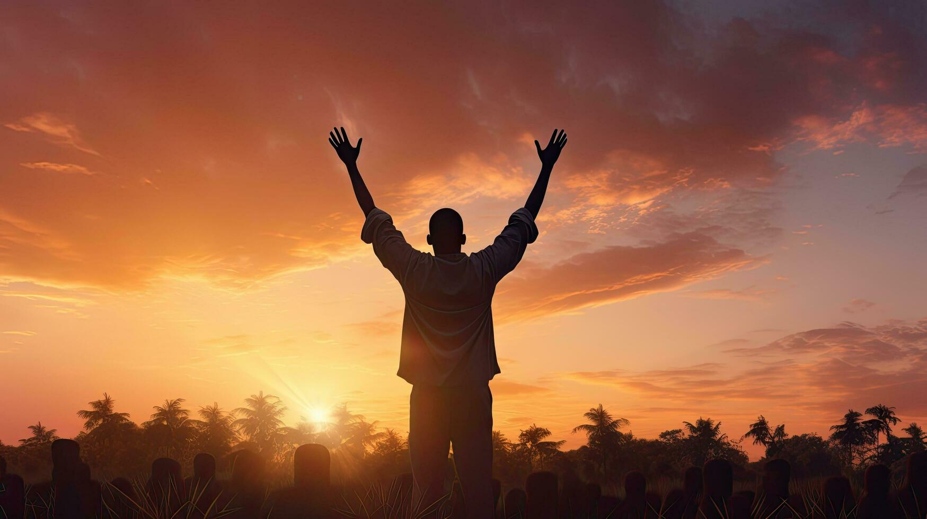


The
Psalms
73-74
The Sanctuary Of Purpose

Slide 2
The Sanctuary of Purpose
Don’t Focus on the Sinners

Slide 3
Psalm 24:3-4
“Who may ascend into the mountain of Yahweh? Who may rise in His holy place? He who has innocent hands & a pure heart, Who has not lifted up his soul to worthlessness & has not sworn deceitfully.”

Slide 4
Psalm 51:10
“Create in me a clean heart, O God, & renew a steadfast spirit within me.”

Slide 5
Matthew 5:8
“Blessed are the pure in heart, for they shall see God.”

Slide 6
The Sanctuary of Purpose
Don’t Focus on the Sinners
Don’t Focus on Self

Slide 7
I Peter 5:7
“Casting all your anxiety on Him, because He cares for you.”

Slide 8
The Sanctuary of Purpose
Don’t Focus on the Sinners
Don’t Focus on Self
Focus on the Savior
Then we’re Forever Satisfied
*Expect attacks & damage*
*Bring continual rededication*

