Slide 1
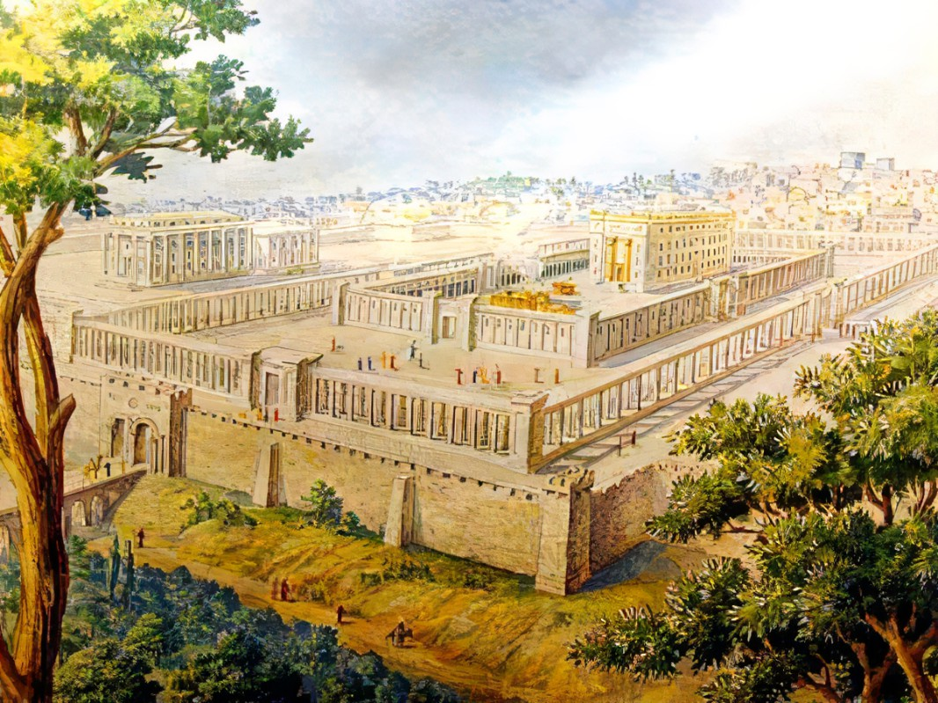


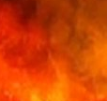
Defining
Egypt’s Defiance
Ezekiel
The
Book of
Chapter
29-32

Slide 2
Ezekiel in 5 Sections
Ezekiel’s Commission (Chap 1-3)
Against Judah (Chap 4-24)
Against Nations (Chap 25-32)
Of Israel’s Restoration (Chap 33-39)
Of the Millennial Kingdom (Chap 40-48)

Slide 3
Defining
Egypt’s Defiance
Ezekiel
The
Book of
Chapter
29-32

Slide 4
Defining Egypt’s Defiance
The Problem: Pride is thinking you’re the source, sustainer & object of your prosperity
The Method: God restrains evil… until He doesn’t

Slide 5
Matthew 24:22
“And unless those days had been cut short, no life would have been saved; but for the sake of the elect those days will be cut short.”

Slide 6
Defining Egypt’s Defiance
The Problem: Pride is thinking you’re the source, sustainer & object of your prosperity
The Method: God restrains evil… until He doesn’t
The Challenge: Who is your role-model?
The Solution: Agree w/ God’s assessment of things

Slide 7
Revelation 3:17
“Because you say, “I am rich, & have become wealthy, & have need of nothing,” & you do not know that you are wretched & pitiable & poor & blind & naked.”

Slide 8
Defining Egypt’s Defiance
The Problem: Pride is thinking you’re the source, sustainer & object of your prosperity
The Method: God restrains evil… until He doesn’t
The Challenge: Who is your role-model?
The Solution: Agree w/ God’s assessment of things

