Slide 1
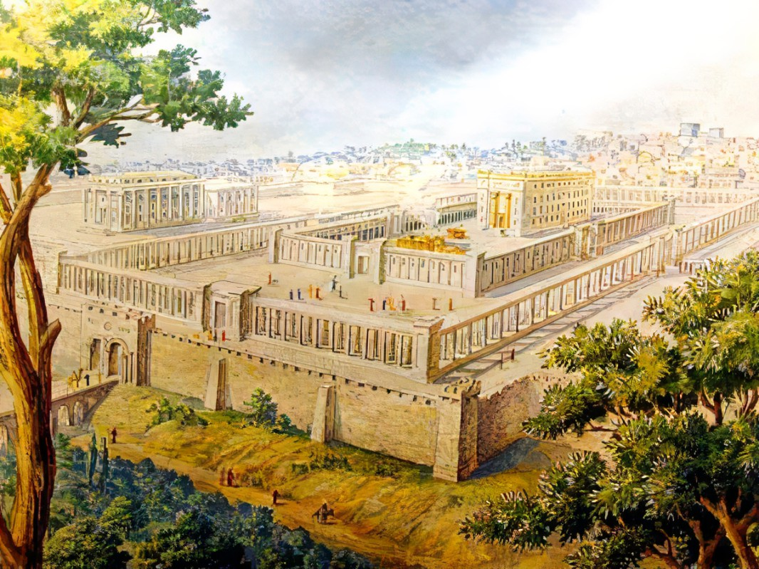



Symbolically Led To Reality
Ezekiel
The
Book of
Chapter
4-5

Slide 2
Ezekiel in 5 Sections
Ezekiel’s Commission (Chap 1-3)
Against Judah (Chap 4-24)
Against Nations (Chap 25-32)
Of Israel’s Restoration (Chap 33-39)
Of the Millennial Kingdom (Chap 40-48)

Slide 3
Symbolically Led To Reality
Lying Down: We see judgement’s length

Slide 4
Jeremiah 25:11
“This whole land will be a waste place & an object of horror, & these nations will serve the king of Babylon seventy years.”

Slide 5
Jeremiah 29:10
“For thus says Yahweh, ‘When seventy years have been fulfilled for Babylon, I will visit you & establish My good word to you, to return you to this place.”

Slide 6
The Ezekiel 4 Prophecy
Jeremiah Predicts 70 year punishment
II Chronicles 36:21 says – Babylonian Captivity IS fulfillment of Jeremiah
Ezekiel Predicts 430 year punishment
70
430 years
536 BC
605 BC

Slide 7
Nehemiah 1:8
“Remember the word which You commanded Your servant Moses, saying, ‘If you are unfaithful, I will scatter you among the peoples.”

Slide 8
Nehemiah 13:17-18
“Then I contended with the nobles of Judah & said to them, “What is this evil thing you are doing, even profaning the sabbath day? Did not your fathers do the same, so our God brought on us & on this city all this calamity? Yet you are adding to His anger on Israel by profaning the sabbath.”

Slide 9
Malachi 2:2
“If you do not listen, & if you do not set it upon your heart to give honor to My name,” says Yahweh of hosts, “then I will send the curse upon you, & I will curse your blessings; & indeed, I have cursed them already because you are not setting it upon your heart.”

Slide 10
The Ezekiel 4 Prophecy
Jeremiah Predicts 70 year punishment
II Chronicles 36:21 says – Babylonian Captivity IS fulfillment of Jeremiah
Ezekiel Predicts 430 year punishment
70
430 years
536 BC Israel is still rebellious, therefore Leviticus 26 applies
536 BC
Convert to 365.25 day years & add 1 year (no year 0) 1948 AD
605 BC
Daniel & Nehemiah agree - Babylonian Captivity IS the curse of Lev 26
Remaining 360 years x 7 = 2520 years

Slide 11
Symbolically Led To Reality
Lying Down: We see judgement’s length
Cooking Food: We see judgement’s embarrassment
A Mourning Shave: We see judgement’s depth

