Slide 1
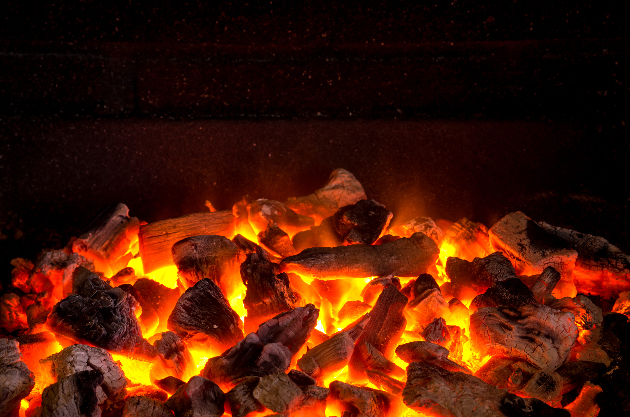

The
Book
Isaiah
The Enemy Without & Within
OF
Chapter 36-39

Slide 2

“Tactics of the Enemy as seen in Hezekiah”
Enemy attacks w/ lies & temporary bribes

Slide 3
Proverbs 26:4-5
“Answer not a fool according to his folly, lest thou also be like unto him. Answer a fool according to his folly, lest he be wise in his own conceit.”

Slide 4
“Tactics of the Enemy as seen in Hezekiah”
Enemy attacks w/ lies & temporary bribes
Enemy persists until God assists

Slide 5
I Peter 5:6-7
“Humble yourselves therefore under the mighty hand of God, that He may exalt you in due time: Casting all your care upon Him; for He careth for you.”

Slide 6
Isaiah 10:15
“Shall the axe boast itself against him that heweth therewith? or shall the saw magnify itself against him that shaketh it? as if the rod should shake itself against them that lift it up, or as if the staff should lift up itself, as if it were no wood.”

Slide 7
“Tactics of the Enemy as seen in Hezekiah”
Enemy attacks w/ lies & temporary bribes
Enemy persists until God assists
Enemy within > enemy without

Slide 8
Philippians 1:21-23
“For to me to live is Christ, & to die is gain. But if I live in the flesh, this is the fruit of my labour: yet what I shall choose I wot not. For I am in a strait betwixt two, having a desire to depart, & to be with Christ; which is far better.”

Slide 9
“Tactics of the Enemy as seen in Hezekiah”
Enemy attacks w/ lies & temporary bribes
Enemy persists until God assists
Enemy within > enemy without

Slide 10
I Kings 10:1, 4-6
“When the Queen of Sheba heard of the fame of Solomon concerning the name of the LORD, she came to prove him w/ hard questions…. and when the queen of Sheba had seen all Solomon's wisdom, & the house that he had built, & the meat of his table… & his cupbearers, & his ascent by which he went up unto the house of the LORD; there was no more spirit in her. She said to the king, It was a true report that I heard in mine own land of thy acts & of thy wisdom.”

Slide 11
“Tactics of the Enemy as seen in Hezekiah”
Enemy attacks w/ lies & temporary bribes
Enemy persists until God assists
Enemy within > enemy without

