Slide 1


God’s Word Luke 22:35-71

Slide 2

Our Heart Revealed in the Moment of Truth
Is our heart set on serving God?

Slide 3
John 3:36
“He that believeth on the Son hath everlasting life: & he that believeth not the Son shall not see life; but the wrath of God abideth on him.”

Slide 4
I Thessalonians 5:9
“For God hath not appointed us to wrath, but to obtain salvation by our Lord Jesus Christ.”

Slide 5

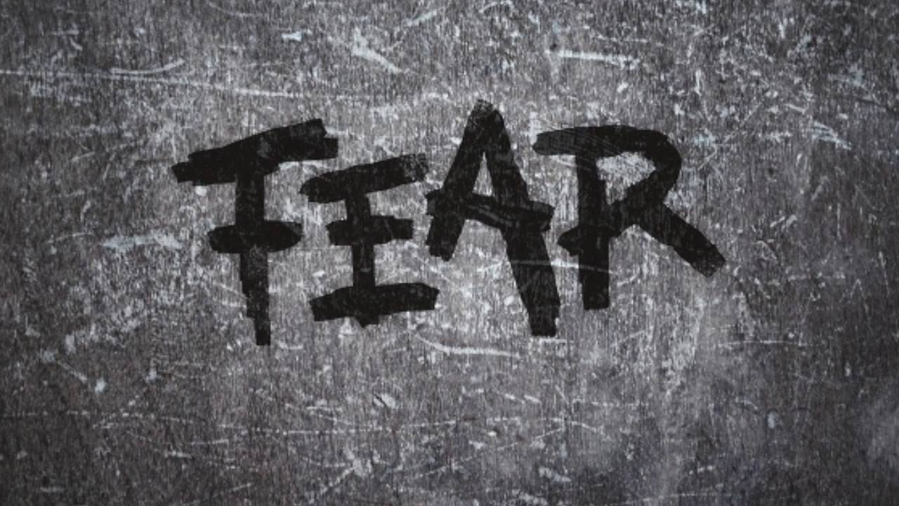
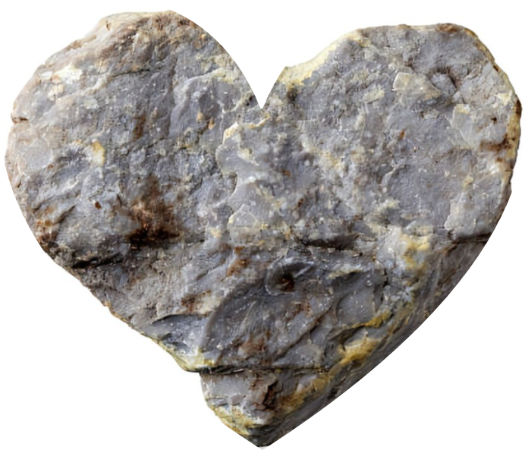
Our Heart Revealed in the Moment of Truth
Is our heart set on serving God?
Is our heart set on serving people?
Is our heart set on fear of what might happen?
Is our heart set in stone unwilling to be humbled?

Slide 6
Isaiah 52:14
“As many were astonied at Thee; His visage was so marred more than any man, & His form more than the sons of men.”

Slide 7
Our Heart Revealed in the Moment of Truth
Is our heart set on serving God?
Is our heart set on serving people?
Is our heart set on fear of what might happen?
Is our heart set in stone unwilling to be humbled?

