Slide 1
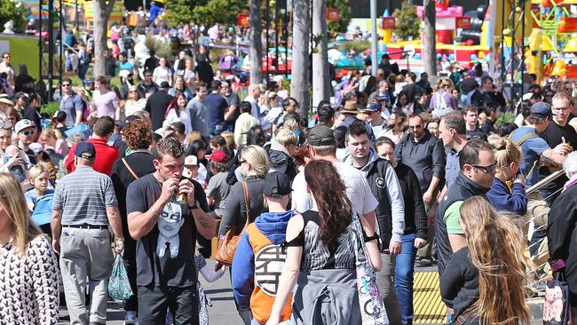

Intoxicated
God’s Word
Luke 17:20-37
With
NORMALCY

Slide 2

The Kingdom of God
Intoxicated
With
is not normal
NORMALCY
The Kingdom isn’t found geographically, but is found within a new heart

Slide 3
John 3:8
“The wind bloweth where it listeth, and thou hearest the sound thereof, but canst not tell whence it cometh, and whither it goeth: so is every one that is born of the Spirit.”

Slide 4
The Kingdom of God
Intoxicated
With
is not normal
NORMALCY
The Kingdom isn’t found geographically, but is found within a new heart

Slide 5
I Corinthians 2:14
“But the natural man receiveth not the things of the Spirit of God: for they are foolishness unto him: neither can he know them, because they are spiritually discerned.”

Slide 6
Zechariah 9:14-17a
“The LORD shall be seen over them, & His arrow shall go forth as the lightning: & the Lord GOD shall blow the trumpet, & shall go with whirlwinds of the south. The LORD of hosts shall defend them; & they shall devour, & subdue with sling stones; & they shall drink, & make a noise as through wine; & they shall be filled like bowls, & as the corners of the altar. the LORD their God shall save them in that day as the flock of His people: for they shall be as the stones of a crown, lifted up as an ensign upon His land. For how great is His goodness, & how great is His beauty!”

Slide 7
The Kingdom of God
Intoxicated
With
is not normal
NORMALCY
The Kingdom isn’t found geographically, but is found within a new heart
The Kingdom isn’t founded on a conquering king but on a suffering Messiah
The Kingdom doesn’t culminate slowly over time but with a sudden totality

Slide 8
Genesis 6:5
“And GOD saw that the wickedness of man was great in the earth, and that every imagination of the thoughts of his heart was only evil continually.”

Slide 9
Matthew 13:15-17
“For this people's heart is waxed gross, & their ears are dull of hearing, & their eyes they have closed; lest at any time they should see with their eyes, & hear with their ears, & should understand with their heart, & should be converted, & I should heal them. But blessed are your eyes, for they see: & your ears, for they hear. For verily I say unto you, that many prophets & righteous men have desired to see those things which ye see, & have not seen them; & to hear those things which ye hear, & have not heard them.”

Slide 10
The Kingdom of God
Intoxicated
With
is not normal
NORMALCY
The Kingdom isn’t found geographically, but is found within a new heart
The Kingdom isn’t founded on a conquering king but on a suffering Messiah
The Kingdom doesn’t culminate slowly over time but with a sudden totality

Slide 11
Ezekiel 16:49
“Behold, this was the iniquity of thy sister Sodom, pride, fulness of bread, & abundance of idleness was in her & in her daughters, neither did she strengthen the hand of the poor & needy.”

Slide 12
The Kingdom of God
Intoxicated
With
is not normal
NORMALCY
The Kingdom isn’t found geographically, but is found within a new heart
The Kingdom isn’t founded on a conquering king but on a suffering Messiah
The Kingdom doesn’t culminate slowly over time but with a sudden totality
The Kingdom divides those ‘under the sun’ from those ‘in the Son’

