Slide 1

Grateful For Restoration
God’s Word
Luke 17:1-19

Slide 2
Levels of restoration
LEVEL #1: We recognize that there is a means to restore a sinner & restore fellowship

Slide 3
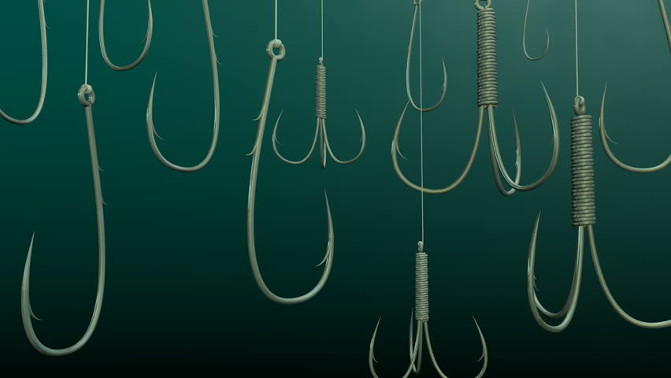
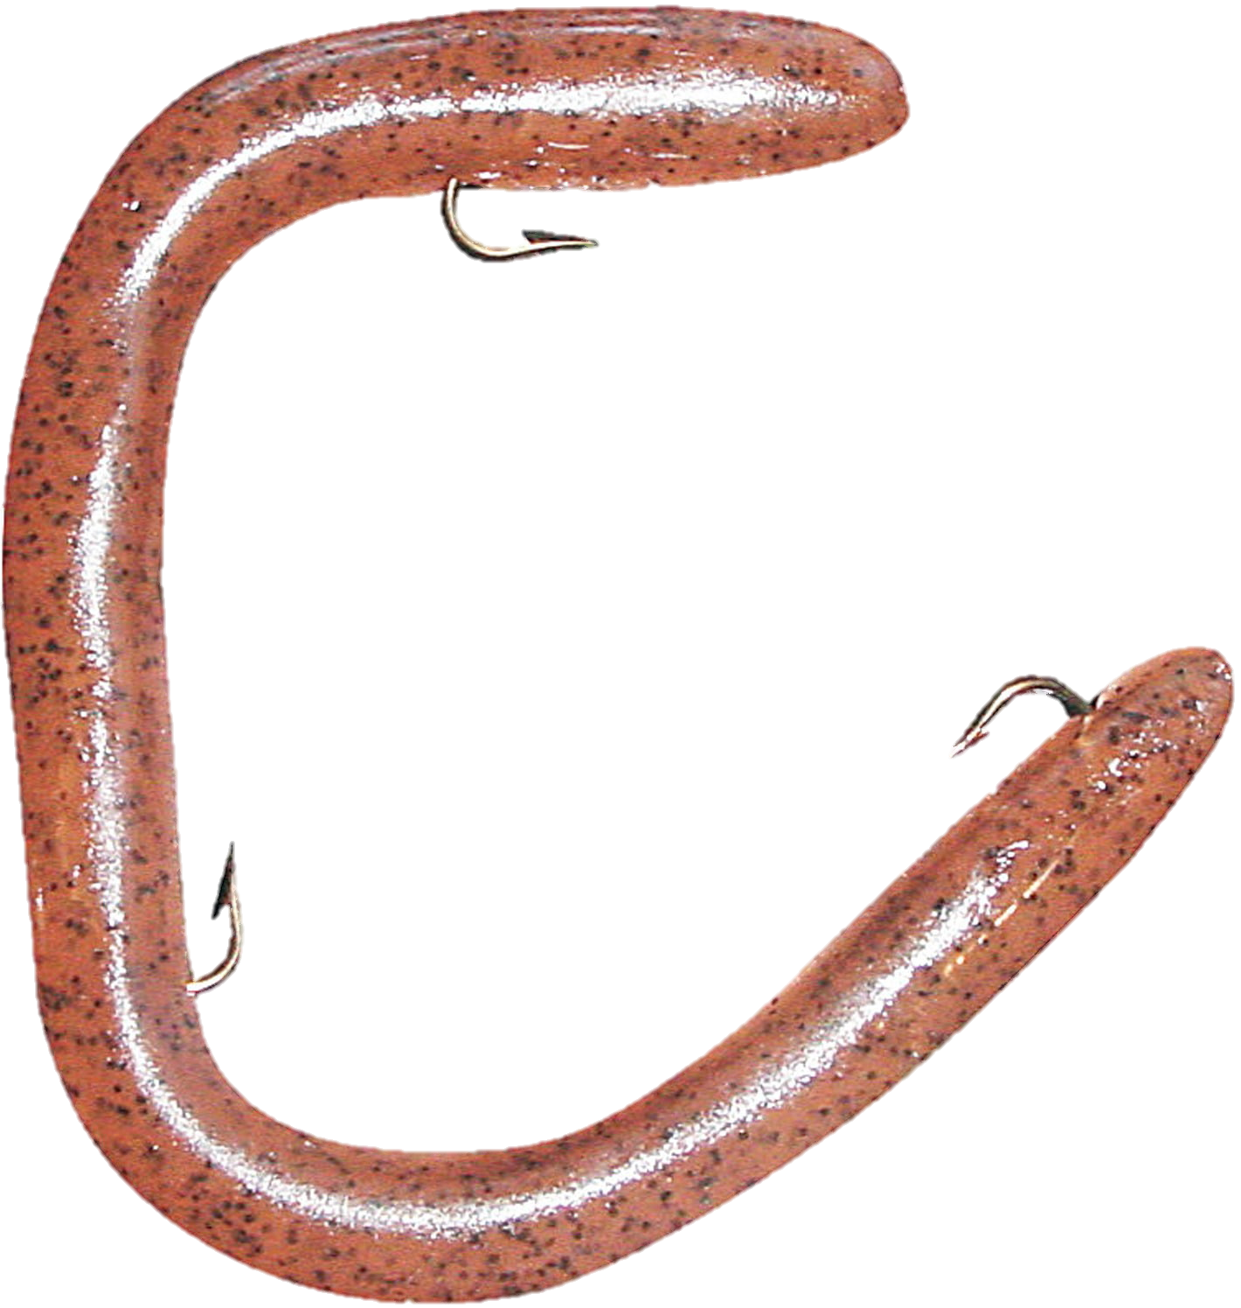
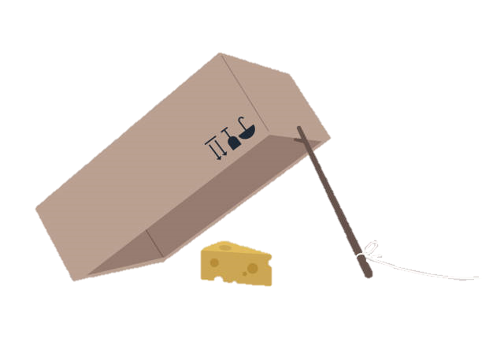

Slide 4
Levels of restoration
LEVEL #1: We recognize that there is a means to restore a sinner & restore fellowship

Slide 5
Matthew 18:21-22
“Then came Peter to Him, & said, Lord, how oft shall my brother sin against me, & I forgive him? till seven times? Jesus saith unto him, I say not unto thee, until seven times: but, until seventy times seven.”

Slide 6
Levels of restoration
LEVEL #1: We recognize that there is a means to restore a sinner & restore fellowship

Slide 7
Mark 4:31-32
“It is like a grain of mustard seed, which, when it is sown in the earth, is less than all the seeds that be in the earth: but when it is sown, it groweth up, & becometh greater than all herbs, & shooteth out great branches; so that the fowls of the air may lodge under the shadow of it.”

Slide 8
Levels of restoration
LEVEL #1: We recognize that there is a means to restore a sinner & restore fellowship
LEVEL #2: We willingly serve together
LEVEL #3: We become grateful for our position in Christ

Slide 9
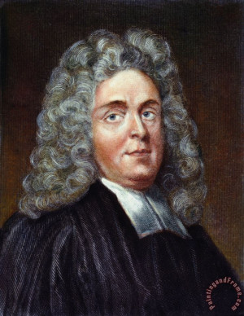
Matthew Henry …after being robbed
I am thankful…
I’ve never been robbed before
Though they took my wallet, they didn’t take my life
Though they took my wallet, it wasn’t very much
That I was the one robbed & not the one doing the robbing

Slide 10
Levels of restoration
LEVEL #1: We recognize that there is a means to restore a sinner & restore fellowship
LEVEL #2: We willingly serve together
LEVEL #3: We become grateful for our position in Christ

Slide 11
Tips for being grateful (Generalizing Matthew Henry’s comments)
I am thankful that this current hardship…
Doesn’t happen all the time
Could have cost me more
Hasn’t cost me that much
Isn’t because of my own sin

