Slide 1

Choosing Foresight Over Eyesight
God’s Word
Luke 16

Slide 2
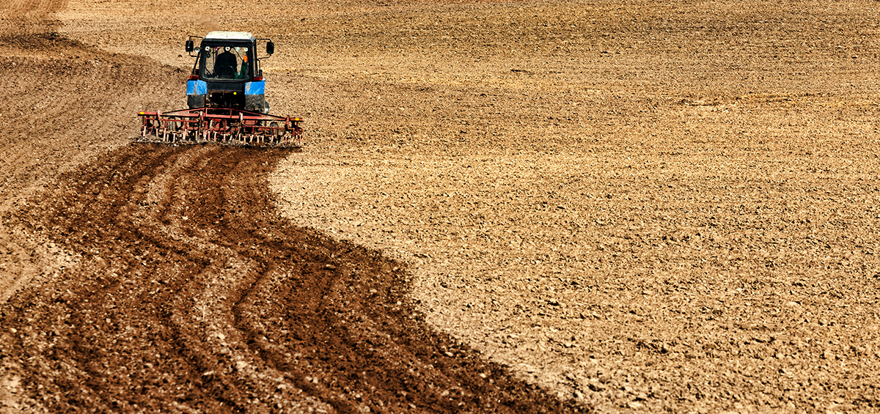
Choosing Foresight Over Eyesight
We’re prudent in using our resources for the next phase of life – eternity

Slide 3
We’ll all give an account
Romans
14:12
We’ll give an account of ourselves
II Corinthians
5:10
We’ll receive for little or much
Matthew
12:36
We’ll give an account of every idle word
Believers and Non-believers, all give an account
I Peter
4:5

Slide 4
Choosing Foresight Over Eyesight
We’re prudent in using our resources for the next phase of life – eternity

Slide 5


“There be 4 things which are little upon the earth, but they are exceeding wise: The ants are a people not strong, yet they prepare their meat in the summer.”
Proverbs 30:24-25

Slide 6
Choosing Foresight Over Eyesight
We’re prudent in using our resources for the next phase of life – eternity
We’re clear regarding whom we serve

Slide 7
“Not that we are sufficient of ourselves to think any thing as of ourselves; but our sufficiency is of God.”
II Corinthians 3:5

Slide 8
Choosing Foresight Over Eyesight
We’re prudent in using our resources for the next phase of life – eternity
We’re clear regarding whom we serve
We’re faithful to believe all of God’s Word

