Slide 1

“Learning to see what the Father is doing”
Pastor Ed McGlasson

Slide 2
Just say the word
Go and heal that doctor

Slide 3
“For the sake of Christ, then, I am content with weaknesses, insults, hardships, persecutions, and calamities. For when I am weak, then I am strong.”
2 Cor. 12:10 ESV

Slide 4
When our identity is parked in our giftedness, our identity can turn towards our gifts and keep us from discovering our true identity.

Slide 5
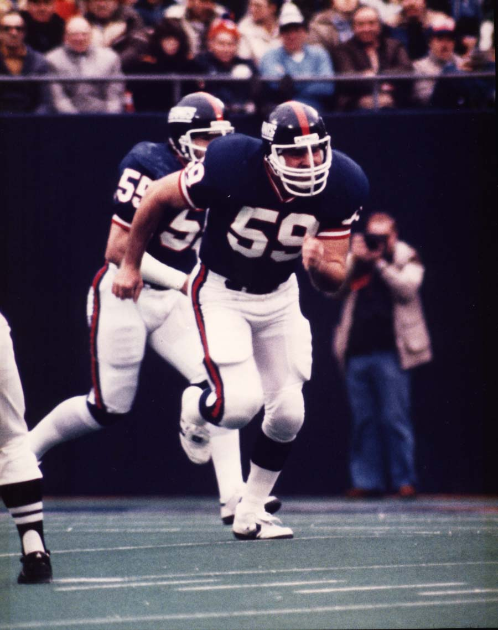
I was trained to be a champion and win
Wimber – “I didn’t think you would make it ministry”

Slide 6
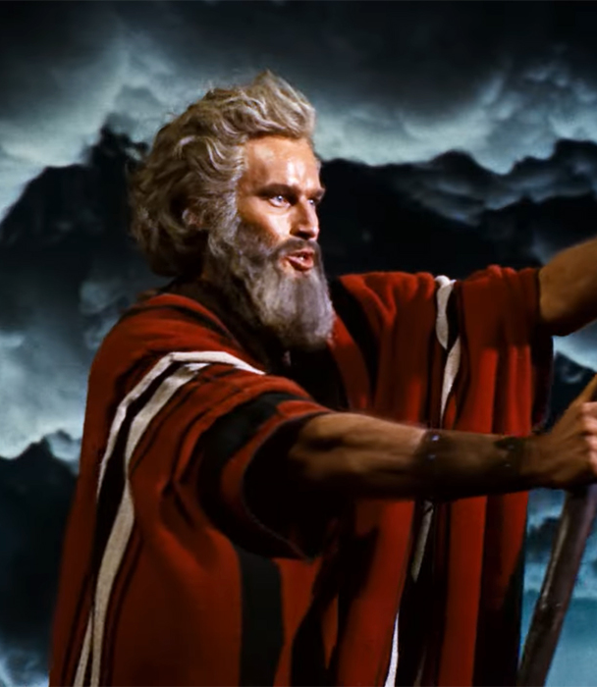
“Triple the anointing of Elijah?” ☹

Slide 7
“Truly, I say to you, among those born of women there has arisen no one greater than John the Baptist. Yet the one who is least in the kingdom of heaven is greater than he.”
Matt. 11:11 ESV

Slide 8
“As Jesus passed on from there, he saw a man called Matthew sitting at the tax booth, and he said to him, “Follow me.” And he rose and followed him.”
(Matt. 9:9 ESV).

Slide 9
Imagine being able to see what the Father is doing all around you everyday and doing it with Him
Larry Myers Wedding

Slide 10
“This resurrection life you received from God is not a timid, grave-tending life. It’s adventurously expectant, greeting God with a childlike ‘What’s next, Papa?’”
Rom. 8:15 The Message

Slide 11
“Until now you have asked nothing in my name. Ask, and you will receive, that your joy may be full. “I have said these things to you in figures of speech. The hour is coming when I will no longer speak to you in figures of speech but will tell you plainly about the Father.
John 16:24–275ESV

Slide 12
In that day you will ask in my name, and I do not say to you that I will ask the Father on your behalf; for the Father himself loves you, because you have loved me and have believed that I came from God.”
John 16:26–27 ESV

Slide 13
When the core of our identity is in being a son or daughter and being loved by the Father the way Jesus was, our eyes will be open to see what the Father is doing.

Slide 14
“Jesus said to them, “Truly, truly, I say to you, the Son can do nothing of his own accord, but only what he sees the Father doing. For whatever the Father does, that the Son does likewise.” (John 5:19)

Slide 15
“For the Father loves the Son and shows him all that he himself is doing. And greater works than these will he show him, so that you may marvel.” (John 5:20 ESV)

Slide 16
My Prayer changed from, anoint me to do this to: Father, show me what you are doing

Slide 17
Being fathered by God will:
Change the way you see yourself.
Connect you to his love and presence.
Open your eyes to see what the Father is doing around you.

Slide 18
Jesus asked questions of His disciples instead of just giving them answers, I wondered if that’s how the Father spoke to Him?

Slide 19
In the Gospels, Jesus asks 307 questions. He is asked 183 of which he only answers 3. Asking questions was central for Jesus learning to see and hear what the Father is doing

Slide 20
Could it be that when Jesus was a young boy, the Father asked Him questions, drawing Him to scripture, so that He could fully discover who He was?

Slide 21
Father show me what you are doing:
With my wife?
With my Kids?

Slide 22
“Now when all the people were baptized, and when Jesus also had been baptized and was praying, the heavens were opened

Slide 23
and the Holy Spirit descended on him in bodily form, like a dove; and a voice came from heaven, “You are my beloved Son; with you I am well pleased.” (Luke 3:21–22 ESV)

Slide 24
Jesus prayed, Two prayers
COME HOLY SPIRIT AND FILL ME WITH YOUR POWER

Slide 25
Jesus prayed, Two prayers
FATHER, REVEAL YOUR LOVE TO ME AS YOUR SON

Slide 26
“And along with the Spirit, a voice: “This is my Son, chosen and marked by my love, delight of my life.” (Matt. 3:17 MESSAGE)

Slide 27
Let’s bless our Kids

Slide 28


Slide 29


Slide 30

Jesus answered, “I am the way, and the truth, and the life.
No one comes to the Father except through Me… Anyone who has seen Me has seen the Father.”
The Next Step:
John 14:6,9

Slide 31
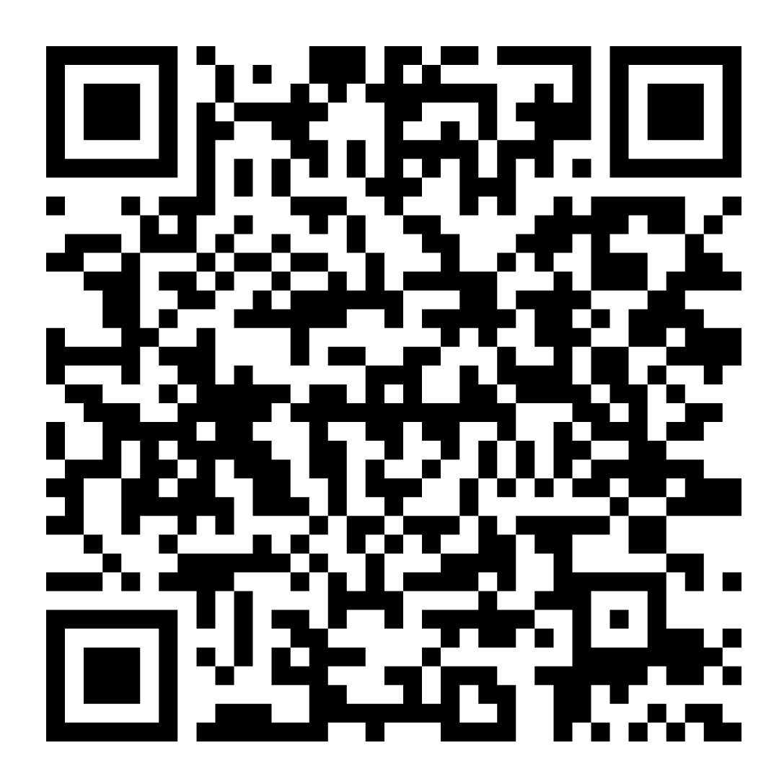
Scan Me =>
For Free
Access

Slide 32


