Slide 1


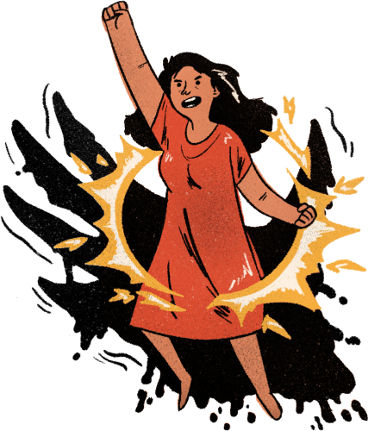
Peer Pressure
and Influence
Week 8

Slide 2
Let’s practice Psalms 91

Slide 3
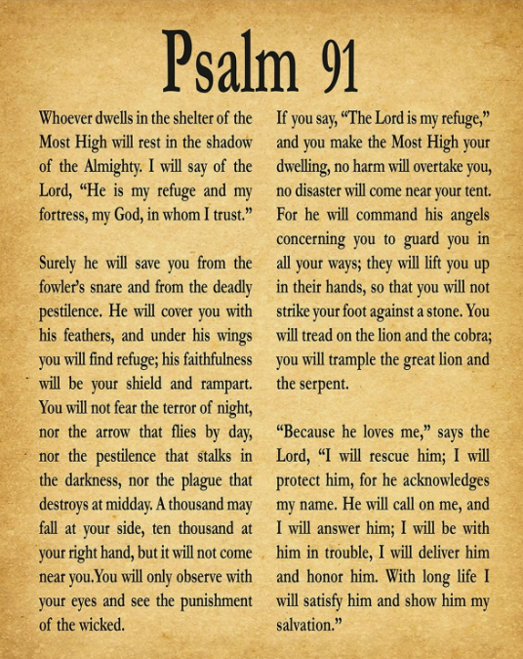
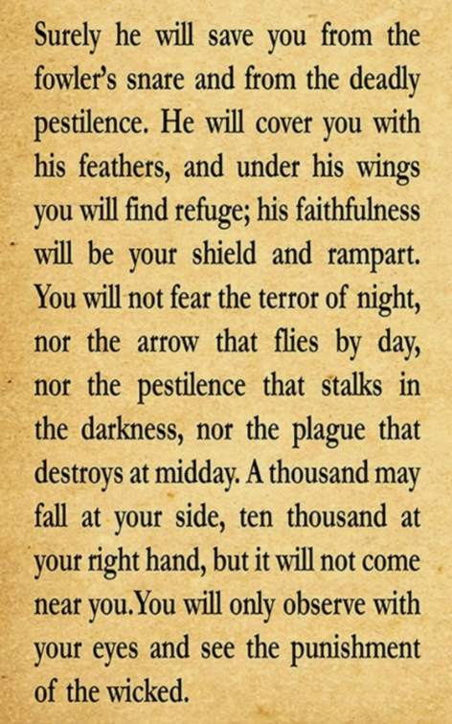
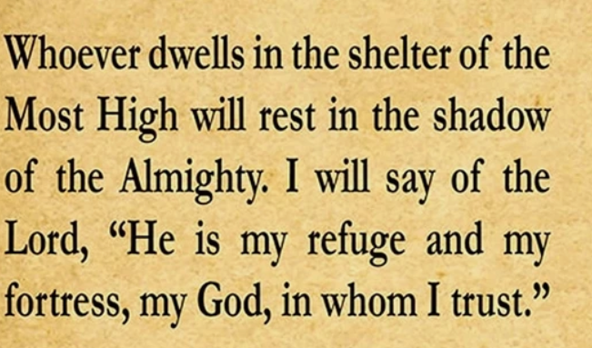


Slide 4
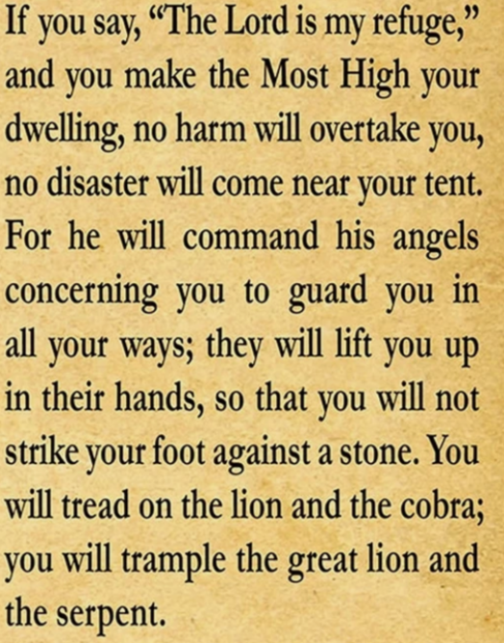
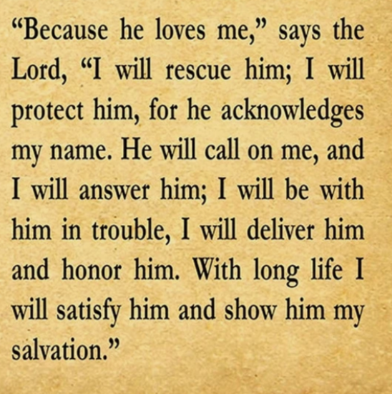

Slide 5
1 Corinthians 15:33
"Do not be misled: 'Bad company corrupts good character.'"

Slide 6
Focus
Making safe choices often means standing up to negative peer pressure.

Slide 7
Discussion Questions
1.What types of peer pressure have you faced?
2.How can faith guide your choices when friends are doing wrong?
3.What are positive ways to influence others?

Slide 8
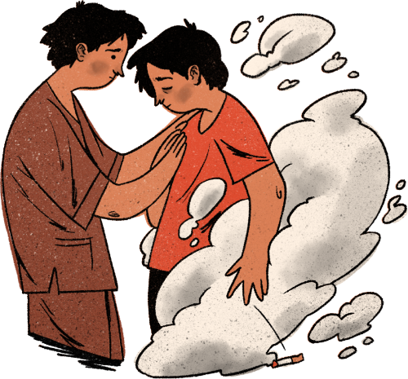
Self Esteem
When you believe in yourself, you're less likely to seek validation from others.

Slide 9
Identity in Christ
When you know who you are in Christ you won’t feel the need to have the approval from others.

Slide 10
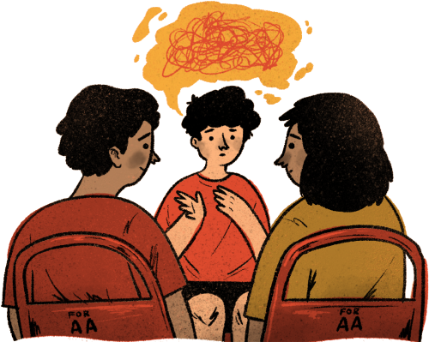
Practice Assertiveness
Learn to express your thoughts and feelings in a clear, respectful, and assertive manner.

Slide 11
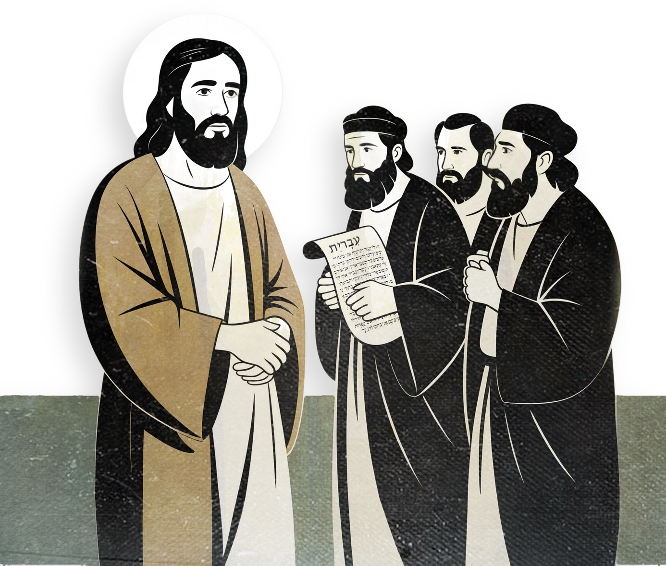
Jesus talks to Leaders
When Jesus talked to the pharasees and scribes He spoke the truth to them. He wasn’t pressured!

Slide 12
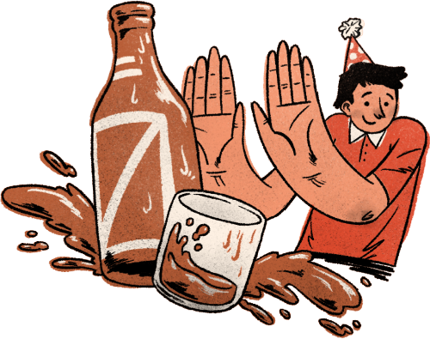
Practice Saying "No"
Being able to say "no" without being too aggressive or passive is crucial.

Slide 13
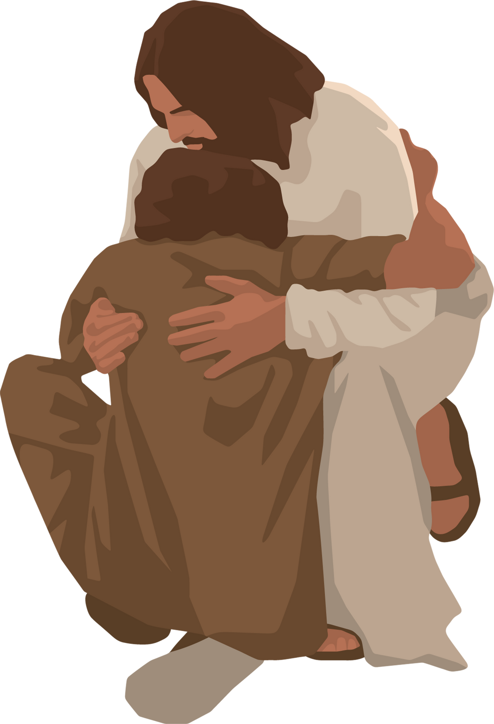
A Woman Caught in Adultery
When they brought the woman to Jesus they wanted to stone her but how did Jesus handle it?
John 8:1-11

Slide 14
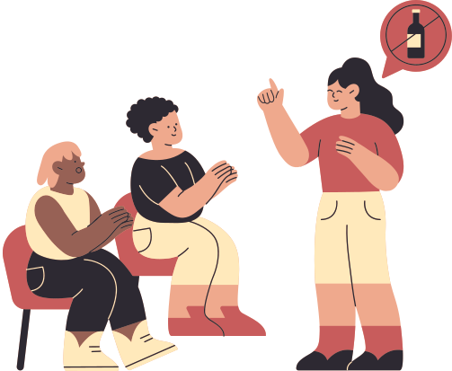
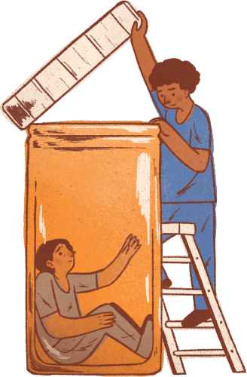
Say “NO” to drugs, alcohol and inappropriate touches.
Drugs and alcohol distort the mind, offering temporary pleasure that fades quickly—much like sin.

Slide 15
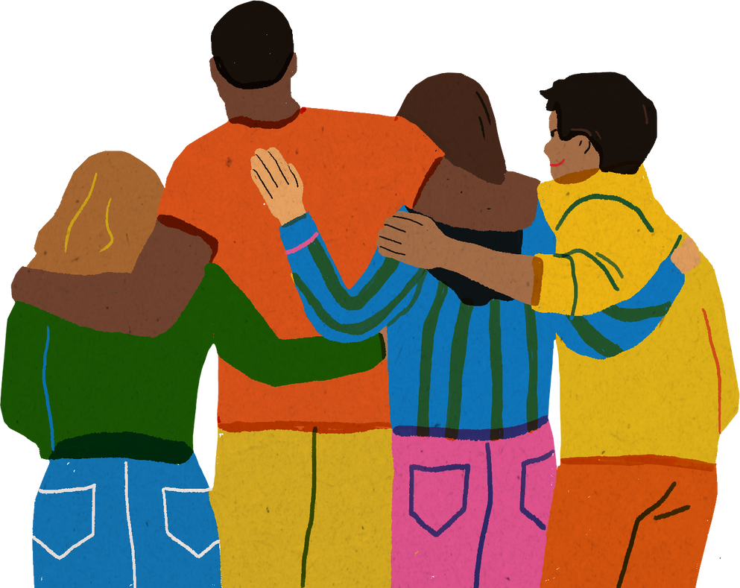
Choose the Right Friends
Surround yourself with people who share your values and respect your boundaries.

Slide 16
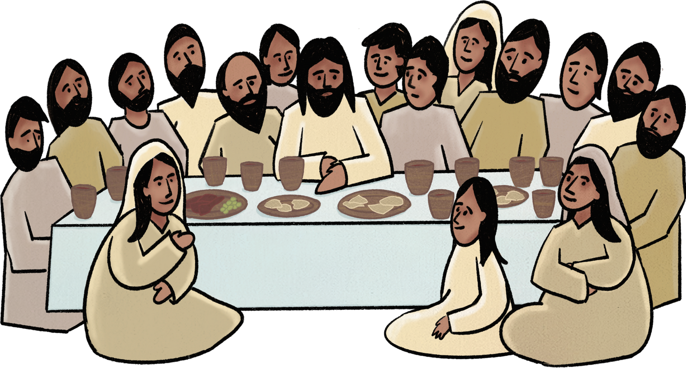
Jesus had friends
Jesus had many friends, including his close inner circle of Peter, James, and John, his very close friends in Bethany like Mary, Martha, and Lazarus,

Slide 17
Remember what we learned in this series: Safe in God’s Hands
God is our protector but we must choose to use wisdom in situations! The world wants us to do bad things. We are going to be different and we won’t fit in with the world if we are following Jesus!! Like Jesus we must stay close to God!
Also we can help our friends not fall into peer pressure. We are called to do great things for God even when we’re young!

Slide 18
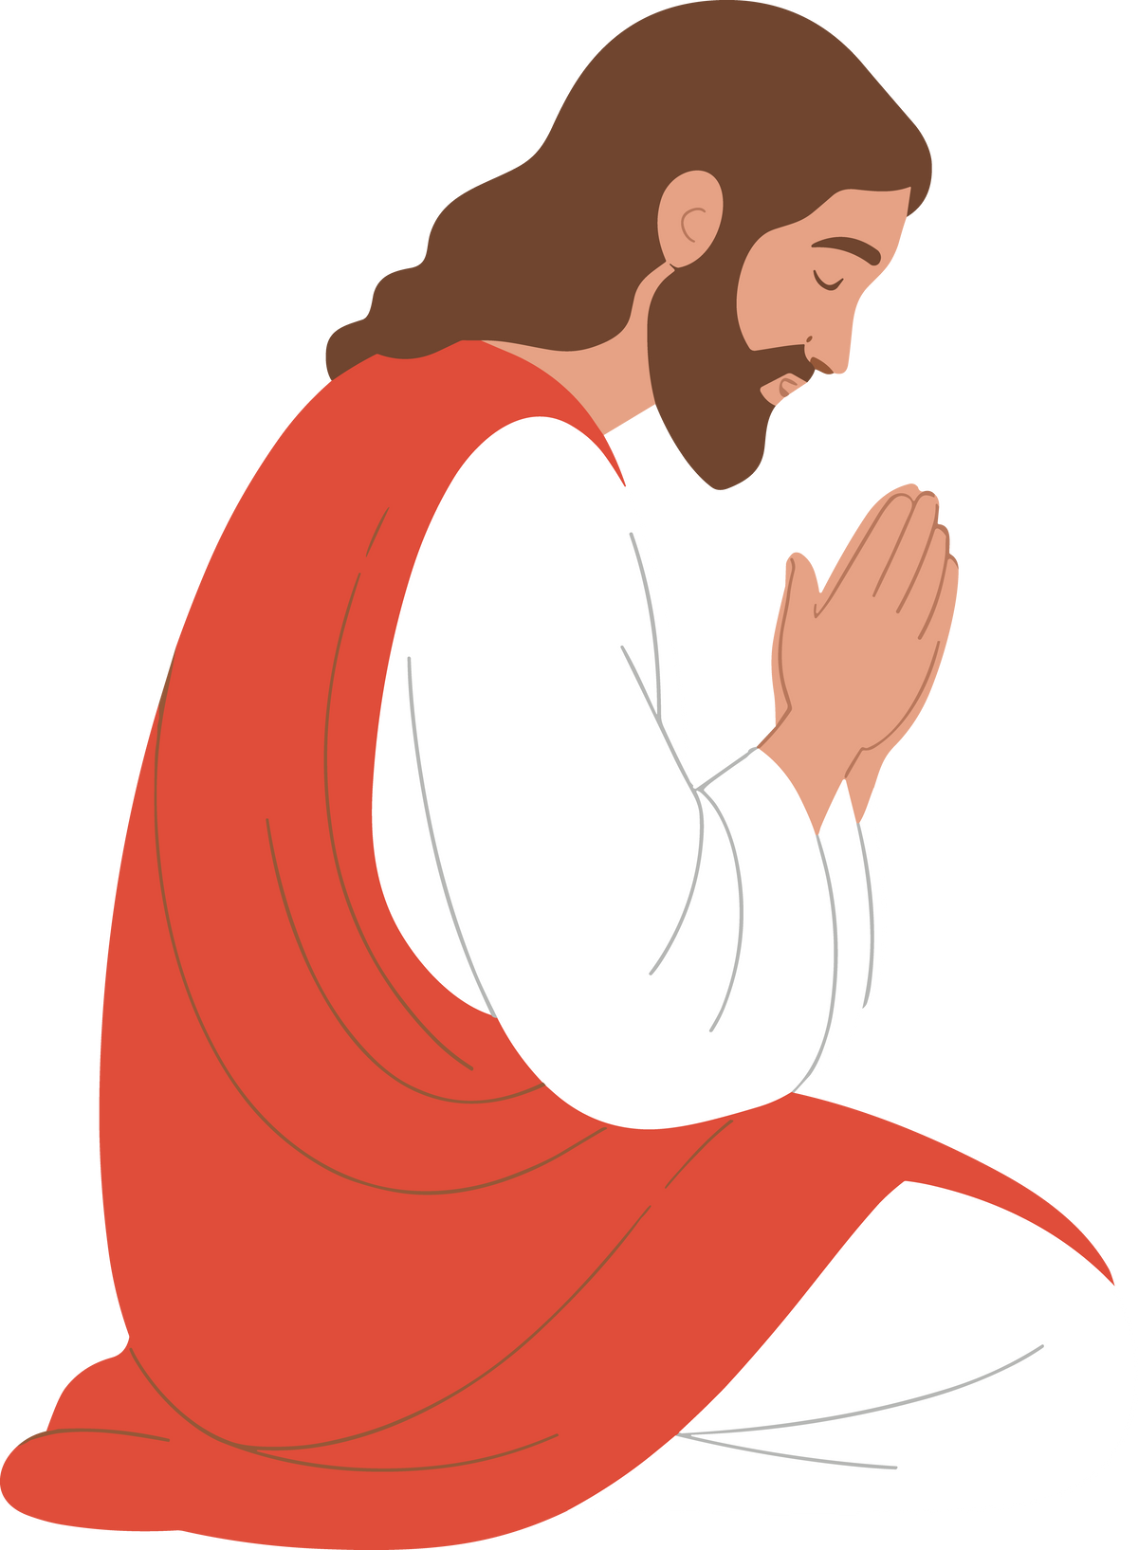
Jesus prays
Jesus would often go to be by Himself to pray to God.

Slide 19

Set boundaries
Establish clear personal boundaries and make sure others are aware of them.

Slide 20


Fish and the loaves
Jesus didn’t allow people to use Him. When the crowd came looking for Him, He recognized their motives and refused to follow their pressure. This teaches us that we don’t have to give in to others just to be accepted—especially when their intentions aren’t right.
John 6:26

Slide 21
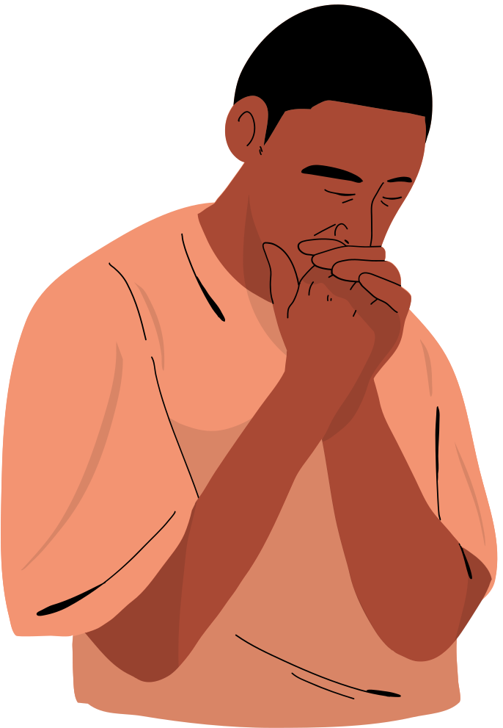
Staying close to God gives us the wisdom to make the right choices. With the help of the Holy Spirit, we can set boundaries and won’t fall into peer pressure.

Slide 22

Activity -Get a paper and pen or pencil
Write a personal commitment to stand firm in faith and safety.

Slide 23
closing Prayer
"Lord, give me courage to stand strong in my choices. Help me honor You even when others push me to do wrong. Amen."

