Slide 1








Saying “No” to Peer Pressure
Week 8

Slide 2
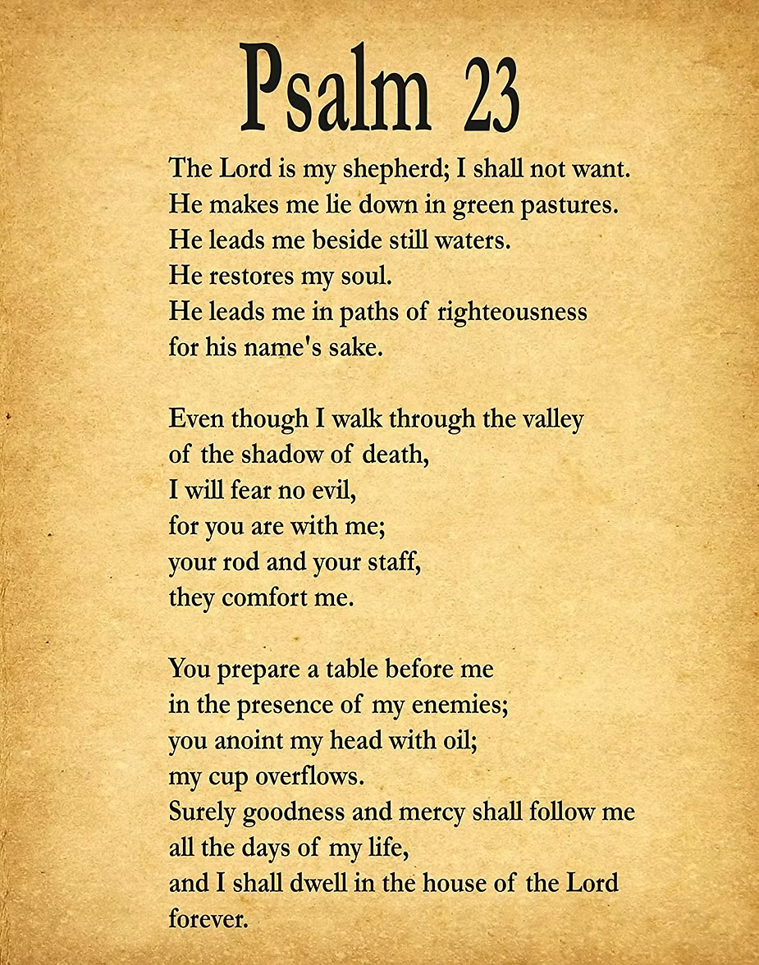


Slide 3






1 Corinthians 15:33 — “Choose good friends.

Slide 4






Focus
God helps us make safe choices, even when friends do wrong.

Slide 5

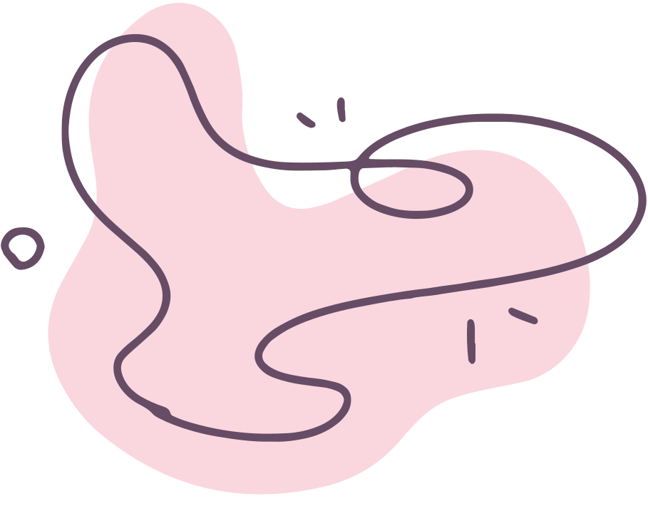





We will learn to practice saying “no” when needed.

Slide 6






Discussion Questions
What can you say if friends ask you to do something unsafe?
How can God help you choose right?

Slide 7




Peer Pressure Video

Slide 8
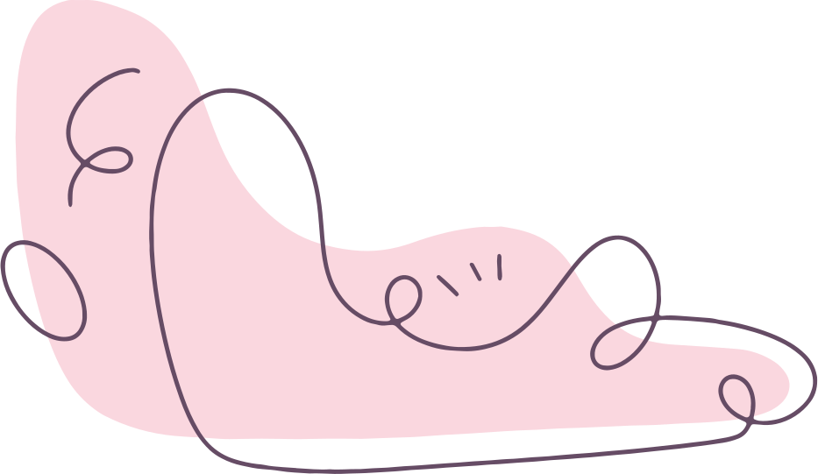




Identity in Christ
When you know who you are in Christ you won’t feel you have to do what others are doing so they can like you.

Slide 9
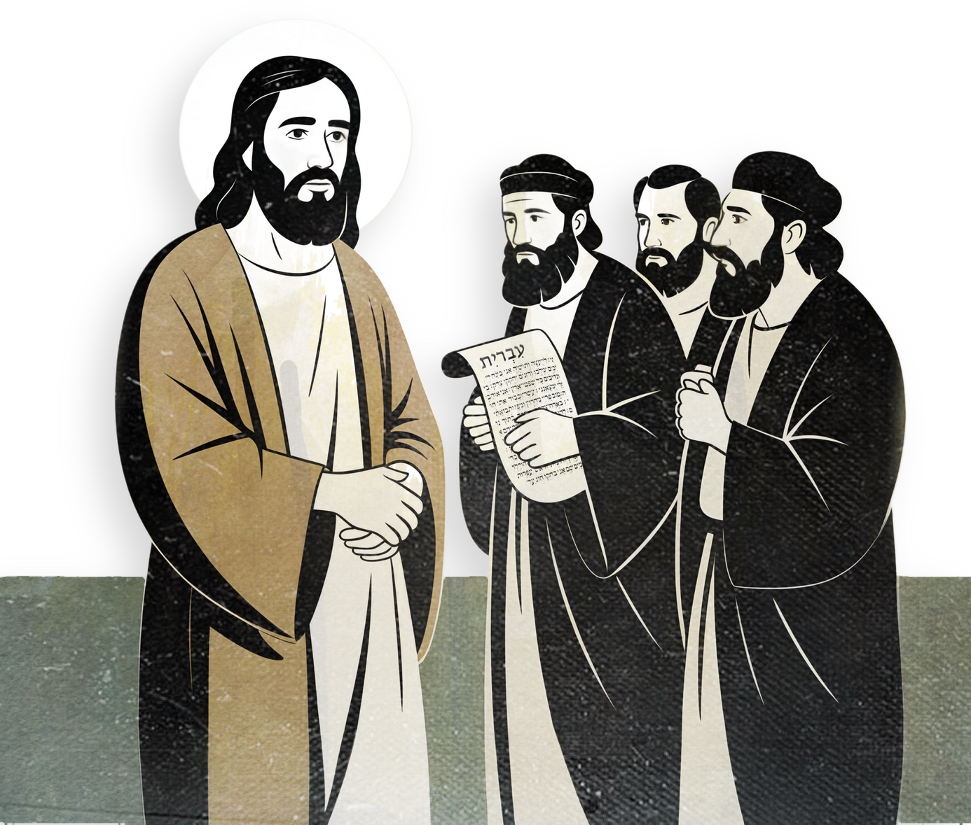
Jesus talks to Leaders
When Jesus talked to the pharasees and scribes He spoke the truth to them. He wasn’t pressured!

Slide 10
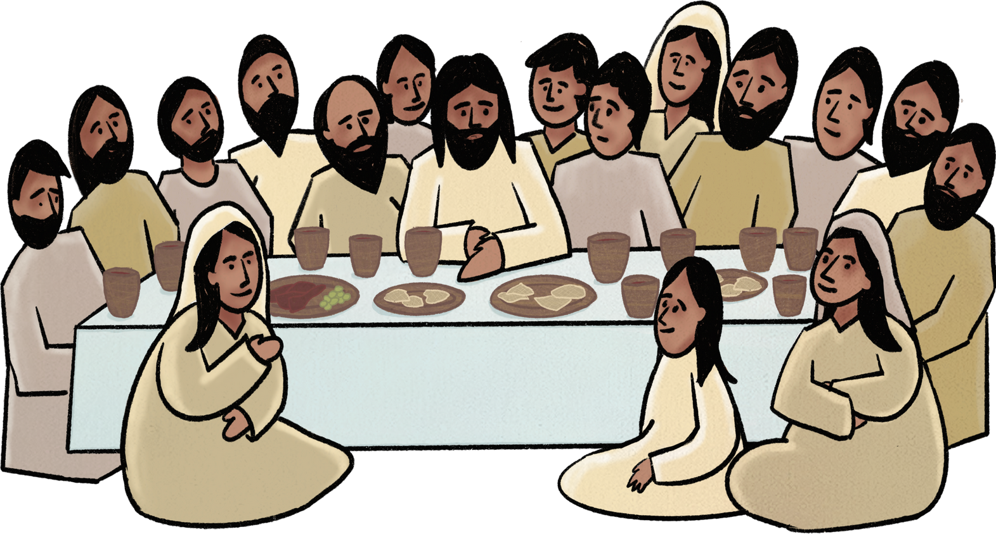
Jesus had friends
Jesus had many friends, including his close inner circle of Peter, James, and John, his very close friends in Bethany like Mary, Martha, and Lazarus,

Slide 11
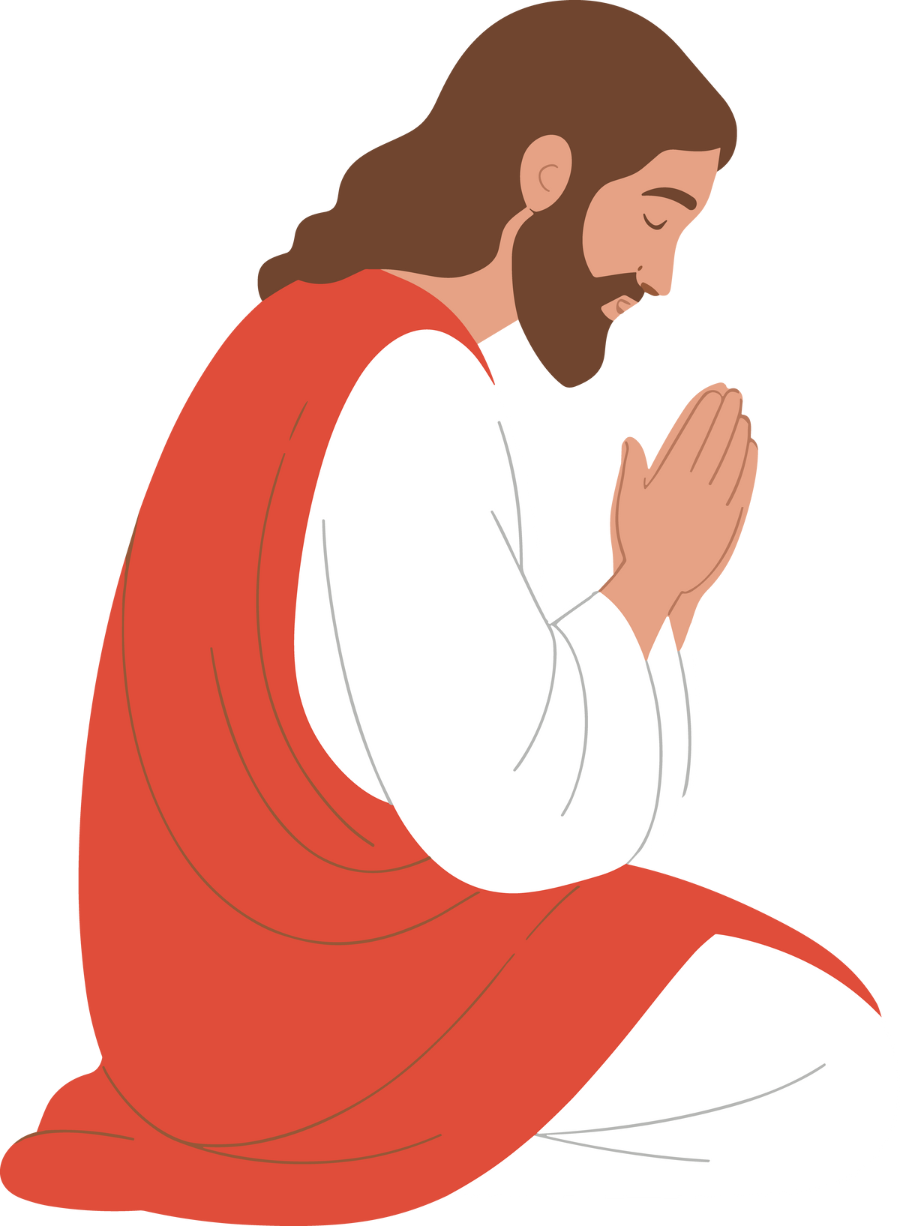
Jesus prays
Jesus would often go to be by Himself to pray to God.

Slide 12
Remember what we learned in this series: Safe in God’s Hands
God is our protector but we must choose to make good choices! The world wants us to do bad things. We are going to be different and we won’t fit in with the world if we are following Jesus!! Like Jesus we must stay close to God!
Also we can help our friends not fall into peer pressure. We are called to do great things for God even when we’re young!

Slide 13


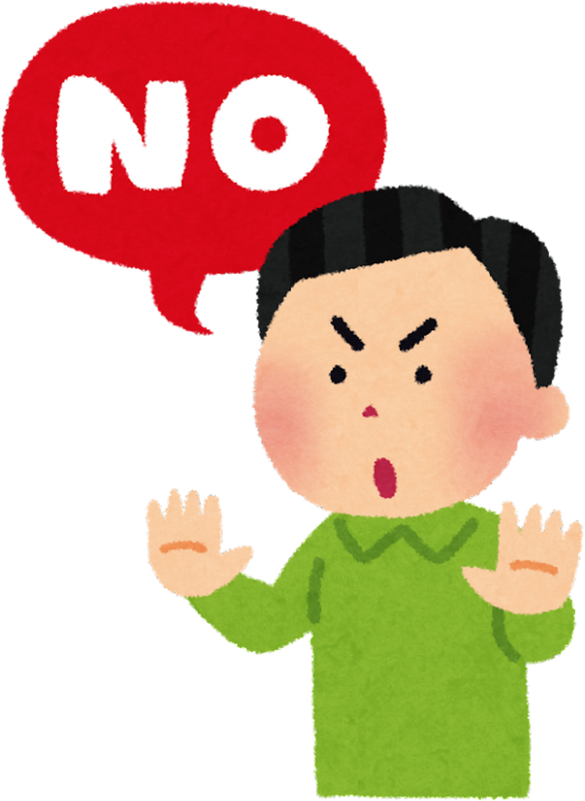
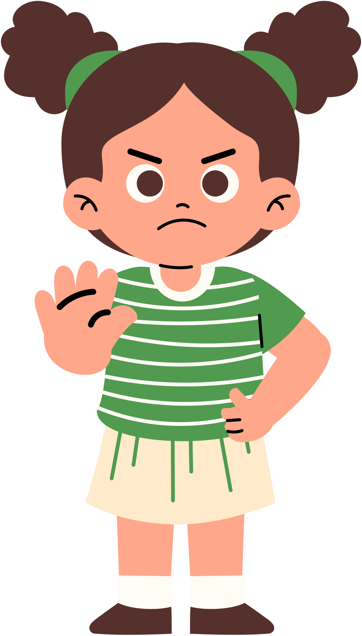


We can say no to negative peer pressure!!

Slide 14




Activity

Slide 15





CLOSING PRAYER
“God, help me make good choices and be a good friend. Amen.”

