Slide 1

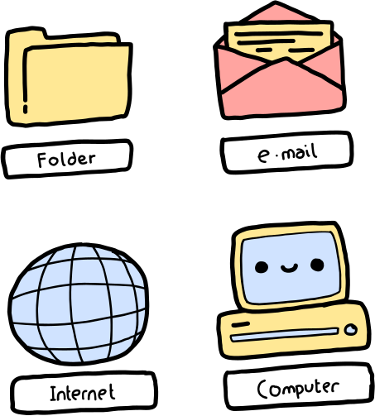
WEEK 7
STAYING SAFE ONLINE

Slide 2
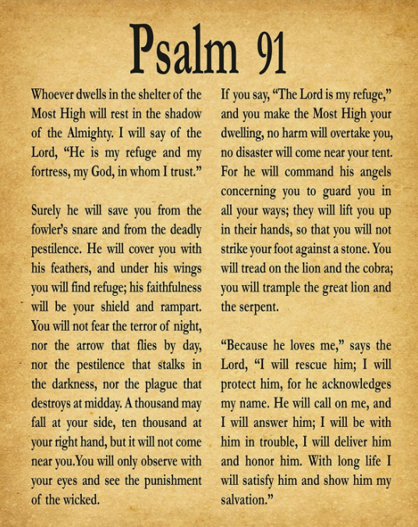
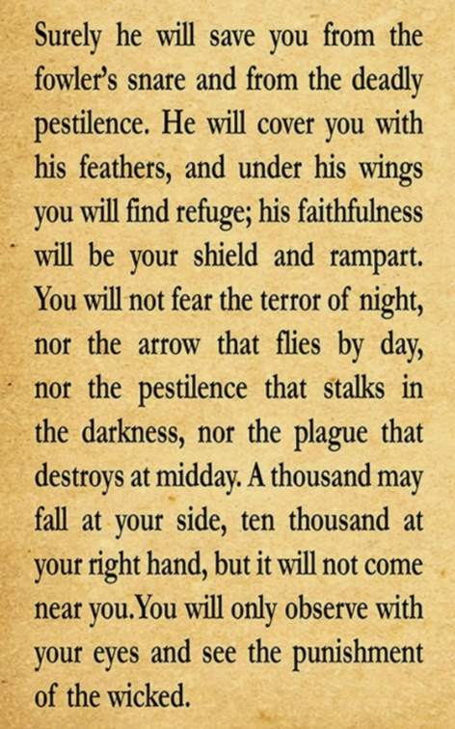
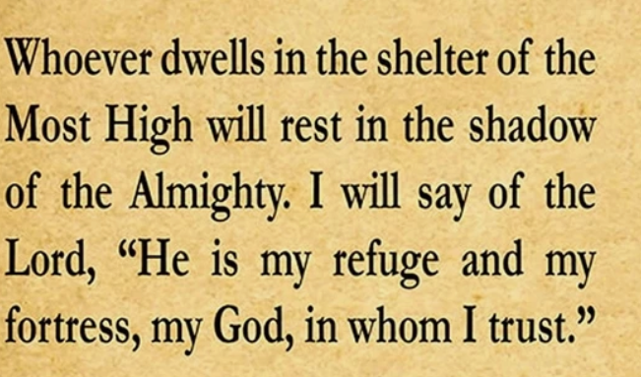


Slide 3
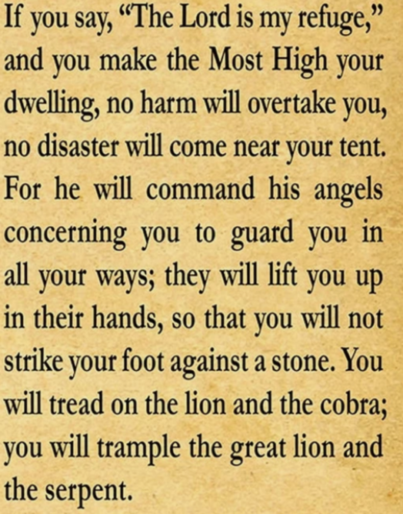
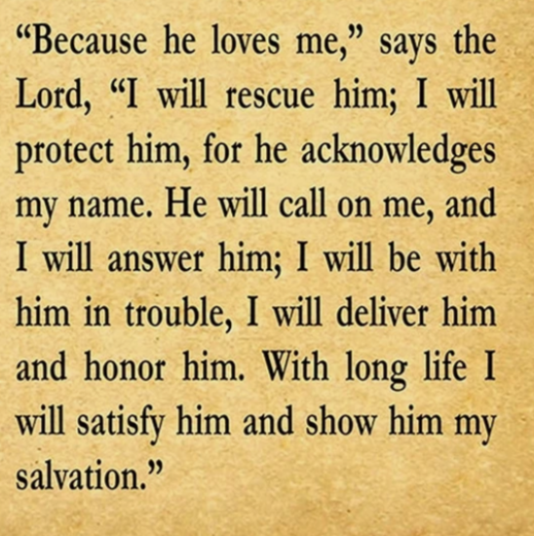

Slide 4

PROVERBS 4:23
"Above all else, guard your heart, for everything you do flows from it."

Slide 5
FOCUS
Safety extends to digital spaces; God calls us to wisdom in online activities.

Slide 6
We will identify potential online dangers.
We will learn practical ways to protect personal information and relationships online.

Slide 7
DISCUSSION QUESTIONS
1.What are some risks of social media and online chats?
2.How can you respond if someone online makes you feel unsafe?
3.How does God want us to behave online?

Slide 8

THINK FIRST
Avoid clicking on suspicious links or downloading unknown files.

Slide 9
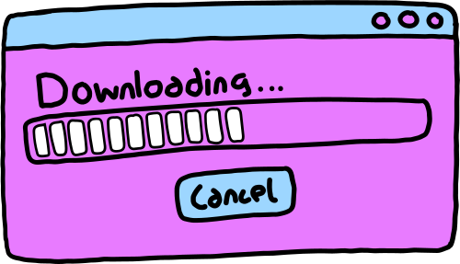
ASK FIRST
Always ask a trusted adult before downloading apps or games.

Slide 10

PERSONAL INFORMATION
Don’t share your full name, address, phone number, or school online to anyone!

Slide 11
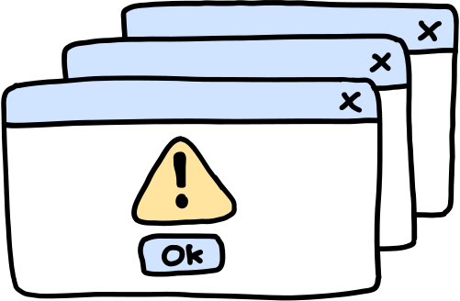
LOG OUT
Always log out of accounts when you’re done, especially on shared devices.

Slide 12

STRANGER DANGER
Don’t talk to or accept friend requests from people you don’t know in real life.

Slide 13

IMAGE SHARING
Only share pictures with people you know and with permission from a parent.

Slide 14
USING THE WEB
Only visit websites that are trusted and appropriate for kids and with permission from a parent.

Slide 15
DIGITAL FOOTPRINT
Treat others with respect and kindness, just like you would in person.

Slide 16
SCREEN TIME
Take breaks and don’t spend too much time online.

Slide 17
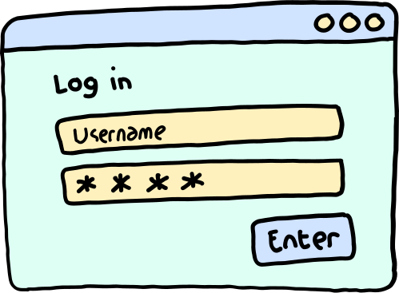
PASSWORDS
Create tricky passwords and never share them with anyone except trusted adults.

Slide 18
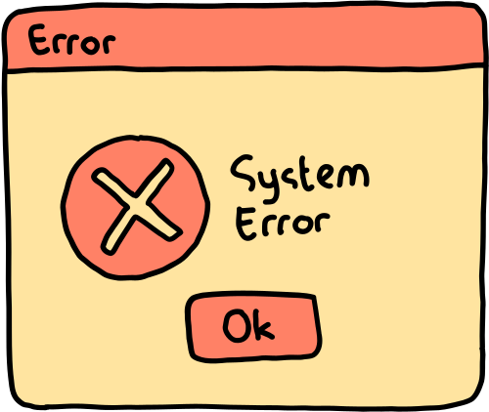
PRIVACY SETTINGS
Make sure your profiles on social media or games are set to private so only friends can see your information.

Slide 19

REPORTING
If someone is being mean or making you feel uncomfortable online, tell a trusted adult right away.

Slide 20
WHAT IS CYBER BULLYING?

Slide 21









Why Does It Happen?
Cyberbullying often stems from misuse of digital tools or from people not understanding proper online behavior. Peer influence can also encourage such actions, but awareness helps prevent it.
Misuse of technology
Lack of awareness about digital manners.

Slide 22


Call to Action
Cyberbullying can only be stopped if we all work together.
Spread positivity
1
Share kind words and uplifting content.
Choose respect
2
Treat others with fairness in every interaction.
Support one another
3
Stand by friends, family, and peers when they need help.

Slide 23
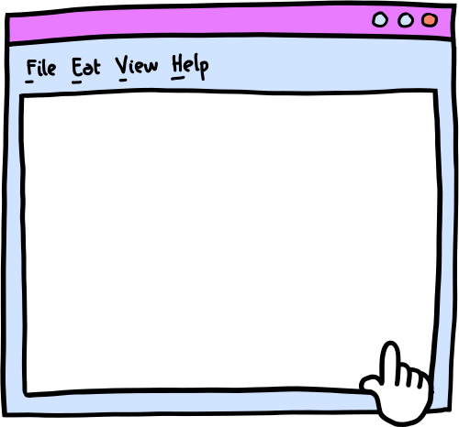
DIGITAL SIGNATURE
I agree to being cyber-safe online.
Signed:

Slide 24
ACTIVITY

Slide 25
LET’S PRAY!

