Slide 1


WEEK 7
STAYING SAFE ONLINE

Slide 2
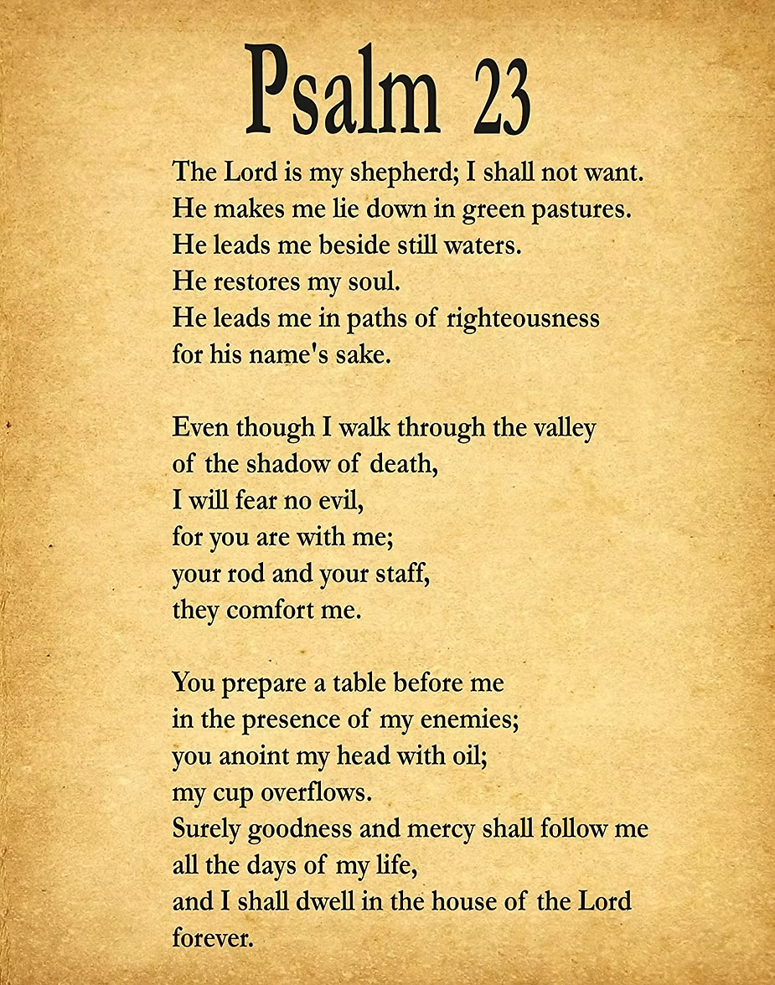


Slide 3

PROVERBS 4:23
“Keep your heart safe.”

Slide 4
FOCUS
God helps us make good choices online.

Slide 5
We will learn to understand simple online safety.

Slide 6
DISCUSSION QUESTIONS
  What should we share online?
  Who can help if something online feels scary?

Slide 7

THINK FIRST
Avoid clicking on suspicious links or downloading unknown files.

Slide 8
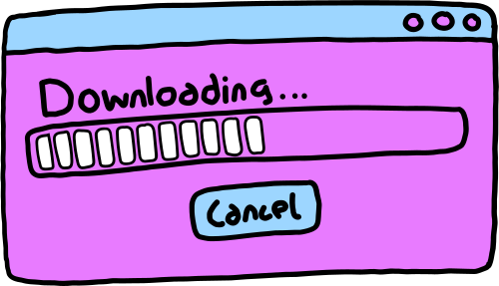
ASK FIRST
Always ask a trusted adult before downloading apps or games.

Slide 9

PERSONAL INFORMATION
Don’t share your full name, address, phone number, or school online to anyone!

Slide 10

LOG OUT
Always log out of accounts when you’re done, especially on shared devices.

Slide 11

STRANGER DANGER
Don’t talk to or accept friend requests from people you don’t know in real life.

Slide 12

IMAGE SHARING
Only share pictures with people you know and with permission from a parent.

Slide 13
USING THE WEB
Only visit websites that are trusted and appropriate for kids and with permission from a parent.

Slide 14
DIGITAL FOOTPRINT
Treat others with respect and kindness, just like you would in person.

Slide 15
SCREEN TIME
Take breaks and don’t spend too much time online.

Slide 16
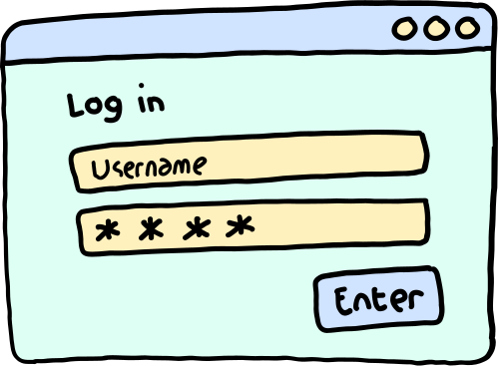
PASSWORDS
Create tricky passwords and never share them with anyone except trusted adults.

Slide 17
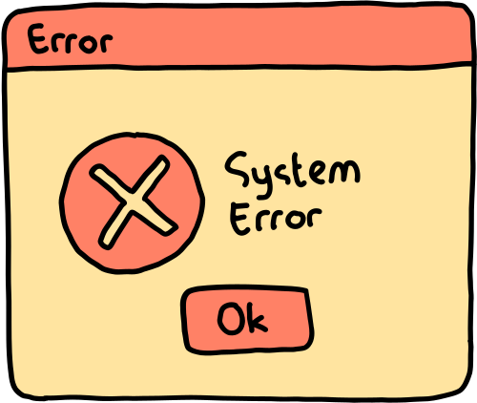
PRIVACY SETTINGS
Make sure your profiles on social media or games are set to private so only friends can see your information.

Slide 18

REPORTING
If someone is being mean or making you feel uncomfortable online, tell a trusted adult right away.

Slide 19

DIGITAL SIGNATURE
I agree to being cyber-safe online.
Signed:

Slide 20
ACTIVITY

Slide 21
LET’S PRAY!

