Slide 1














Guard Your Heart and Mind
Week 6

Slide 2
Let’s practice Psalms 23
Week 6

Slide 3
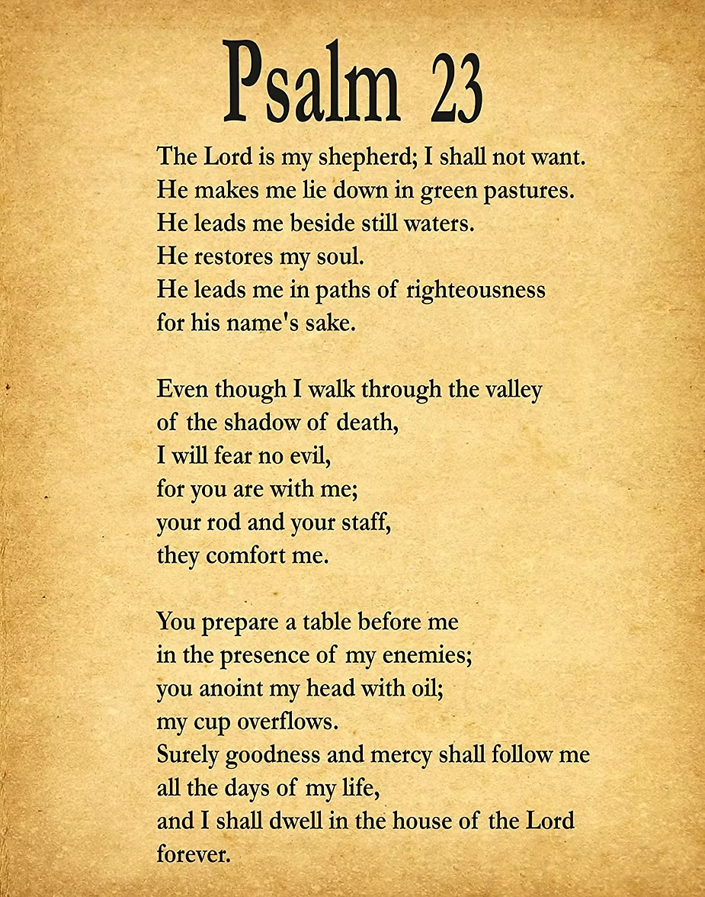


Slide 4

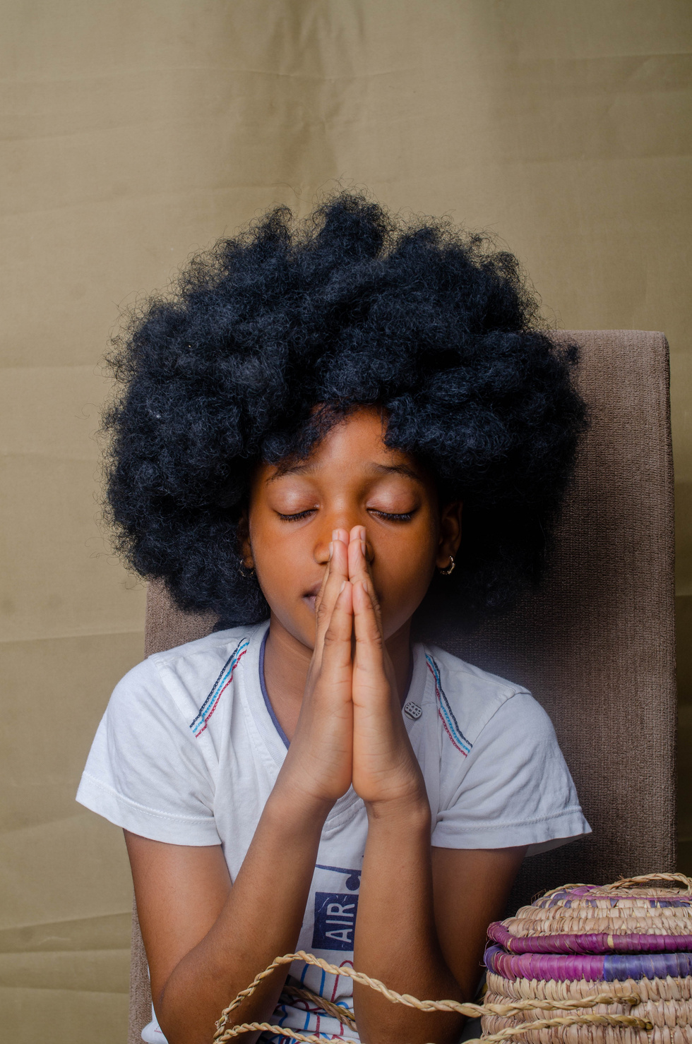

Philippians 4:8 — "Think about good things."

Slide 5
We will learn to think about nice and true things.

Slide 6

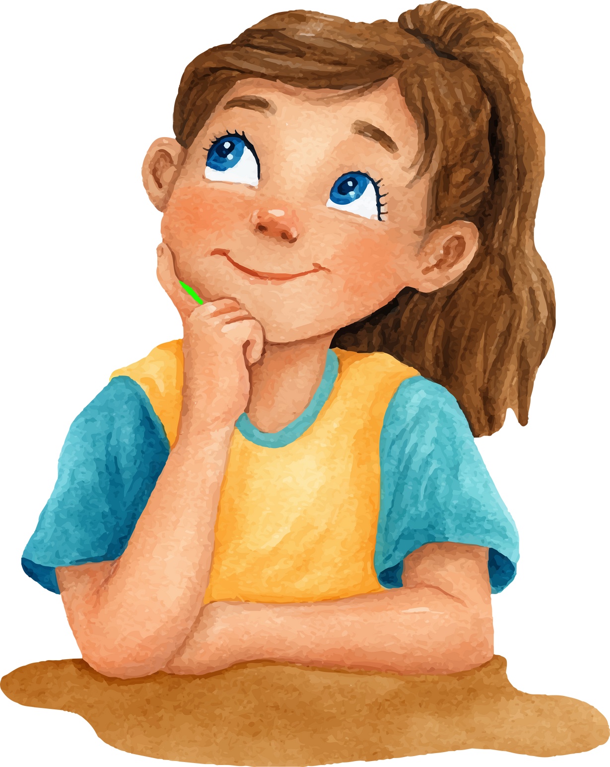

Discussion Questions
What happy thoughts make you feel safe?
How can we think about God's love?

Slide 7
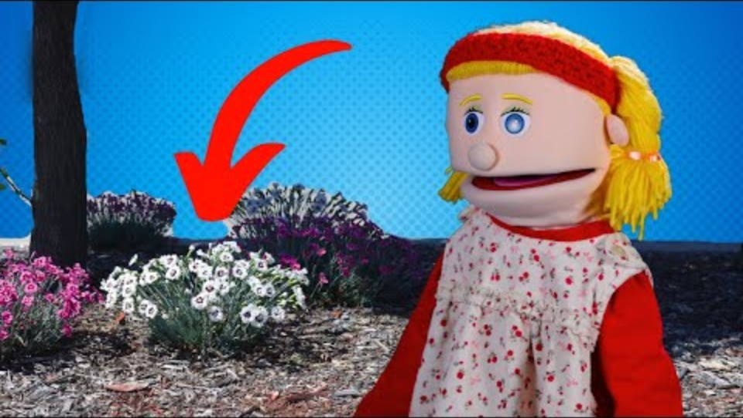

Slide 8
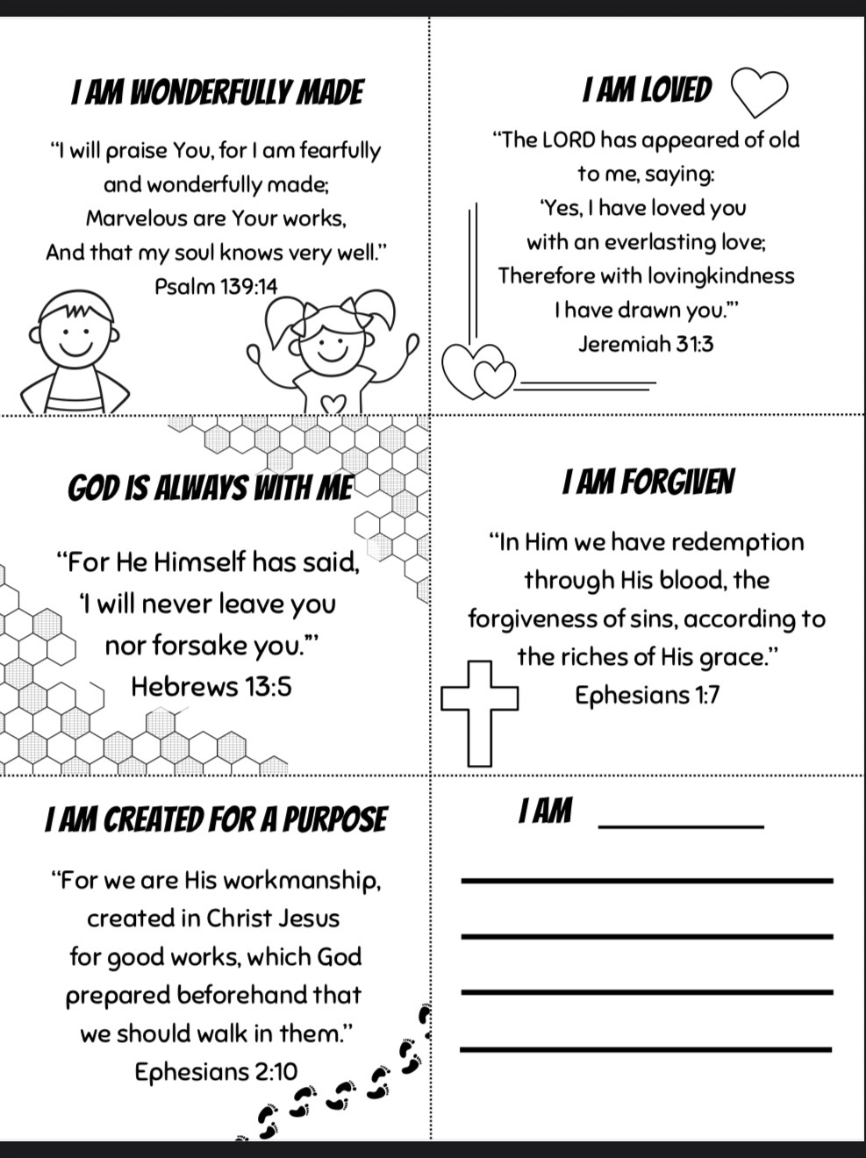
Let’s Talk about what we can meditate on

Slide 9
Activity time!

Slide 10
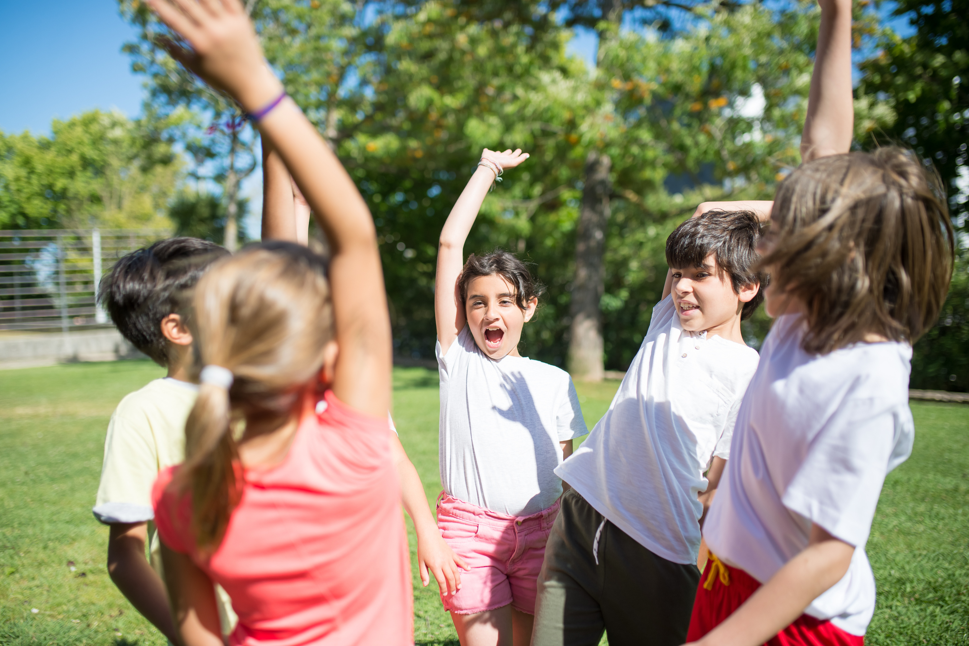

We think about nice and true things!!!!

Slide 11
Closing Prayer
“God, help me think about good things. Amen.”

