Slide 1


Protecting and Caring for Others
WEEK 5

Slide 2
Let’s practice Psalms 91
WEEK 5

Slide 3
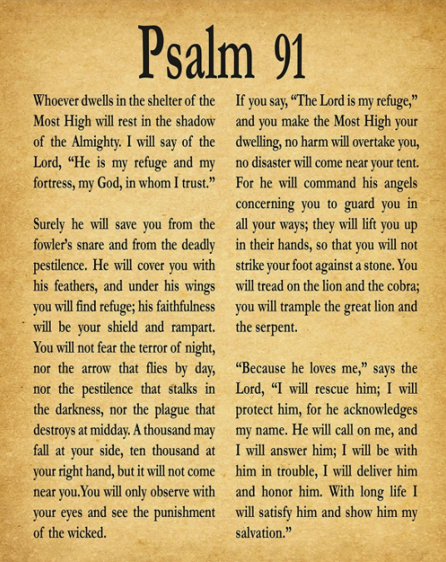
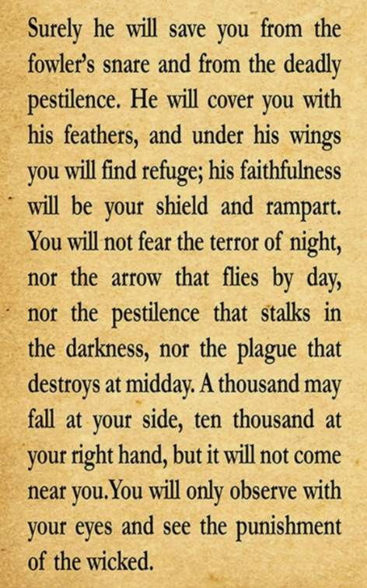
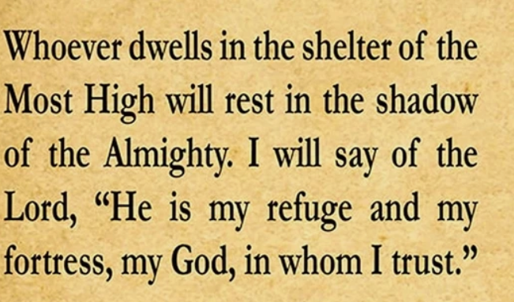


Slide 4
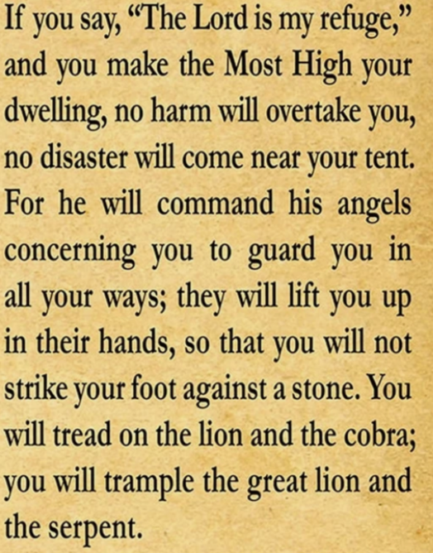
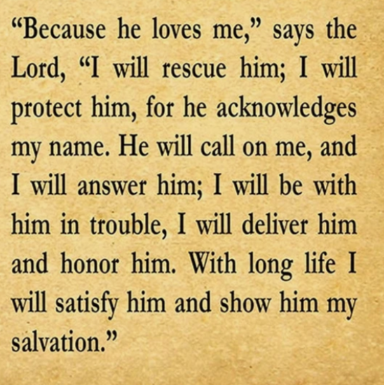

Slide 5

Galatians 6:2 — “Carry each other’s burdens, and in this way you will fulfill the law of Christ.”

Slide 6
Focus
God calls us to care about others’ safety as much as our own. Safety and protection are strengthened when we support and hold each other accountable.

Slide 7
We will learn that helping others stay safe honors God.
We will practice being a protector and encourager for others.
We will understand the value of godly friendships and mentors.
We will identify ways to create a safe, accountable community.

Slide 8
Discussion Questions:
How can you help your friends make safe choices?
What should you do if someone you know is in danger or trouble?
How can our church be a “safe space” for everyone?

Slide 9
Do you know what Jesus Christ said is the greatest law? To love God. And the second most important law is to love our neighbors as much as we love ourselves. That is why helping someone with their burdens helps us obey the law of Christ—it is a great way to show love. Burdens come in all shapes and sizes. Some of them can easily be seen from the outside, like when Mom comes home with a car full of groceries and needs help carrying them inside. Some of them are hidden, and can only be seen when someone talks about them, like when you are upset because someone said something mean to you. Just like a bag of groceries, sometimes facing something hard or feeling sad can almost feel “heavy”! It weighs you down and makes you feel tired, but when someone helps you through it you feel light again!

Slide 10
Let’s learn what the bible says...
Let’s read from
Luke 10:25-37

Slide 11
Let’s watch a clip...

Slide 12
Closing Prayer
“Jesus, teach us to care for one another the way You care for us. Help us to be protectors, encouragers, and peacemakers in our world. Amen.”

Slide 13
Activity Time!

