Slide 1



Caring for Others
WEEK 5

Slide 2
Let’s practice Psalms 23
WEEK 5

Slide 3
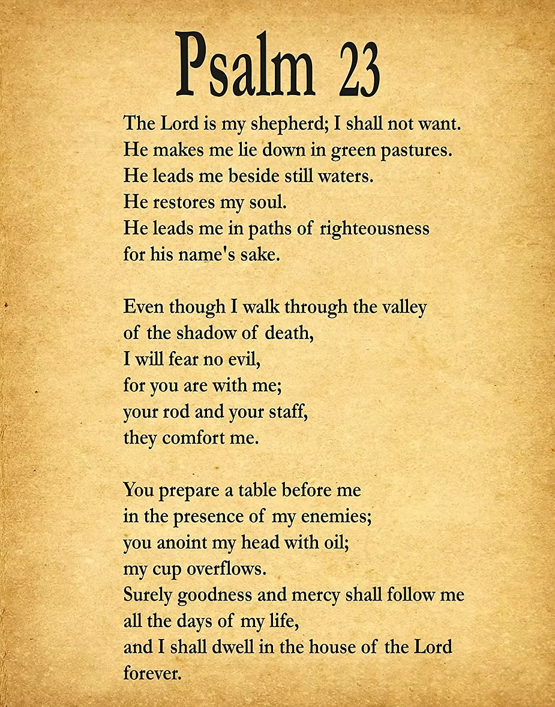


Slide 4

Galatians 6:2 — “Help each other.”

Slide 5
Focus
God wants us to help and protect friends.

Slide 6
We will learn that helping others is part of God’s plan.

Slide 7
How can you help your friends?
How can you show kindness today?

Slide 8
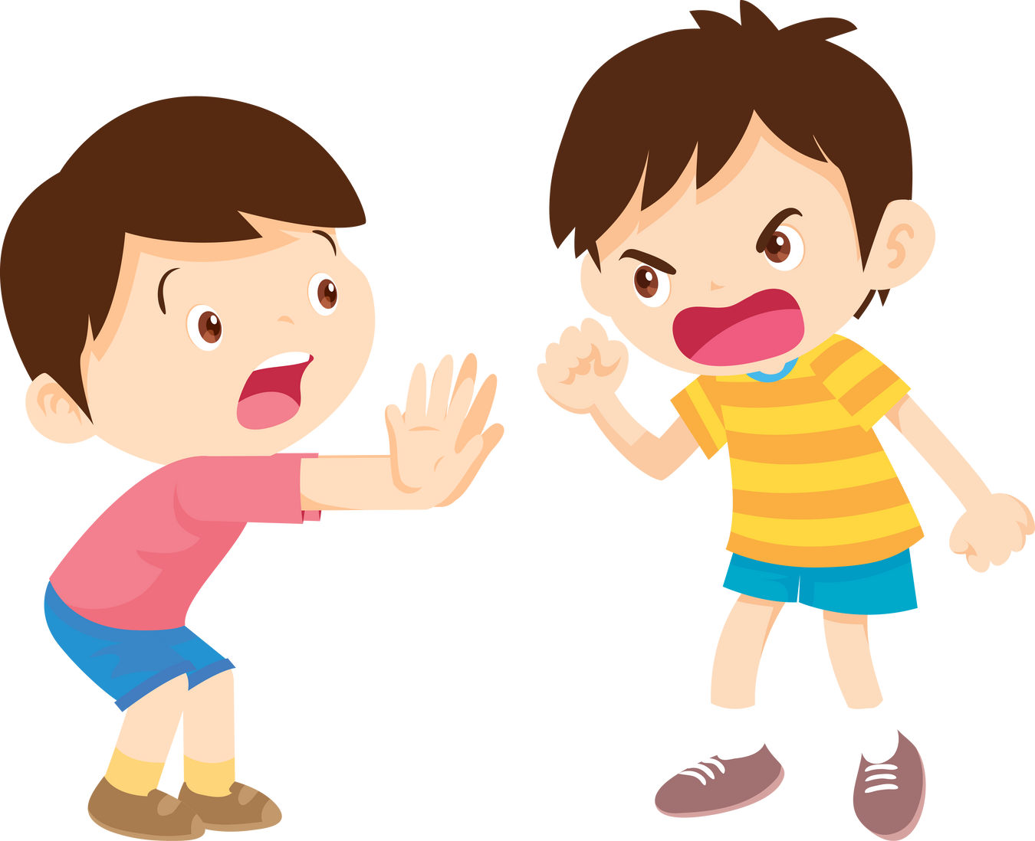
Our friends might get scared if
we use our hands in a mean way.

Slide 9

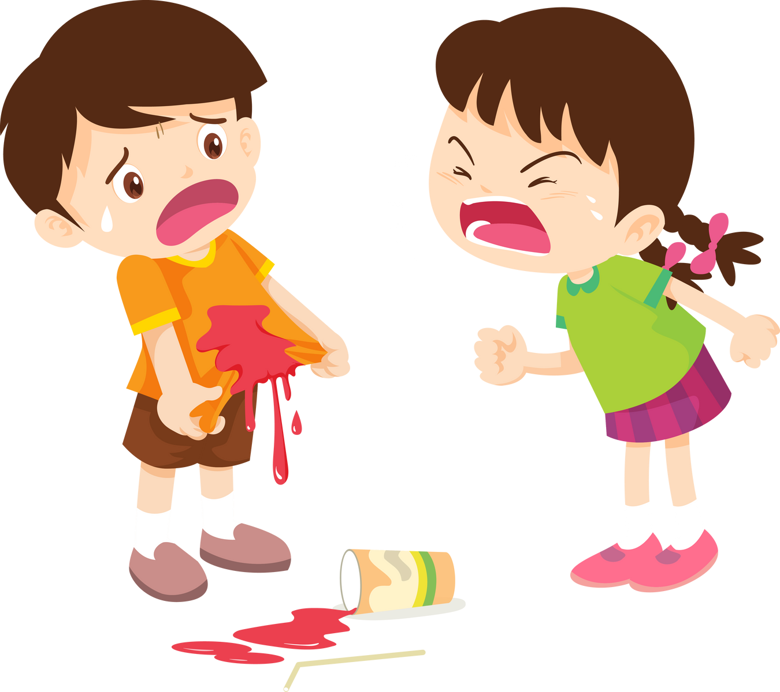
Our friends might be sad if we
use our hands to hurt them.

Slide 10
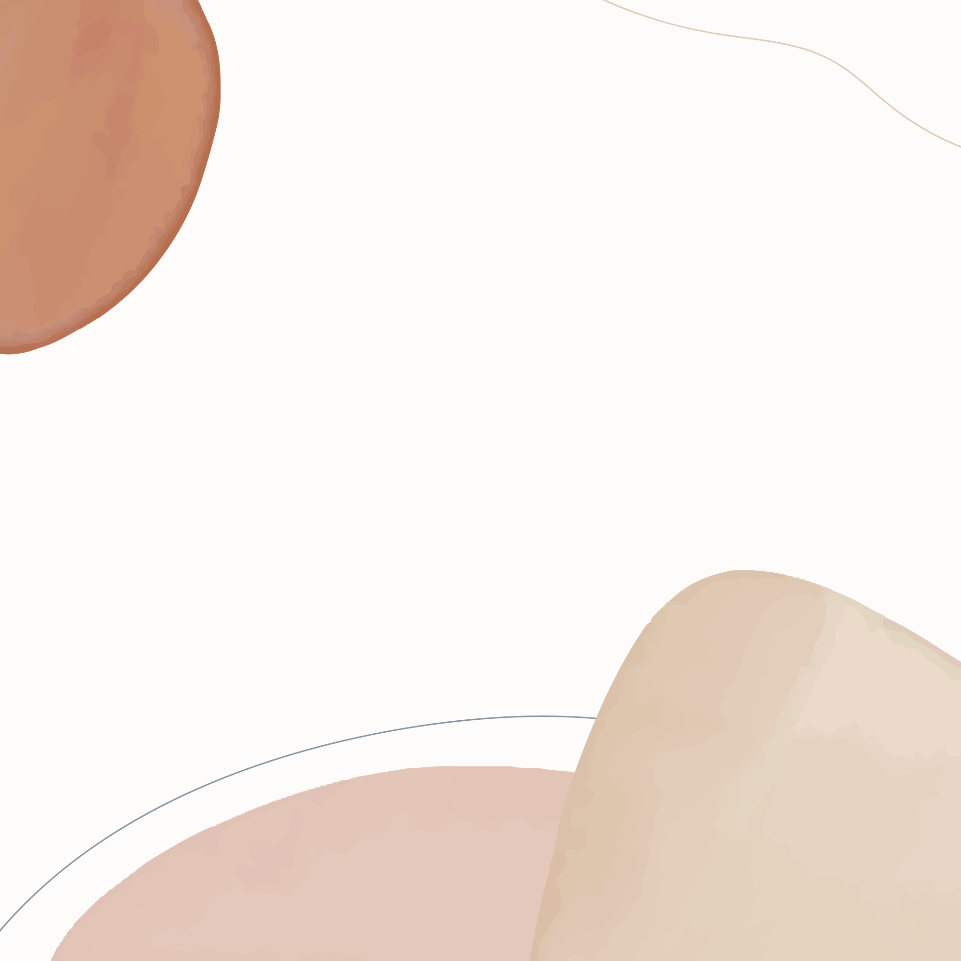
We can use our hands to help others. Helping
a friend carry their books is a good choice.

Slide 11
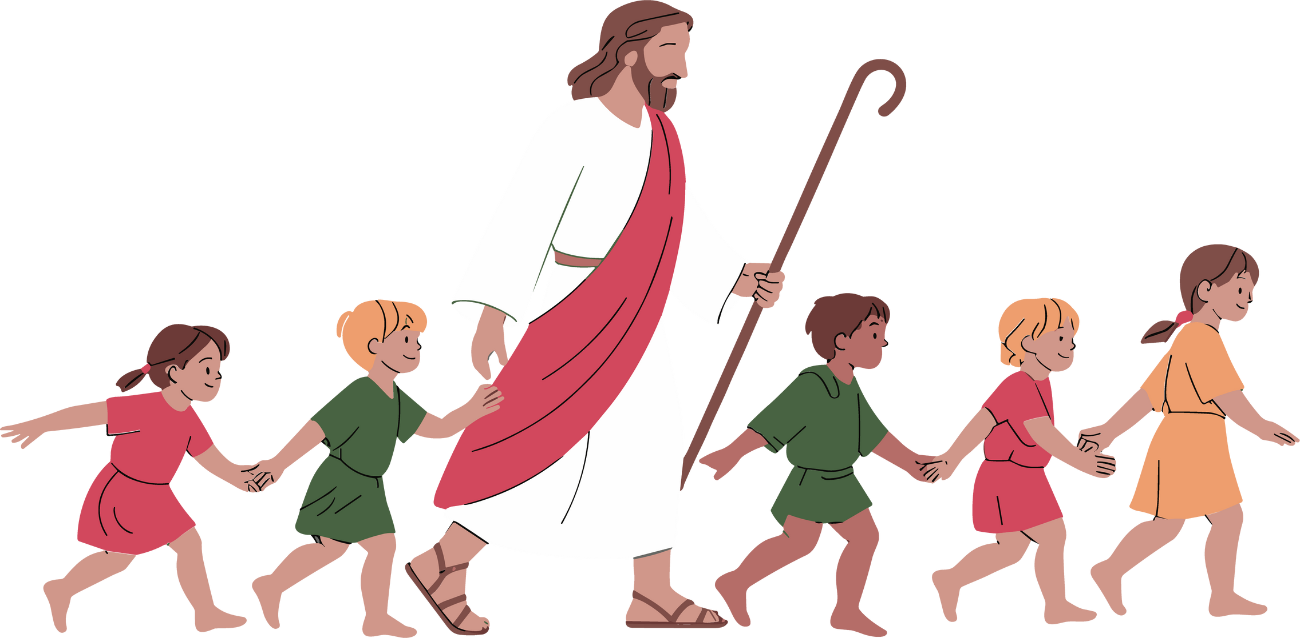
God wants to help you use your
hands to be helpful and do good things.

Slide 12
Let’s learn what the bible says...
We bear one another's burdens

Slide 13
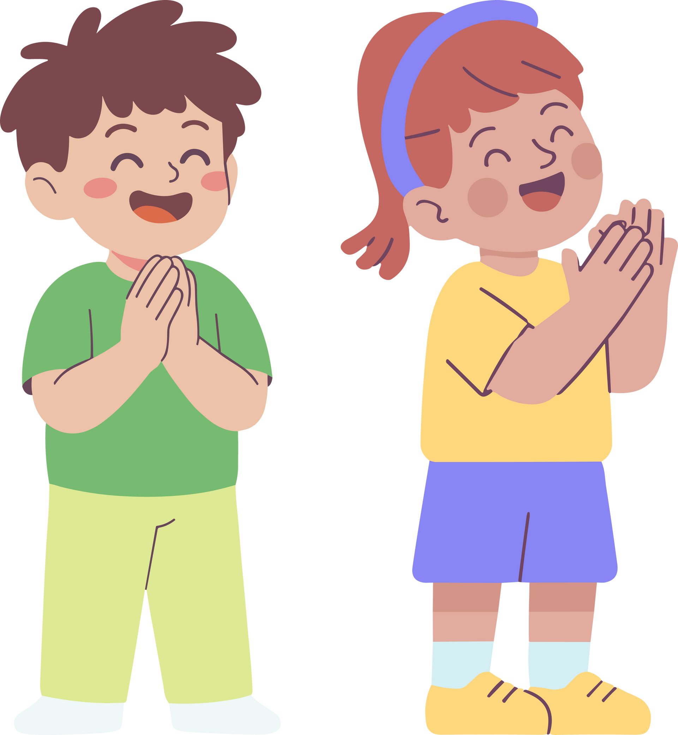
Closing Prayer
“God, help me care for my friends. Amen.”

Slide 14
Activity Time!

Slide 15

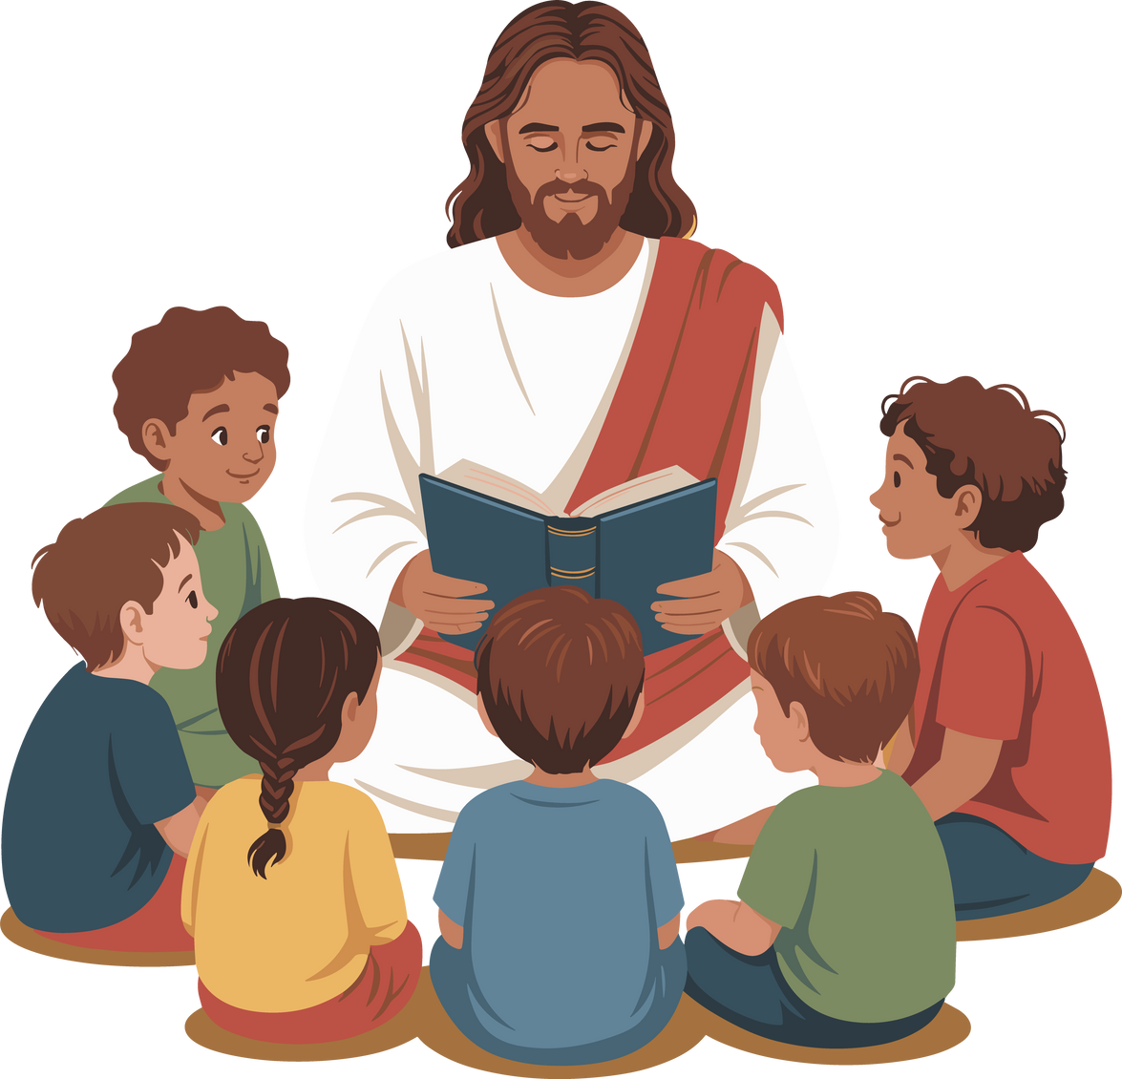

Would Jesus rather...?
Gal 6:2 Edition

Slide 16

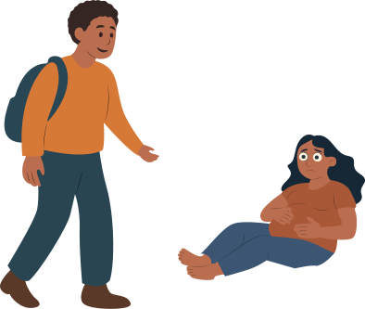
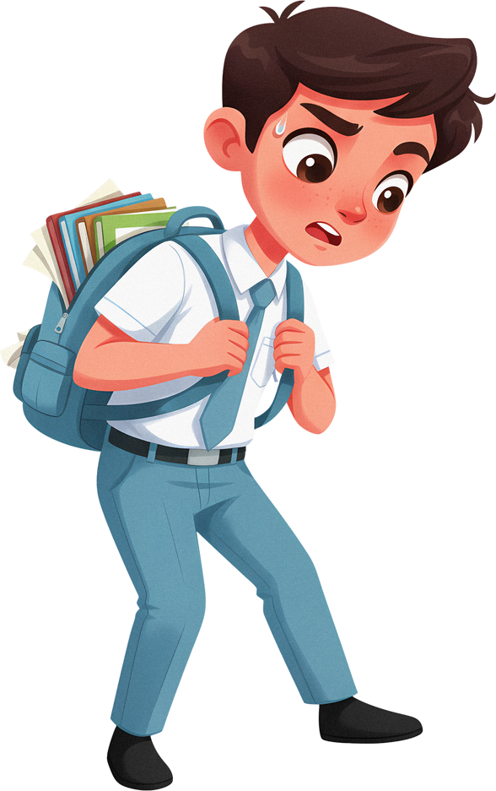
Would Jesus rather...
watch someone carry their very full and heavy backpack to school.
help someone carry it

Slide 17
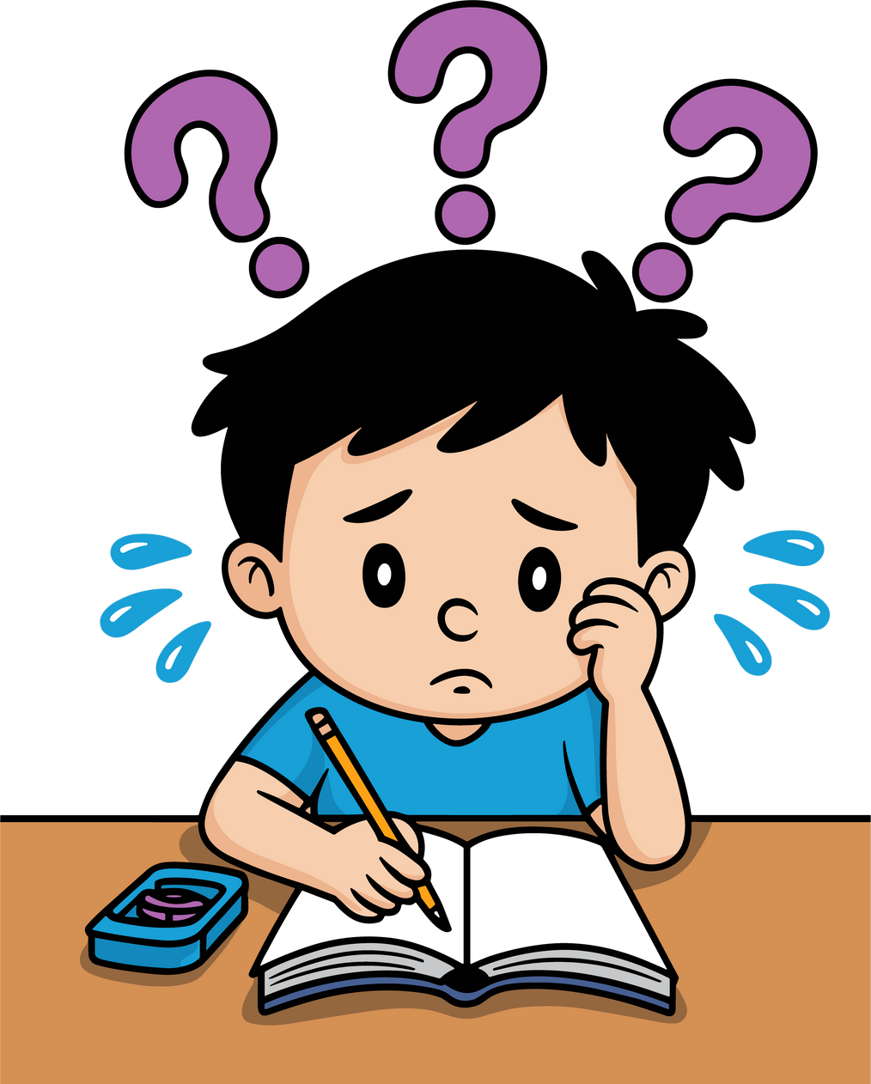
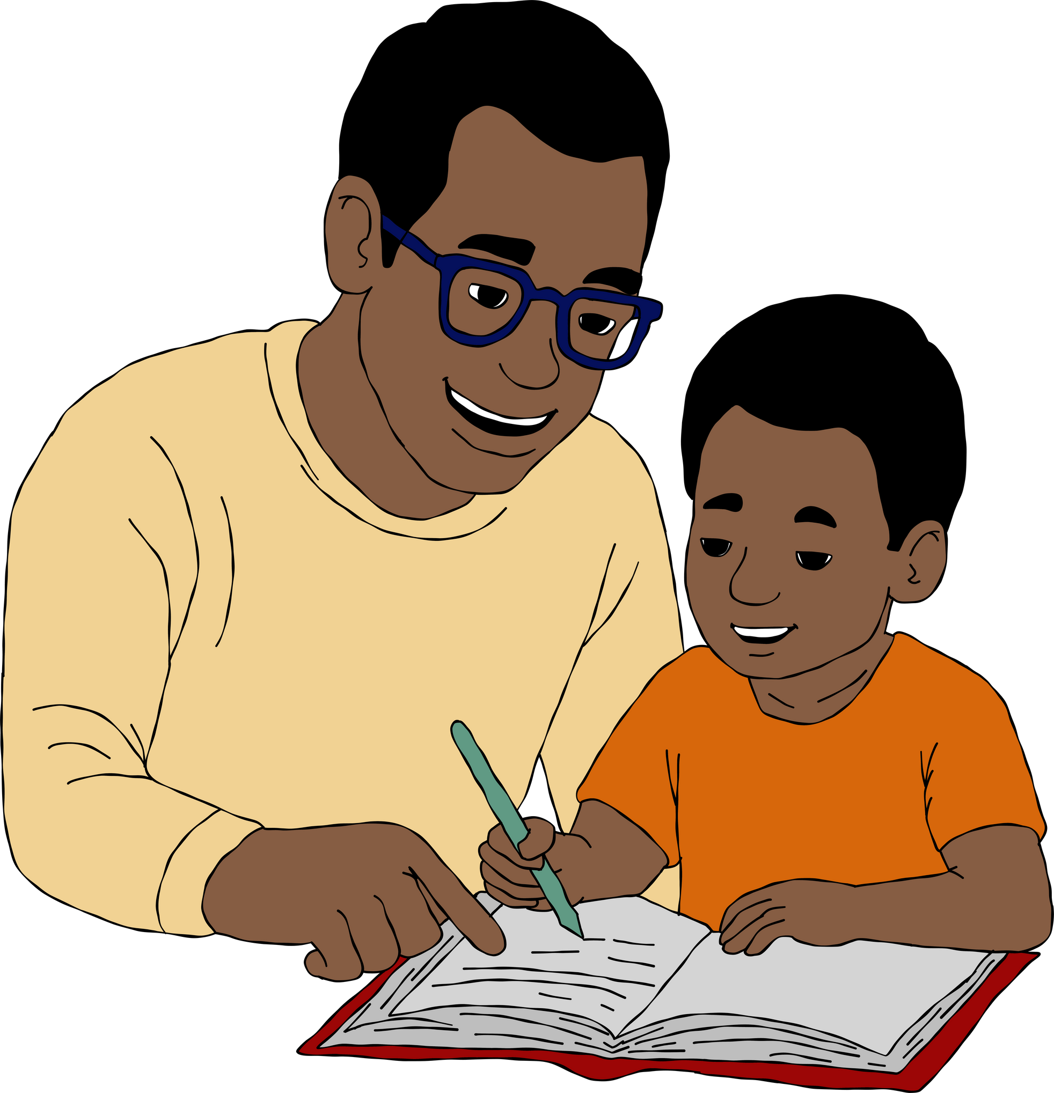
Would Jesus rather...
watch someone who needs help with homework
help someone with their homework

Slide 18
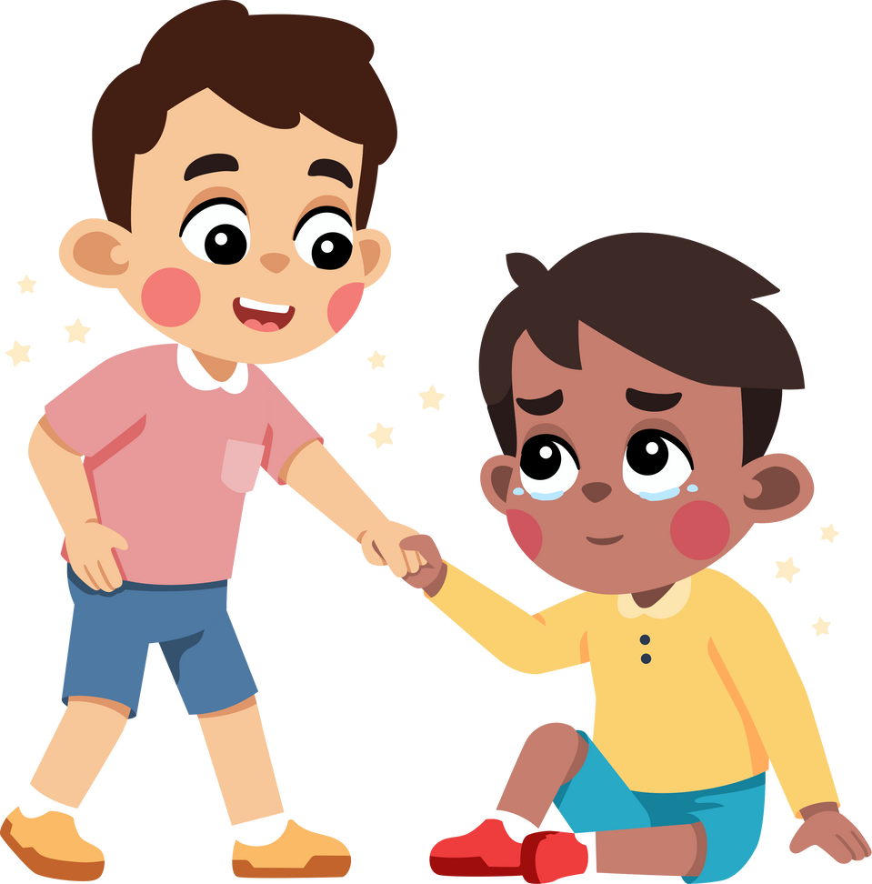
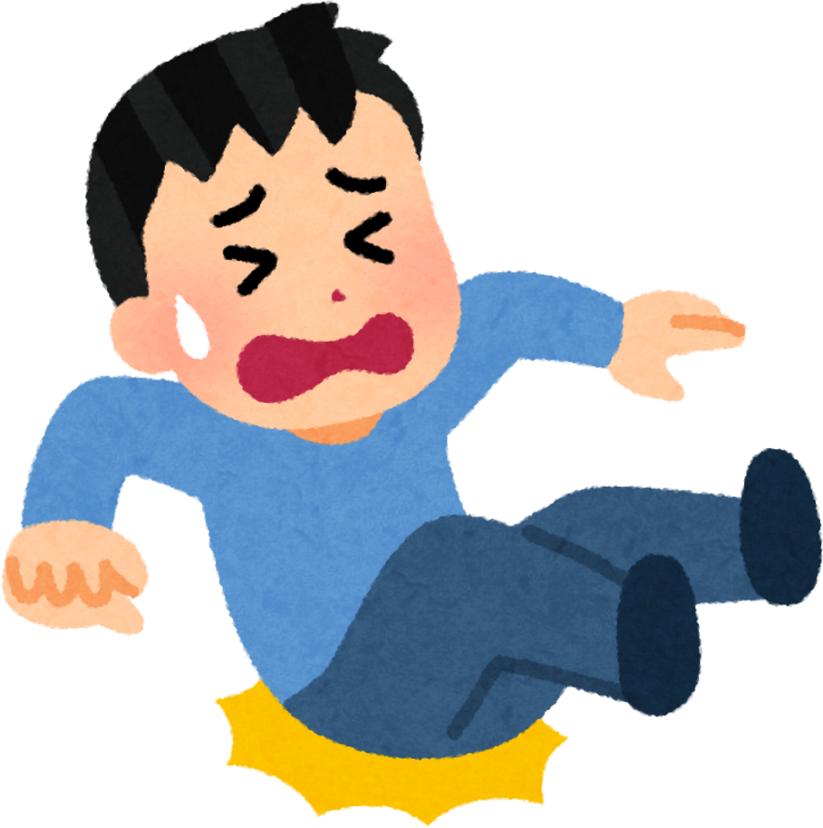
Would Jesus rather...
keep walking when someone falls
help someone get up

Slide 19
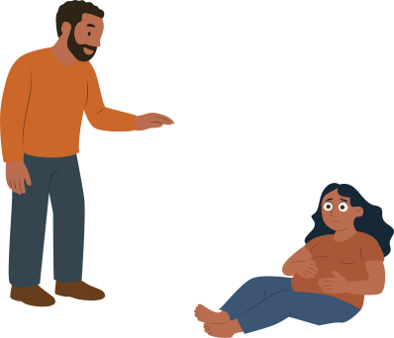
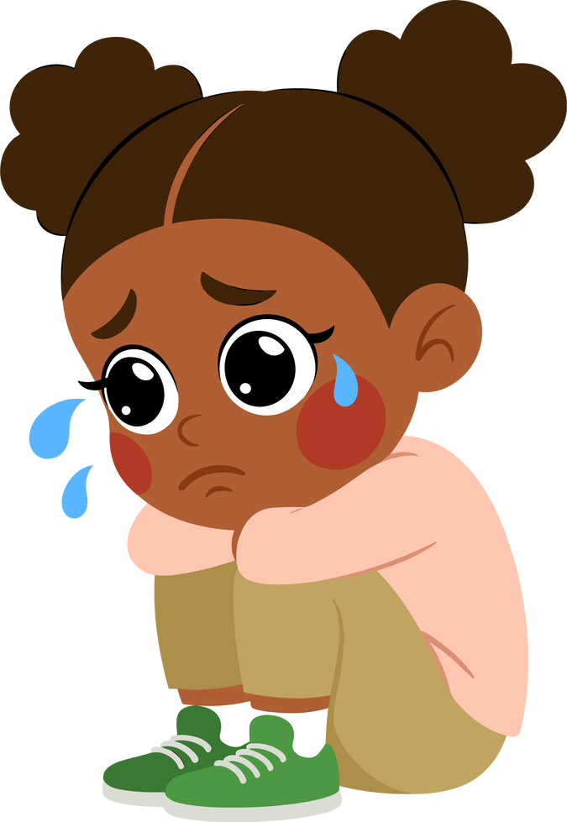
Would Jesus rather...
ignore someone who is sad
help someone who is sad

Slide 20

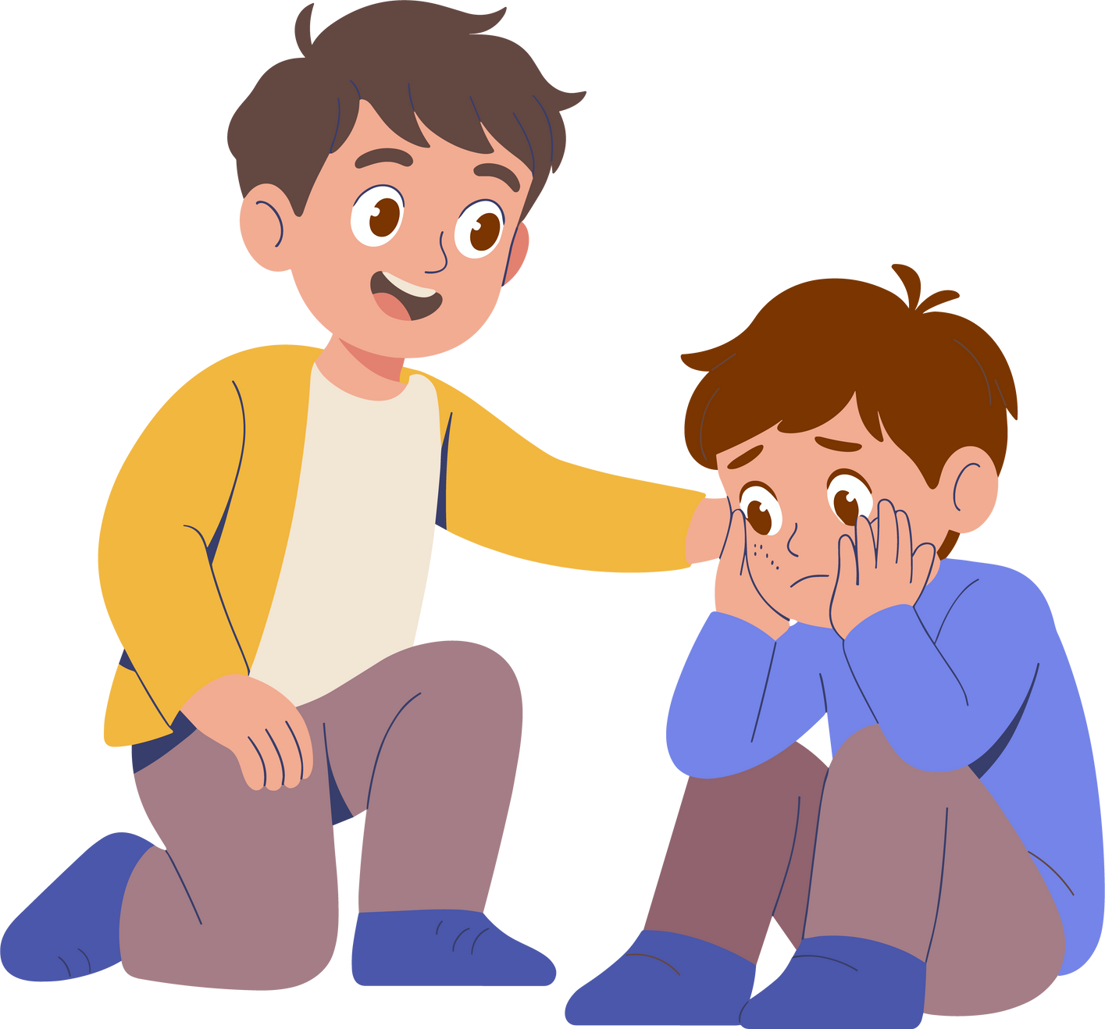
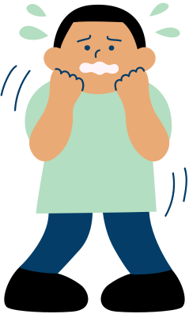

Would Jesus rather...
preach too someone who is scared
comfort someone who is scared

Slide 21
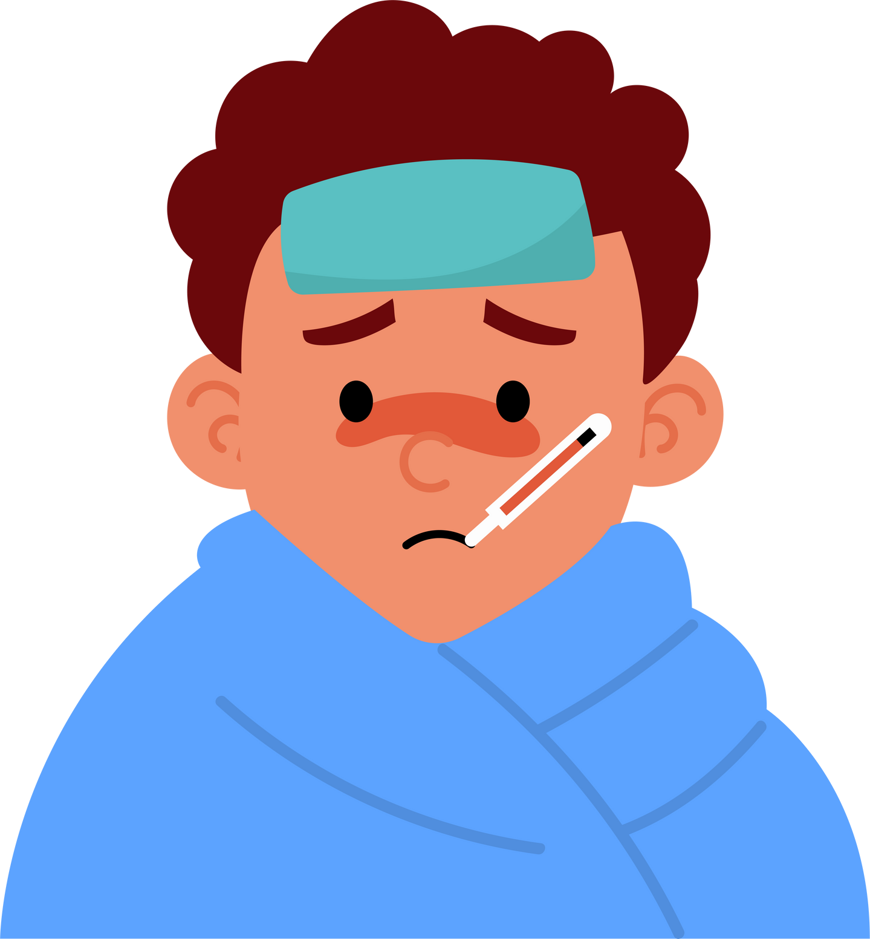
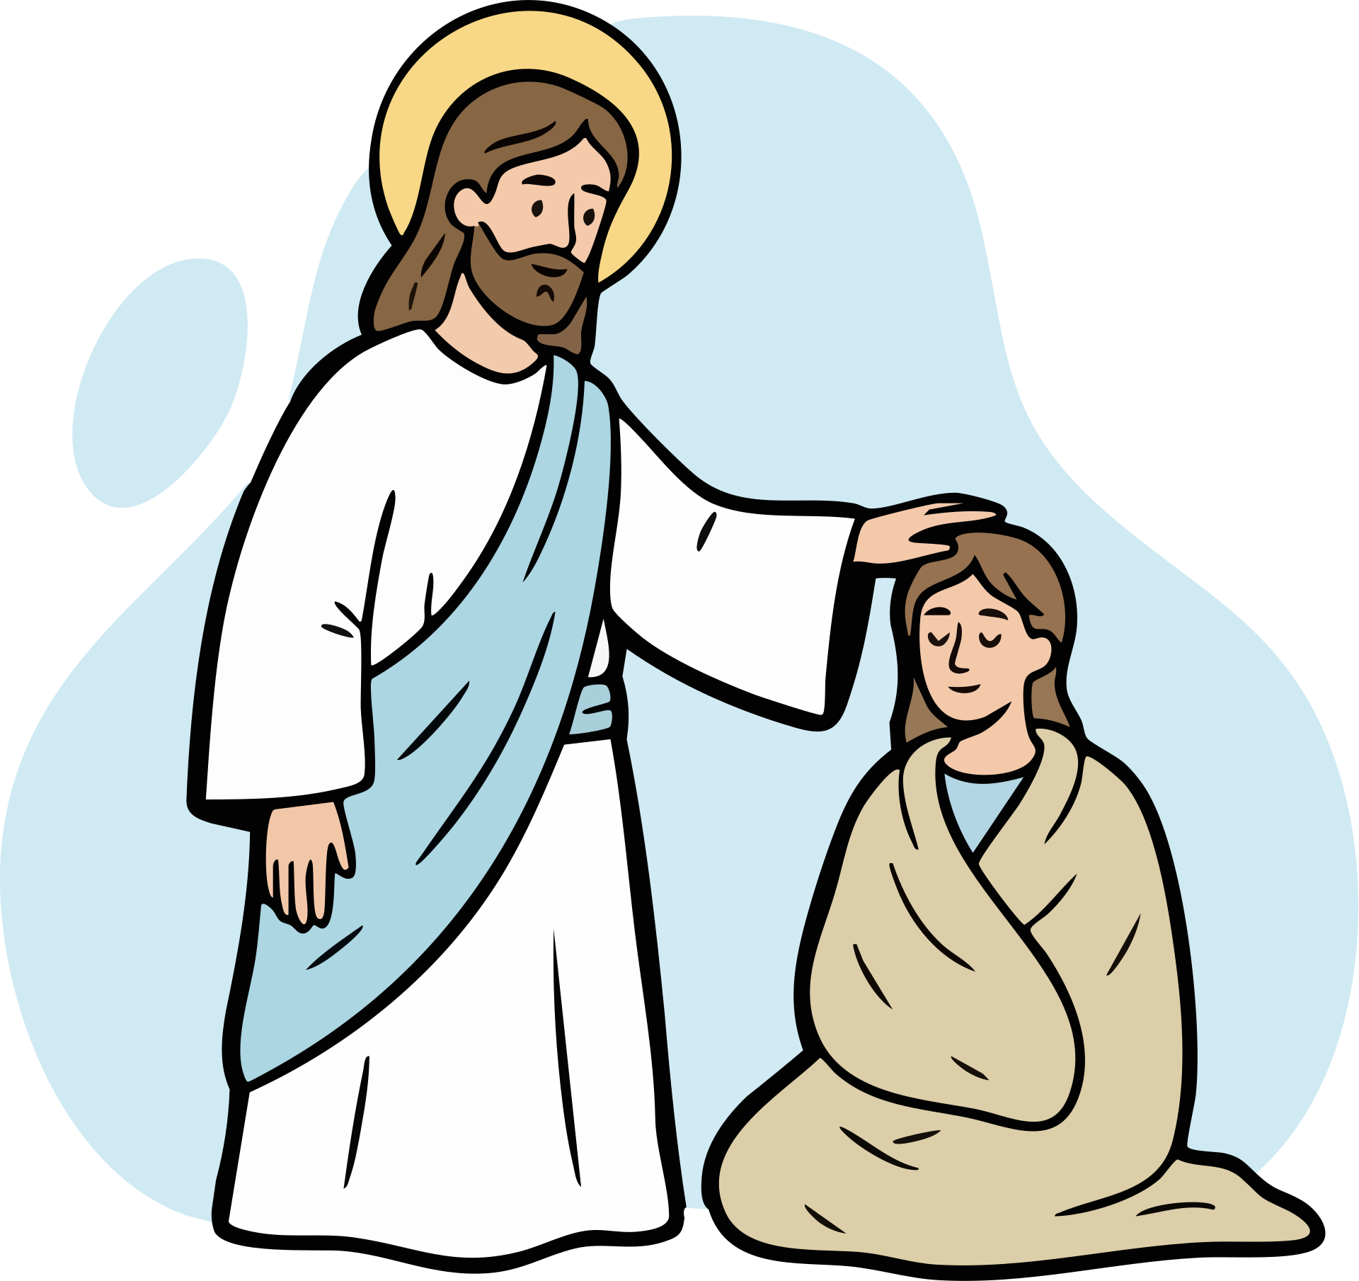
Would Jesus rather...
give the sick medicine
heal the sick

Slide 22

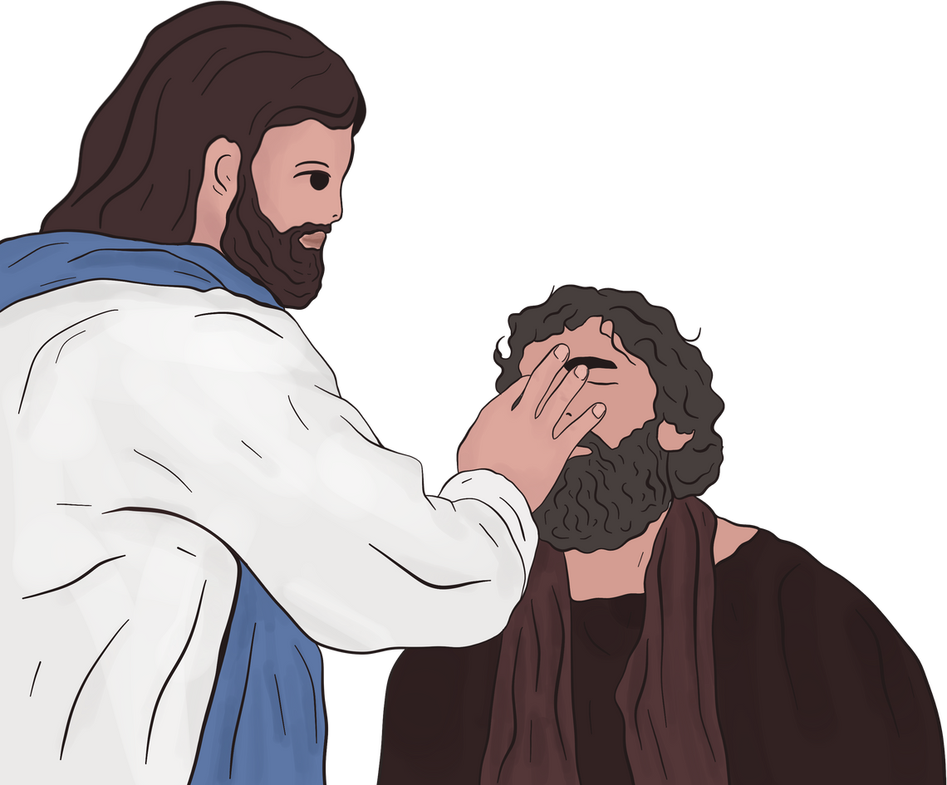
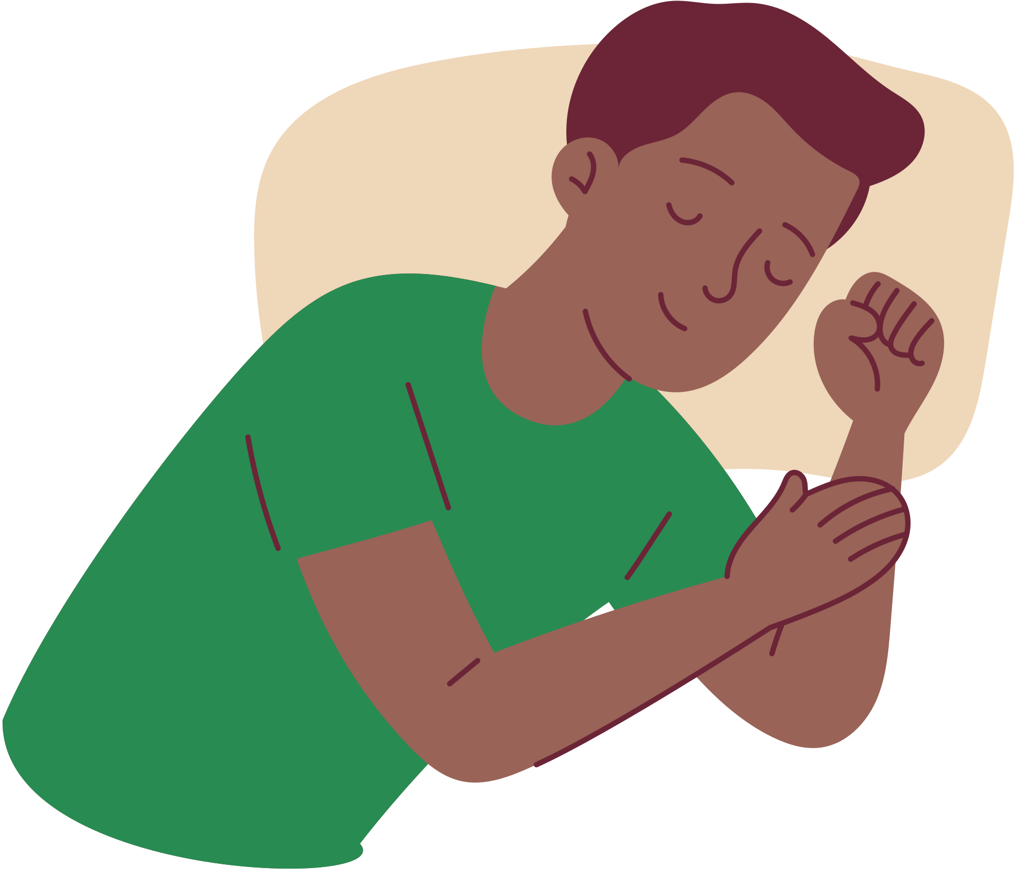

Would Jesus rather...
heal the blind
sleep

Slide 23

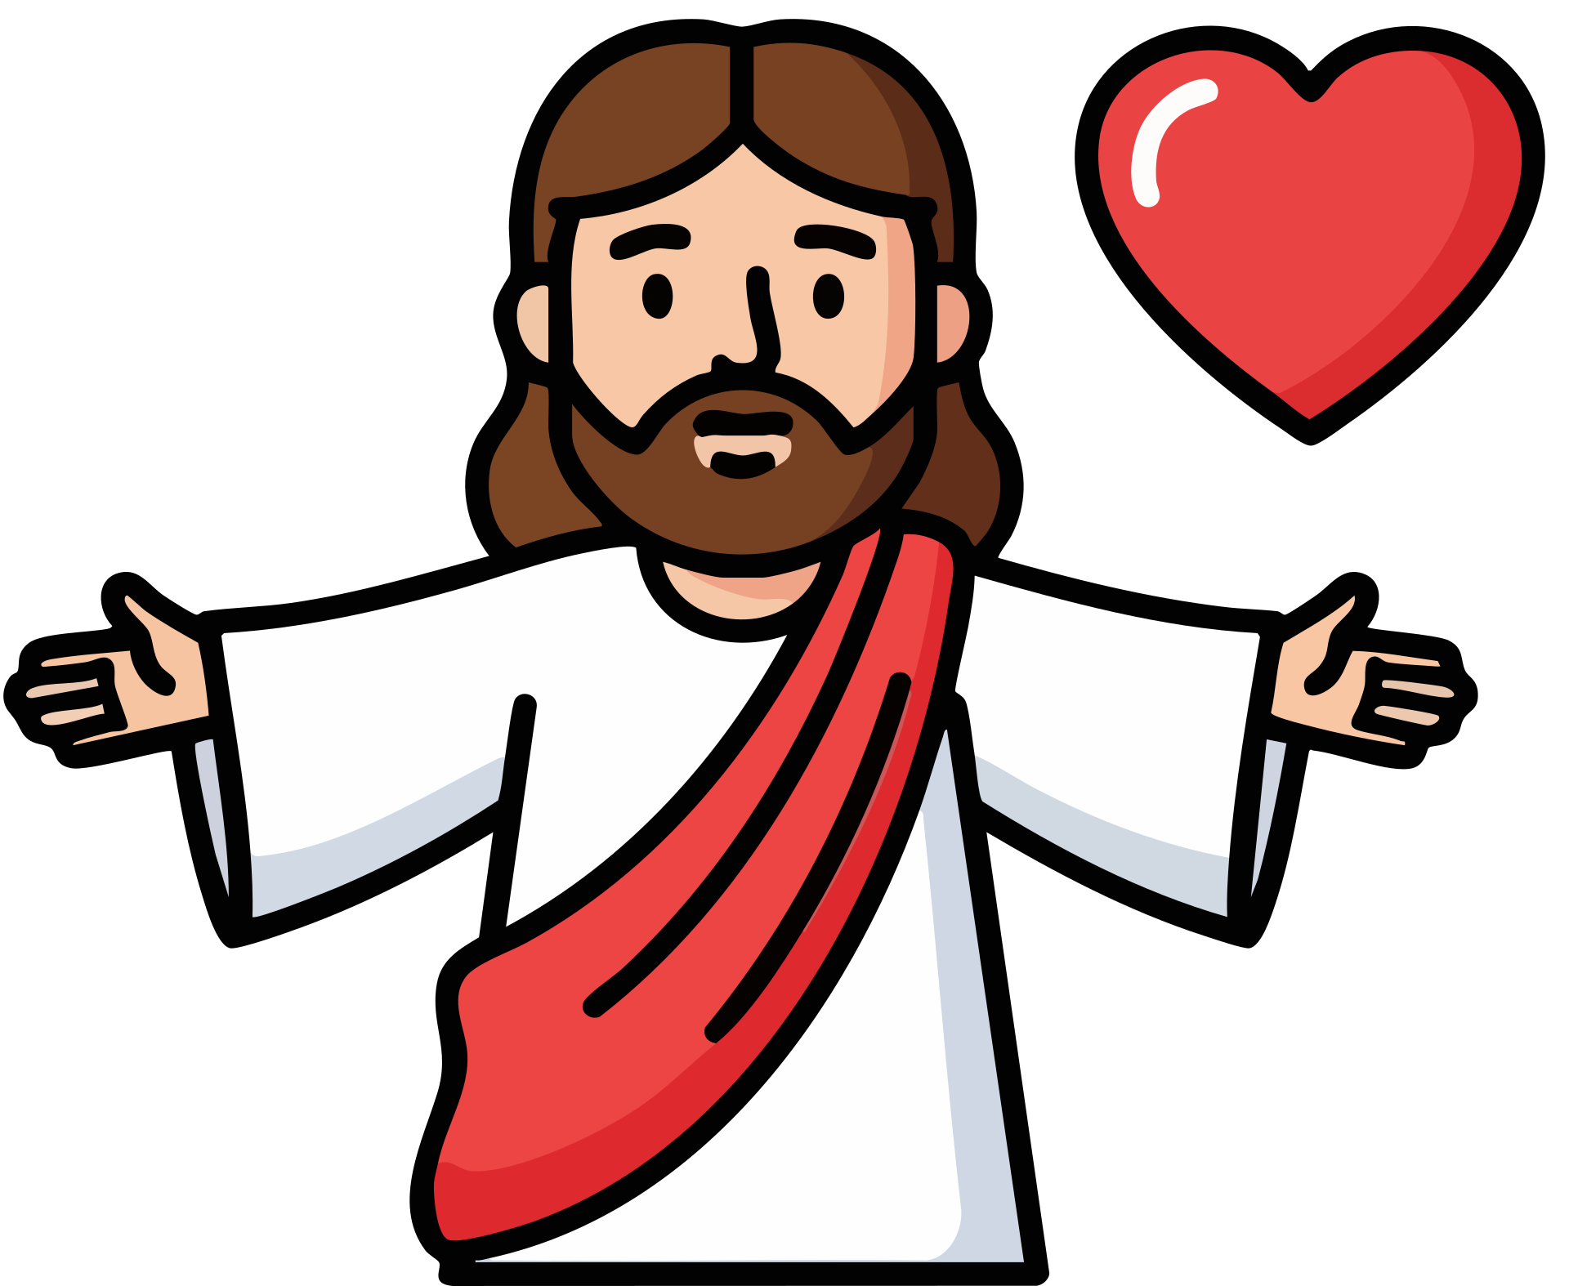
Would you rather...
be like Jesus
be like devil

Slide 24

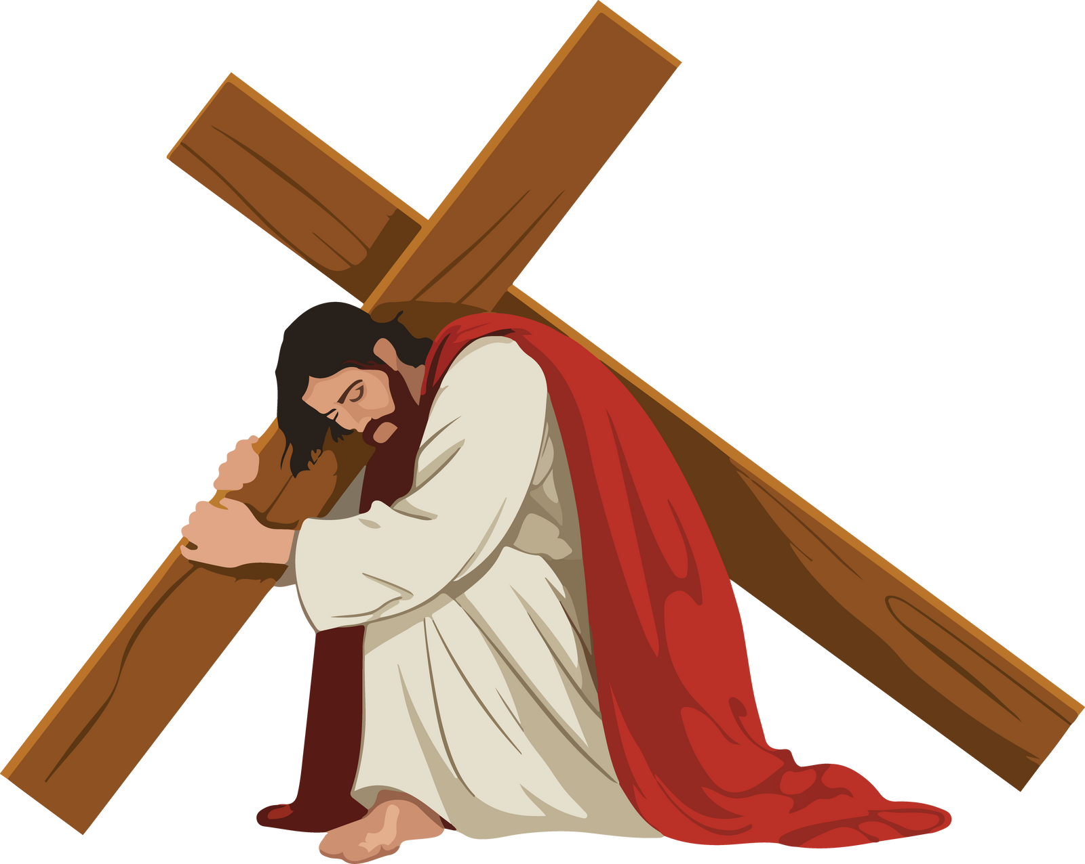
Be like Jesus and help others

