Slide 1






THE POWER OF FORGIVENESS
Why Forgiveness Matters
Unit 1-Growing Strong in Faith
Week 4

Slide 2


FOCUS SCRIPTURES
Matthew 6:14-15
“For if you forgive other people when they sin against you, your heavenly Father will also forgive you. But if you do not forgive others their sins, your Father will not forgive your sins.”
‭‭Matthew‬ ‭6‬:‭14‬-‭15‬ ‭NIV‬‬

Slide 3


FORGIVNESS IS NECESSARY
At some point in life, we all get hurt. People may say things that offend us, betray our trust, or do things that feel unfair. Our natural reaction is often to hold on to anger, resentment, or even seek revenge. But Jesus teaches that forgiveness is necessary for our spiritual growth and peace.

Slide 4
WHY WE NEED TO FORGIVE
In Matthew 6:14-15, Jesus says that if we forgive others, God will also forgive us. But if we refuse to forgive, we hold ourselves back from experiencing the fullness of God’s grace.
Forgiveness doesn’t mean that what someone did was okay. It means we are choosing to let go of the burden and give it to God. When we forgive, we free ourselves from bitterness and open the door for healing.

Slide 5
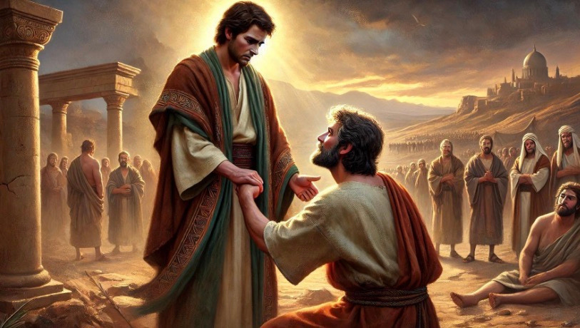
JESUS GAVE THE ULTIMATE EXAMPLE OF FORGIVENESS ON THE CROSS. EVEN AS HE WAS BEING CRUCIFIED, HE PRAYED, "FATHER, FORGIVE THEM." IF JESUS CAN FORGIVE THOSE WHO HURT HIM, WE CAN ALSO LEARN TO FORGIVE THOSE WHO WRONG US.

Slide 6

KEY LESSONS
FORGIVING OTHERS ALLOWS US TO EXPERIENCE GOD’S FORGIVENESS.
​HOLDING ONTO BITTERNESS ONLY HURTS US.
FORGIVENESS BRINGS HEALING, PEACE, AND FREEDOM.

Slide 7

LIFE APPLICATIONS
When someone hurts us, it can feel impossible to forgive. But choosing to let go of anger and give the situation to God brings us peace.

Slide 8
HERE ARE SOME WAYS TO PRACTICE FORGIVENESS:
✅ Pray for the person who hurt you, even if it’s hard.
✅ Choose to let go instead of holding on to grudges.
✅ Remember that forgiving doesn’t mean forgetting—it means healing.
✅ Trust that God sees everything and will bring justice in His time.
Forgiveness is not always easy, but it sets us free.

Slide 9



REFLECTIVE QUESTIONS
1. ​Is there someone in your life you need to forgive?
2. ​How does Jesus’ example of forgiveness challenge you? ​
3. ​How does holding on to anger affect your heart and mind?

Slide 10

ACTIVITY
CREATE A RAP OR POEM ABOUT FORGIVENESS

Slide 11
PRAYER
Dear God,
Help me to forgive as You have forgiven me. I don’t want to hold onto anger or bitterness. Teach me to let go and trust You to bring healing. Thank You for Your endless grace and love. Amen.

