Slide 1
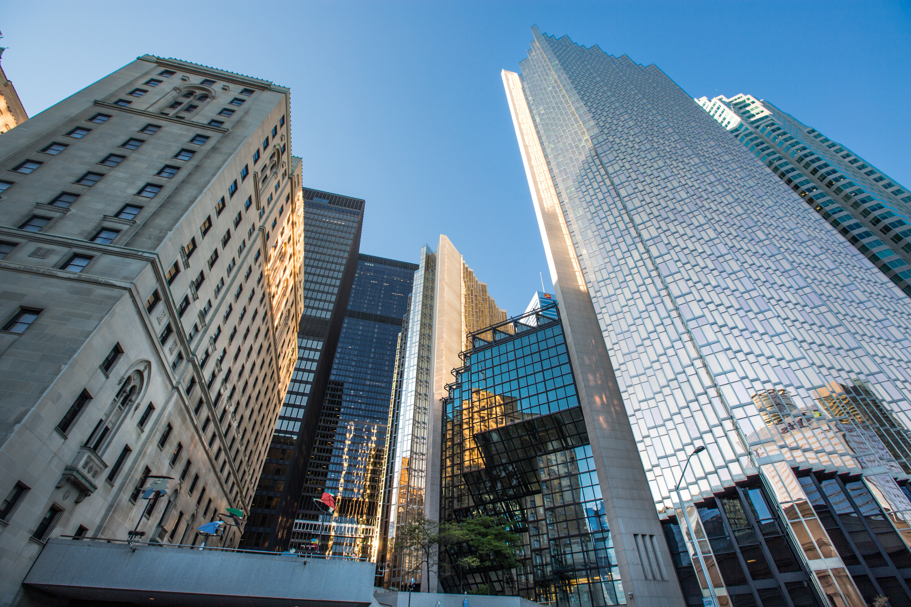




Let’s first practice reading psalms 91

Slide 2
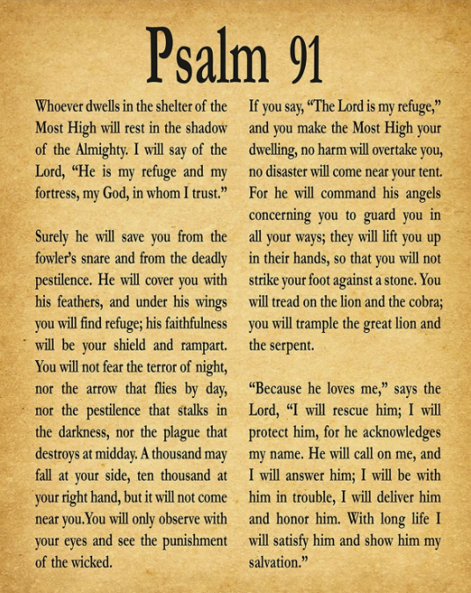
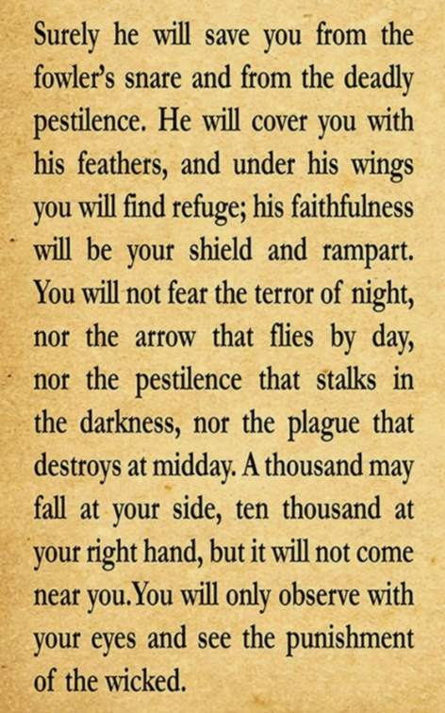
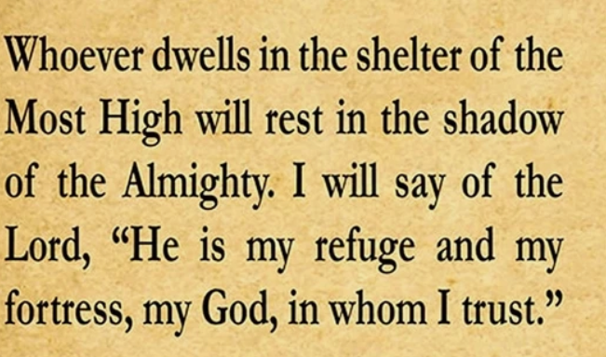


Slide 3
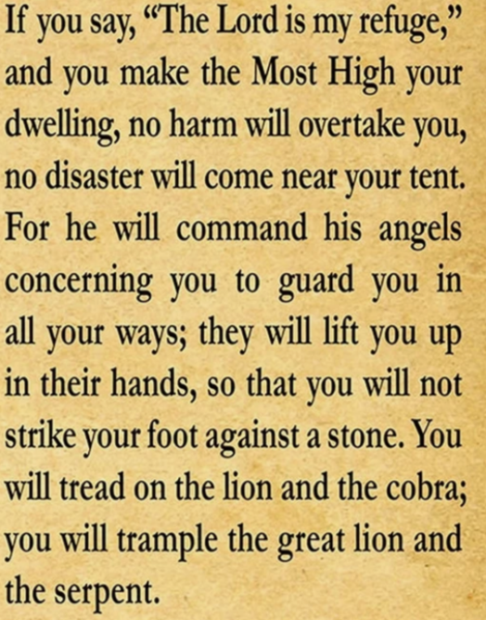
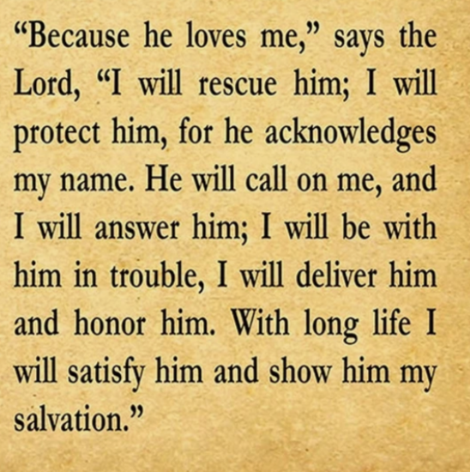

Slide 4
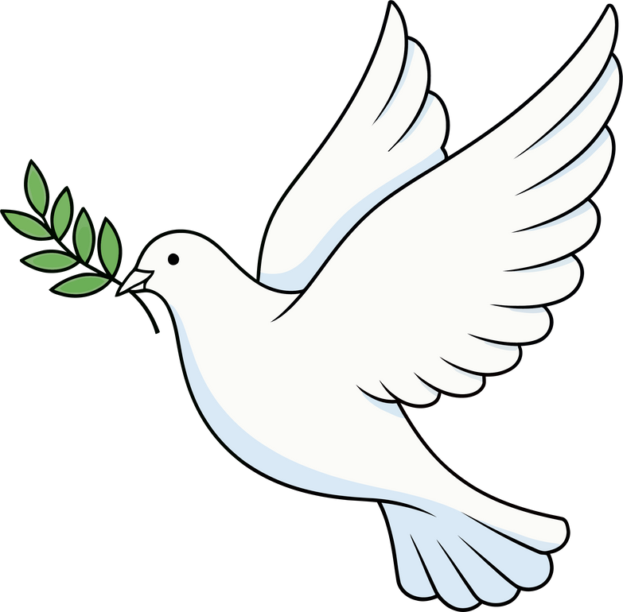

Week 4
Stay Close to God for Spiritual Safety

Slide 5

Proverbs 18:10
“The name of the Lord is a strong tower; the righteous run to it and are safe.”

Slide 6


Focus
Spiritual safety comes from being close to God.

Slide 7
we will Recognize how prayer, Scripture, and worship protect our hearts.
Identify ways to stay spiritually strong in daily life.

Slide 8


today we will learn how David was spiritually strong and felt safe with god

Slide 9


Slide 10
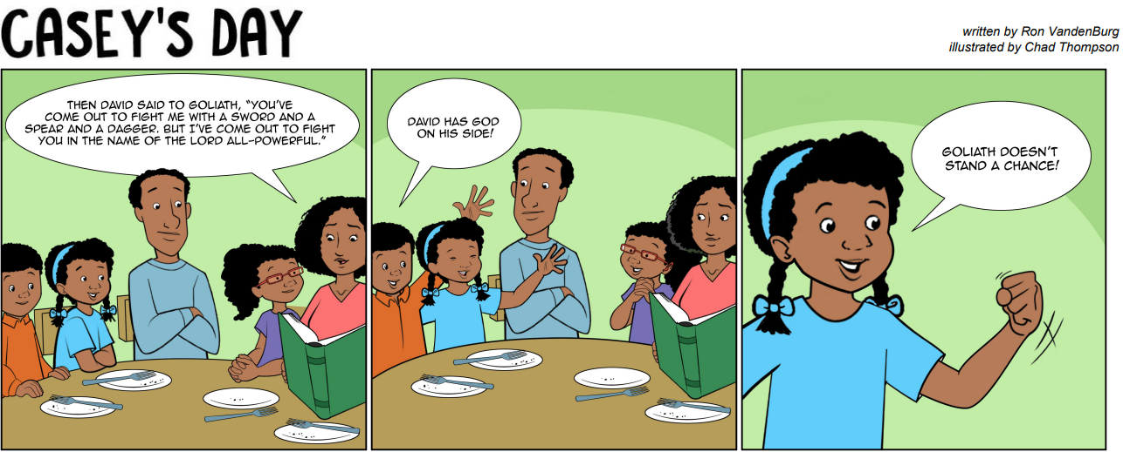

Slide 11

how did david “run to god?
how can we “run to god” when we are in trouble?

Slide 12
david was close to god because he loved God, knew the power of god and he trusted god!

Slide 13
What are some “spiritual dangers” in our world today?

Slide 14
How does reading the Bible help you stay safe spiritually?

Slide 15
we can stay spiritually strong in daily life by:
reading our bible
obeying
praying
trusting God
loving god and people

Slide 16
closing prayer
God, help us stay close to You every day. Protect our minds and hearts from things that lead us away from You. Amen

Slide 17
activity

