Slide 1


BIG BEGINNINGS WITH A BIG GOD
RAINBOWS AND PROMISES
GOD SAVES NOAH
UNIT 1
WEEK 4

Slide 2
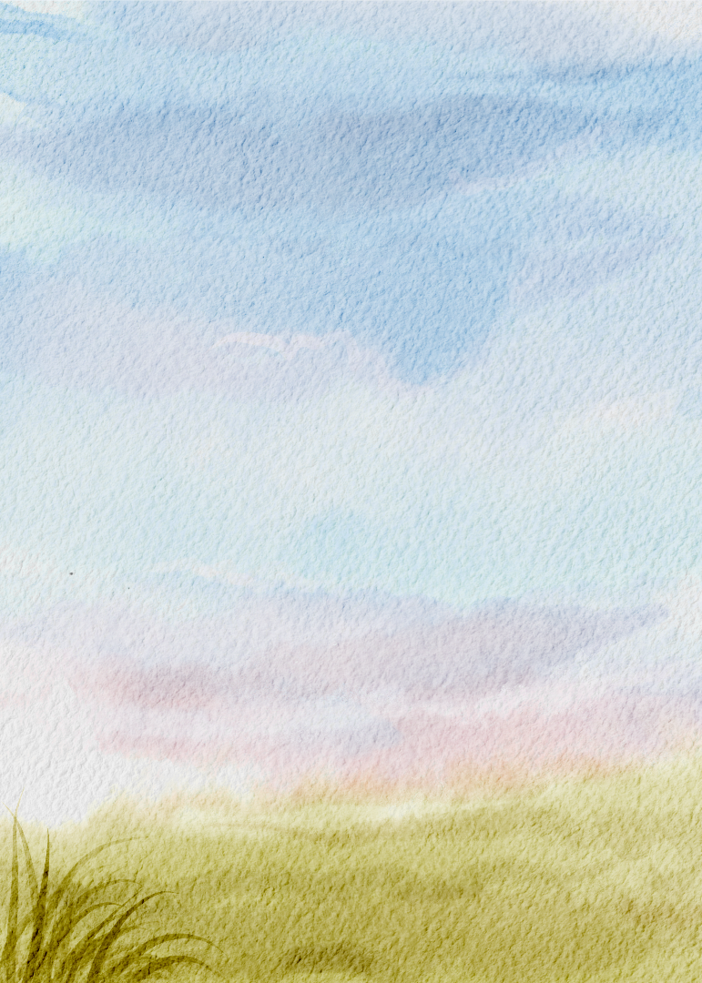
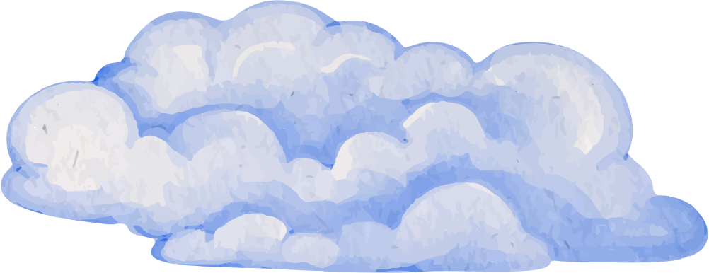
FOCUS SCRIPTURE
“Whenever the rainbow appears in the clouds, I will see it and remember...” – Genesis 9:16

Slide 3

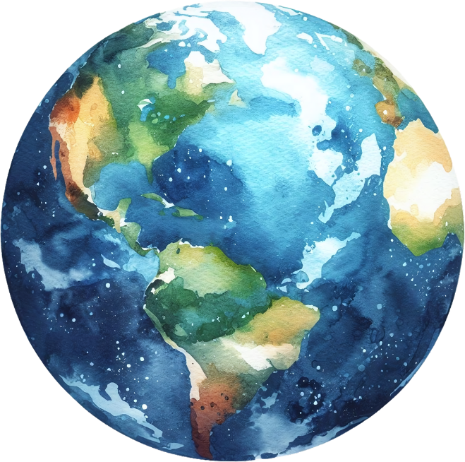
NOAH WAS GOOD
A long time after Adam and Eve, people on the earth had forgotten how to follow Father God. They were doing whatever they wanted, hurting one another, and choosing sin over Father God's ways. The Bible says Noah was a good man who listened and walked with Father God, even when no one else did.

Slide 4
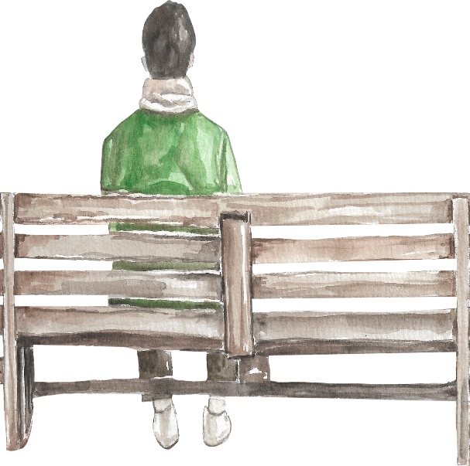
FATHER GOD’S MESSAGE
Father God told Noah, 'A big rain is coming to wash the earth clean from all the evil. You must build a giant boat called an Ark to keep your family safe.’ Noah trusted Father God and obeyed.

Slide 5
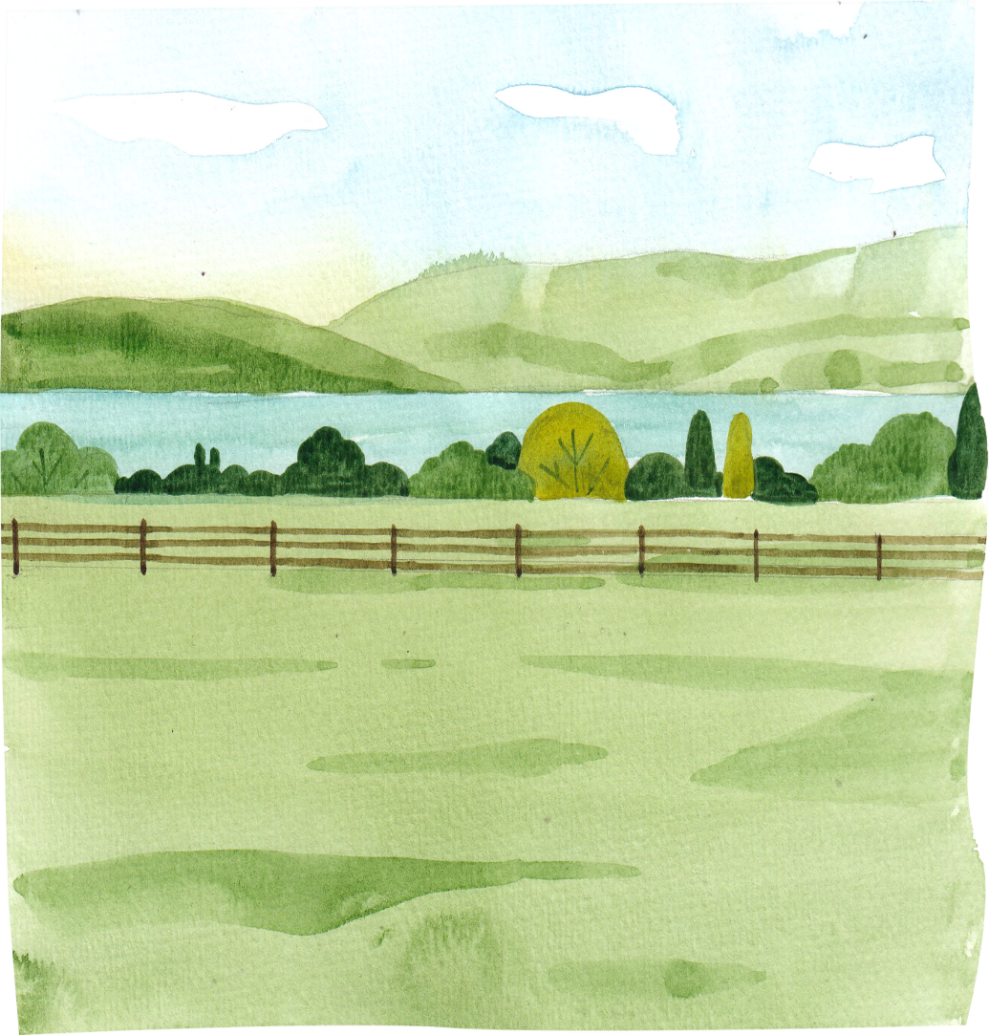
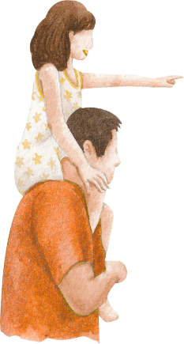
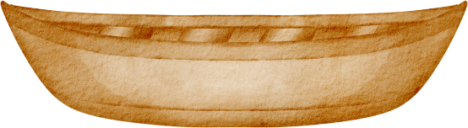
BUILDING THE
ARK
Noah didn't wait! He and his family listened to Father God and worked very hard, building the giant wooden Ark just as Father God asked. He worked for a long time, building and warning people, but they didn’t listen.

Slide 6
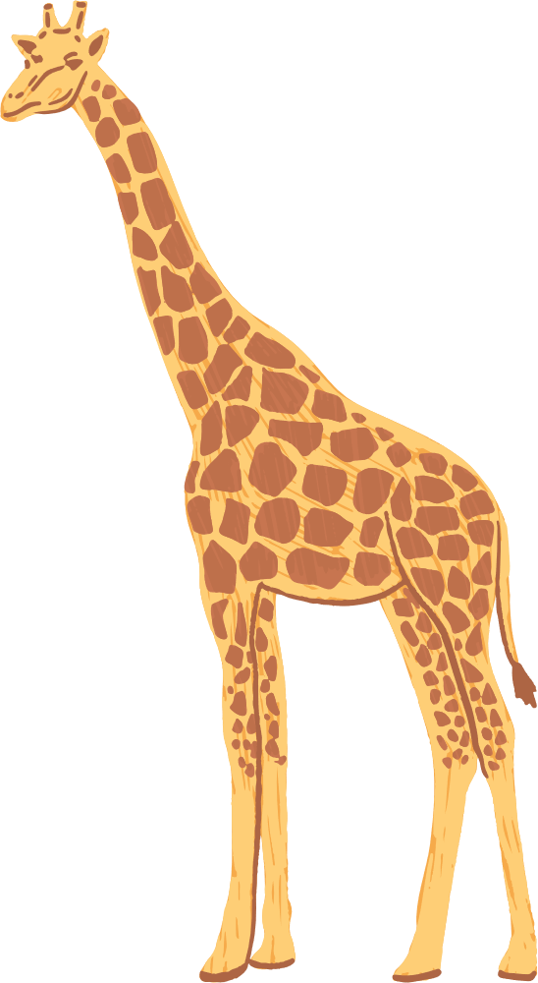

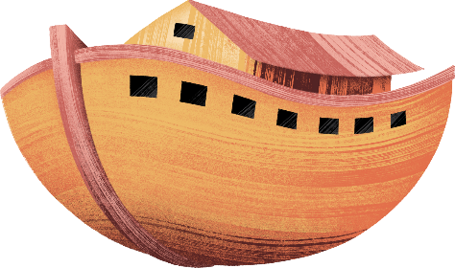

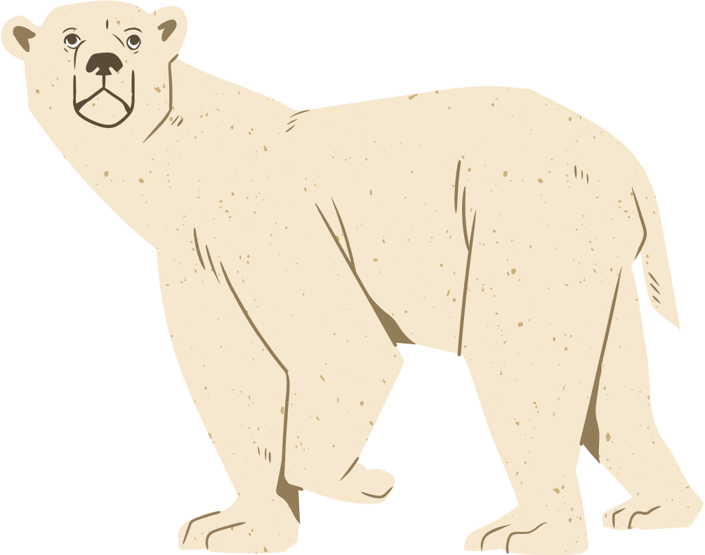

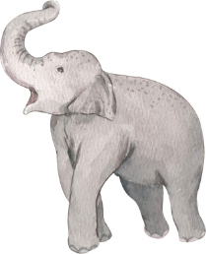
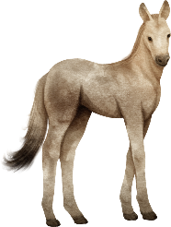
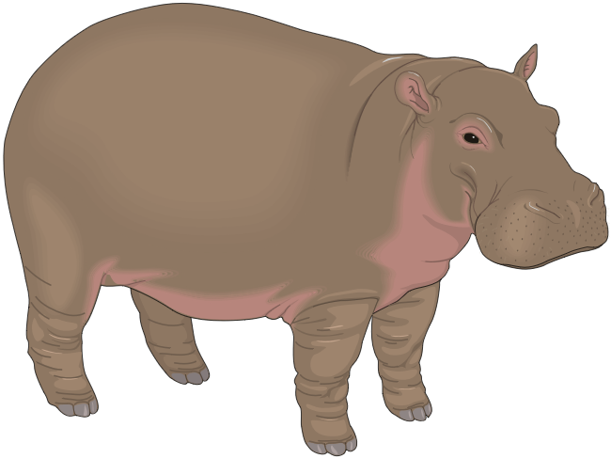
TWO OF EVERY KIND
Father God sent every kind of animal to the Ark! Two of each kind walked, hopped, and slithered right in!

Slide 7
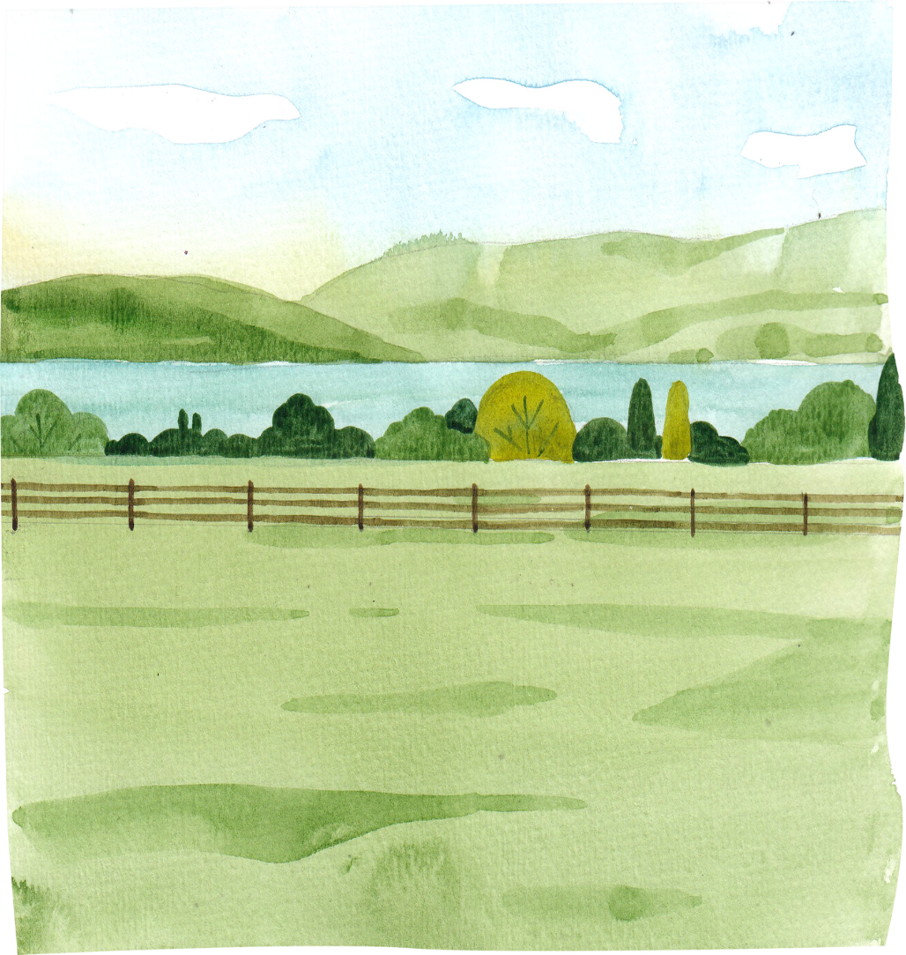

THE DOORS SHUT TIGHT
Noah, his family, and all the animals went safely inside. Father God closed the door tight!

Slide 8
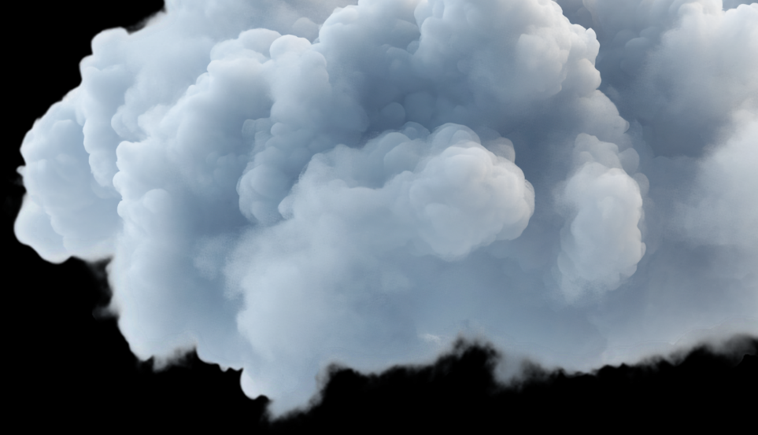

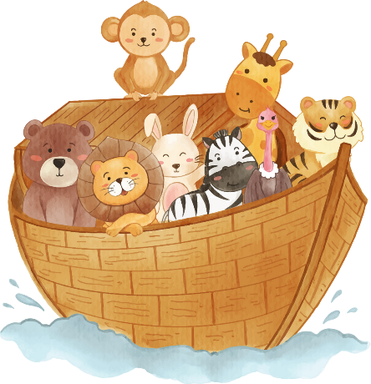
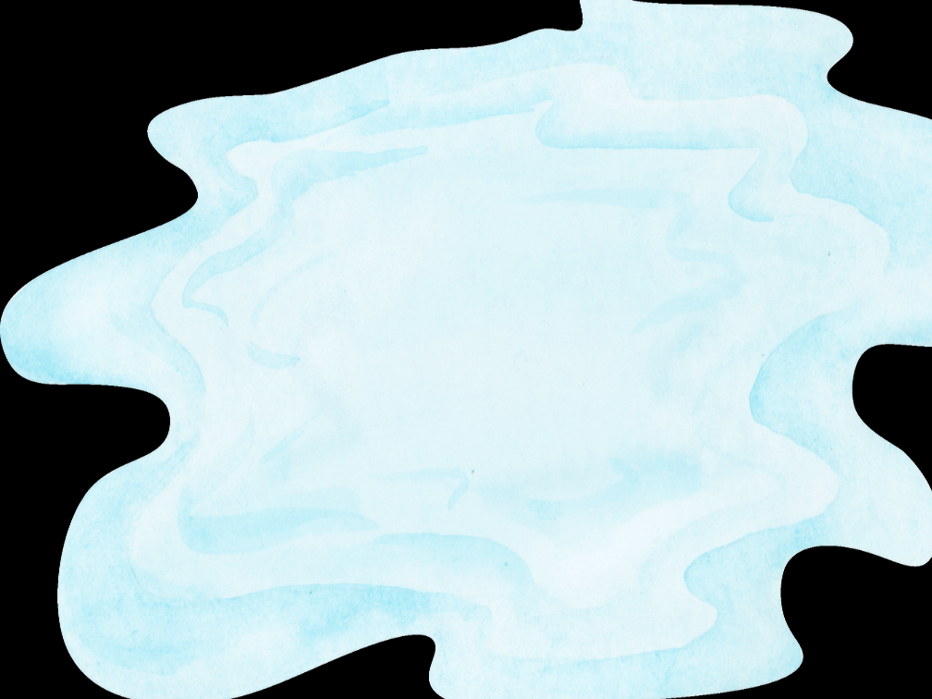
THE RAIN FALLS
When the rain came, it poured for 40 days and 40 nights.

Slide 9
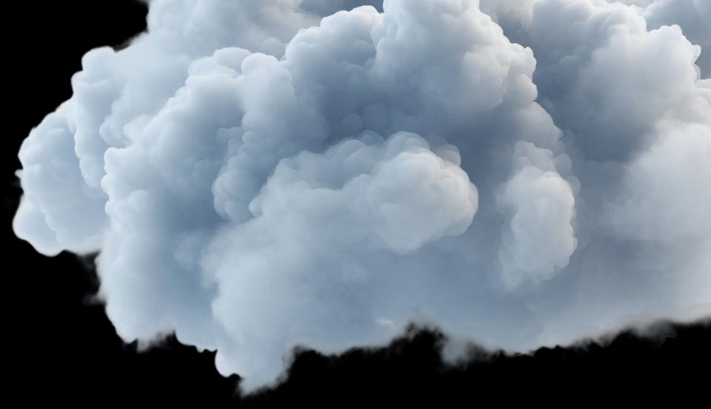
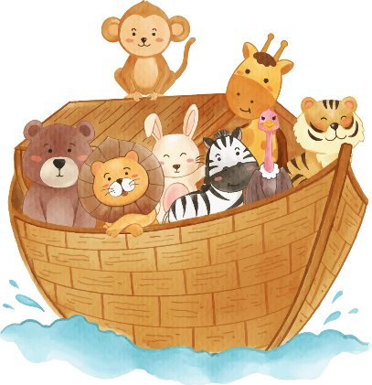
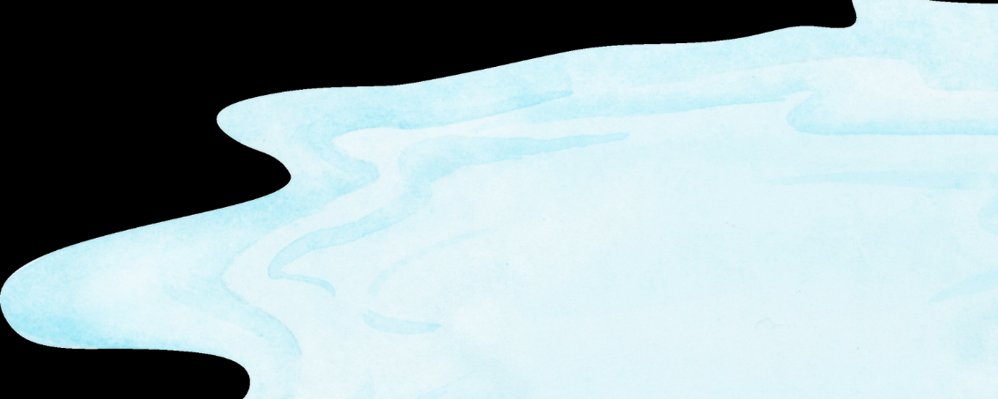
SAFE IN THE ARK
For many days, the rain fell. But Noah and everyone inside the strong Ark were safe and sound! Father God took care of them. Noah sent a dove out of the ark and the second time it came back with an olive branch.

Slide 10
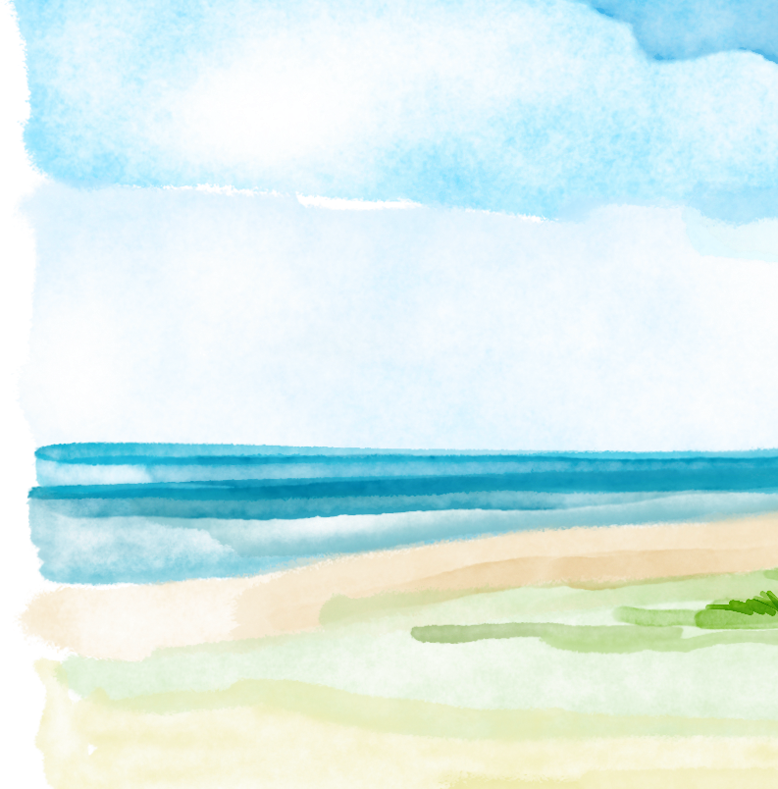





BACK ON DRY LAND
After many days in the ark, the water finally dried up.

Slide 11
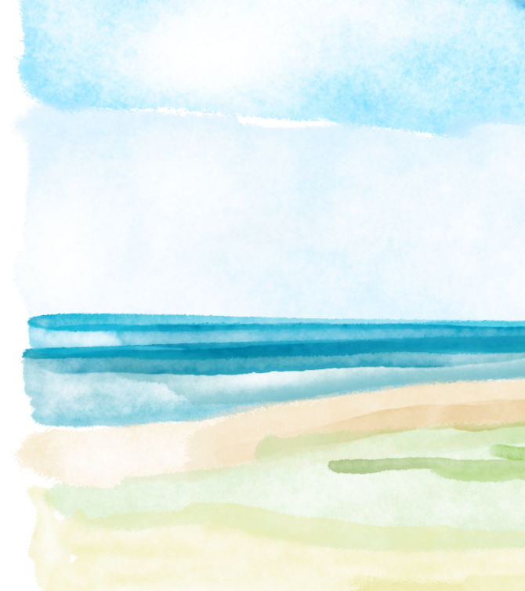

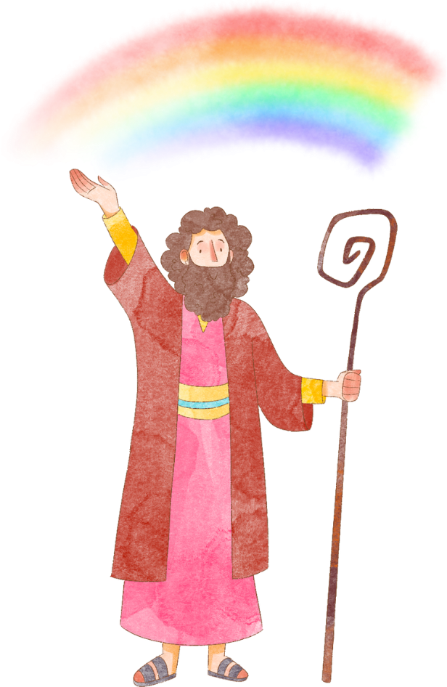
THE BEAUTIFUL RAINBOW
Father God put a rainbow in the sky and made a promise: He would never again flood the entire earth. The rainbow is Father God's sign of His faithful love and promises. Even today, when we see a rainbow, it reminds us that Father God keeps His promises and watches over those who trust Him just like He did with Noah.

Slide 12
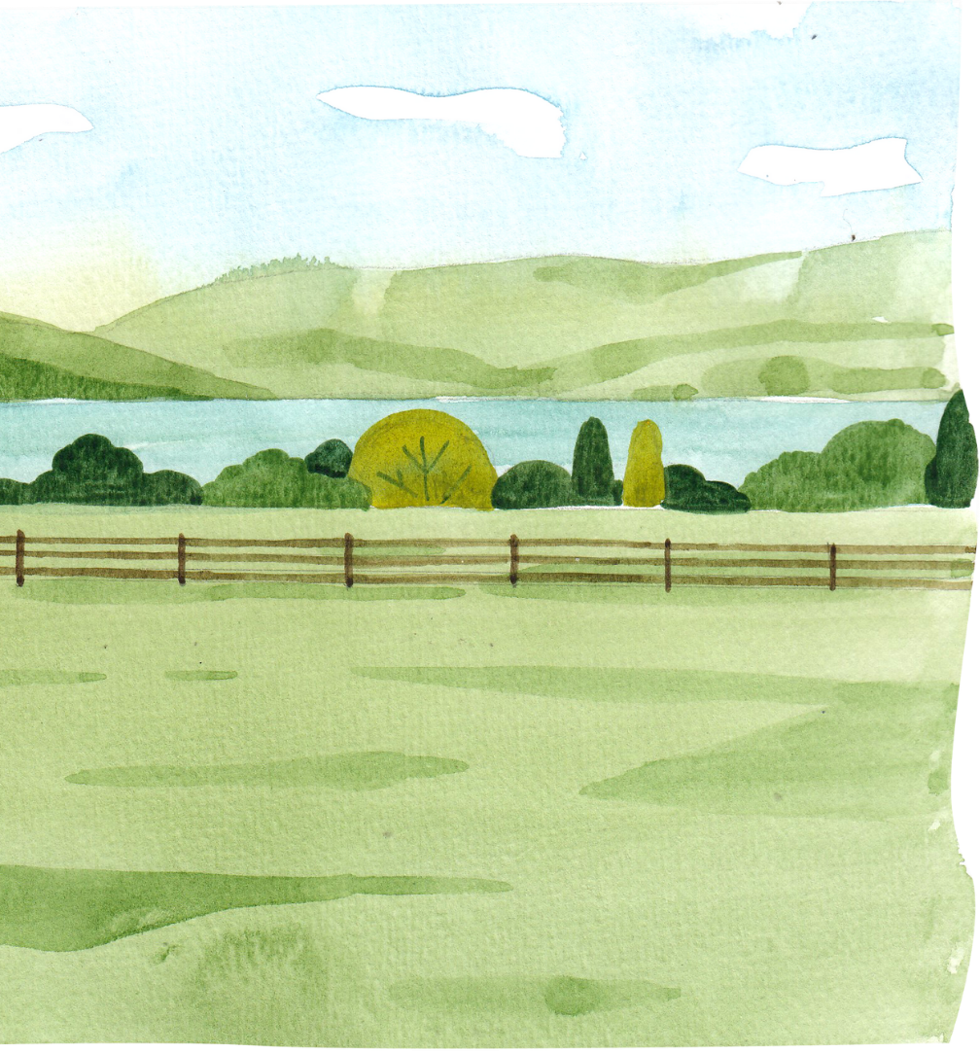

LET’S REMEMBER
Even when the world is dark, Father God always keeps His promises.

Slide 13
DISCUSSION QUESTIONS
1. Why did Father God choose Noah to build the ark?
2. How did Noah show his trust in Father God?
3. What do rainbows remind you of today?

Slide 14


Slide 15
ACTIVITY: CHARADES
HAVE ONE CHILD ACT OUT AN ANIMAL AND THE OTHER CHILDREN GUESS IT. EVERYONE GETS A TURN.

Slide 16
PRAYER
Dear Father God, thank You for being a promise-keeper. Sometimes the world feels scary, but I know You are always watching over us. Thank You for your rainbow of hope that reminds me of Your love and care. Teach me to walk with You every day, rain or shine. Amen.

