Slide 1





Let’s first practice reading psalms 23

Slide 2
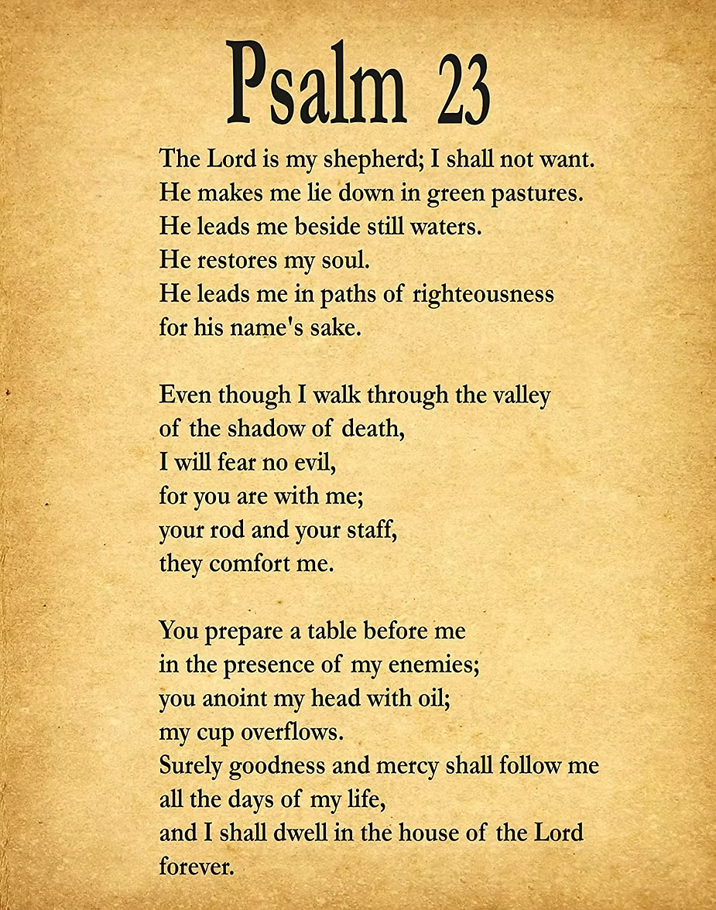


Slide 3
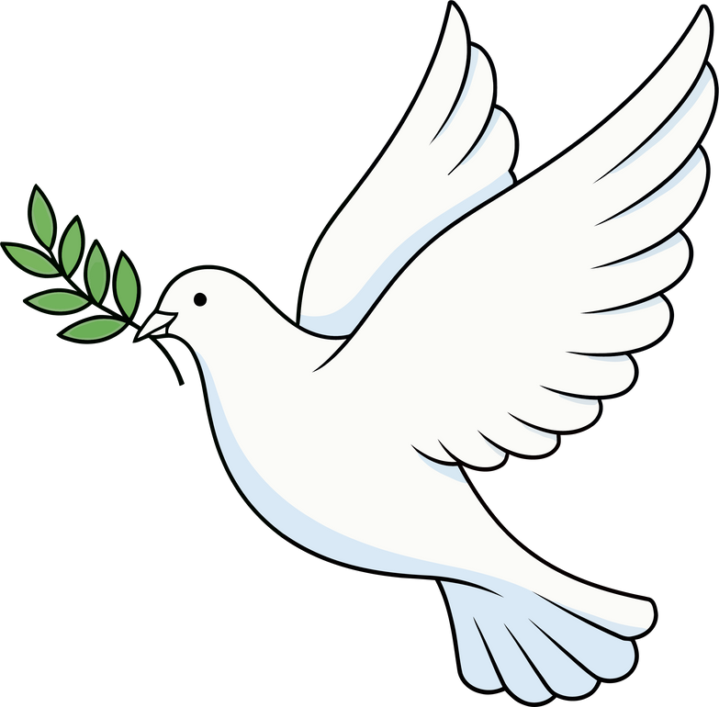

Week 4
Stay Close to god

Slide 4




Proverbs 18:10
God is my safe tower

Slide 5


Focus
Being close to God keeps our hearts safe.

Slide 6

we will learn ways to be close to god
we will learn that we can feel safe in his love

Slide 7


today we will learn from the bible how david was close to god and felt safe with god

Slide 8


Slide 9
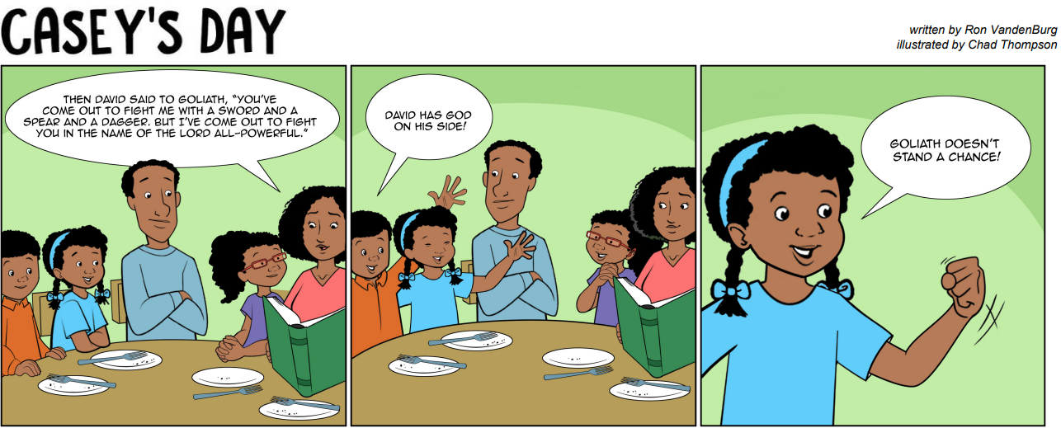

Slide 10

how did david stay close to god?
how can we stay close to god?

Slide 11
david was close to god because he loved God, knew the power of god and he trusted god!

Slide 12
what helps you feel safe in your heart?

Slide 13
we can stay close to god by:
reading our bible
obeying
praying
trusting God
loving god and people

Slide 14

closing prayer
God, help me stay close to You. Amen.

Slide 15
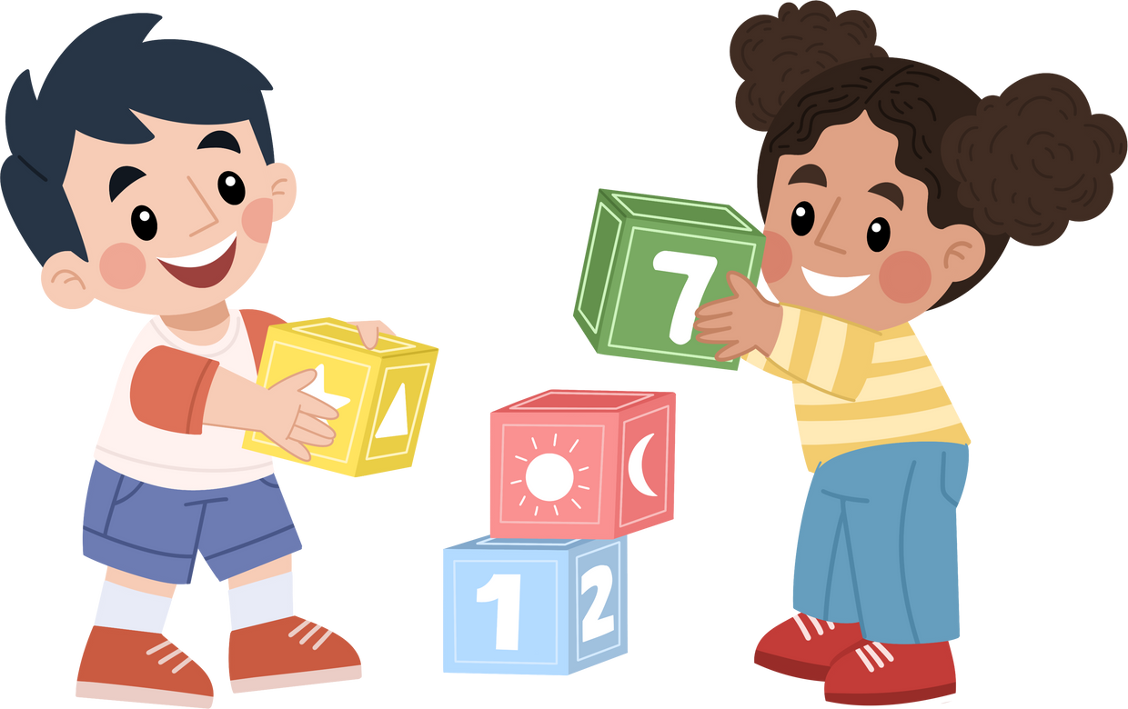
activity

