Slide 1













Week 3
Courage and Caution

Slide 2




What is Courage?
Courage means facing challenges even when we feel afraid. It helps us grow stronger and more confident in life.
Facing fear
Building strength
Growing confidence

Slide 3
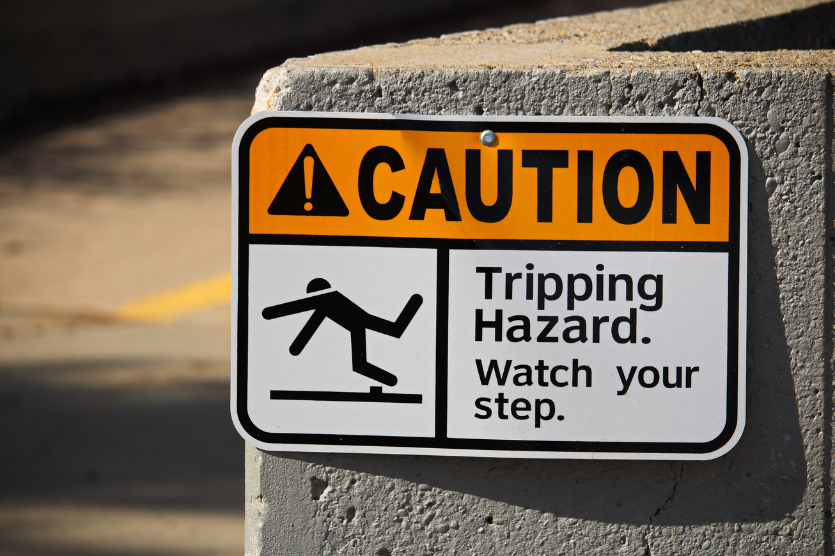
What is Caution?
Caution means to be careful, alert, and prudent in a hazardous situation to avoid danger or risk.

Slide 4



focus
God gives courage, but He also wants us to use good judgment.

Slide 5





We will learn that courage comes from trusting God.
Being careful doesn’t mean being afraid.

Slide 6

Let’s see an example from the bible how courage comes from trusting God and how being careful doesn’t mean being afraid.

Slide 7
We will learn that courage comes from trusting God.
Being careful doesn’t mean being afraid.
JOSHUA WAS COURAGEOUS BECAUSE HE TRUSTED AND OBEYED GOD AND BECAME THE NEW LEADER.
GOD TOLD JOSHUA TO BE CAREFUL BY OBEYING GOD’S WORD BUT HE WASN’T AFRAID.

Slide 8
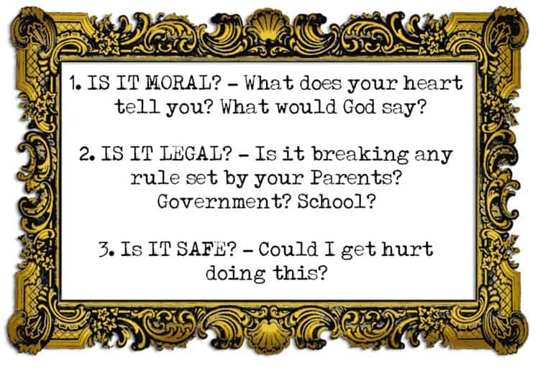

Slide 9
Discussion Questions
What’s a situation where courage helped you stay safe?

Slide 10
Discussion Questions
How does God’s presence help you when you feel afraid?

Slide 11
Discussion Questions
What’s the difference between courage and recklessness?

Slide 12
Courage at Home
At home, courage is about taking responsibility, admitting mistakes, and helping with family chores even when it’s hard.

Slide 13
Courage at school
At school, courage can mean raising your hand in class, standing up against bullying, or asking questions when you don’t understand.

Slide 14
Activity
Let’s play a game!

Slide 15

closing Prayer
Lord, thank You for giving us courage. Help us be brave and wise in every situation. Keep us from fear and from danger. Amen.”

