Slide 1



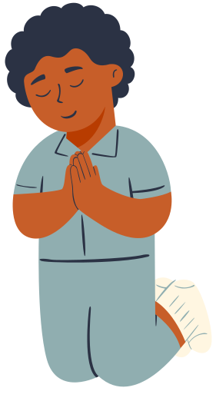

WEEK 3
courage and cAre

Slide 2
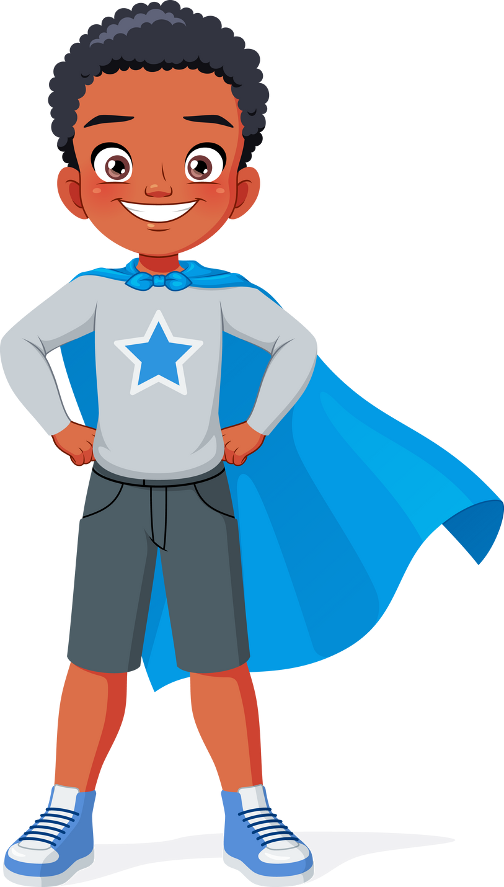
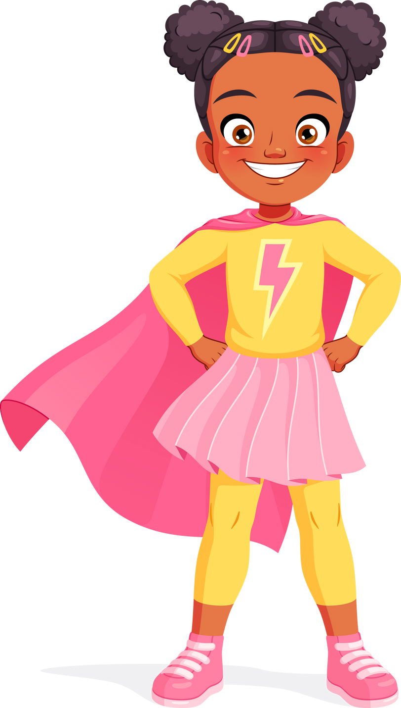
What is Courage?
COURAGE MEANS FACING WHAT’S HARD EVEN WHEN WE FEEL AFRAID. IT HELPS US GROW STRONGER AND MORE CONFIDENT IN LIFE.

Slide 3
Joshua 1:9
Be Brave! God is with you

Slide 4

FOCUS
god gives us courage and teaches us to be careful.

Slide 5

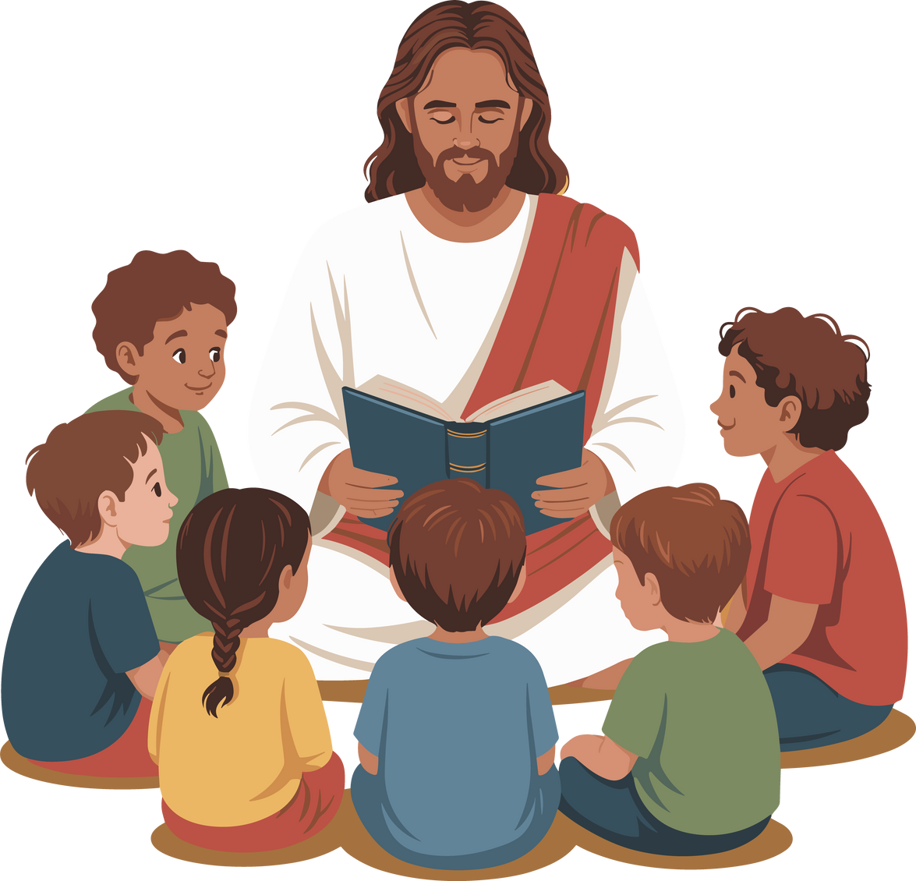

WE CAN FEEL BRAVE WITH GOD
BEING CAREFUL IS GOOD

Slide 6

LET’S LEARN FROM THE BIBLE HOW WE CAN FEEL BRAVE WITH GOD AND HOW BEING CAREFUL IS GOOD.

Slide 7
WE CAN FEEL BRAVE WITH GOD
BEING CAREFUL IS GOOD
JOSHUA WAS BRAVE BECAUSE HE BECAME THE NEW LEADER
GOD TOLD JOSHUA TO BE CAREFUL BY OBEYING GOD’S WORD-THE BIBLE

Slide 8


discussion questions
WHAT IS SOMETHING YOU WERE BRAVE TO DO?
HOW DOES GOD HELP YOU WHEN YOU ARE AFRAID?

Slide 9
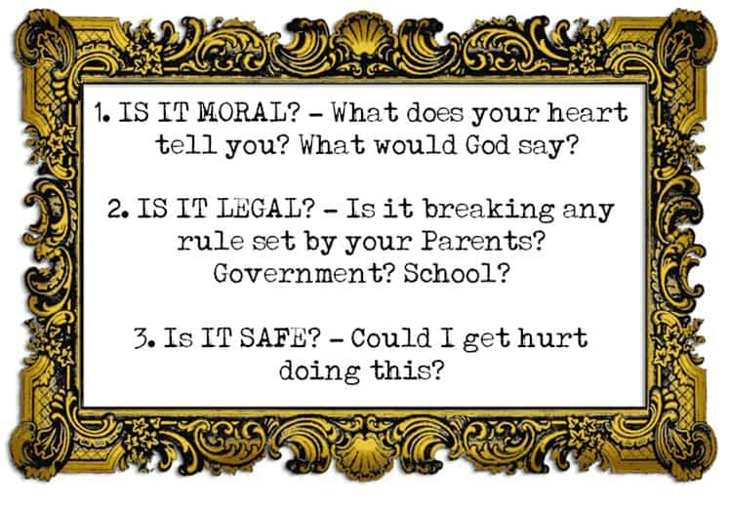

Slide 10
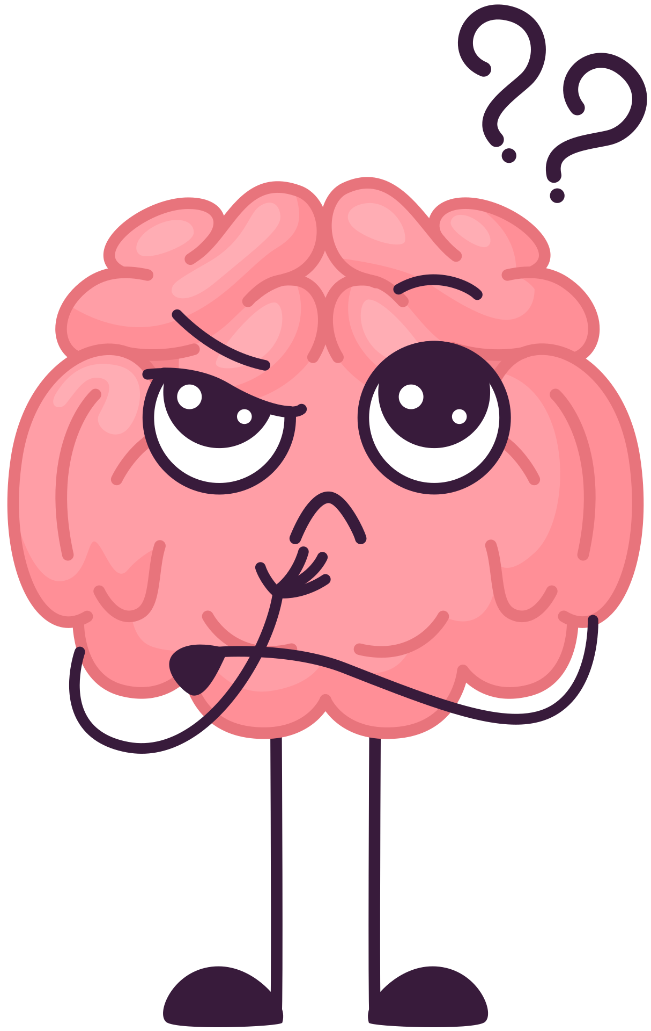
LET’S DO THIS
YOUR MOM IS INSIDE GETTING LUNCH. YOU HAVE A FRIEND OVER AND ARE PLAYING IN THE BACK YARD. IT’S A SUNNY DAY, SO YOU HAVE YOUR SWIM SUIT ON. YOU ALSO HAVE A LIFE JACKET ON. YOUR FRIEND SAYS THAT YOU SHOULD SHOW HOW BRAVE YOU ARE BY JUMPING OFF THE DOCK.
WHAT DO YOU DO?

Slide 11
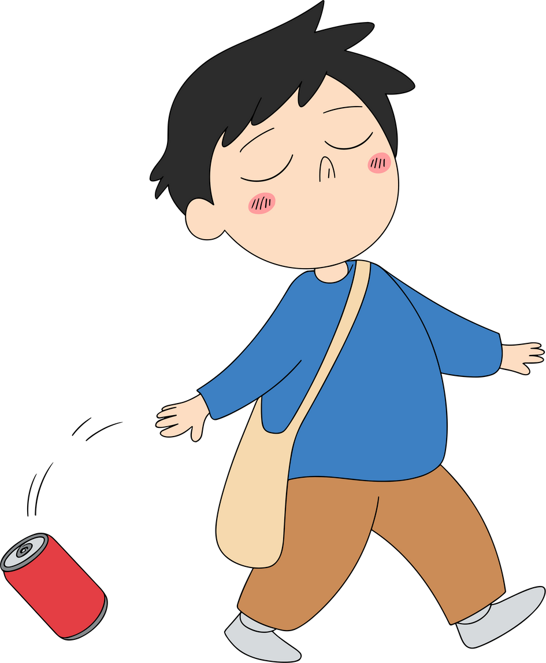
LET’S DO THIS
YOU SEE SOMEONE AT THE PARK WHO IS LITTERING
WHAT DO YOU DO?

Slide 12
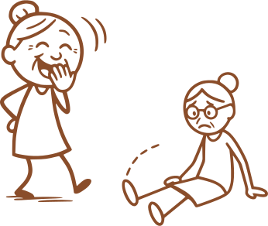
LET’S DO THIS
YOU ARE AT SCHOOL AND ONE OF YOUR FRIENDS IS SAYING MEAN THINGS ABOUT SOMEONE ELSE.
WHAT DO YOU DO?

Slide 13

when you stand up and do what is right you are being brave!

Slide 14
Being careful is
also a way of being brave! we are choosing to be obedient like joshua!

Slide 15

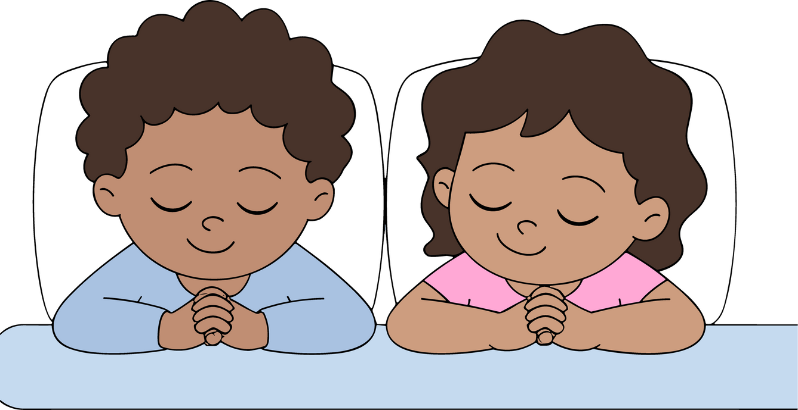

ClOSING PRAYER
“THANK YOU, GOD, FOR GIVING ME COURAGE. AMEN.”

