Slide 1







TRUSTING GOD THROUGH CHALLENGES
Learning To Trust God
Unit 1
Week 2

Slide 2




FOCUS SCRIPTURE
Proverbs 3:5-6
Trust in the Lord with all your heart and lean not on your own understanding; in all your ways submit to him, and he will make your paths straight.

Slide 3

GOD IS WITH US
Life is full of ups and downs, and sometimes, we face situations that seem too big or overwhelming. In these moments, it can be tempting to feel afraid, worried, or uncertain. But the Bible teaches us that we don’t have to figure everything out on our own—God is with us.
Points of reflection:
Instead of trying to solve everything by ourselves, we should turn to God and allow Him to guide us.
Trusting God doesn’t mean that problems will disappear, but it does mean that we won’t face them alone.
When we believe that God is in control and has a plan for our lives, we can find peace even in the middle of difficulties.

Slide 4





LIFE APPLICATION
It’s easy to trust God when life is going well, but the real test of faith comes when things get difficult or uncertain. Instead of letting fear take over, we can pray and ask God for wisdom. We can also read His Word and seek encouragement from people who remind us of His promises.
Even when things don’t make sense, we can hold on to the truth that God loves us and is always working for our good.
Some Things To Do When Challenges Arise:
Read His word.
Pray and ask God for wisdom.
Hold on to the truth.

Slide 5
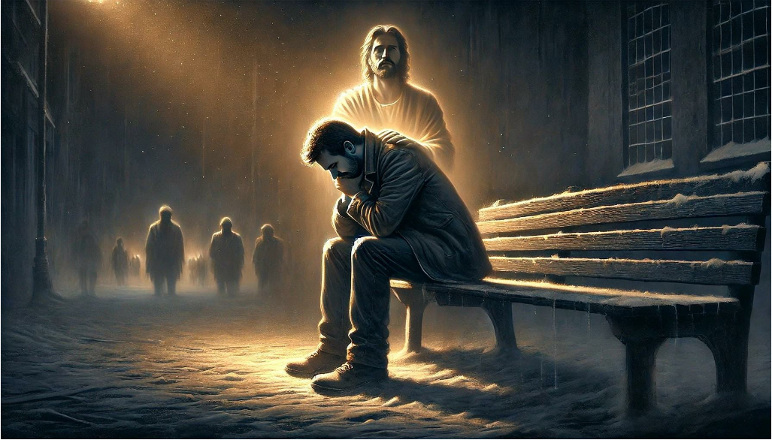


Trusting God means relying on Him instead of worrying about things we can’t control.
God’s plan is always better than ours, even when we don’t understand it right away.
​​When we follow God’s guidance, He will lead us in the right direction.
TURN TO GOD

Slide 6
REFLECTIVE QUESTIONS
1. ​What is a situation where you have struggled to trust God?
​2. ​How can Proverbs 3:5-6 help you rely on God more in difficult times?
​3. ​What are some ways you can remind yourself to trust God every day?

Slide 7


Slide 8
ACTIVITY

Slide 9
Prayer
Dear God,
Help me to trust You in every situation, even when things seem uncertain. Teach me to lean on Your wisdom instead of my own understanding. Thank You for always being with me. Amen.

