Slide 1




Week 2
Wisdom Keeps us Safe

Slide 2


What is wisdom?

Slide 3
Wisdom is the ability to use your knowledge, experience, and good judgment to make sound decisions. It's about more than just being smart; it's about pausing to think through the consequences of your actions, being open-minded, and learning from mistakes. Wisdom means knowing the right thing to do and choosing to do it, which can help you avoid trouble and lead to happiness and safety.
What is wisdom?

Slide 4

“Discretion will protect you, and understanding will guard you.”
Key Verse
PROVERBS 2:11

Slide 5




Focus
God gives us wisdom to make safe and smart choices.

Slide 6




We will learn that wisdom is part of God’s protection.

Slide 7




We will learn how to practice making wise decisions in daily life.

Slide 8



What’s the difference between being smart and being wise?

Slide 9


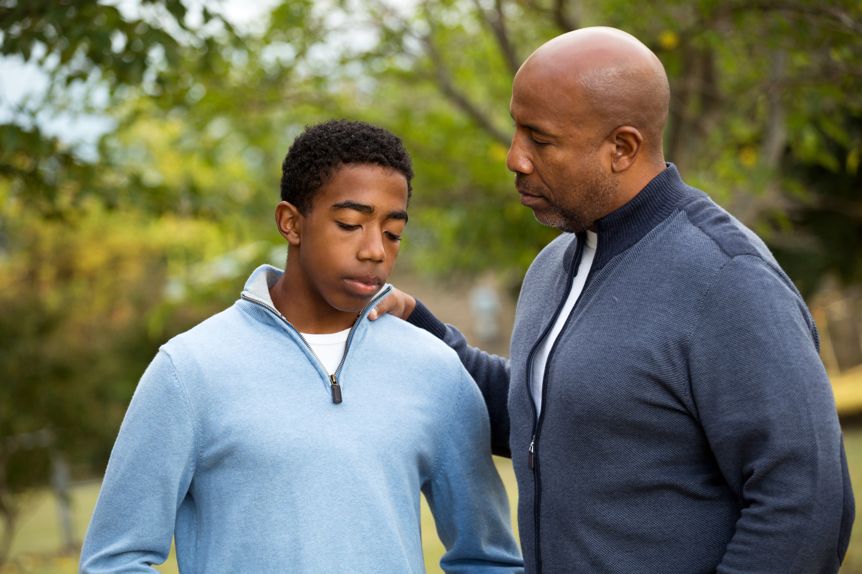
How can listening to parents or mentors keep you safe?

Slide 10
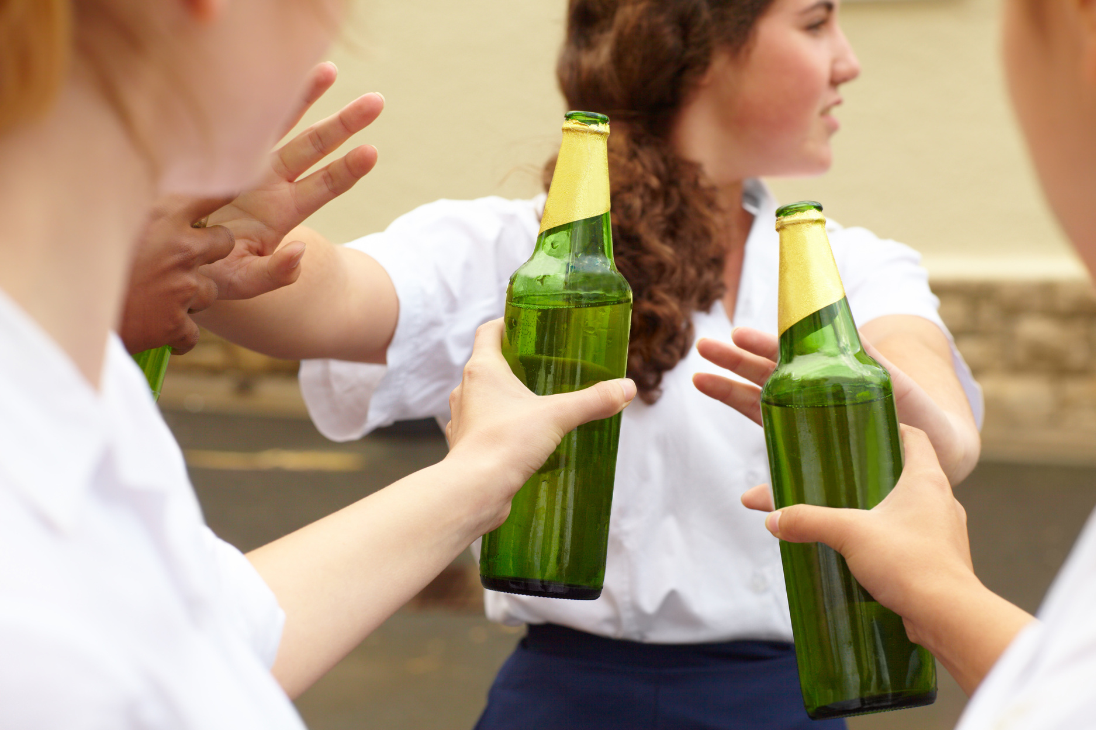
What would you do if your friends pressured you to do something risky?

Slide 11


Activity
“Safety Scenario Challenge” – small groups act out situations where you must use wisdom to stay safe.

Slide 12




Reflection
Practical Application Steps
In our daily lives, it is essential to apply the teachings of the Gospel. Reflect on how faith influences actions. Each morning, invite God into your decisions, seeking His guidance in all matters. As we face challenges, remember that practicing kindness and forgiveness reflects Christ's love. Engage with your community, serving others as a testament to your faith. This journey strengthens not only your spirit but also those around you.

Slide 13

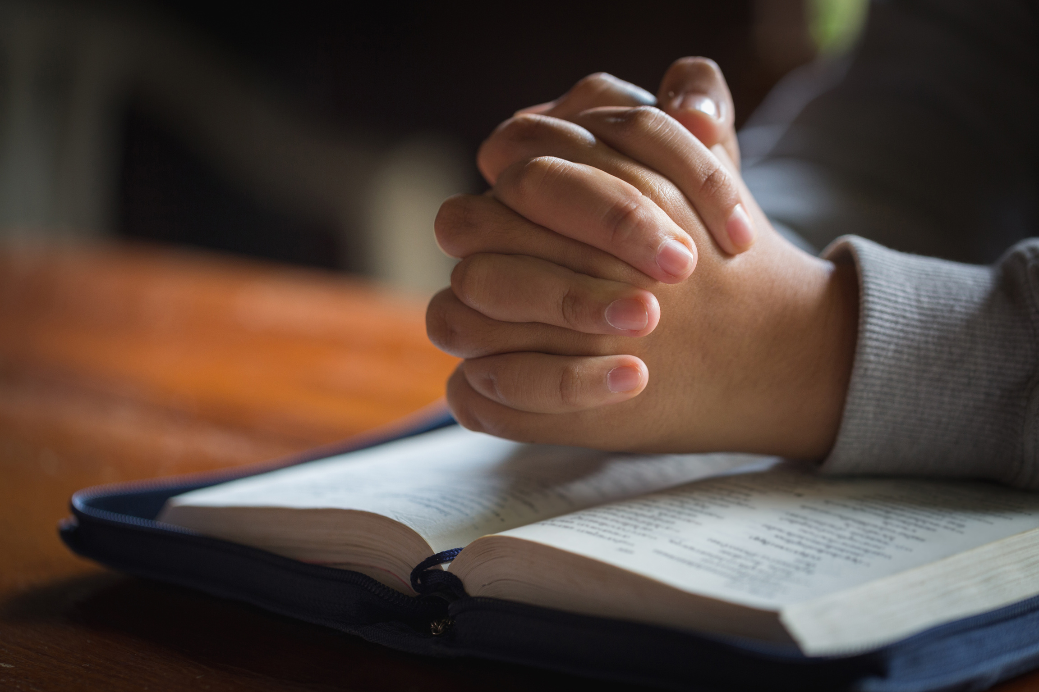

Closing Prayer
“God, give us Your wisdom so we can make choices that protect us and honor You. Help us see danger before it hurts us. Amen.”

Slide 14



Thank You for coming today!
How can we pray for you?

