Slide 1

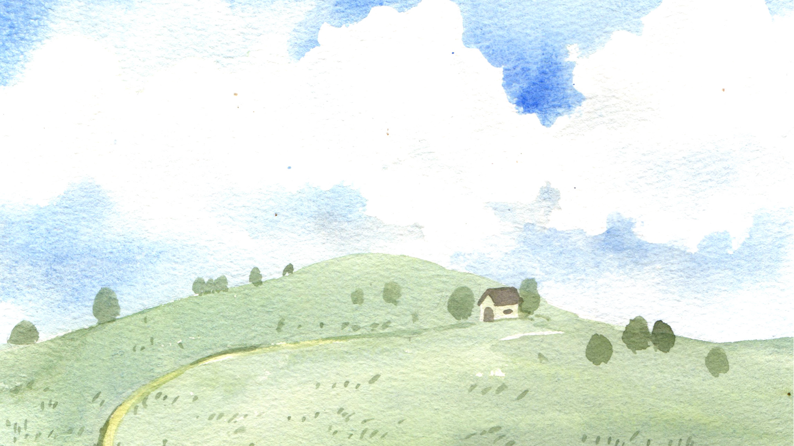
BIG BEGINNINGS WITH A BIG GOD
THE FIRST GARDEN EVER!
ADAM, EVE &GOD’S PERFECT WORLD
UNIT 1
Week 2

Slide 2

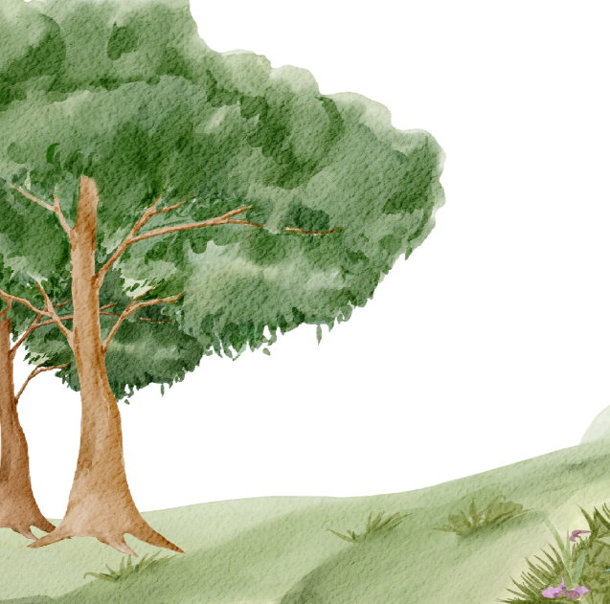
Focus Scripture
“I praise You because I am fearfully and wonderfully made.” – Psalm 139:14

Slide 3

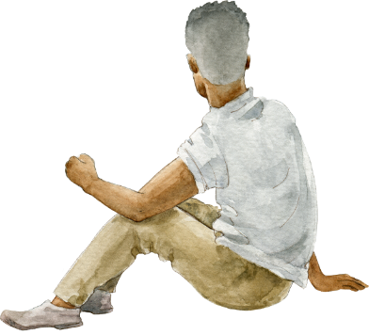
A Man Named Adam
Father God made the first person. His name was Adam! Adam was ready to take care of the world.

Slide 4


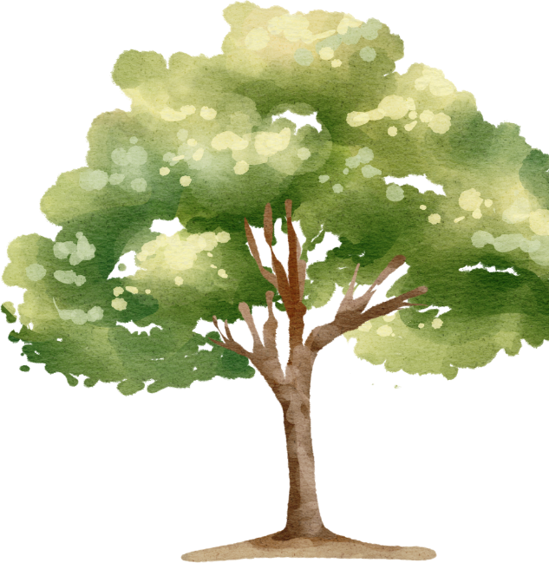


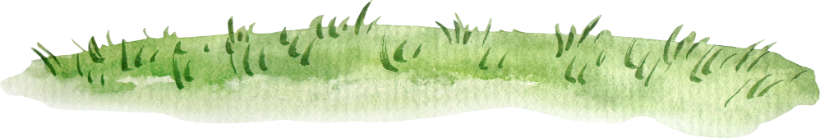

the garden of eden
This garden wasn’t like any park or yard you’ve seen, it was perfect! There were tall trees, rivers, sweet-smelling flowers, colorful fruit, and animals of all kinds.

Slide 5
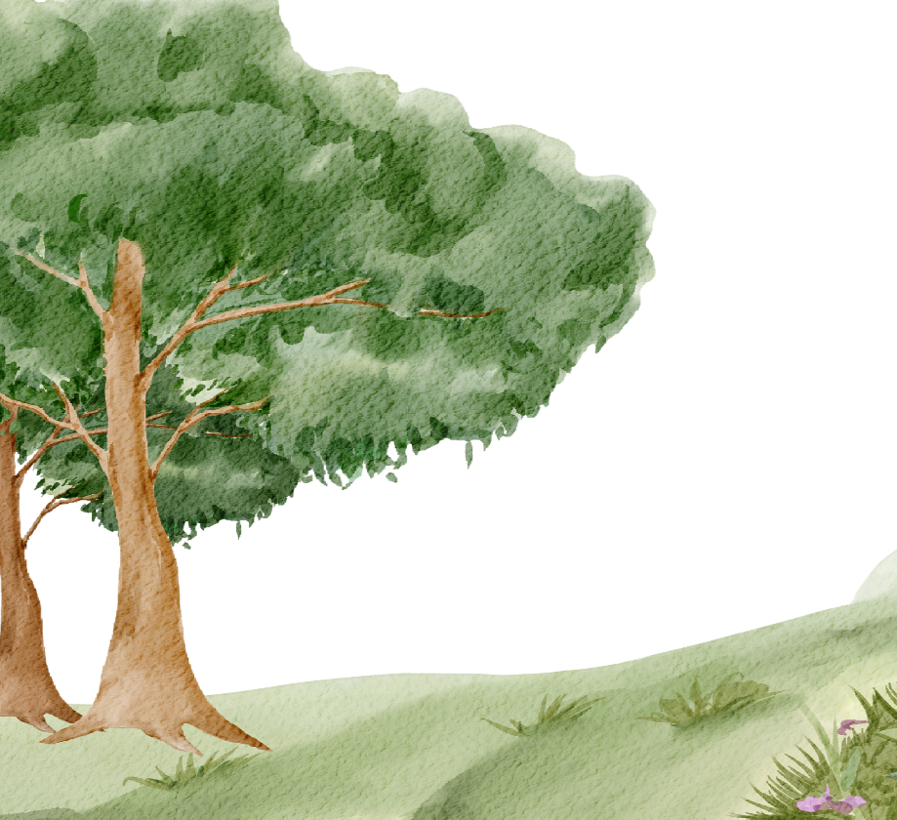

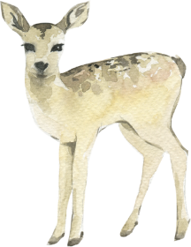
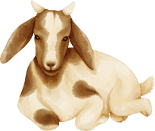

Adam Needs a Friend
Adam named all the animals—but he was all alone. Father God said, 'Adam needs a helper!’

Slide 6
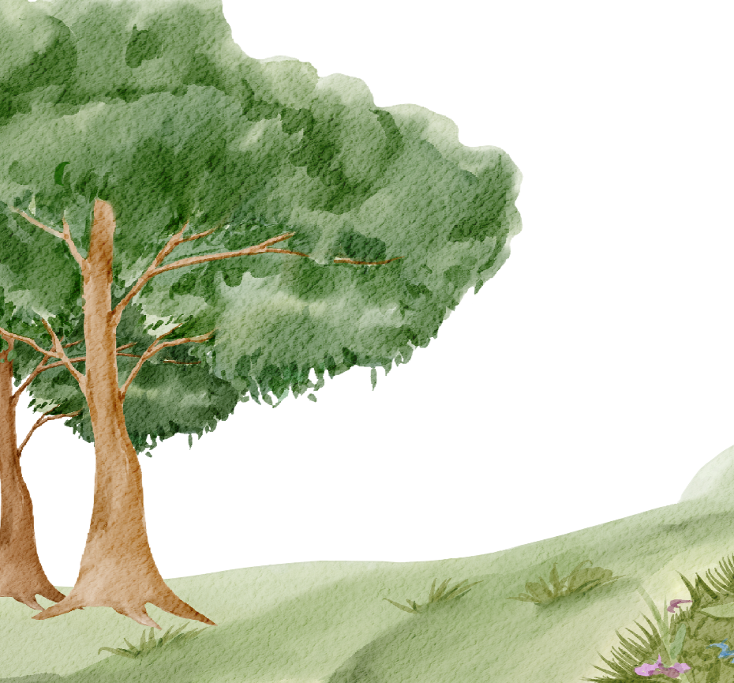

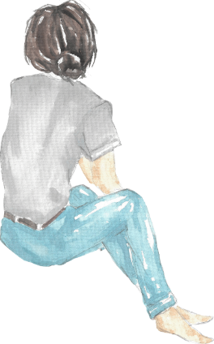
Father God Makes Eve
God made the first woman, named Eve to be his friend and helper. They were the first people ever made! Father God gave them a job: to take care of the garden.

Slide 7
Relationship with god
Father God made Adam and Eve in His own image. That means they could think, feel, create, and love just like God! And guess what? You were made like that too. Father God walked with Adam and Eve in the garden because He wanted to be close to them. It was a place filled with peace, joy, and everything they needed to be happy.

Slide 8
discussion questions
1. What do you think the Garden of Eden looked like?
2. Why did Father God make Eve?
3. How can you take care of Father God’s creation?

Slide 9


Slide 10
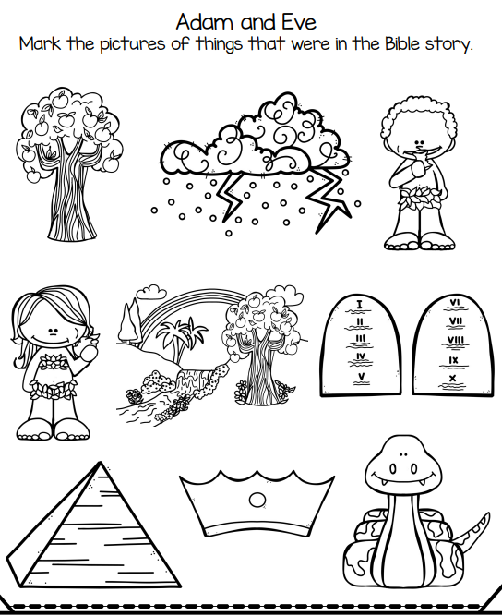
activity

Slide 11
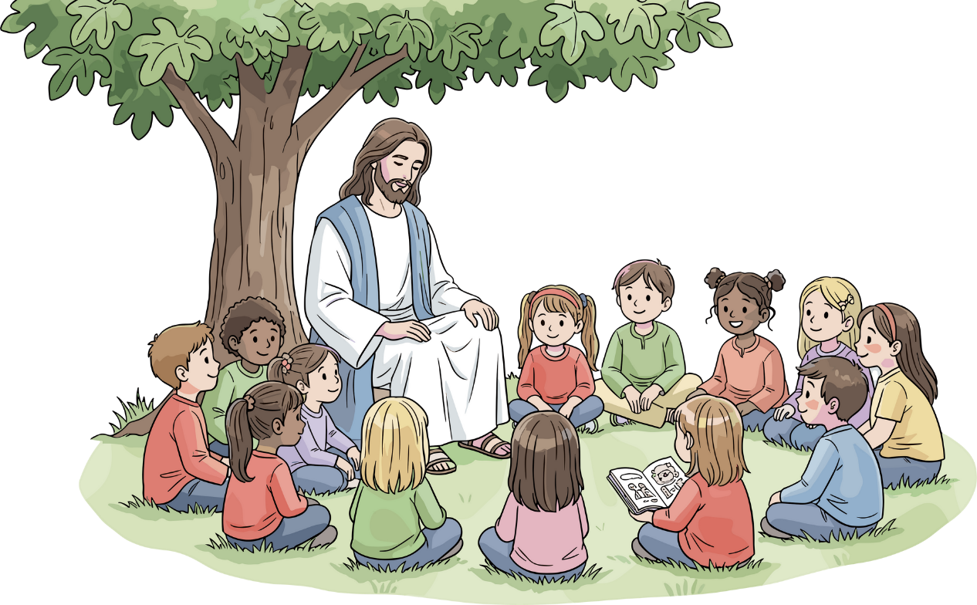
Let’s Remember
God made us for a relationship with Him and with each other.

Slide 12
Prayer
Dear God, thank You for creating Adam and Eve and for making people in Your image. Thank You for friendships and for the beauty around us. Help me to care for the world and love others the way You want me to. Amen.

