Slide 1





WEEK 1
GOD IS OUR ULTIMATE PROTECTOR — HIS PRESENCE IS OUR SAFE PLACE.

Slide 2
Scripture: Psalm 91:1
“Whoever dwells in the shelter of the Most High will rest in the shadow of the Almighty.”

Slide 3
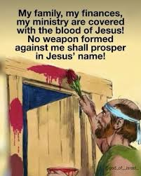
UNDERSTAND THAT GOD’S PROTECTION COVERS EVERY PART OF LIFE.

Slide 4


Slide 5




LEARN TO TRUST HIM IN FEARFUL OR UNCERTAIN TIMES.

Slide 6

WHAT MAKES YOU FEEL UNSAFE SOMETIMES?

Slide 7

HOW CAN PRAYER AND FAITH HELP WHEN YOU’RE SCARED?

Slide 8
WHAT DOES IT MEAN TO “REST IN GOD’S SHADOW”?

Slide 9
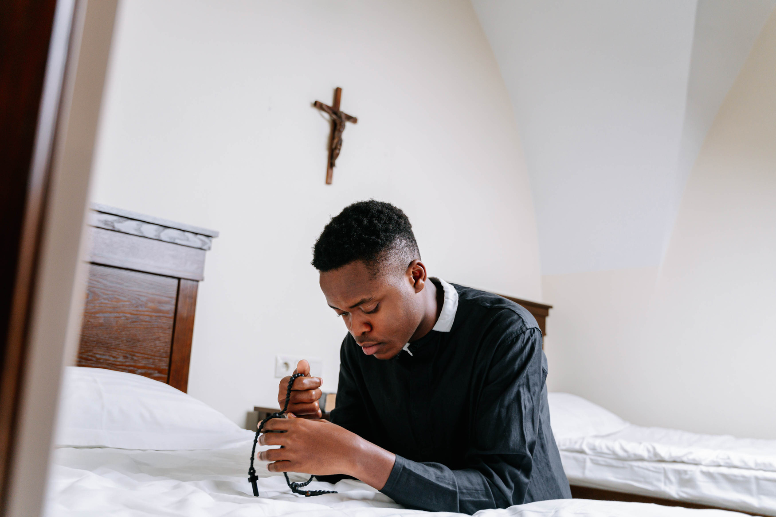
THE "SHADOW" IS GOD'S CLOSENESS, SO RESTING IN IT REQUIRES STAYING CLOSE TO HIM THROUGH PRACTICES LIKE PRAYER AND READING HIS WORD.

Slide 10


CREATE “SHELTER POSTERS” SHOWING SYMBOLS OR WORDS THAT REMIND YOU OF GOD’S PROTECTION.

Slide 11

CLOSING PRAYER
“Lord, thank You for being our protector. Help us remember that You are always watching over us. Keep us safe in Your love.”
Amen

