Slide 1







GOD’S UNCONDITIONAL LOVE
God’s Love Never Fails
Unit 1
Week 1

Slide 2




FOCUS SCRIPTURE
Romans 8:38-39
For I am convinced that neither death nor life, neither angels nor demons, neither the present nor the future, nor any powers, neither height nor depth, nor anything else in all creation, will be able to separate us from the love of God that is in Christ Jesus our Lord.

Slide 3



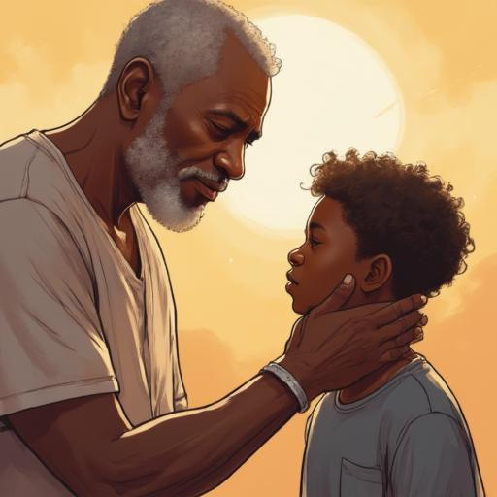


UNSHAKEABLE LOVE
No matter what we go through in life—mistakes, challenges, or even times when we feel distant from God—His love never changes.
His love is not based on what we do but on who He is.
His love is not something we earn- it’s freely given.
His love is deeper than human love—it is constant, patient, and everlasting.

Slide 4


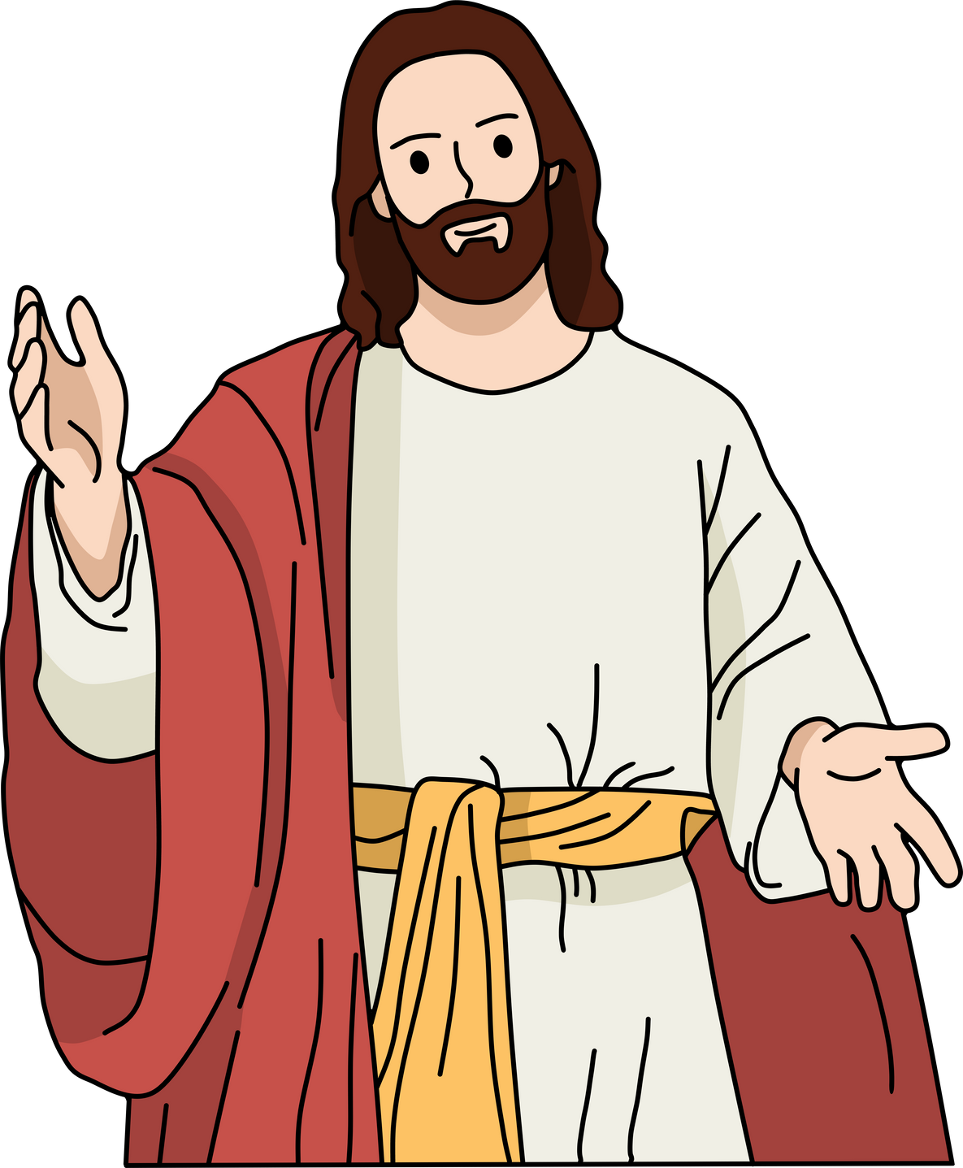
LIFE APPLICATIONS
Understanding God’s love can change the way we live. When we know that we are fully loved, we don’t have to seek approval from others or feel unworthy. Instead of trying to "earn" God’s love, we can rest in the fact that He already loves us completely. This also helps us show love to others the way God loves us—with kindness, patience, and forgiveness.

Slide 5


Slide 6






REFLECTIVE QUESTIONS
1. ​What does it mean to you that nothing can separate you from God’s love?
​2. ​How does knowing that God loves you unconditionally affect the way you see yourself?
3. ​In what ways can you show God’s love to others this week?

Slide 7
ACTIVITY
HAVE EACH CHILD ACT OUT BEING THE FATHER AND SON OF THE PRODIGAL SON STORY.
THINK ABOUT...
HOW THE FATHER REACTED WHEN HE SEEN HIS SON COMING HOME?
HOW DO YOU THINK THE SON REACTED TO HIS FATHERS EMBRACE?

Slide 8



PRAYER
Heavenly Father,
Thank You for loving me no matter what. Help me to understand and accept Your love fully. Teach me to love others the same way You love me—with kindness and forgiveness. Amen.

