Slide 1

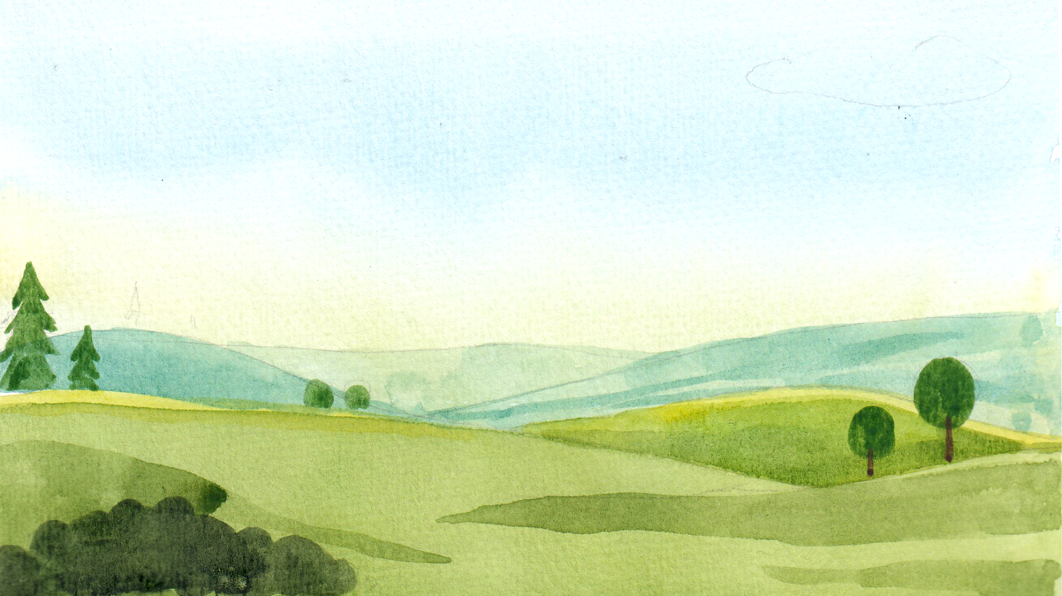
BIG BEGINNIGS WITH A BIG GOD
LET THERE BE LIGHT!
DISCOVERING GOD’S CREATION
UNIT 1
Week 1

Slide 2

FOCUS SCRIPTURE
“In the beginning, God created the heavens and the earth.” (Genesis 1:1)

Slide 3
IN THE BEGINNING...
there was nothing—no sky, no earth, no animals, and no people. Only Father God was there. Then God decided to make the world.

Slide 4
DAY 1 – LIGHT AND DARKNESS
God created the heavens and the earth, which were formless and dark. His Spirit moved over the waters. God said, “Let there be light,” and there was light. He saw it was good and separated it from darkness, naming them day and night.” This was the first day.

Slide 5
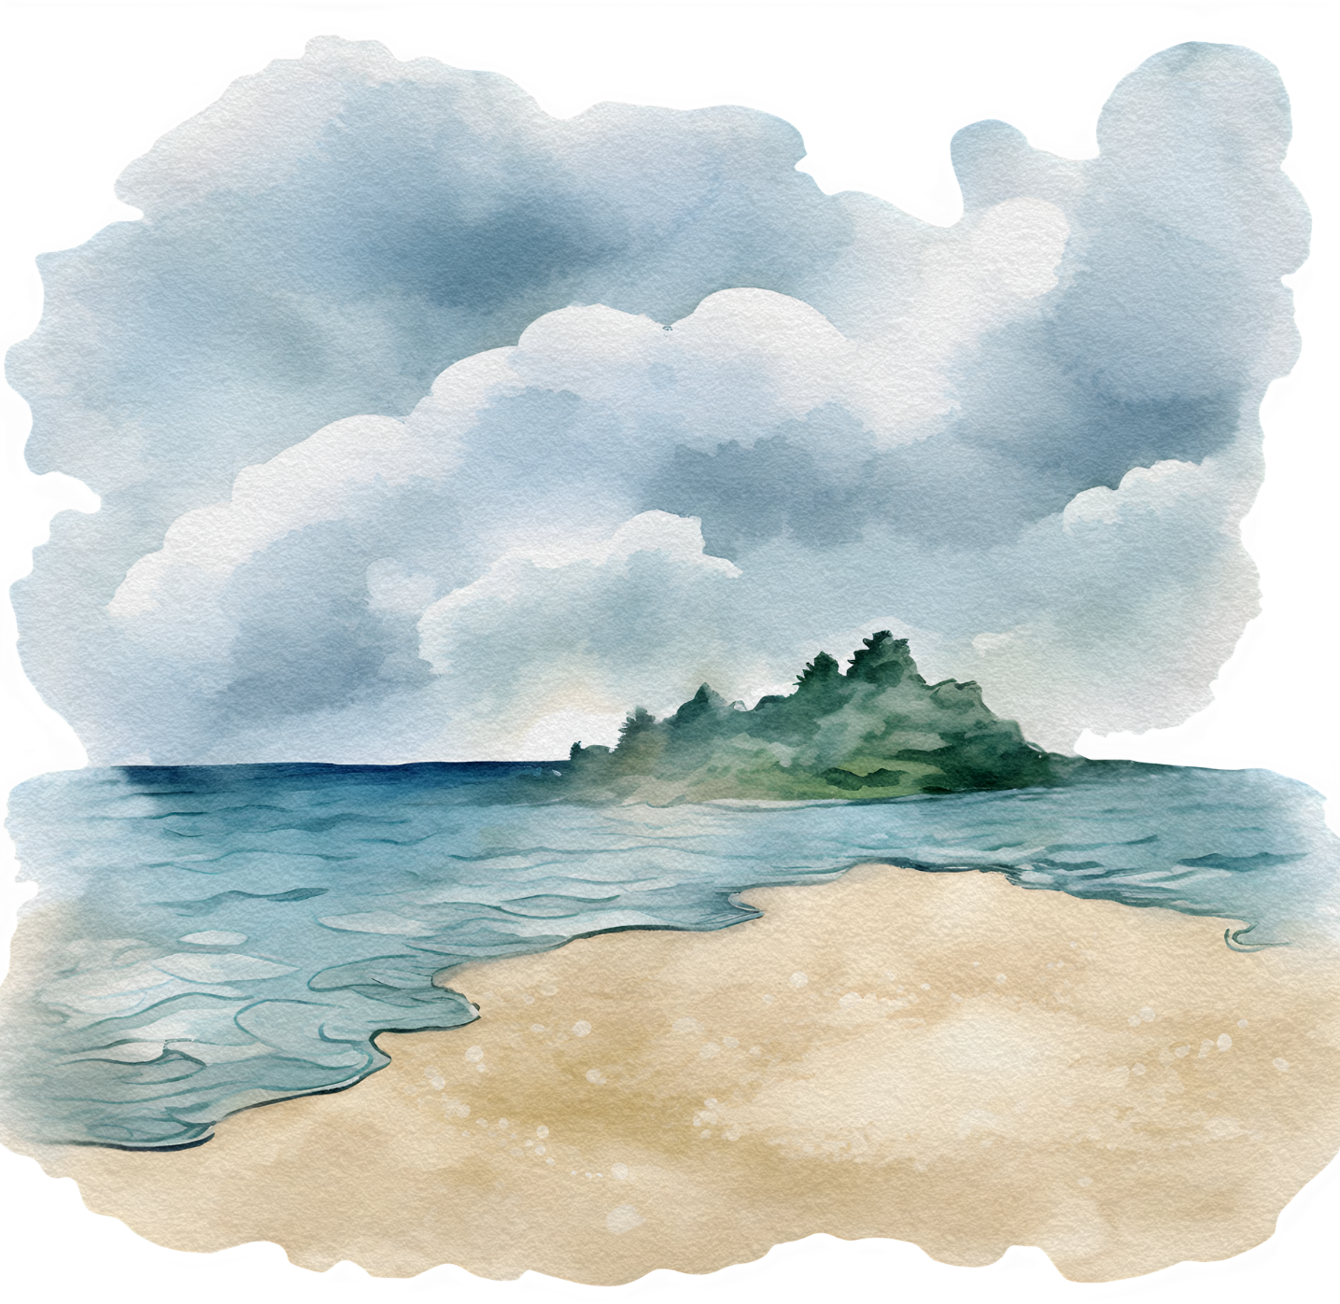
DAY 2 – SKY AND WATERS
On the second day, God created the sky to separate the waters above from those below, completing day two.

Slide 6
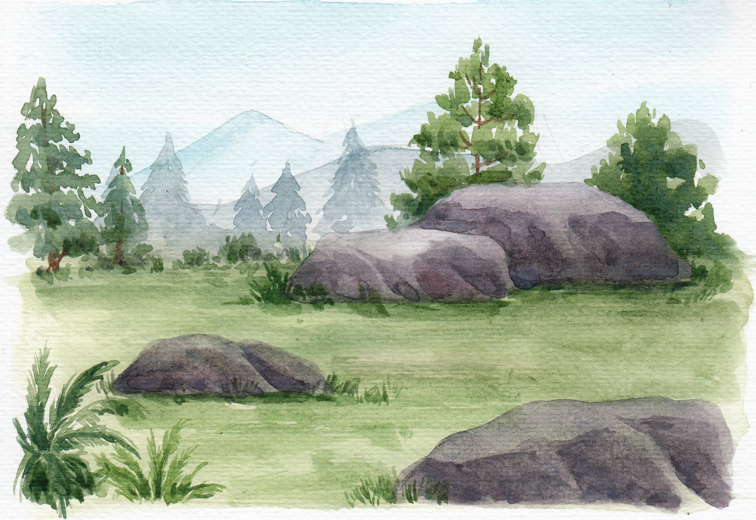
DAY 3 – LAND, SEA, AND PLANTS
On the third day, God gathered the waters to reveal dry land, naming it "Earth," and the waters "Seas." He then created vegetation—grasses, herbs, and fruit trees—each with seeds. This set the foundation for life and concluded the day with the Earth filled with plant life.

Slide 7
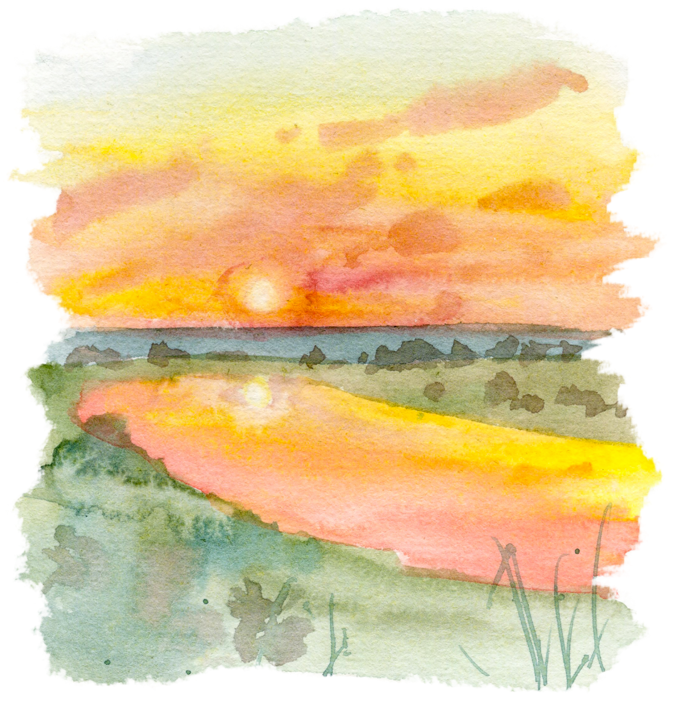
DAY 4 – SUN, MOON, AND STARS
On the fourth day, God created the sun to rule the day and the moon and stars to light the night, marking time and seasons.

Slide 8
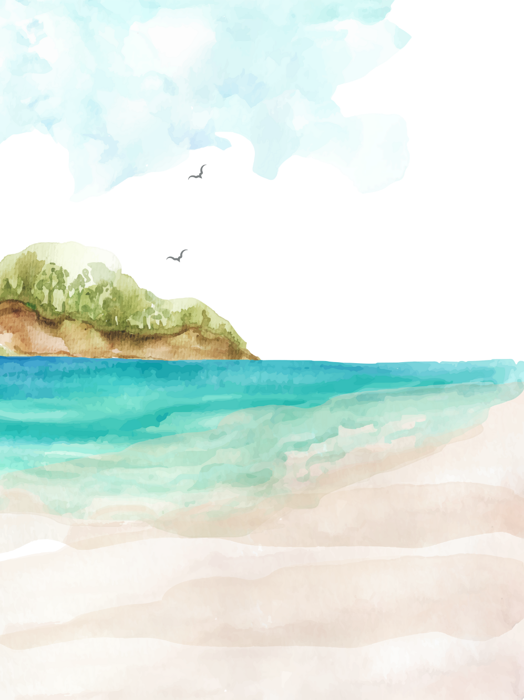

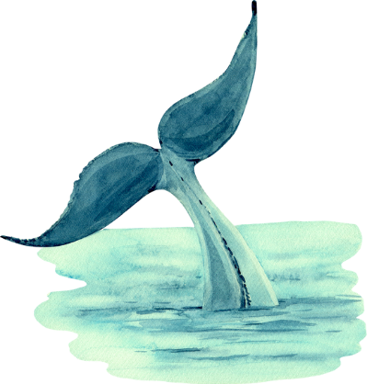
DAY 5 – BIRDS AND SEA CREATURES
On the fifth day of creation, God filled the seas with creatures and the skies with birds. He blessed them to be fruitful and multiply, ensuring life would flourish in the waters and skies.

Slide 9
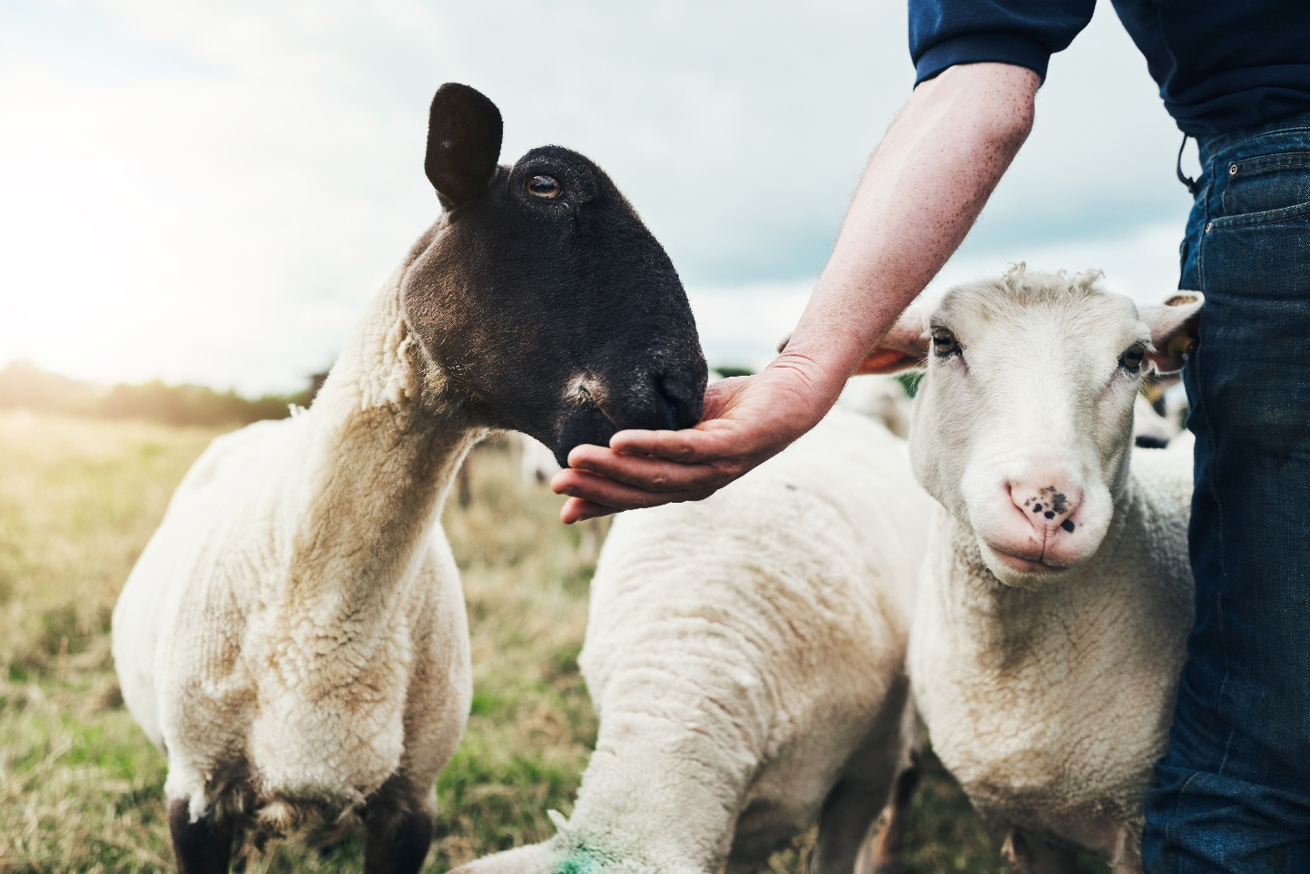
DAY 6 – ANIMALS AND HUMANS
On the sixth day, God created animals and humankind in His image, granting them stewardship over the Earth. He instructed them to be fruitful and have dominion over all creatures. By day's end, everything was very good.

Slide 10
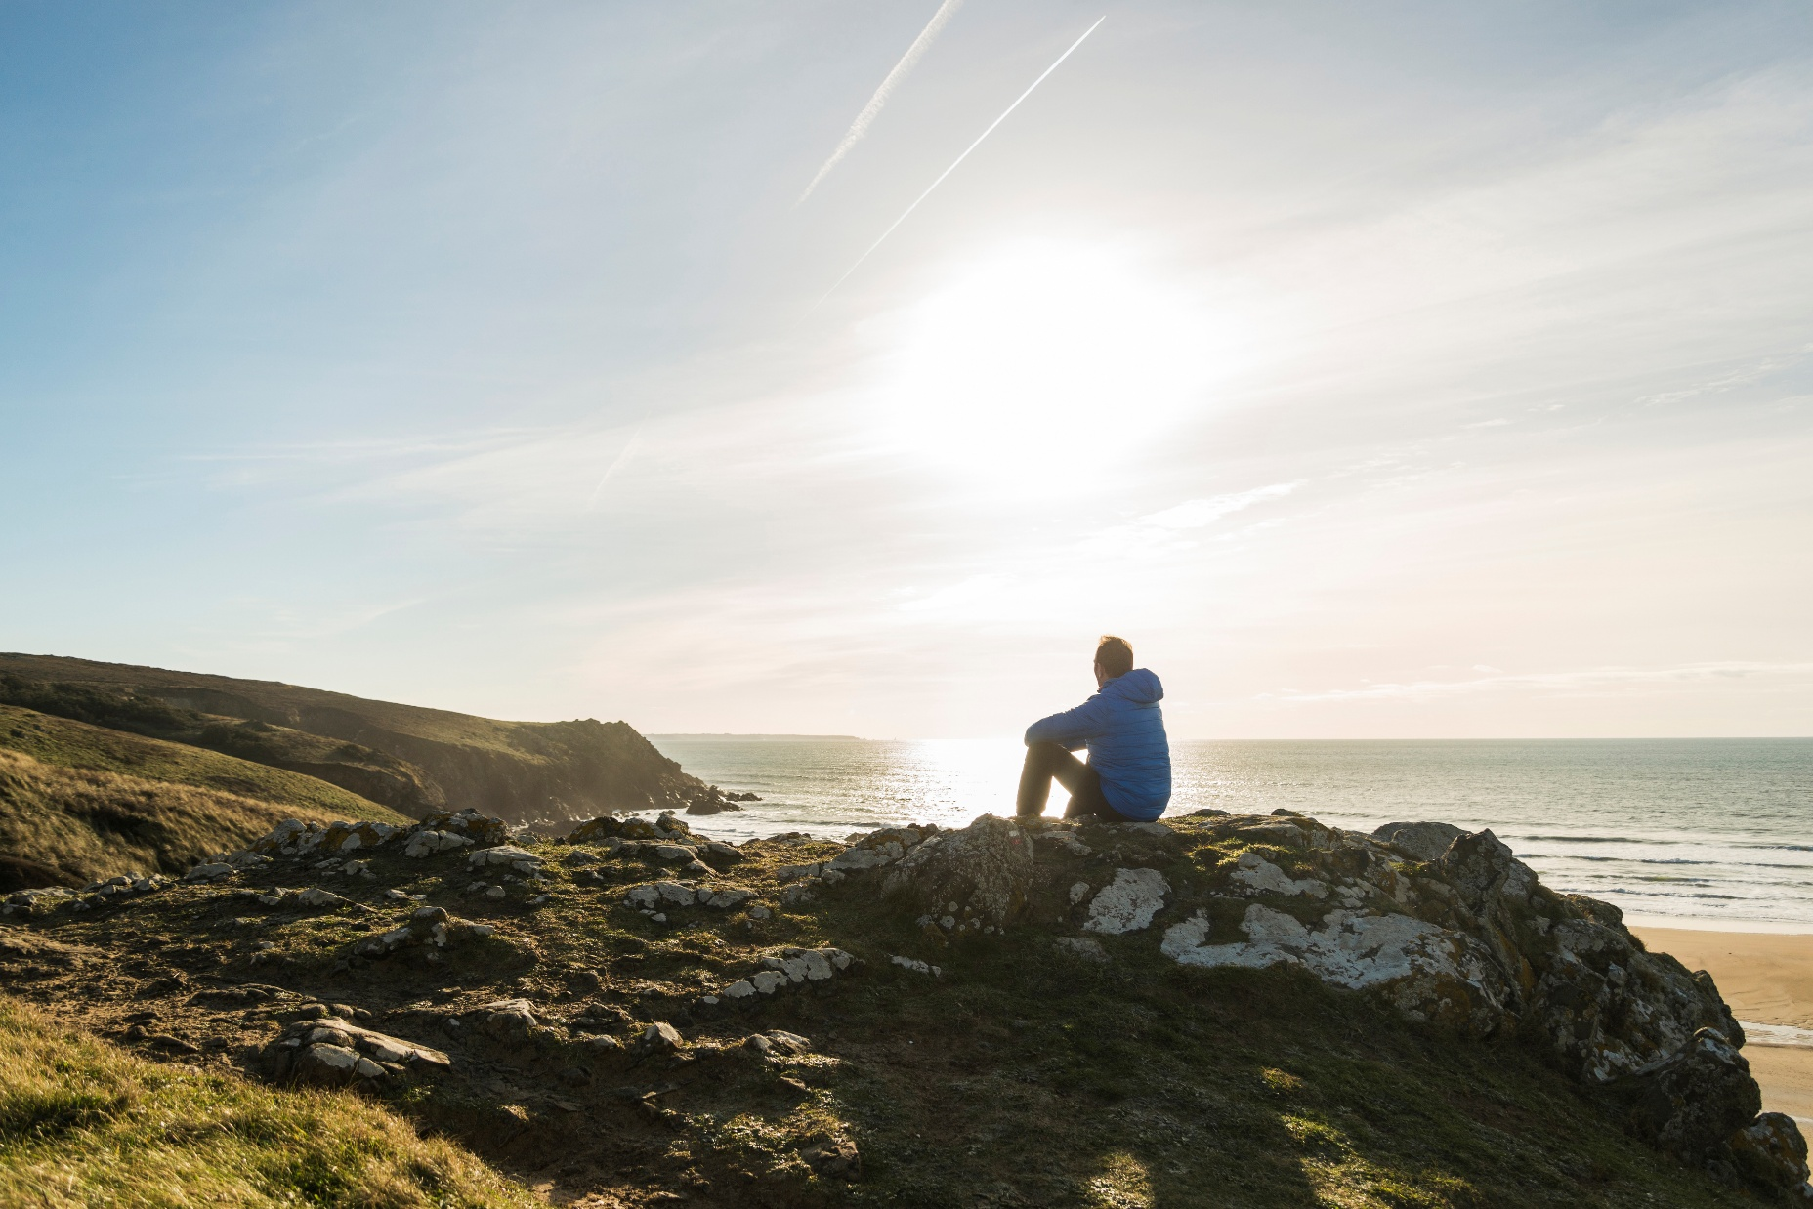
DAY 7 –
REST DAY
On the seventh day, God finished His work and rested. He blessed this day, making it holy. God didn’t use tools or magic. He didn’t even have to touch anything. All He had to do was speak, and everything came to life! That’s how powerful He is. He looked at everything He made and said it was very good.

Slide 11
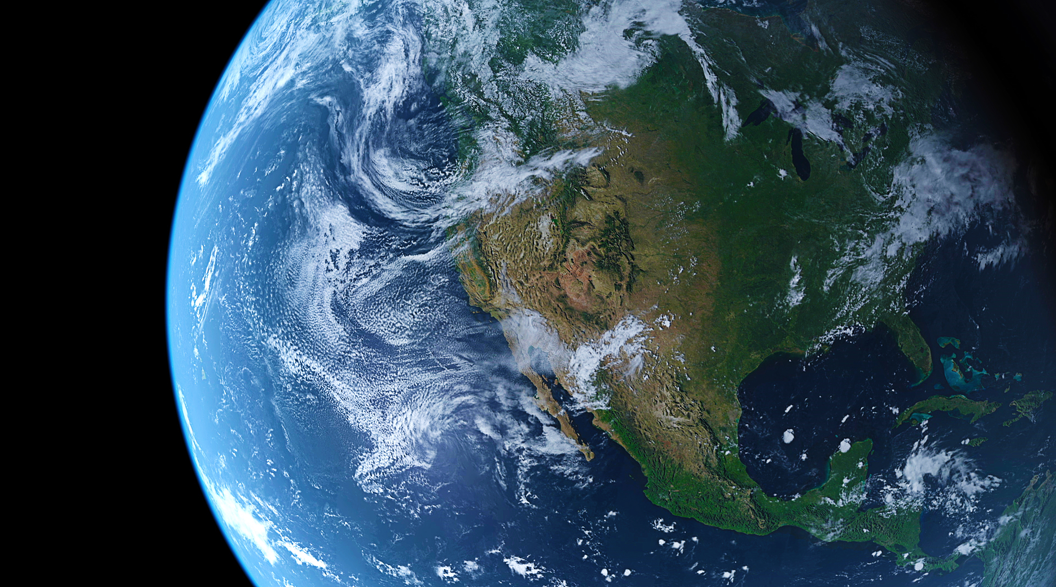
FATHER GOD’S BEAUTIFUL WORLD
God made the world because He wanted to share His love with us. And He made YOU as part of His beautiful plan! Beautifully and wonderfully made by God who is also so much interested in your life and in all you do. It must be a beautiful feeling to know that you are made special.

Slide 12
DISCUSSION QUESTIONS
1. What’s your favorite thing that God created?
2. Why do you think God made people last?
3. How does it feel to know that God made you special?

Slide 13


Slide 14
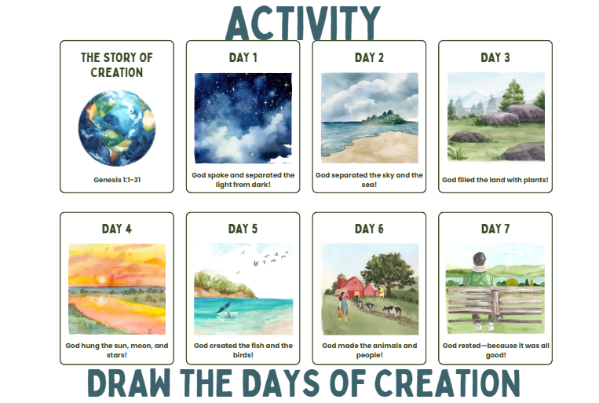

Slide 15

LET’S REMEMBER
You are a special part of Father God’s creation. He made you with love, and you are His masterpiece.

Slide 16
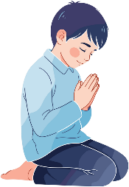
PRAYER
Dear Father God, thank You for making this amazing world! Thank You for flowers, mountains, animals, and stars. And thank You for making me. Help me remember that I’m Your special creation. Amen.

